Slide 1
3GPP 29.202
SS7 Signaling Transport Network in the Core Network
CENTLING
CentLing Technologies Co., Ltd.
Kavon Ma
Apr. 2014

Slide 2
3GPP 29.202
3GPP 29.202 overview
Introduction
MTP-based SS7 signaling transport network
IP-based SS7 signaling transport network
ATM-based SS7 signaling transport network

Slide 3
Introduction
The Core Network enables the transport of SS7 signaling protocols between two entities by means of different underlying networks:
  MTP-based
  IP-based
  ATM-based

Slide 4
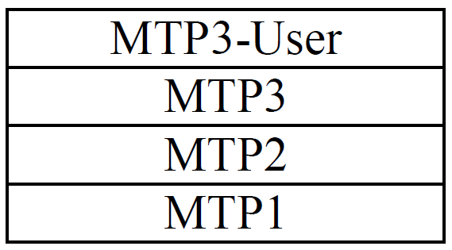
MTP-based SS7 protocol architecture
The protocol architecture applicable in the case of MTP-based signaling transport network:
Notes:
Tandem office:汇接局
End office: 终端局

Slide 5
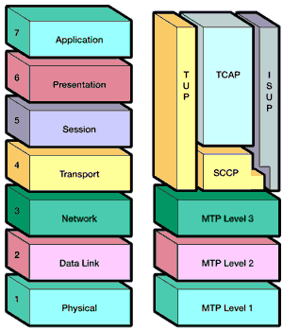
MTP-based SS7 Protocol Stack

Slide 6
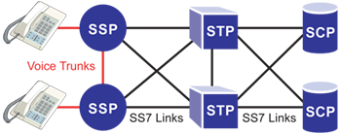
MTP-based SS7 signaling transport network
SSP (Service switching point)
  Switches (end office or tandem office) equipped with SS7 capable software and terminating SS7 links. They generally originate, terminate or switch calls
STP (Signal transfer point)
  Specific exchange receive and route incoming signaling messages towards the proper destination. They also perform specialized routing functions.
SCP (Service control point)
  Databases that provides information necessary for advanced call-processing capabilities.
Notes:
Tandem office:汇接局
End office: 终端局

Slide 7
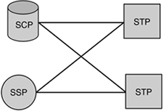
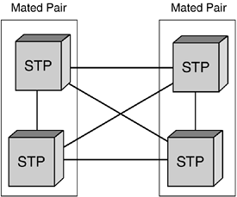
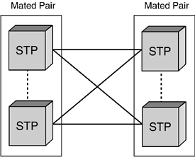
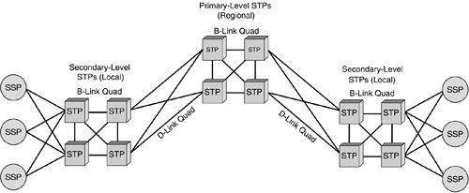
Link Type
A Links
C Links
B Links
D Links

Slide 8
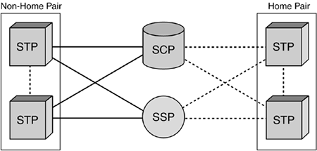
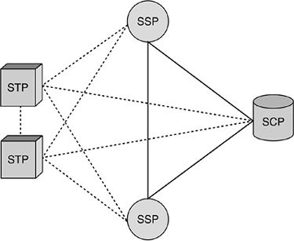
Link Type Cont.
E Links
F Links

Slide 9
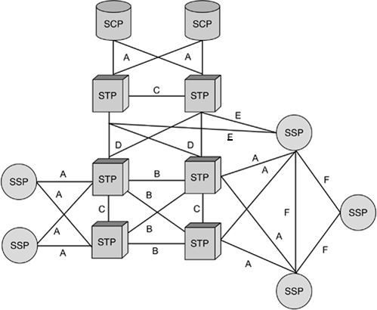
Link Type Cont.

Slide 10
Link definition
Access links (A links), provide access to the network. They connect "outer" SPs (SSPs or SCPs) to the STP backbone. A links connect SSPs and SCPs to their serving STP or STP mated pair.
Cross links (C links), are used to connect two STPs to form a mated pairs, that is, a pair linked such that if one fails, the other takes the load of both.
Bridge links (B links) are used to connect mated pairs of STPs to each other across different regions within a network at the same hierarchical level. These links help form the backbone of the SS7 network. B links are normally deployed in link quad configuration between mated pairs for redundancy.
Diagonal links (D links), are the same as B links in that they connect mated STP pairs. The difference is that they connect mated STP pairs that belong to different hierarchical levels or to different networks altogether. For example, they may connect an interexchange carrier (IXC) STP pair to a local exchange carrier (LEC) STP pair or a cellular regional STP pair to a cellular metro STP pair.

Slide 11
Link definition Cont.
Extended links (E links), connect SSPs and SCPs to an STP pair, as with A links, except that the pair they connect to is not the normal home pair. Instead, E links connect to a nonhome STP pair. They are also called alternate access (AA) links. E links are used to provide additional reliability or, in some cases, to offload signaling traffic from the home STP pair in high-traffic corridors. For example, an SSP serving national government agencies or emergency services might use E links to provide additional alternate routing because of the criticality of service.
Fully-associated links (F links), are used to connect network SSPs and/or SCPs directly to each other without using STPs. The most common application of this type of link is in metropolitan areas. F links can establish direct connectivity between all switches in the area for trunk signaling and Custom Local Area Signaling Service (CLASS), or to their corresponding SCPs.

Slide 12
Point Code
PC (Point Code): An unique identifier of an SS7 node in the network. Similar as IP address in IP network.
IP: 192.168.1.1 | 0xC0 A8 01 01
PC: 01-021-01 | 0x01 15 01 (ANSI type, 24bits 8-8-8)
01-21-01 | 00100010101001 (ITU type, 14bits 3-8-3)
OPC (Originating Point Code): PC of the SS7 node sending the SS7 message
DPC (Destination Point Code): PC of the SS7 node for which the SS7 message is destined
APC (Adjacent Point Code): An office in network that is directly connected to this office

Slide 13
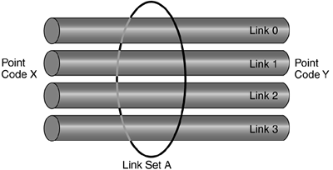
Link and Link Set
Signaling Link: The link between 2 SS7 nodes, which is for signaling transmission.
Link Set: Logical combination of one or more signaling links.
Link and Linkset

Slide 14
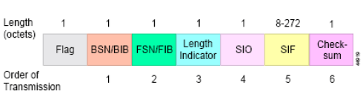
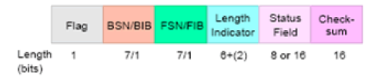
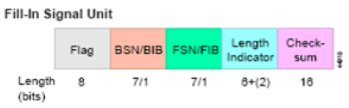
Message Unit
Message Signal Unit
Link Status Signal Unit
Fill-In Signal Unit

Slide 15
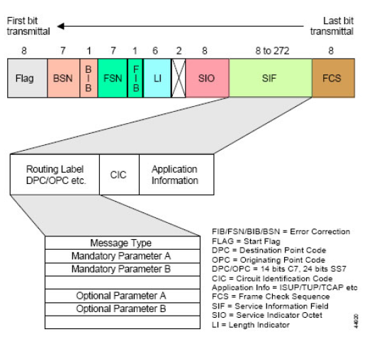
Message Unit Cont.

Slide 16
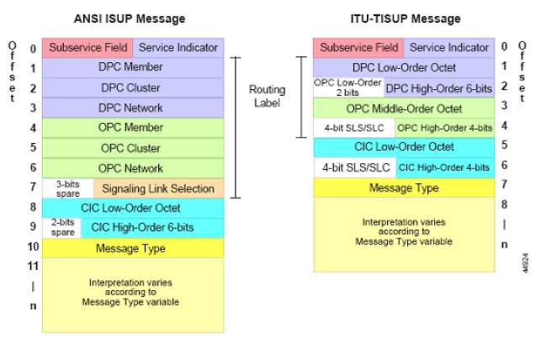
ISUP Message Format

Slide 17
ISUP Message Cont.
8
7
6
5
4
3
2
1
ROUTING LABEL
Order of Octet Transmission
CIRCUIT IDENTIFICATION CODE
MESSAGE TYPE CODE
MANDATORY PARAMETER A
Mandatory Fixed Part
MANDATORY PARAMETER F
POINTER TO PARAMETER M
POINTER TO PARAMETER P
POINTER TO START OF OPTIONAL PART
LENGTH INDICATOR OF PARAMETER M
Mandatory Variable Part
s
PARAMETER M
s
s
s
LENGTH INDICATOR OF PARAMETER P
PARAMETER P
PARAMETER NAME=X
LENGTH INDICATOR OF PARAMETER X
PARAMETER X
PARAMETER NAME=Z
Optional Part
s
LENGTH INDICATOR OF PARAMETER Z
s
s
PARAMETER NAME Z
s
END OF OPTIONAL PARAMETERS

Slide 18
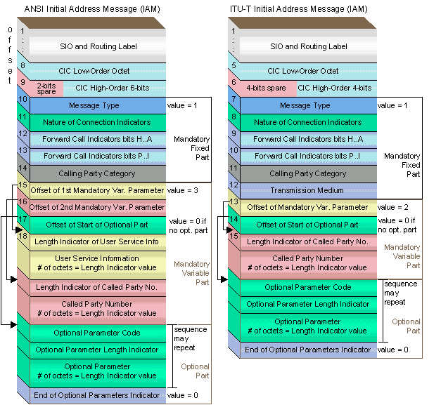
ISUP Message Format Cont.

Slide 19
To decode a message – IAM
IAM raw data:
01 00 21 00 0A 02 02 09 07 01 10 12 52 55 21 21 0A 06 01 15 88 16 65 42 00

Slide 20
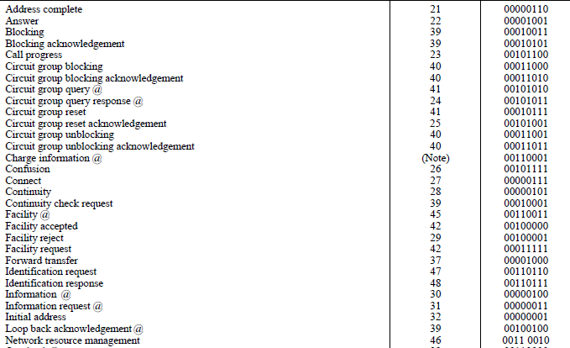
To decode a message – IAM
01 00 21 00 0A 02 02 09 07 01 10 12 52 55 21 21 0A 06 01 15 88 16 65 42 00
01: message type - IAM

Slide 21
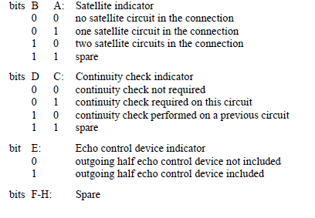
To decode a message – IAM
01 00 21 00 0A 02 02 09 07 01 10 12 52 55 21 21 0A 06 01 15 88 16 65 42 00
00: nature of connection indicator
H | G | F | E | D | C | B | A

Slide 22

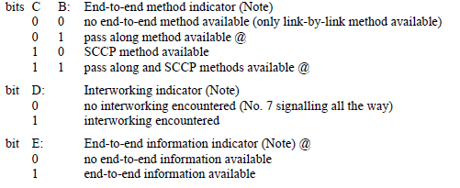
To decode a message – IAM
01 00 21 00 0A 02 02 09 07 01 10 12 52 55 21 21 00
21 00: Forward call indicators parameter
0010 0001
0000 0000
H | G | F | E | D | C | B | A
P | O | N | M | L | K | J | I

Slide 23
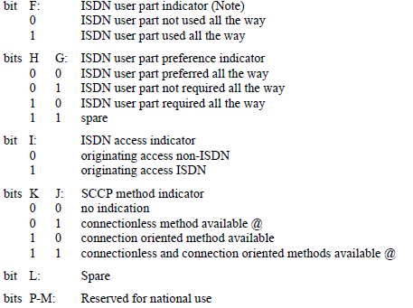
To decode a message – IAM
01 00 21 00 0A 02 02 09 07 01 10 12 52 55 21 21 0A 06 01 15 88 16 65 42 00
21 00: Forward call indicators parameter
0010 0001
0000 0000
H | G | F | E | D | C | B | A
P | O | N | M | L | K | J | I

Slide 24
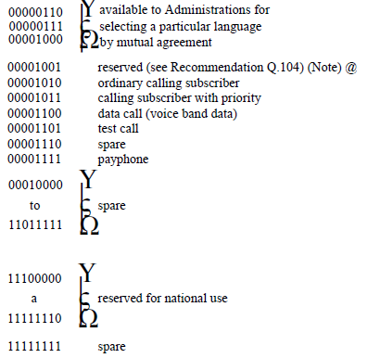
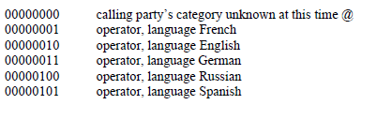
To decode a message – IAM
01 00 21 00 0A 02 02 09 07 01 10 12 52 55 21 21 0A 06 01 15 88 16 65 42 00
0A: Calling party’s category

Slide 25
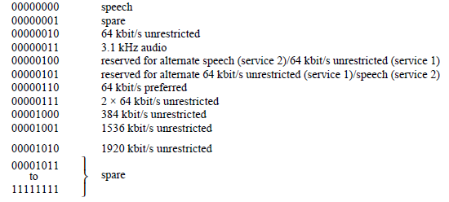
To decode a message – IAM
01 00 21 00 0A 02 02 09 07 01 10 12 52 55 21 21 0A 06 01 15 88 16 65 42 00
02: Transmission medium requirement

Slide 26
To decode a message – IAM
01 00 21 00 0A 02 02 09 07 01 10 12 52 55 21 21 0A 06 01 15 88 16 65 42 00
02: Point to the mandatory variable parameter CDPN
09: Point to the optional parameter CGPN

Slide 27
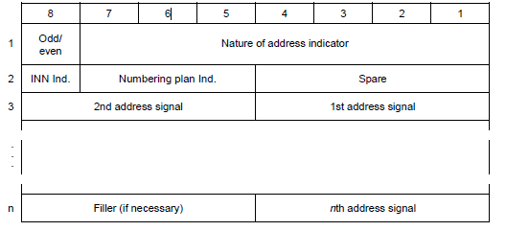
To decode a message – IAM
Note: CDPN is a mandatory parameter no need to include parameter type.
07 01 10 12 52 55 21 21
07: length of the CDPN parameter
12 52 55 21 21: BCD code 2125551212

Slide 28
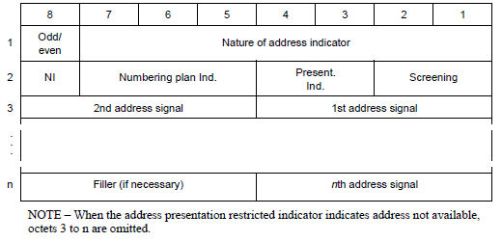
To decode a message – IAM
01 00 21 00 0A 02 02 09 07 01 10 12 52 55 21 21 0A 06 01 15 88 16 65 42 00
09: Point to the optional parameter CGPN
OA: Calling party number //for optional parameter, need include type.
06: length

Slide 29
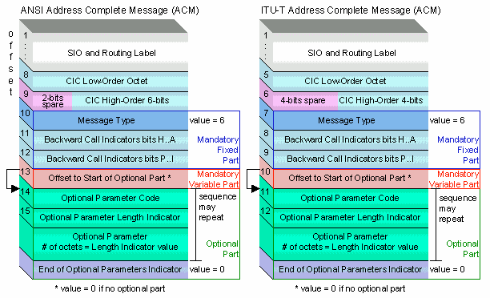
ACM

Slide 30
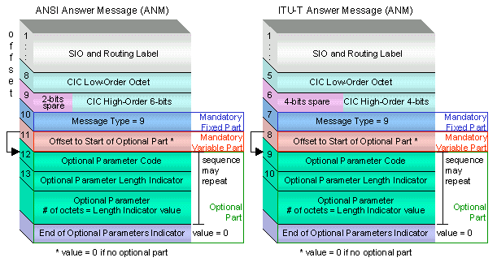
ANM

Slide 31
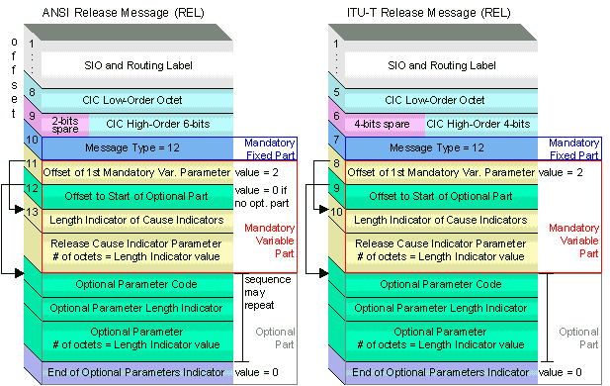
REL

Slide 32
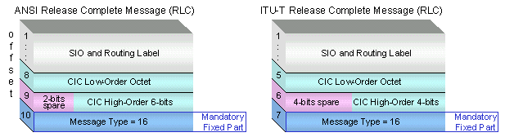
RLC

Slide 33
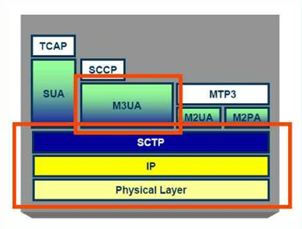
IP-based SS7 protocol architecture
The protocol architecture applicable in the case of IP-based signaling transport network:
Notes:
Tandem office:汇接局
End office: 终端局

Slide 34
PSTN and VoIP Network Interworking
PSTN
SCN
PSTN
SCN
MGC
SIP
MGC
SIGTRAN
SS7
ISUP/TCAP
SIGTRAN
MEGACO
SS7
ISUP/TCAP
MEGACO
SG
SIGTRAN
SG
SIGTRAN
SCP
MG
RTP
MG
Circuit
Voice Stream
Packet Voice Stream
Circuit
Voice Stream
IP NETWORK
MGC: Media Gateway Controller SG: Signaling Gateway SCP: Service Control Point
MG: Media Gateway SIP: Session Initiation Protocol RTP: Real Time Protocol
MEGACO: Media Gateway Control SIGTRAN: Signaling Transport SCN: Switched Circuit Network
IETF defined SIGTRAN protocols specify the means by which SS7 messages can be reliably and efficiently transported over IP network.

Slide 35
SS7<->IP over M3UA
M3UA
Note: MTP3 only at SG;
the MTP User is at ISEP
SS7 UP
(e.g., SCCP
or ISUP)
SS7 UP
(e.g., SCCP
or ISUP)
NIF
MTP-3
MTP-3
M3UA
M3UA
Each M3UA message contains an
RC value that identifies a particular
application
MTP-2
MTP-2
SCTP
SCTP
MTP-1
MTP-1
IP
SEP
SS7
SG
M3UA
ISEP

Slide 36
SS7<->IP over M2UA
SS7 UP
SS7 UP
M2UA (Backhaul)
Note: no MTP3 at the SG,
MTP3 is only at end points
MTP-3
MTP-3
Each M2UA message
contains the Interface
Identifier identifying
an SS7 link at SG
NIF
MTP-2
MTP-2
M2UA
M2UA
SCTP
SCTP
MTP-1
MTP-1
IP
SEP/STP
SS7
SG
M2UA
ASP
SEP

Slide 37
SS7 <-> M2PA
M2PA
Note: MTP3 at SG
and at ISEP
SS7 UP
SS7 UP
MTP-3
MTP-3
MTP-3
Peer-to-peer
Peer-to-peer
MTP-2
MTP-2
M2PA
M2PA
M2PA link carries MSU and LSSU but no FISU
SCTP
SCTP
MTP-1
MTP-1
IP
SEP
SS7
SG (STP)
M2PA
ISEP

Slide 38
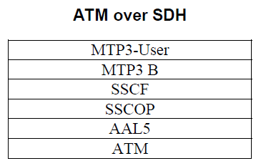
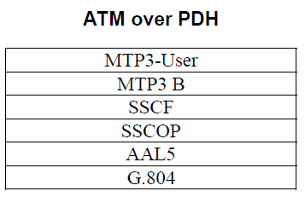
ATM-based SS7 protocol architecture
The protocol architecture applicable in the case of ATM-based signaling transport network:
Notes:
Tandem office:汇接局
End office: 终端局

Slide 39
Q&A

