Slide 1
SLAM-TL1 FSM
Alpha Zhang
9/10/2010

Slide 2
Outline
TL1
Important CB
SLAM-TL1 FSM

Slide 3
TL1
1). TL1 command sent to Slam, following parts should be contained:
-- transaction ID(transId)
TL1GenXtag(transId)
-- command type (tl1Cmd)
such as SM_ENT_REQUEST, SM_ED_REQUEST …
-- value (rowKey, colArray)
-- table ID
2). Slam Receive from TL1 agent via GA
-- Get data and put it to m_buffer
-- pst initialization
pst.srcEnt = ENTGA;
pst.event=SM_CMD_CLASS_INT
pst.spare1=NULL_EVENT_INT
-- SPstTsk(&pst, mBuf) Post message to system services
Notes:
A ctag is a user specified correlation tag used to match a command response to a command request. Since the user controls the ctag, it is not guaranteed to be unique which prevents it from being used as a TL1 "transaction" ID.
An xtag is basically an extended ctag that provides a unique transaction ID for TL1. Since the range of a ctag is 0 - 999999, the xtag can co-exist with the ctag by using the unused high bits of the ctag. This mechanism allows the original ctag to be easily extracted from the xtag.
#define SM_ENT_REQUEST ( 0 | CMD_SIG)
#define SM_ED_REQUEST ( 1 | CMD_SIG)
#define SM_DLT_REQUEST ( 2 | CMD_SIG)
#define SM_RTRV_REQUEST ( 3 | CMD_SIG)
#define SM_GETNEXT_REQUEST ( 4 | CMD_SIG)
#define SM_VALIDATE_REQUEST ( 5 | CMD_SIG)
#define SM_GETMULTI_REQUEST ( 6 | CMD_SIG)
#define SM_GETNEXTMULTI_REQUEST ( 7 | CMD_SIG)

Slide 4
Important CB
typedef struct cmFsmCp
{
CmEvalEvDepFp evalEvDep;
CmFsmEvFp fsmEvFp;
U32 maxInst;
Region region;
Pool pool;
U8 numStates;
U8 numEvents;
CmFsmStateInfo *states;
CmFsmEventInfo *events;
CmFsmRow *fsmMt; /* FSM state matrix */
CmHashListEnt fsmCpHlEnt; /* global FSM control point hash list entry */
CmHashListCp instHlCp; /* FSM instance hash list control point */
CmQCp instQCp; /* FSM instance queue control point */
} CmFsmCp;

Slide 5
Important CB
CmFsmCp: (slam/base/sl_tl1.c)
cmFsmInstInit(): initialize FSM CP and insert it into slCb
fsmCp->evalEvDep = slTl1FsmEvalDep;
fsmCp->fsmEvFp = slTl1FsmDr; slTl1Func
fsmCp->maxInst = TELICA_MAX_TL1_1_INST;
fsmCp->numStates = SLTL1_ST_MAX;
fsmCp->numEvents = SLTL1_EV_MAX;
fsmCp->states = slTl1States;//二维数组首"SLTL1_ST_IDLE",
fsmCp->events = slTl1Events;//SLTL1_EV_TL1_ENT
fsmCp->fsmMt = &slTl1_1_FsmMt[0][0];
fsmCp->region = slCb.region;
fsmCp->pool = slCb.pool;
fsmCp->entity = ENTSLM;
Example:
CmFsmRow slTl1_1_FsmMt[SLTL1_ST_MAX][SLTL1_EV_MAX] =
{
/* SLTL1_ST_IDLE */
{
{slTl1_start_lower, SLTL1_ST_AWT_X10_DONE}, /* SLTL1_EV_TL1_ENT

Slide 6
Important CB
typedef struct cmFsmEnt
{ U16 lastEvt; /* last event received */
U16 lastState; /* last state */
U16 state; /* current state */
U32 instId; /* instance Id for this FSM instance */
CmFsmCp *fsmCp; /* FSM control point */
CmQCp evtQCp; /* event queue */Q
CmHashListEnt instHlEnt; /* FSM instance hash list entry */
CmQEnt instQEnt; /* FSM instance queue entry */
DateTime timestamp; /* create time, to order across related FSMs */
CmTimer timers[CM_FSM_MAX_TIMERS];
Pst pst; /* pst stuct for the current event, if any */
Buffer *mBuf; /* mBuf for the current event, if any */
} CmFsmEnt;
Notes:
fsmEnt->fsmCp = fsmCp;
fsmEnt->instId = instId;
fsmEnt->instTimeout = instTimeout;
fsmEnt->trcLvl = fsmCp->trcLvl;
SGetDateTime(&fsmEnt->timestamp);
fsmEnt->lastState = 0; /* idle */
fsmEnt->state = SLTL1_ST_IDLE;

Slide 7
Important CB
New control block: (slam/base/sl_tl1.c)
1). SlTl1TransIdCb
slGetNewTransIdCb(&transIdCb, transId);
typedef struct slTl1TransIdCb
{
TsTransId tl1TransId;
U32 fsmInstId;
CmHashListEnt tl1TransIdHl;
} SlTl1TransIdCb;
2). slGetNewTl1Cb (&slTl1Cb, transId);
SlTl1Cb ----- It is context of TL1 command

Slide 8
Important CB
typedef struct slTl1Cb {
U8 lmTl1Evt;
TsTableId tableId;
TsTransId transId;
TsSmiRowKey *rowKey;
TsSmiColArray *colArray;
TL1_CMD_BUF_t tl1Cmd;
CmFsmEnt fsmEnt;
U32 userState;
U32 userEvent;
void *userVar;
SlTransCb slTransCb; /*slFindEvMt(), slGetNextTl1FsmInst () */
ClamData clamData[TELICA_MAX_CLAM_ID+1];
U16clamCtr;
U8 addClamIdFlg;
U32 peerFsmInst;
Bool replicatedFlag;
Bool reTxFlag;
…
} SlTl1Cb;
Receive from TL1 agent
TL1 FSM variant
Notes:
slFindEvMt
slTl1Cb->slTransCb.mtInfo = tmpMtHlBlk->mt;

Slide 9
Important CB
3). slFindEvMt(slTl1Cb);
typedef struct lmEvtMt
{
U16 mtId;
S8 *mtStr;
LmKey lmkey[LM_MAX_MT_KEYS];
U8 rollBack;
U8 numLevels;
U16 mt[LM_MAX_LEVELS][LM_MAX_BROADCAST];
slTl1Fp slTl1Func;
U8 lmTl1Class;
…
} LmEvtMt;
All the SLAM Event Matrixes are in lm_bdy1.c
The key of Event Matrix
The entrance function
Notes:
LmEvtMt lmTl1BiccTrkEntMt =
{ LM_TL1_BICCTRK_ENT_MT, "BICC Trk TL1 ent",
{{LM_TL1_EVT, {tl1Key2: {BICCTRK_TAB_ID, LM_TL1_ENT_EVT}}}},
TRUE, /* rollback */
NULL, NULL,
2,
{
{1, LM_REP},
{1, LM_BICC},
},
IFSLAM(slTl1_ent_biccTrk_fsm),
LM_TL1_FSM_CLASS_1,
};

Slide 10
SLAM-TL1 FSM
slActvTsk()
handleGaPst()
slHandleTL1Evt()
slProcessTl1Evt() transfer tl1cmd to event (tl1FsmEvt )
slGetNewTransIdCb()→ Get new Transaction ID
slGetNewTl1Cb() → Get slTl1Cb
slTl1CheckAllClams()→ Check clam status
slFindEvMt() → Find corresponding LmEvtMt
slGetNextTl1FsmInst() → Get new FSM instance ID
cmFsmInstInit() → Init FSM
cmFsmQueueEvt() → Start TL1 SLAM FSM(tl1FsmEvt )

Slide 11
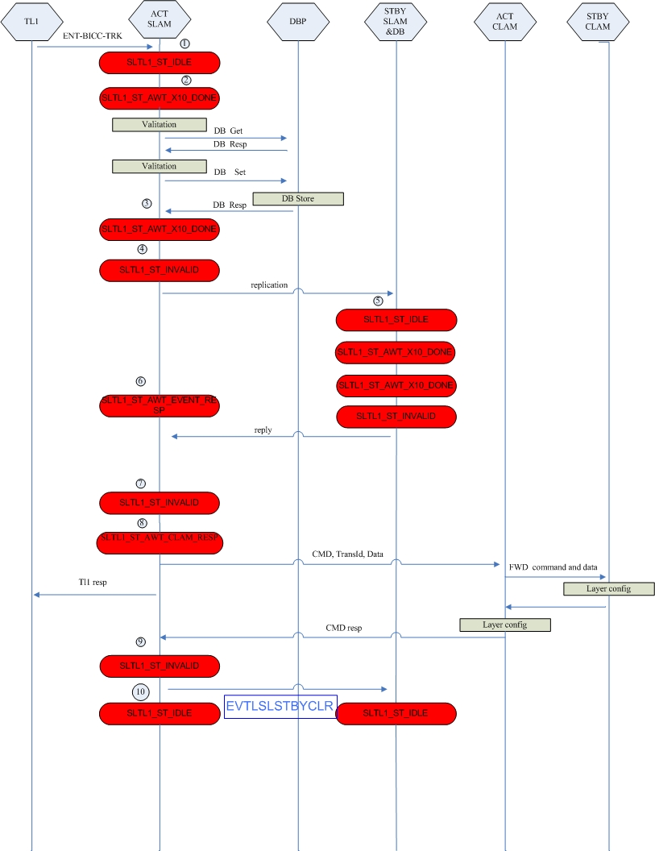
SLAM-TL1 FSM

Slide 12
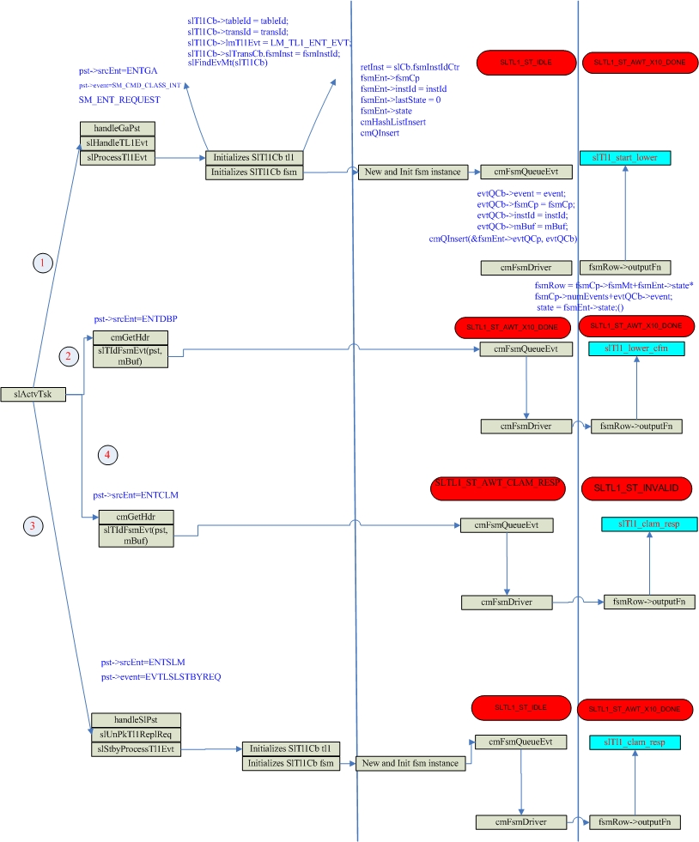
SLAM-TL1 FSM

Slide 13
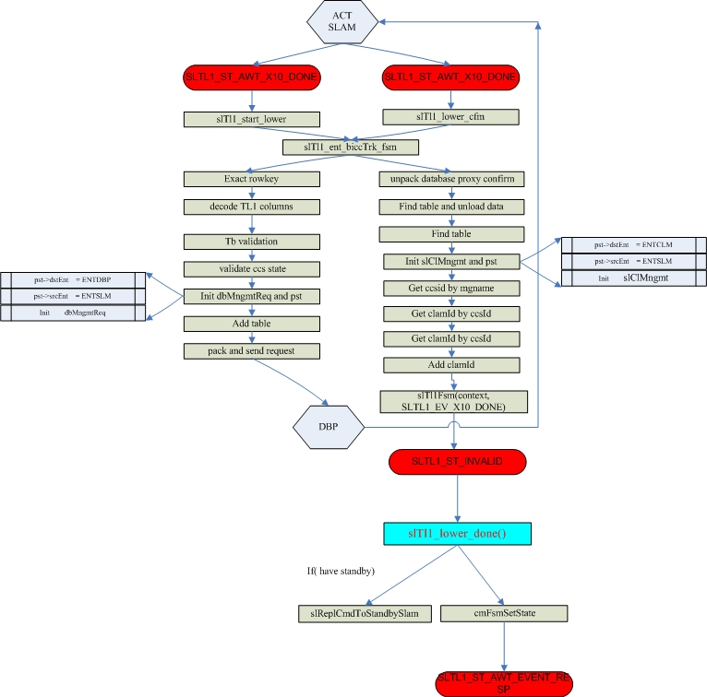
SLAM-TL1 FSM
22

Slide 14
Common function
//slam/base/sl_tl1.c
slTl1_start_lower() (SlTl1Cb *context) // Kicks off the SLAM Unit functions.
{
…
(context->slTransCb.mtInfo->slTl1Func)(context); /*call matrix event--LmEvtMt*/
slTl1Fsm() //Wrapper function to send TL1 FSM an EVENT
…slSendTl1Resp(context,TSSMI_GEN_ERROR……) //send TL1 response
}
Function:
a). Do validation for parameters.
b). Update DB and prepare data which will be forwarded to CLAM.
slDecodeSmiCols() → Decode row to table structure
tbValidateRow() → Validate the columns via the column definitions
slInitPstDbpMngmt () → Init DBP Management
cmTbAddTbl () → Add table
cmPkDbMngmtReq() → Pack data to DBP
Notes:
slTl1Fsm(){ ret = cmFsmQueueEvt}

Slide 15
Common function
slTl1_lower_cfm () /*Get data from DB and fill ClamData structure.*/
{
…
(context->slTransCb.mtInfo->slTl1Func)(context); /*call matrix event--LmEvtMt*/
…
}
SlTl1Cb
{ …
ClamData clamData[TELICA_MAX_CLAM_ID+1];
}
cmUnpkDbMngmtCfm() → Unpk data from dbMngmtCfm
cmTbFndDlnkTbl() → Find the row from cmTbCb
slInitPstClmMngmt() → sets up SlClMngmt struct for a CLAM
cmTbAddTbl() → Add data into table
slAddClamId() → Fill ClamData
Fetch data from DB and fill this structure
Notes:
slTl1_ent_tgp_db_cfm()
slActvTsk()
slTIdFsmEvt() (case ENTDBP)
cmFsmQueueEvt()

Slide 16
Common function
slTl1_lower_done():
when active SP complete transaction with DBP (receive event DBP final confirm). Active SP post event EVTLSLSTBYREQ to standby SP. The corresponding function is slReplCmdToStandbySlam()
During this state:
The sameTL1 FSM will be execute on Standby SP.
State change:
when standby SP complete transaction with DBP (receive event DBP final confirm). Standby SP will post event EVTLSLSTBYRSP to active SP The corresponding function is slSendRespToActSlam()

Slide 17
Common function
when standby SP complete transaction with DBP (receive event EVTLSLSTBYRSP from standby SP).
slTl1_standby_resp():
1. If active SP receives a bad response from standby SP, standby SP will failed and reboot. Alarm name--SLAM_FAM_REPL_FLD_EVT
2. Send a response to TL1 agent (active SP) slSendTl1Resp()
3. send to corresponding CLAM. slSendToClamList()
State change:
When active SP receives response from all CLAM (SLTL1_EV_ACT_CLAM_RESP)

Slide 18
Common function
slTl1_clam_resp():
On active SP:
When receive event SLTL1_EV_ACT_CLAM_RESP from CLAM.
1. Post event “EVTLSLSTBYCLR” to standby slSendClrTrans()
2. Set TL1 state to SLTL1_ST_IDLE
3. Free all control block slTl1FsmCleanup(context)
-- SlTl1Cb
-- table list
…
On standby SP:
When standby receive event EVTLSLSTBYCLR from active SP:
release all allocated memory
-- SlTl1Cb
-- table list
-- transaction CP

Slide 19
My deepest gratitude goes first to Alpha, my mentor. Without his patience and guidance I won’t learn so much. Second, I want to pay my sincere thanks to Sophia who give me chances to take different tasks and to learn more. Also, I greatly appreciate to Colin, Paolo and all the colleagues in our team who helped me a lot during the work.

