Slide 2

5060 MGC-8 Cloud/Chef Installation (Openstack Grizzly)
November 2013

Slide 3
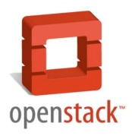






Chef Workstation Environment Setup
Acquire:
external network Id
Allocate public IPs
Cloud Orchestration
Metadata
Chef Server
Download and install Openstack knife plug-in* and cookbooks
Configure knife, plug-in, and the Openstack settings
Customize infrastructure.yml to define how many MGC-8 VMs to create
Chef Workstation
Openstack plug-in
Note: * The Openstack plug-in is forked from: https://github.com/opscode/knife-openstack

Slide 4
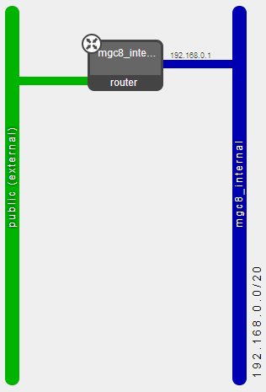
Upload MGC-8 Image and Create MGC-8 Network
Cloud Orchestration
Metadata
Chef Server
knife openstack image add
knife openstack network create
Chef Workstation
Openstack plug-in

Slide 5


Execute “spiceweasel” Tool (the “Easy-Button”)
Hostname
Chef-client data
Ssh keys
Public IP
Cloud Orchestration
Metadata
Chef Server
6c. Fetch Metadata (cloud-init, upstart)
6b. Create VMs
(knife openstack server create, assign IPs)
MGC-8 VM
6d. Fetch Recipes (chef-client)
6a. Upload Cookbooks (3 knife commands)
MGC-8 VM
6e. Chef client executes recipes (ntp, security, etc)
Chef Workstation
MGC-8 VM
(Act CP)
6f. VMs registering with CP
(SW Version, Public IP,
“virtual slot”)
Openstack plug-in
Note: The spiceweasel tool: https://github.com/mattray/spiceweasel

Slide 6
Application Bulk Configuration
Hostname
Chef-client data
Ssh keys
Public IP
Cloud Orchestration
Metadata
Chef Server
MGC-8 VM
MGC-8 VM
Chef Workstation
MGC-8 VM
(Act CP)
Openstack plug-in
1. knife ssh command to:
a. transfer bulk config file
b. execute bulk config

Slide 7
Growth with MGC8 Knife Plug-in
Hostname
Chef-client data
Ssh keys
Public IP
Cloud Orchestration
Metadata
Chef Server
1b. Fetch Metadata (cloud-init, upstart)
1a. Create VMs
(knife openstack server create, assign IPs)
1c. Fetch Recipes (chef-client)
MGC-8 VM
(growth)
1d. Chef client executes recipes (ntp, security, etc)
MGC-8 VM
(growth)
Chef Workstation
MGC-8 VM
(Act CP)
Openstack plug-in
1e. VMs registering with CP
(SW Version, Public IP,
“virtual slot”)

Slide 8
Chef Openstack ‘gem’ Sample API COMMANDS
Pre-deployment steps (manual in approx. 30 minutes)
Create user account and tenant (Project) via Openstack Horizon.
Download ‘Openstack RC’ file for access to Openstack APIs.
(Optional) Create and download key-pair for ssh access to VMs (e.g. MGC8-key.pem).
Access the ‘chef-workstation’ and follow the steps below:
tar –xzf mgc8-chef-repo.tar.gz
gem install ~/mgc8-chef-repo/knife-openstack-0.8.1.gem
Setup the environment variables with the OpenStack RC (e.g. source <project>-openrc.sh)
(Optional) Save the ‘MGC8-key.pem’ to ~/mgc8-chef-repo/.chef/
Customize the ~/mgc8-chef-repo/.chef/knife.rb to fit the deployment needs.
Customize the ‘spiceweasel’ ~/mgc8-chef-repo/infrastructure.yml to define the number of MGC-8 nodes needed.
Note: A ‘chef-workstation’ image can be made available with 2.a and 2.b already installed.

Slide 9
Chef Openstack ‘gem’ API COMMANDS (con’t)
MGC-8 deployment (auto deploy in < 10 minutes)
Add the MGC-8 application image to OpenStack
root@chef-workstation:~/mgc8-chef-repo# knife openstack image add
Create the internal network, subnet, router, and gateway (single network)
root@chef-workstation:~/mgc8-chef-repo# knife openstack network create
Execute the ‘spiceweasel –e infrastructure.yml’ to deploy, bootstrap, and configure the MGC-8 nodes.
root@chef-workstation:~/mgc8-chef-repo# spiceweasel –e infrastructure.yml
Note: TBD the security groups and ACLs.

