Slide 1

Options of Diameter for Plexus
IPC/Socket (Network Programming)
02/23/2010
Tony Liu (x5810, zhi_cai.liu@)
(Originated by Alan Tang & Albin Wang)
12/05/2006

Slide 2
Contents
• Section 1 Introduction
• Section 2 Signal
• Section 3 Pipe
• Section 4 System V IPC -- Message Queue
• Section 5 System V IPC -- Semaphore
• Section 6 System V IPC -- Shared Memory
• Section 7 Socket

Slide 3
Section 1
Introduction
Notes:
The goal of this training is:
Overview of IPCs (Inter Process Communication)

Slide 4
IPC and network Programming
IPC – Inter-Process Communication
  Signal
  Pipe
  Message Queue
  Semaphore
  Shared Memory
  Socket
Network Programming: Socket
  Connection (TCP/SCTP)
  Connectionless (UDP)

Slide 5
Section 2
Signal
Notes:
The goal of this training is:
Overview of IPCs (Inter Process Communication)
Focus on section 7: Socket

Slide 6
Signal Concept
a notification to a process that an asynchronous event has occurred
disposition: signal handler
generate, deliver, pending, block/unblock

Slide 7
How does it work
Install signal handler
One process can raise a signal to another process
The destination process catches the signal then handle it

Slide 8
Signal – Raise the signal
Unix command “kill” (man 1 kill)
System call “kill” (man 2 kill)

Slide 9
Signal Handler in the Destination Process
  Set Signal Handler
    SYNOPSIS
    #include <signal.h>
    typedef void (*sighandler_t)(int);
    sighandler_t signal(int signum, sighandler_t handler);
  Implement Signal Handler (func)

Slide 10
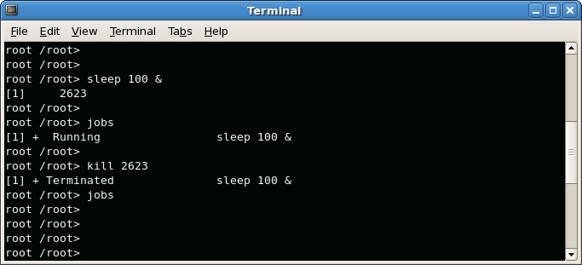
Signal Handler In-CLASS PRACTICE

Slide 11
Signal Handler In-CLASS PRACTICE 2
mkdir –p /home/lgp/IPC/signal
Copy the contents in the notes to the file /home/lgp/IPC/signal/signal.c
gcc –o signal signal.c
./signal
Type CTRL+C (SIGINT) to see the result
Notes:
#include <stdio.h>
#include <stdlib.h>
#include <errno.h>
#include <signal.h>
int main(void)
{
void sigint_handler(int sig); /* prototype */
char s[200];
/* set up the handler */
if (signal(SIGINT, sigint_handler) == SIG_ERR) {
perror("signal");
exit(1);
}
printf("Enter a string:\n");
if (fgets(s, 200, stdin) == NULL)
{
perror(“fgets");
}
else
{
printf("You entered: %s\n", s);
}
return 0;
}
/* this is the handler */
void sigint_handler(int sig)
{
printf("Not this time!\n");
}

Slide 12
Use POSIX Signal Handling functions
Please Note: The signal() is old way. The new POSIX signal functions should be used instead!!
SYNOPSIS
#include <signal.h>
int sigaction(int signum, const struct sigaction *act, struct sigaction
*oldact);
int sigprocmask(int how, const sigset_t *set, sigset_t *oldset);
int sigpending(sigset_t *set);
int sigsuspend(const sigset_t *mask);
Refer to APUE

Slide 13
Summary
What is signal
Raising a signal
Signal handling

Slide 14
Section 3
Pipe
Notes:
The goal of this training is:
Overview of IPCs (Inter Process Communication)
Focus on section 7: Socket

Slide 15

Pipe
A pipe contains a pair of file descriptors
    SYNOPSIS
    #include <unistd.h>
    int pipe(int fd[2]);
Write to the write descriptor(fd[1])
Read from the read descriptor(fd[0])

Slide 16
Picture after pipe() is called
user process
user process
or
fd[0]
fd[1]
fd[0]
fd[1]
pipe
kernel

Slide 17
Pipe – explanation to fork()
1 #include <stdio.h>
2 #include <stdlib.h>
3 #include <errno.h>
4 #include <unistd.h>
5 #include <sys/types.h>
6 #include <sys/wait.h>
7
8 main()
9 {
10 pid_t pid;
11 int rv;
12
13 switch(pid=fork()) {
14 case -1:
15 perror("fork"); /* something went wrong */
16 exit(1); /* parent exits */
17
18 case 0:
19 printf(" CHILD: This is the child process!\n");
20 printf(" CHILD: My PID is %d\n", getpid());
21 printf(" CHILD: My parent's PID is %d\n", getppid());
22 printf(" CHILD: Enter my exit status (make it small): ");
23 scanf(" %d", &rv);
24 printf(" CHILD: I'm outta here!\n");
25 exit(rv);
26
27 default: /* return value == pid of child process
28 printf("PARENT: This is the parent process!\n");
29 }
30 }

Slide 18
Picture after pipe() and fork()
parent
child
fork
fd[0]
fd[1]
fd[0]
fd[1]
pipe
kernel

Slide 19
Pipe – In-Class PRACTICE
1 #include <stdio.h>
2 #include <stdlib.h>
3 #include <sys/types.h>
4 #include <unistd.h>
5
6 int main()
7 {
8 int pfds[2];
9 char buf[30];
10
11 pipe(pfds);
12
13 if (!fork()) {
14 printf(" CHILD: writing to the pipe\n"); // fork() returns 0, this is the child process.
15 write(pfds[1], "test", 5);
16 printf(" CHILD: exiting\n");
17 exit(0);
18 } else {
19 printf("PARENT: reading from pipe\n");
20 read(pfds[0], buf, 5);
21 printf("PARENT: read \"%s\"\n", buf);
22 wait(NULL);
23 }
24 }
Notes:
#include <stdio.h>
#include <stdlib.h>
#include <sys/types.h>
#include <unistd.h>
int main()
{
int pfds[2];
char buf[30];
pipe(pfds);
if (!fork()) {
printf(" CHILD: writing to the pipe\n");
write(pfds[1], "test", 5);
printf(" CHILD: exiting\n");
exit(0);
} else {
printf("PARENT: reading from pipe\n");
read(pfds[0], buf, 5);
printf("PARENT: read \"%s\"\n", buf);
wait(NULL);
}
}

Slide 20
Pipe – In-Class PRACTICE
Mkdir /home/lgp/IPC/pipe
Copy the contents in the note of previous page to pipe.c
gcc –o pipe pipe.c
./pipe

Slide 21
Pipe – used in shell commands
ls | more
steps implied by above command
  A child process is forked
  The child and parent uses pipe to communicate
  The output of ls is write to the pipe
  The more reads the input from read end of the pipe

Slide 22
Summary
What is pipe
Pipe usage in C
Pipe usage in shell

Slide 23
Section 4
System V IPC -- Message Queue
Notes:
The goal of this training is:
Overview of IPCs (Inter Process Communication)
Focus on section 7: Socket

Slide 24
Message Queue
A queue can be used by multiple processes to write/read messages to/from.
The messages are taken off the queue as the order they are put on the queue.
There are also ways to cut the line.
Can be used for IPC on the same machine

Slide 25
Message Queue – Create/Attach to the queue
#include <sys/msg.h>
key = ftok("/home/lgp/somefile", 'b');
  ftok() creates a key which will be used by msgget
  Any other process that wants to attach to the same queue must use the same key
msqid = msgget(key, 0666 | IPC_CREAT);
  Create or attach to the queue

Slide 26
Message Queue – Sending to the queue
#include <sys/msg.h>
int msgsnd(int msqid, const void *msgp, size_t msgsz, int msgflg);

Slide 27
Message Queue – Receiving from the queue
SYNOPSIS
#include <sys/types.h>
#include <sys/ipc.h>
#include <sys/msg.h>
ssize_t msgrcv(int msqid, struct msgbuf *msgp, size_t msgsz, long msgtyp, int msgflg);

Slide 28
Message Queue – Destroying the queue
SYNOPSIS
#include <sys/types.h>
#include <sys/ipc.h>
#include <sys/msg.h>
int msgctl(int msqid, int cmd, struct msqid_ds *buf);
Example: msgctl(msqid, IPC_RMID, NULL)

Slide 29
Message Queue – In-Class PRACTICE
mkdir /home/lgp/messageQueue
Copy the contents in the notes of this page to writeQ.c
gcc –o writeQ writeQ.c
Notes:
#include <stdio.h>
#include <stdlib.h>
#include <errno.h>
#include <sys/types.h>
#include <sys/ipc.h>
#include <sys/msg.h>
struct my_msgbuf {
long mtype;
char mtext[200];
};
int main(void)
{
struct my_msgbuf buf;
int msqid;
key_t key;
if ((key = ftok("writeQ.c", 'B')) == -1) {
perror("ftok");
exit(1);
}
if ((msqid = msgget(key, 0644 | IPC_CREAT)) == -1) {
perror("msgget");
exit(1);
}
printf("Enter lines of text, ^D to quit:\n");
buf.mtype = 1; /* we don't really care in this case */
while(fgets(buf.mtext, 200, stdin)) {
if (msgsnd(msqid, (struct msgbuf *)&buf, sizeof(buf), 0) == -1)
perror("msgsnd");
}
if (msgctl(msqid, IPC_RMID, NULL) == -1) {
perror("msgctl");
exit(1);
}
return 0;
}

Slide 30
Message Queue – In-Class PRACTICE
Copy the contents in the notes of this page to readQ.c
gcc –o readQ readQ.c
Notes:
#include <stdio.h>
#include <stdlib.h>
#include <errno.h>
#include <sys/types.h>
#include <sys/ipc.h>
#include <sys/msg.h>
struct my_msgbuf {
long mtype;
char mtext[200];
};
int main(void)
{
struct my_msgbuf buf;
int msqid;
key_t key;
if ((key = ftok("writeQ.c", 'B')) == -1) { /* same key as writeQ.c */
perror("ftok");
exit(1);
}
if ((msqid = msgget(key, 0644 | IPC_CREAT)) == -1) { /* connect to the queue */
perror("msgget");
exit(1);
}
printf("readQ: ready to receive messages, captain.\n");
for(;;) { /* Spock never quits! */
if (msgrcv(msqid, (struct msgbuf *)&buf, sizeof(buf), 0, 0) == -1) {
perror("msgrcv");
exit(1);
}
printf("readQ: %s\n", buf.mtext);
}
return 0;
}

Slide 31
Message Queue – In-Class PRACTICE
If you have multiple terminals
  run readQ from terminal 1
  run writeQ from terminal 2
  Write something on terminal 2, what you get?
Otherwise:
  run readQ& from terminal 1
  run writeQ in same terminal
  write something in writeQ, see what you get?

Slide 32
Summary
Message queue
Real example for reading queue
Real example for writing queue

Slide 33
Section 5
System V IPC -- Semaphore

Slide 34
Semaphore
A counter to provide access to shared data for multiple processes
A process needs to test the semaphore before using shared data
If semaphore > 0, decrement it by 1 and proceed;
Otherwise, the process is put to sleep till semaphore > 0
After using shared data, process increments semaphore by 1
Any process waiting for this semaphore will be awakened

Slide 35
System V IPC Semaphore – Creation
#include <sys/ipc.h>
#include <sys/sem.h>
key_t key;
int semid;
/* key creation */
key = ftok("/home/lgp/somefile", 'E');
/* semaphore creation */
semid = semget(key, 10, 0666 | IPC_CREAT);

Slide 36
System V IPC Semaphore – Init
Like what we put the pens on the notebook
SYNOPSIS
#include <sys/types.h>
#include <sys/ipc.h>
#include <sys/sem.h>
int semctl(int semid, int semnum, int cmd, ...);
Example:
union semun arg;
arg.val = 1;
if (semctl(semid, 0, SETVAL, arg) == -1)
{
perror("semctl");
exit(1);
}

Slide 37
System V IPC Semaphore – Operation
SYNOPSIS
#include <sys/types.h>
#include <sys/ipc.h>
#include <sys/sem.h>
int semop(int semid, struct sembuf *sops, unsigned nsops);
struct sembuf
{
ushort sem_num;
short sem_op;
short sem_flg;
};

Slide 38
System V IPC Semaphore – Operation cont’d
Sem_op values:
<0 (-1 means get one resource)
  |sem_op| <= current semaphore value (the available resource), get the resource, current semaphore decrease
  |sem_op| > current semaphore, wait
>0, proceed, current semaphore increase (return the resource)
=0, wait till the semaphore == 0

Slide 39
System V IPC Semaphore – Destroying
union semun arg;
semctl(semid, 0, IPC_RMID, arg);
Arg value does not matter.

Slide 40
System V IPC Semaphore – In-Class PRACTICE
mkdir ~lgp/IPC/semaphore
Copy the contents in the notes of this page to semaphoreInit.c
gcc –o semaphoreInit semaphoreInit.c
Notes:
#include <stdio.h>
#include <stdlib.h>
#include <errno.h>
#include <sys/types.h>
#include <sys/ipc.h>
#include <sys/sem.h>
int main(void)
{
key_t key;
int semid;
union semun {
int val; /* value for SETVAL */
struct semid_ds *buf; /* buffer for IPC_STAT, IPC_SET */
unsigned short *array; /* array for GETALL, SETALL */
/* Linux specific part: */
struct seminfo *__buf; /* buffer for IPC_INFO */
};
union semun arg;
if ((key = ftok("semaphore.c", 'J')) == -1) {
perror("ftok");
exit(1);
}
/* create a semaphore set with 1 semaphore: */
if ((semid = semget(key, 1, 0666 | IPC_CREAT)) == -1) {
perror("semget");
exit(1);
}
/* initialize semaphore #0 to 1: */
arg.val = 1;
if (semctl(semid, 0, SETVAL, arg) == -1) {
perror("semctl");
exit(1);
}
return 0;
}

Slide 41
System V IPC Semaphore – In-Class PRACTICE
Copy the contents in the notes of this page to semaphore.c
gcc –o semaphore semaphore.c
Notes:
#include <stdio.h>
#include <stdlib.h>
#include <errno.h>
#include <sys/types.h>
#include <sys/ipc.h>
#include <sys/sem.h>
int main(void)
{
key_t key;
int semid;
struct sembuf sb = {0, -1, 0}; /* set to allocate resource */
if ((key = ftok("semaphore.c", 'J')) == -1) {
perror("ftok");
exit(1);
}
/* grab the semaphore set */
if ((semid = semget(key, 1, 0)) == -1) {
perror("semget");
exit(1);
}
printf("Press return to lock: ");
getchar();
printf("Trying to lock...\n");
if (semop(semid, &sb, 1) == -1) {
perror("semop");
exit(1);
}
printf("Locked.\n");
printf("Press return to unlock: ");
getchar();
sb.sem_op = 1; /* free resource */
if (semop(semid, &sb, 1) == -1) {
perror("semop");
exit(1);
}
printf("Unlocked\n");
return 0;
}

Slide 42
System V IPC Semaphore – In-Class PRACTICE
run semaphoreInit
run semaphore in process one
  Press return to lock
  Stop here
run semaphore in process two
In process two can you get the resource? Why?
Release the resource in process one.
Can you get the resource in process two now?
Notes:
#include <stdio.h>
#include <stdlib.h>
#include <errno.h>
#include <sys/types.h>
#include <sys/ipc.h>
#include <sys/sem.h>
int main(void)
{
key_t key;
int semid;
struct sembuf sb = {0, -1, 0}; /* set to allocate resource */
if ((key = ftok("semaphore.c", 'J')) == -1) {
perror("ftok");
exit(1);
}
/* grab the semaphore set */
if ((semid = semget(key, 1, 0)) == -1) {
perror("semget");
exit(1);
}
printf("Press return to lock: ");
getchar();
printf("Trying to lock...\n");
if (semop(semid, &sb, 1) == -1) {
perror("semop");
exit(1);
}
printf("Locked.\n");
printf("Press return to unlock: ");
getchar();
sb.sem_op = 1; /* free resource */
if (semop(semid, &sb, 1) == -1) {
perror("semop");
exit(1);
}
printf("Unlocked\n");
return 0;
}

Slide 43
System V IPC Semaphore – In-Class PRACTICE
Clean up the semaphore created by you
Use ipcs to show all the ipcs
Use “ipcrm –s <semaphore id>” to delete the semaphore.

Slide 44
Summary
Semaphore demo
Creation
Operation
Destroying

Slide 45
Section 6
System V IPC – Shared memory

Slide 46
System V IPC Shared Memory -- Creating
NAME
shmget - allocates a shared memory segment
SYNOPSIS
#include <sys/ipc.h>
#include <sys/shm.h>
int shmget(key_t key, int size, int shmflg);
Example of creating a 1K segment with 644 permissions (rw-r--r--):
key_t key;
int shmid;
key = ftok("/home/lgp/somefile", 'R');
shmid = shmget(key, 1024, 0644 | IPC_CREAT);

Slide 47
System V IPC Shared Memory -- Attaching
SYNOPSIS
#include <sys/types.h>
#include <sys/shm.h>
void *shmat(int shmid, const void *shmaddr, int shmflg);
Example of attaching to the shared memory:
key_t key;
int shmid;
char *data;
key = ftok("/home/lgp/somefile", 'R');
shmid = shmget(key, 1024, 0644 | IPC_CREAT);
data = shmat(shmid, (void *)0, 0);

Slide 48
System V IPC Shared Memory – Reading and Writing
Just like to handle the normal memory segment.
If it stores characters, you can use string functions.
If it stores whatever format you know, you will need to handle it by using the C pointer.

Slide 49
System V IPC Shared Memory – Detaching
When you are done with the shared memory, use shmdt() to detach from it.
SYNOPSIS
#include <sys/types.h>
#include <sys/shm.h>
int shmdt(const void *shmaddr);

Slide 50
System V IPC Shared Memory – Destroying
Use shmctl() to destroy the memory segment.
SYNOPSIS
#include <sys/ipc.h>
#include <sys/shm.h>
int shmctl(int shmid, int cmd, struct shmid_ds *buf);
Example:
shmctl(shmid, IPC_RMID, NULL);

Slide 51
System V IPC Shared Memory – In-Class PRACTICE
mkdir –p /home/lgp/IPC/sharedMem
Copy the contents in notes to sharedMemRC.c
gcc –o sharedMemRC sharedMemRC.c
./sharedMemRC w&
./sharedMemRC
What do you see?
run it again: ./sharedMemRC
What go you see?
Notes:
#include <stdio.h>
#include <stdlib.h>
#include <string.h>
#include <sys/types.h>
#include <sys/ipc.h>
#include <sys/shm.h>
#define SHM_SIZE 1024 /* make it a 1K shared memory segment */
int main(int argc, char *argv[])
{
key_t key;
int shmid;
char *data;
int mode;
int i;
if (argc > 2) {
fprintf(stderr, "usage: shmdemo [w], w: tell the program to write the data to the shared memory\n");
exit(1);
}
/* make the key: */
if ((key = ftok("sharedMemRC.c", 'R')) == -1) {
perror("ftok");
exit(1);
}
/* connect to (and possibly create) the segment: */
if ((shmid = shmget(key, SHM_SIZE, 0644 | IPC_CREAT)) == -1) {
perror("shmget");
exit(1);
}
/* attach to the segment to get a pointer to it: */
data = shmat(shmid, (void *)0, 0);
if (data == (char *)(-1)) {
perror("shmat");
exit(1);
}
/* read or modify the segment, based on the command line: */
if (argc == 2) {
printf("Writing to segment...\n");
for (i=0; i<=20; i++){
sleep(1);
strncpy(data+i*12, "hello world\n", SHM_SIZE);
}
printf("Done writing to segment.\n");
} else {
printf("Read: segment contains: \n%s\n", data);
}
/* detach from the segment: */
if (shmdt(data) == -1) {
perror("shmdt");
exit(1);
}
return 0;
}

Slide 52
System V IPC Shared Memory – Concurrency issue
Any difference between the first read and second read?
This is the concurrency issue of accessing the shared resource.
By the time it reads the data from shared memory, another process is writing data to it
This is also called a race condition
How to have it resolved?

Slide 53
Summary
Shared memory
Creation
Attaching
Reading/Writing
Detaching
Destroying

Slide 54
Section 7
Socket APIs

Slide 55
What is a socket?
A socket is like a two way pipe!

Slide 56
Internet Sockets – Stream socket and Datagram socket
Stream internet socket
  connection socket
  TCP/SCTP
  Reliable
Datagram internet socket
  connectionless socket
  UDP
  Unreliable

Slide 57
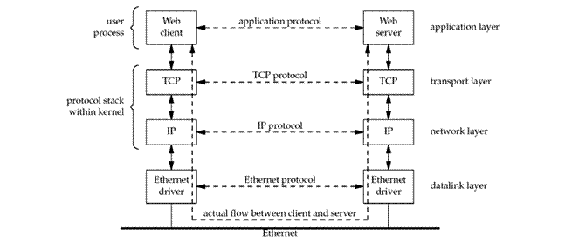
Network Layering

Slide 58

Network Layering – data encapsulation
Network Access Internet Transport Application
• Application Layer (telnet, ftp, etc.)
• Host-to-Host Transport Layer (TCP, UDP)
• Internet Layer (IP and routing)
• Network Access Layer (Ethernet, ATM, or whatever)

Slide 59
Socket programming -- Structs and Data
Every thing is a file on Unix/Linux
When open a file you get a file descriptor
A socket is a file descriptor too
The fist data: socket descriptor
  type int
  int socket(int domain, int type, int protocol);

Slide 60
Socket programming -- Structs and Data
Generic sock address structure
struct sockaddr {
unsigned short sa_family; // address family, AF_xxx
char sa_data[14]; // 14 bytes of protocol address
};
sa_family: address family, AF_INET is used for internet sockets
sa_data: contains a destination address and port number for the socket
This data structure is not user friendly, we need an adaptor

Slide 61
Socket programming -- Structs and Data
New generic socket address structure to cover IPv6
/* Structure large enough to hold any socket address (with the historical
exception of AF_UNIX). We reserve 128 bytes. */
#if ULONG_MAX > 0xffffffff
# define __ss_aligntype __uint64_t
#else
# define __ss_aligntype __uint32_t
#endif
#define _SS_SIZE 128
#define _SS_PADSIZE (_SS_SIZE - (2 * sizeof (__ss_aligntype)))
struct sockaddr_storage
{
__SOCKADDR_COMMON (ss_); /* Address family, etc. */
__ss_aligntype __ss_align; /* Force desired alignment. */
char __ss_padding[_SS_PADSIZE];
};

Slide 62
Socket programming -- Structs and Data
Why generic socket address?
A socket address structures is always passed by reference when passed as an argument to any socket functions. But any socket function that takes one of these pointers as an argument must deal with socket address structures from any of the supported protocol families.
A problem arises in how to declare the type of pointer that is passed. With ANSI C, the solution is simple: void * is the generic pointer type. But, the socket functions predate ANSI C and the solution chosen in 1982 was to define a generic socket address structure in the <sys/socket.h> header.

Slide 63
Socket programming -- Structs and Data
Adaptor sockaddr structure
struct sockaddr_in {
short int sin_family; // Address family
unsigned short int sin_port; // Port number, network byte ordering
struct in_addr sin_addr; // Internet address, network byte ordering
unsigned char sin_zero[8]; // Padding to have same size as struct sockaddr
};
struct in_addr {
uint32_t s_addr; // that's a 32-bit int (4 bytes), network byte ordering
};

Slide 64
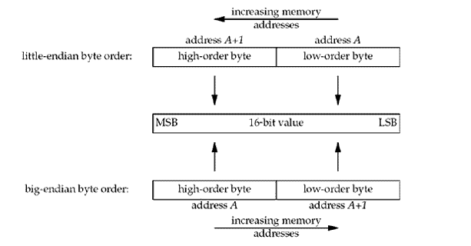
Socket programming -- Structs and Data
Byte ordering

Slide 65
Socket programming -- Structs and Data
Byte ordering
Example: “68”, if 6 is in low address it is big-endian
big means high order
endian means LOW address
If 8 is in low address it is little-endian
Note: though 6<8, 6 is BIG and 8 is LITTLE!!
big-endian is also called network ordering

Slide 66
Socket programming -- Structs and Data
Byte ordering – byte ordering converting functions
htons() host to network short
htonl() host to network long
ntohs() network to host short
ntohl() network to host long
Used for converting port numbers

Slide 67
Socket programming -- Structs and Data
Byte ordering – byte ordering converting functions
Inet_ntop(); // network to presentation
Inet_pton(); // presentation to network
Used for IP address converting
Presentation format: 135.252.34.201
Network binary format: 337253186 in network byte ordering
Always use these functions instead of using inet_aton() or inet_ntoa() which only works for IPv4.
Notes:
#include <sys/types.h>
#include <sys/socket.h>
#include <arpa/inet.h>
#include <netinet/in.h>
#include <stdio.h>
int main(){
unsigned long l = htonl(1000);
//unsigned long hl = ntohl(l);
unsigned long hl = l;
printf("IPaddress is :%u.%u.%u.%u:\n",
(hl >> 24) & 0xff,
(hl >> 16) & 0xff,
(hl >> 8) & 0xff,
hl & 0xff);
struct sockaddr_in sin;
inet_pton(AF_INET, "135.252.34.201", &sin,sin_addr);
printf("IP address of 135.252.34.201 is :%d:\n", ntohl(sin.sin_addr.s_addr));
return 0;
}

Slide 68
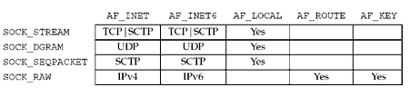
Socket programming – Socket APIs
Socket creating
SYNOPSIS
#include <sys/types.h>
#include <sys/socket.h>
int socket(int domain, int type, int protocol);
Type Protocol Family
Notes:
Now that we know the data structures, we start looking at the API usage.

Slide 69
Socket programming – Socket APIs
Server side APIs
bind();
  associate the IP address and port to socket descriptor
listen();
  waiting for clients to connect to me
accept()
  accepts connection from client

Slide 70
Socket programming – Socket APIs
Server side APIs
bind();
  SYNOPSIS
  #include <sys/types.h>
  #include <sys/socket.h>
  int bind(int sockfd, struct sockaddr *my_addr, socklen_t addrlen);

Slide 71
Socket programming – Socket APIs
Server side APIs
listen();
  SYNOPSIS
  #include <sys/socket.h>
  int listen(int s, int backlog);
backlog is the number of connections allowed on the incoming queue.
Incoming connections are going to wait in this queue until you accept()
them and this is the limit on how many can queue up.

Slide 72
Socket programming – Socket APIs
Server side APIs
accept();
  SYNOPSIS
  #include <sys/types.h>
  #include <sys/socket.h>
  int accept(int s, struct sockaddr *addr, socklen_t *addrlen);
The accept function is used with connection-based socket types (SOCK_STREAM,
SOCK_SEQPACKET and SOCK_RAW). It extracts the first connection request on the queue
of pending connections, creates a new connected socket with mostly the same
properties as s, and allocates a new file descriptor for the socket, which is returned.
The newly created socket is no longer in the listening state. The original socket s is
unaffected by this call.

Slide 73
Socket programming – In-Class PRACTICE
First simple server:
mkdir –p /home/lgp/IPC/socket
copy the contents in this page to server1.c
gcc –o server1 server1.c
./server1
from another window, run “telnet 127.0.0.1 8888”
Notes:
#include <string.h>
#include <sys/types.h>
#include <sys/socket.h>
#include <netinet/in.h>
#define MYPORT 8888 // the port users will be connecting to
#define BACKLOG 10 // how many pending connections queue will hold
int main(void)
{
int sockfd, new_fd; // listen on sock_fd, new connection on new_fd
struct sockaddr_in my_addr; // my address information
struct sockaddr_in their_addr; // connector's address information
socklen_t sin_size;
sockfd = socket(PF_INET, SOCK_STREAM, 0); // do some error checking!
bzero(&my_addr, sizeof(my_addr));
my_addr.sin_family = AF_INET; // host byte order
my_addr.sin_port = htons(MYPORT); // short, network byte order
my_addr.sin_addr.s_addr = INADDR_ANY; // auto-fill with my IP
memset(my_addr.sin_zero, '\0', sizeof my_addr.sin_zero);
// don't forget your error checking for these calls:
bind(sockfd, (struct sockaddr *)&my_addr, sizeof my_addr);
listen(sockfd, BACKLOG);
sin_size = sizeof their_addr;
#if 0
new_fd = accept(sockfd, (struct sockaddr *)&their_addr, &sin_size);
for(;;){}
#endif
for (;;)
{
new_fd = accept(sockfd, (struct sockaddr *)&their_addr, &sin_size);
printf("Accepted new incoming connection: addr: %s, port: %d\n",
inet_ntoa(their_addr.sin_addr), ntohl(their_addr.sin_port));
close(new_fd);
}
return 0;
}

Slide 74
Socket programming – Socket APIs
Client side APIs
bind(); optional to client
  associate the IP address and port to socket descriptor
connect();
  initiate a connection on a socket

Slide 75
Socket programming – Socket APIs
Client side APIs
connect();
SYNOPSIS
#include <sys/types.h>
#include <sys/socket.h>
int connect(int sockfd, const struct sockaddr *serv_addr, socklen_t
addrlen);

Slide 76
Socket programming – Socket APIs
Common APIs
stream/connected datagram socket APIs
  send();
    send messages to peer
  recv()
    receive messages from peer
unconnected data gram socket APIs
  sendto();
  recvfrom();
close connection
  close();

Slide 77
Socket programming – Socket APIs
Common APIs
send();
SYNOPSIS
#include <sys/types.h>
#include <sys/socket.h>
int send(int s, const void *msg, size_t len, int flags);
Note: the len must be the real data length to be sent
recv()
SYNOPSIS
#include <sys/types.h>
#include <sys/socket.h>
int recv(int s, void *buf, size_t len, int flags);
close();
SYNOPSIS
#include <unistd.h>
int close(int fd);

Slide 78
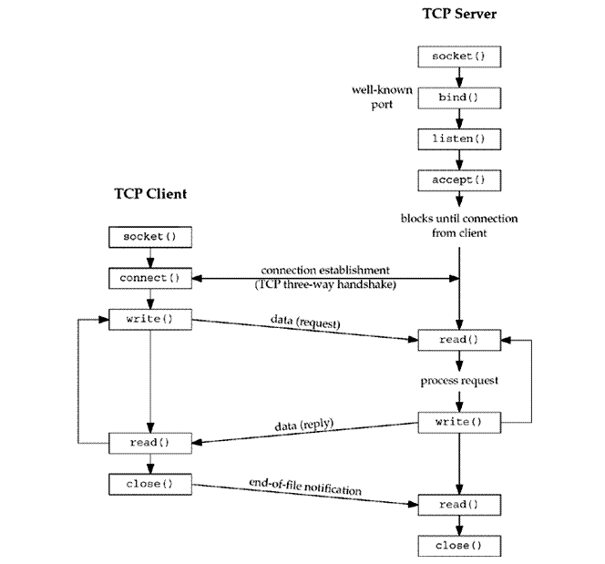
Socket programming – Socket APIs

Slide 79
Socket programming – In-Class PRACTICE
A simple client:
mkdir –p /home/lgp/IPC/socket
copy the contents in this page to client1.c
gcc –o client1 client1.c
./server1&
./client1
netstat -an|grep 8888
tcp 0 0 0.0.0.0:8888 0.0.0.0:* LISTEN
tcp 0 0 127.0.0.1:56500 127.0.0.1:8888 ESTABLISHED
tcp 0 0 127.0.0.1:8888 127.0.0.1:56500 ESTABLISHED
Note: CTRL+C to exit client1, kill %1 to terminate server1
Notes:
#include <string.h>
#include <sys/types.h>
#include <sys/socket.h>
#include <netinet/in.h>
#define DEST_IP "127.0.0.1"
#define DEST_PORT 8888
int main(void)
{
int sockfd;
struct sockaddr_in dest_addr; // will hold the destination addr
sockfd = socket(PF_INET, SOCK_STREAM, 0); // do some error checking!
dest_addr.sin_family = AF_INET; // host byte order
dest_addr.sin_port = htons(DEST_PORT); // short, network byte order
dest_addr.sin_addr.s_addr = inet_addr(DEST_IP);
memset(dest_addr.sin_zero, '\0', sizeof dest_addr.sin_zero);
// don't forget to error check the connect()!
connect(sockfd, (struct sockaddr *)&dest_addr, sizeof dest_addr);
for (;;){}
return 0;
}

Slide 80
Socket programming – In-Class PRACTICE
Client-Server Communication:
mkdir –p /home/lgp/IPC/socket
copy the contents in this page to server2.c
gcc –o server2 server2.c
./server2&
Notes:
#include <string.h>
#include <sys/types.h>
#include <sys/socket.h>
#include <netinet/in.h>
#define MYPORT 8888 // the port users will be connecting to
#define BACKLOG 10 // how many pending connections queue will hold
#define MAXDATASIZE 2000 // max number of bytes we can get at once
int main(void)
{
int sockfd, new_fd; // listen on sock_fd, new connection on new_fd
struct sockaddr_in my_addr; // my address information
struct sockaddr_in their_addr; // connector's address information
int numbytes;
char buf[MAXDATASIZE];
socklen_t sin_size;
sockfd = socket(PF_INET, SOCK_STREAM, 0); // do some error checking!
my_addr.sin_family = AF_INET; // host byte order
my_addr.sin_port = htons(MYPORT); // short, network byte order
my_addr.sin_addr.s_addr = INADDR_ANY;
memset(my_addr.sin_zero, '\0', sizeof my_addr.sin_zero);
// don't forget your error checking for these calls:
bind(sockfd, (struct sockaddr *)&my_addr, sizeof my_addr);
listen(sockfd, BACKLOG);
sin_size = sizeof their_addr;
while (1) {
new_fd = accept(sockfd, (struct sockaddr *)&their_addr, &sin_size);
printf("trying to receive msg...\n");
if ((numbytes=recv(new_fd, buf, MAXDATASIZE-1, 0)) == -1) {
perror("recv");
close(new_fd);
close(sockfd);
exit(1);
}
buf[numbytes] = '\0';
printf("Received msg from client: %s\n",buf);
}
return 0;
}

Slide 81
Socket programming – In-Class PRACTICE
Client-Server Communication:
mkdir –p /home/lgp/IPC/socket
copy the contents in this page to client2.c
gcc –o client2 client2.c
./client2
What did you see from server side?
Notes:
#include <string.h>
#include <sys/types.h>
#include <sys/socket.h>
#include <netinet/in.h>
#define DEST_IP "127.0.0.1"
#define DEST_PORT 8888
int main(void)
{
int sockfd;
struct sockaddr_in dest_addr; // will hold the destination addr
char *msg = "Hello Server!";
int len;
int bytes_sent;
sockfd = socket(AF_INET, SOCK_STREAM, 0); // do some error checking!
dest_addr.sin_family = AF_INET; // host byte order
dest_addr.sin_port = htons(DEST_PORT); // short, network byte order
dest_addr.sin_addr.s_addr = inet_addr(DEST_IP);
memset(dest_addr.sin_zero, '\0', sizeof dest_addr.sin_zero);
if ((connect(sockfd, (struct sockaddr *)&dest_addr, sizeof dest_addr)) == -1){
perror("connect error:");
close(sockfd);
exit(1);
}
len = strlen(msg);
printf("trying to send msg.\n");
bytes_sent = send(sockfd, msg, len, 0);
printf("After trying to send msg.\n");
if (bytes_sent == -1){
perror("send error");
close(sockfd);
exit(0);
}
return 0;
}

Slide 82
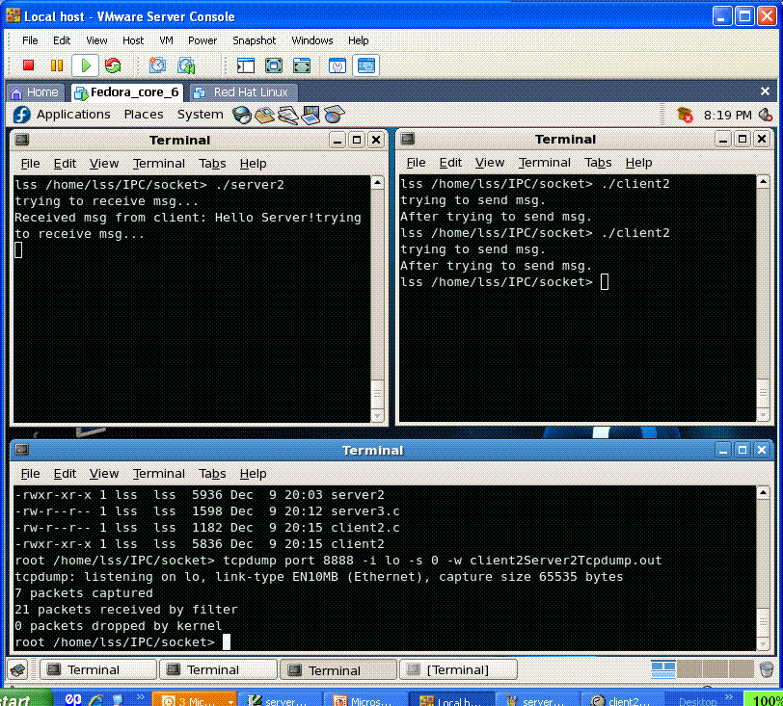
Watching the traffic on the network -- tcpdump
Notes:
#include <string.h>
#include <sys/types.h>
#include <sys/socket.h>
#include <netinet/in.h>
#define DEST_IP "127.0.0.1"
#define DEST_PORT 8888
int main(void)
{
int sockfd;
struct sockaddr_in dest_addr; // will hold the destination addr
char *msg = "Hello Server!";
int len;
int bytes_sent;
sockfd = socket(AF_INET, SOCK_STREAM, 0); // do some error checking!
dest_addr.sin_family = AF_INET; // host byte order
dest_addr.sin_port = htons(DEST_PORT); // short, network byte order
dest_addr.sin_addr.s_addr = inet_addr(DEST_IP);
memset(dest_addr.sin_zero, '\0', sizeof dest_addr.sin_zero);
if ((connect(sockfd, (struct sockaddr *)&dest_addr, sizeof dest_addr)) == -1){
perror("connect error:");
close(sockfd);
exit(1);
}
len = strlen(msg);
printf("trying to send msg.\n");
bytes_sent = send(sockfd, msg, len, 0);
printf("After trying to send msg.\n");
if (bytes_sent == -1){
perror("send error");
close(sockfd);
exit(0);
}
return 0;
}

Slide 83
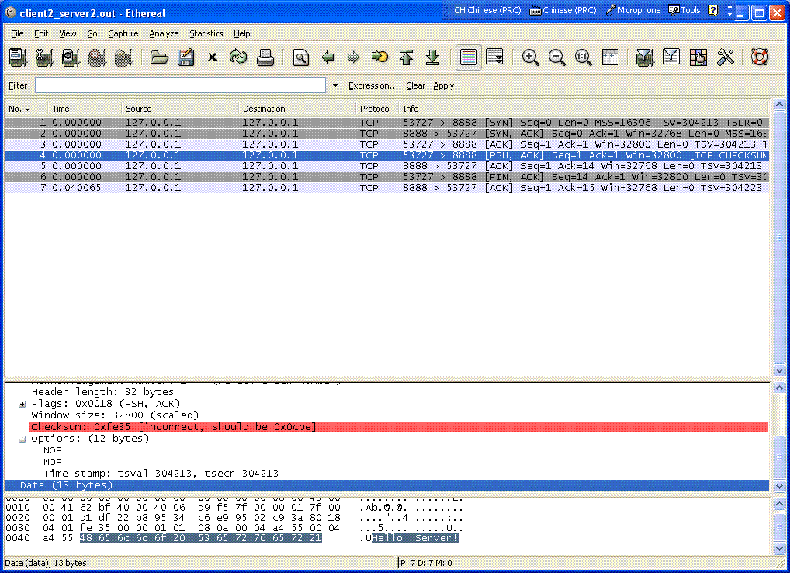
Watching the traffic on the network -- ethereal

Slide 84
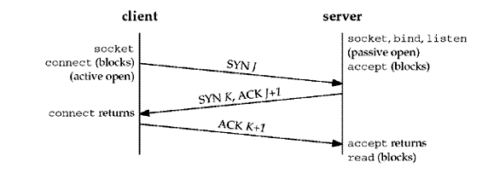
Watching the traffic on the network – TCP 3 way hands-shake

Slide 85
Socket programming – I/O multiplexing
select()
#include <sys/select.h>
#include <sys/time.h>
int select(int maxfdp1, fd_set *readset, fd_set *writeset, fd_set *exceptset, const struct timeval *timeout);
Returns: positive count of ready descriptors, 0 on timeout, –1 on error

Slide 86
Socket programming – I/O multiplexing
pselect() (POSIX select)
#include <sys/select.h>
#include <signal.h>
#include <time.h>
int pselect (int maxfdp1, fd_set *readset, fd_set *writeset, fd_set *exceptset, const struct timespec *timeout, const sigset_t *sigmask);

Slide 87
Summary
Socket
Stream socket and Datagram socket
Client/Server Socket APIs
Network layering
Focused on TCP socket
UDP is similar
Notes:
/*
** selectserver.c -- a cheezy multiperson chat server
*/
#include <stdio.h>
#include <stdlib.h>
#include <string.h>
#include <unistd.h>
#include <sys/types.h>
#include <sys/socket.h>
#include <netinet/in.h>
#include <arpa/inet.h>
#define PORT 8888 // port we're listening on
#define MAX_TRAINEES 200
#define MAX_NAME_LEN 40
int main(void)
{
fd_set master; // master file descriptor list
fd_set read_fds; // temp file descriptor list for select()
struct sockaddr_in myaddr; // server address
struct sockaddr_in remoteaddr; // client address
int fdmax; // maximum file descriptor number
int listener; // listening socket descriptor
int newfd; // newly accept()ed socket descriptor
char buf[1500]; // buffer for client data
char bufTmp[1500]; // tmp buffer for client data: MYNAME=
char bufName[1500]; // tmp buffer for client data: MYNAME=
char clientCFile[200]; // tmp buffer for client data: MYNAME=
char *ptr2Name=NULL;
char *ptr2NameEqu=NULL;
int ptr2NameEquLen = 0;
int nbytes;
int yes=1; // for setsockopt() SO_REUSEADDR, below
size_t addrlen;
int i, j;
char *names[MAX_TRAINEES];
FILE *traineeFiles[MAX_TRAINEES];
for (i=0; i<MAX_TRAINEES; i++){
names[i] = malloc(MAX_NAME_LEN);
traineeFiles[i] = NULL;
}
FD_ZERO(&master); // clear the master and temp sets
FD_ZERO(&read_fds);
// get the listener
if ((listener = socket(PF_INET, SOCK_STREAM, 0)) == -1) {
perror("socket");
exit(1);
}
// lose the pesky "address already in use" error message
if (setsockopt(listener, SOL_SOCKET, SO_REUSEADDR, &yes, \
sizeof(int)) == -1) {
perror("setsockopt");
exit(1);
}
// bind
myaddr.sin_family = AF_INET;
myaddr.sin_addr.s_addr = INADDR_ANY;
myaddr.sin_port = htons(PORT);
memset(myaddr.sin_zero, '\0', sizeof myaddr.sin_zero);
if (bind(listener, (struct sockaddr *)&myaddr, sizeof myaddr) == -1) {
perror("bind");
exit(1);
}
// listen
if (listen(listener, 10) == -1) {
perror("listen");
exit(1);
}
// add the listener to the master set
FD_SET(listener, &master);
// keep track of the biggest file descriptor
fdmax = listener; // so far, it's this one
// main loop
for(;;) {
read_fds = master; // copy it
if (select(fdmax+1, &read_fds, NULL, NULL, NULL) == -1) {
perror("select");
exit(1);
}
// run through the existing connections looking for data to read
for(i = 0; i <= fdmax; i++) {
if (FD_ISSET(i, &read_fds)) { // we got one!!
if (i == listener) {
// handle new connections
addrlen = sizeof remoteaddr;
if ((newfd = accept(listener, \
(struct sockaddr *)&remoteaddr, &addrlen)) == -1) {
perror("accept");
} else {
FD_SET(newfd, &master); // add to master set
if (newfd > fdmax) { // keep track of the maximum
fdmax = newfd;
}
printf("selectserver: new connection from %s on " \
"socket %d\n", \
inet_ntoa(remoteaddr.sin_addr), newfd);
}
} else {
// handle data from a client
if ((nbytes = recv(i, buf, sizeof buf, 0)) <= 0) {
// got error or connection closed by client
if (nbytes == 0) {
// connection closed
printf("selectserver: socket %d hung up\n", i);
} else {
perror("recv");
}
if (traineeFiles[i] != NULL){
fclose(traineeFiles[i]);
// set file pointer to be NULL
traineeFiles[i] = NULL;
}
close(i); // bye!
FD_CLR(i, &master); // remove from master set
} else {
// we got some data from a client
// Write the data to file MYNAME.c based on the MYNAME= protocol
buf[nbytes] = '\0';
//printf("The received data len is :%d:\n", nbytes);
//printf("The received data is :%s:\n", buf);
strcpy(bufTmp, buf);
strcpy(bufName, buf);
bufTmp[strlen("MYNAME=")] = '\0';
if (strcmp(bufTmp, "MYNAME=") == 0){
printf("The received buffer which contains MYNAME= is :%s:\n", bufTmp);
strcpy(names[i], bufTmp);
// open the file then write to the file
if (traineeFiles[i] == NULL){
// get the trainee's name
if ((ptr2Name=strpbrk(bufName, ";")) == NULL){
perror("Wrong application protocal MYNAME=; xpected.\n");
}
else
{
ptr2NameEqu=strpbrk(bufName, "=");
ptr2NameEqu++;
ptr2Name[0] = '\0';
}
printf("The trainee's name is :%s:\n", ptr2NameEqu);
strcpy(clientCFile, ptr2NameEqu);
ptr2NameEquLen = strlen(ptr2NameEqu);
clientCFile[ptr2NameEquLen] = '.';
clientCFile[ptr2NameEquLen+1] = 'c';
clientCFile[ptr2NameEquLen+2] = '\0';
traineeFiles[i] = fopen( clientCFile, "w");
//traineeFiles[i] = fopen( "alanTang.c", "w");
}
fprintf(traineeFiles[i], "%s", ptr2Name+1);
}
else
{
if (traineeFiles[i] == NULL){
perror("Wrong application protocal MYNAME=; expected.\n");
}
else
{
fprintf(traineeFiles[i], "%s", buf);
}
}
}
} // it's SO UGLY!
}
}
}
return 0;
}

Slide 88
The End

