Slide 1
SIPA Introduction
Joey Zhang
December, 2009

Slide 2
Agenda
SIPA Overview
Call Processing
Replication
Process schedule
TL1 interface & Debug
Demo

Slide 3
SIPA Overview
Role
  Voip access – As a component of plexus
  UAC/UAS – From sip protocol point of view
Sip stack – DCL SIP
  DCL 1.2 --- In plexus 3.13 and below, rfc2543 compliance
  DCL 2.3 --- In plexus 3.4 to 6.2, rfc3261 compliance
  DCL 2.4 --- In plexus 6.3

Slide 4
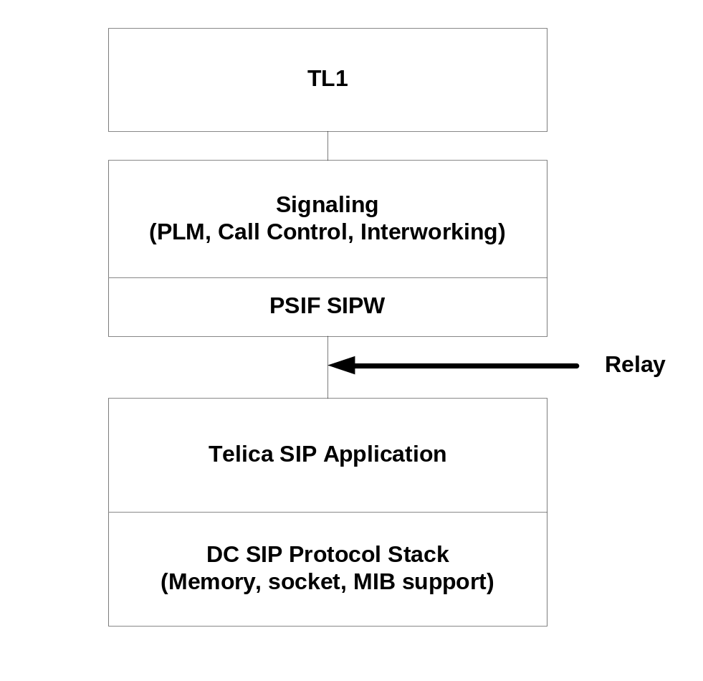
SIPA Overview
Layers

Slide 5
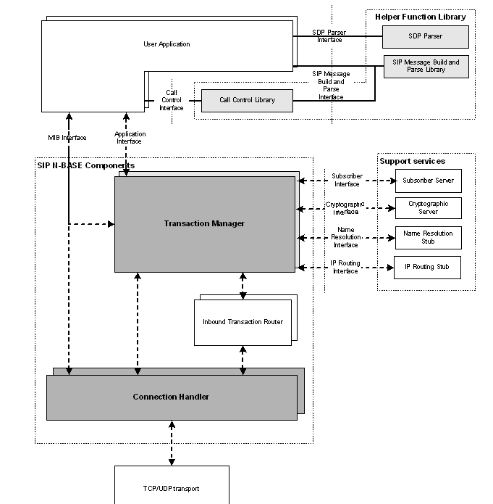
DCL Stack

Slide 6
SIPA Overview
Threads in SIPA
  Logger – logging for sipU
  sipaCheckWdogThread – heartbeat to other threads
  hbServThread – heartbeat to emf
  sipaMain – call processing
    nbs_file_descr_thread_fn – created by sipaMain, incharge of socket creation
  MPLogger – logging for stack
  PollEvents – socket listening

Slide 7
Call Processing -- overview
Thread --- sipaMain
Layers
SIPW
SIPU – sip ua
SIPT – sip transaction
SIPH – connection handler
SCK
*Note: In section ‘Call Processing’, we only talk about SIPU

Slide 8
Call Processing – data structures
  SIPA_IP2TRNK – trunk group
    Virtual trunk group, configuration info based on trunk group, such as codec,dest ip,etc
  SIPA_CALL_CB – call control buffer
    Call state, call Id, etc.
  SIPA_SESSION_CB – session control buffer
    Session info
  SIPA_TRANS_CB – transaction control buffer
    Transaction info, such as method, tag, etc.
  sipa_global_cb_t – global control buffer
    Global configuration ,such t1, congLevel, sipa_call_stats_t

Slide 9
Call Processing – data structures trunk group
How to configure
  Trunk group
  Ent/ed/rtrv/dlt-trkgrp
  i.e, ent-trkgrp::70:::SIP:ipaddr=192.168.164.254;
  Trunk (for 3.x)
Ent/ed/rtrv/dlt-sip-ipaddr
i.e, ent-sip-ipaddr::70-1:::PRIMIPADDR=192.168.164.254;
What will happen if we have not configure it
  Ingress call be rejected by 488
  Egress call will fail with 404/503

Slide 10
Call Processing – message/event flow chart
Downstream: from gcc to sipa
sipa_ua_receive_proc()
Is from gcc to sip?
Y
sipa_process_rly()
Event unpack/verify
Run FSM
sipa_ccl_send_ips()
to send ips to SIPT

Slide 11
Call Processing – message/event flow chart
sipa_ua_receive_proc()
Upstream: from SIPT to sipa
Is from sipt ?
Y
Message type?
request
response
others
sipa_ccl_request_rx()
…
sipa_ccl_response_rx()
Message parse/verify
Run FSM
sipa_send_rlydata()

Slide 12
Call Processing – state machine
States , defined in SIPA_CALL_CB
CS_IDLE = 0,
CS_WAIT_CON_RSP,
CS_WAIT_SIP_18X,
CS_WAIT_CC_18X,
CS_WAIT_CC_XFER,
CS_WAIT_SIP_200,
CS_WAIT_SIP_200_HOLD,
CS_WAIT_SIP_200_XFER,
CS_WAIT_SIP_200_XFER_QRY,
CS_CONNECTED,
CS_HOLD,
CS_XFER,
CS_XFER_XFER,
CS_XFER_QRY,
CS_XFER_CC_RSP,
CS_WAIT_SIP_ACK,
CS_WAIT_SIP_200_REFRESH,
CS_HANGUP,
CS_CC_INV_TIMEOUT,
CS_SIP_INV_TIMEOUT,
CS_WAIT_SIP_QUERY_ACK,
CS_WAIT_SIP_XFER_HOLD_REFRESH_ACK,
CS_WAIT_CC_XFER_QRY_ACK,
CS_MAX

Slide 13
Call Processing – state machine
Sub States , defined in call_states_t
SIP_AUDIT_DONE
SIP_REP_CREATE
SIP_CC_REL_RSP
SIP_CC_REL_REQ
SIP_BYE_SNT
SIP_CANCEL_SNT
SIP_CANCEL_RCV
SIP_18X_RCV
SIP_REL_IND_SNT
SIP_REL_CFM_SNT
SIP_CC_XFER_RSP_PEND
SIP_INV_TIMEOUT
SIP_BYE_TIMEOUT
SIP_CANCEL_TIMEOUT
SIP_CC_PENDING_BYE
SIP_CANNOT_TERMINATE
SIP_BYE_GLARE_1
SIP_BYE_GLARE_2
SIP_CC_INV_TIMEOUT
SIP_ACK_TIMEOUT
SIP_SDP_SENT_IN_RELIABLE_18X

Slide 14
Call Processing – state machine
Events
  Events from Gcc,
    CONREQ,RELREQ,ETC.
  Events from SIPT/ messages from sip end points
    Request, such as INVITE, BYE,CANCEL,etc
    Response, such as 180,200,4xx,etc.
  Timer events

Slide 15
Call Processing – state machine
Actions
  Messages to Gcc,
    CONIND,RELIND,etc.
  Messages to sip end points
    Request, such as INVITE, BYE,CANCEL,etc
    Response, such as 180,200,4xx,etc.
  Others
    Release call, etc

Slide 16
Call Processing – state machine
A example for how it works,
State: CS_IDLE
Event: CE_SIP_INVITE_REQ
Action: sipa_parse_message
save invite_ips
Send SIP 100 Trying
Send CON_IND to CC
Next State: CS_WAIT_CC_18X

Slide 17
Call Processing – state machine
Where the state is stored
SIPA_CALL_CB
{
…
Flags;
conInfo[2]
{
…
State
…
}
}

Slide 18
Call Processing – state machine
Call flow with state change ---- Egress call
GCC
SIPA
FAR END
ConReq
IDLE
INVITE
CS_WAIT_SIP_18X
100 Trying
CnstInd
180
CS_WAIT_SIP_200
200
ConCfm
CS_CONNECTED
ACK
Talking
RelReq
BYE
RelCfm
CS_HUNGUP
200

Slide 19
Call Processing – state machine
Call flow with state change ---- ingress call
GCC
SIPA
FAR END
INVITE
ConInd
IDLE
100 Trying
CnstReq
CS_WAIT_CC_18X
180
ConRsp
200
CS_WAIT_SIP_ACK
ACK
CS_CONNECTED
Talking
RelInd
BYE
RelRsp
CS_HUNGUP
200

Slide 20
Replication
  Purpose
    To keep answered call
  Structures need to be replicated
    sipa_global_cb_t
    SIPA_IP2TRNK
    SIPA_SESSION_CB
    SIPA_CALL_CB
    SIPA_CALL_STATS_CB
  *note, no need to replicate transaction cb

Slide 21
Replication -- types
  Catch up replication
    after standby boot, replicate all structures one by one
    implimentation:
    Register all cb_type, handling function to ahl_data when sipa start
    Once SM(system manager) detected standby is ready, then start replication
    Go through all cb_type registered in ahl_data, for each cb_type, go through all sturctures
  Runtime replication
    During runtime, replicate new/changed/deleted structure to standby

Slide 22
Replication– Catch up replication
Active
RLY
Standby
SM
AHL
AHL
SM
ready
ATG_FT_NEW_BACKUP
REP_REQ(cb1)
REP_RSP
REP_REQ(cb2)
REP_RSP

Slide 23
Replication – code go through
  Cb_type Register
AHL_DEFINE_CB_TYPE
    Cb_type
    Traverse function
    Pack function
    Unpack function
    Etc.
  Replication entrance function
  sipa_ua_receive_proc(), then ahlr_rcv_rep_msg()

Slide 24
Process schedule
‘Processes’ in Thread sipaMain
  SIPU/SIPA
  SIPT
  SIPH
  AHL
  SM
  …

Slide 25
Process schedule
Stop flag is set?
nbb_spin_start
Y
Any procces in
nbb_runnable_process_list
and it can be run?
Y
nbb_schedule_one()
nbb_process_timers()
Handle other things

Slide 26
Process schedule – code go through
  Struct PROCESS_ENTRY
{
  NBB_LQE lqe; /*Used for inserting process entry in runnable process list.*/
  NBB_LQE global_lqe; /*used for inserting in nbb_process_list*/
  NBB_PROC_ID process_id;
NBB_PROCESS_TYPE *process_type;
NBB_RECEIVE_PROC *receive_proc;
…
}
  NBS_REGISTER () to register process when sipa start

Slide 27
TL1 Interface & Debug
Message Path
tl1agent
tl1agent
GCC
slam
PLM
GCC
relay
clam
SIPA
relay
SIPA
3.x’s layout
6.x’s layout

Slide 28
TL1 Interface & Debug
What can TL1 do for Sipa
  Configuration
    Sip-sys
    Sdp-profile
    Trunk group
    Etc.
  Sigdbg command
    Turn on debug bits for logging
    Put some special commands on sipa for trouble shouting or recovery

Slide 29
TL1 Interface & Debug – code go through
Functions in sipa code to handle TL1
  Configuration
    sipa_telica_capabilities()
    sipa_trnk_config()
    Etc
  Sigdbg
    sipaDbgDoCommand()

Slide 30
TL1 Interface & Debug – debug commands
  Some frequently used commands
  sigdbg:::::sipa dumpraw 1; output file: sip_protocol_trace.log
  This will show the raw SIP protocol messages between the socket stub an the app.
  sigdbg:::::sipa dumpraw 0; Disables tracing.
  sigdbg:::::sipa dbglvl 0; output file: sipa.out
There is quite a bit of data here. 0 is the highest level 10 is lowest. (This was done to match the way the dcl stack traces.)
  sigdbg:::::sipa dbglvl 10; Disables debug tracing.
  sigdbg:::::sipw 0; output file: signaling_sp2s.out
  This enables the sip debug in the signaling app.
  sigdbg:::::sipw3; Disables signaling logging.
Also you can do the following to find all sigdbg commands that are valid for sipa. sigdbg:::::sipa help; Lists all commands to the sipa.out sigdbg:::::sipa <cmd> help; Lists all arguments for a specific command <cmd> to the sipa.out file.

Slide 31
TL1 Interface – debug command
Log files
  sipa.out - all telica output.
  sip_protocol_trace.log – Raw output of inbound/outbound sip data (no ip headers)
  Sip_ipstrc.log - DCL internal tracing
  Sip_pdtrc.log - DCL problem tracing (also traced to sipa.out)
  Sip_inttrc.log - Debug build tracing. Not available in release build.
  nbase.ini - Settings for extent of tracing. (Most useful in debug build) See DCL documentation.

Slide 32
SIPA source code
signaling/sip/psif-sip – sip/signaling interface functional support
signaling/sip1.2 – DC Sip Root directory
signaling/sip2.x – DC Sip Root directory (5.3 and above)
DCL directories (/sip1.2)
  nbase/ - DCL’s Micro Kernel
  comn/ - Common support library
  sm/ - System manager
  sip/ - DCL SIP support
  sdp/ - DCL SDP support library
  stubs/hm - Hardware manager support. This is what is used for setting active/standby SP
  libs/ - Misc DCL support (replication etc)
  asn1/ - Mib support
  custom/
  intface/
  sg/
  autogen/
  scr/
  doc/ - Online documentation

Slide 33
SIPA source code
  Telica directories
    rly/ -Telica’s trillium relay support
    genilt/ -Generic interlayer transport. For communication between processors
    tools/telica_sipa -Telica’s SIP application support
    jobs/gnu -Directory for makefiles live.
    jobs/gnu/siptdbg -Directory for objects and sources

Slide 34
Demo
  Configure a sip-sip routing
  Make a call
  Debug command

