Slide 2

5060 MGC-8 Heat Installation (Openstack Havana)
December 2013

Slide 3

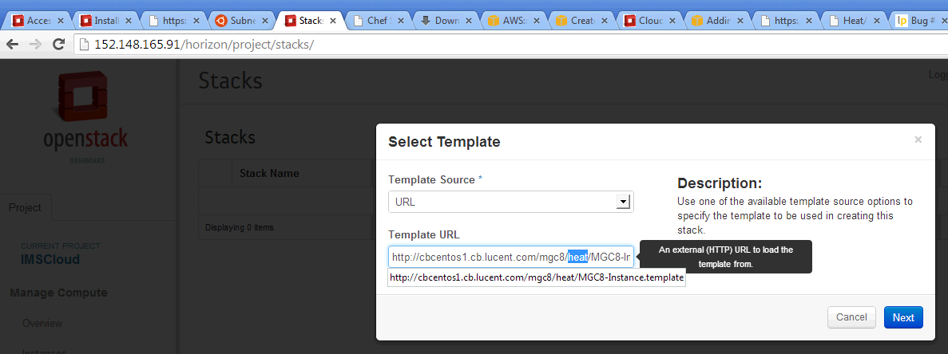
Havana Environment Setup
Cloud Orchestration
Metadata
Access GUI with user/password
Setup Keypair under “Access & Security”
Launch Stack with URL to template: http://cbcentos1.cb.lucent.com/mgc8/heat/MGC8-Instance.template
From any PC browser: http://152.148.165.91/horizon

Slide 4
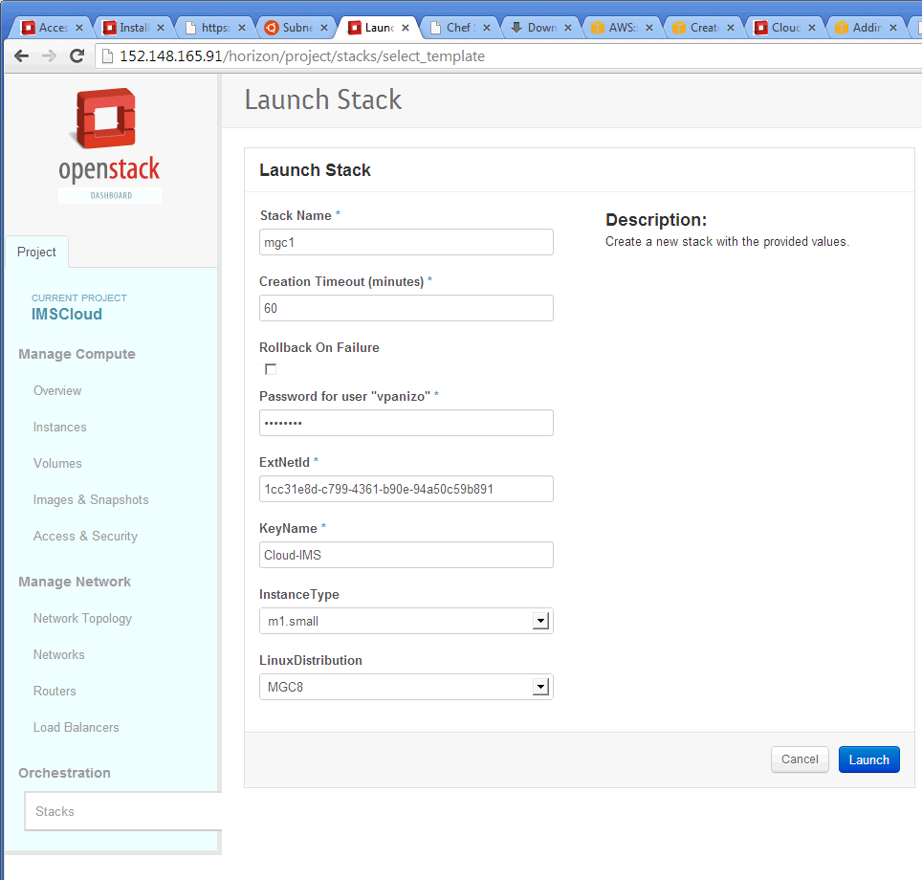
Configure Stack Parameters
Get external network Id (ExtNetId)
Cloud Orchestration
Metadata

Slide 5
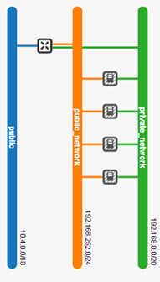
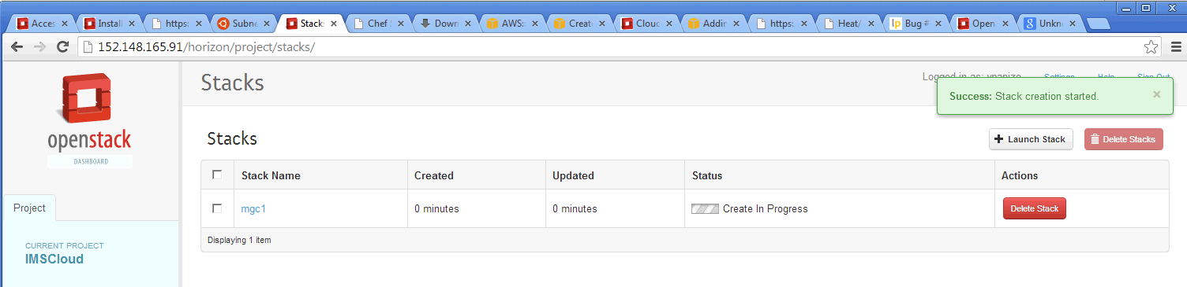
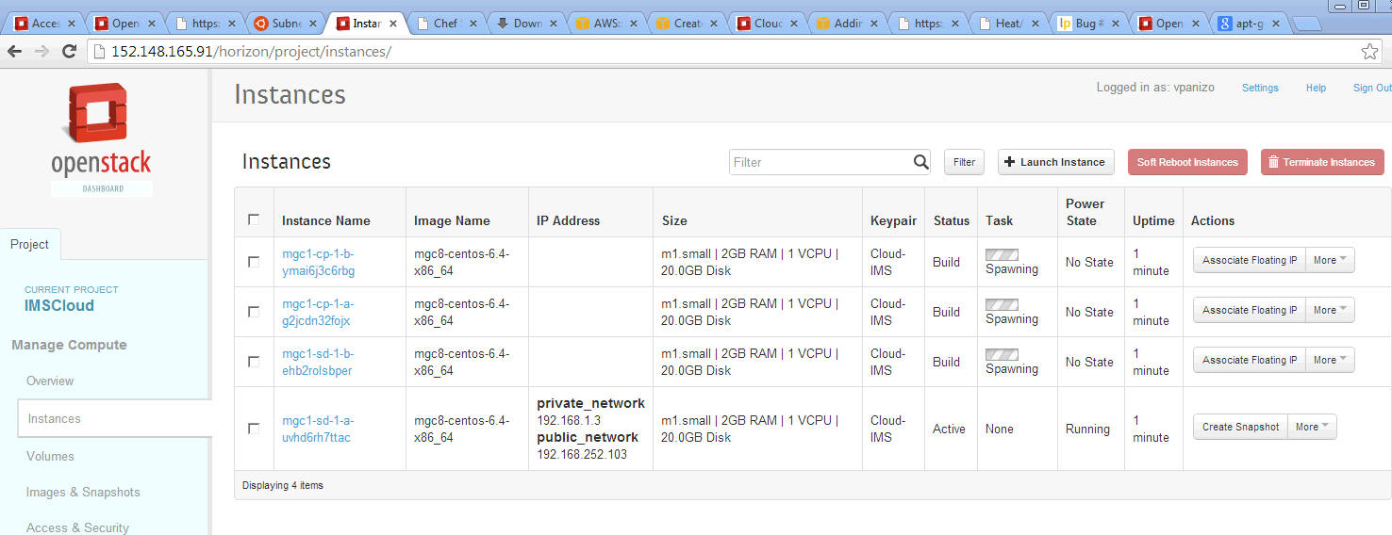
Launch Stack and Wait to “Complete”
Cloud Orchestration
Metadata

Slide 6
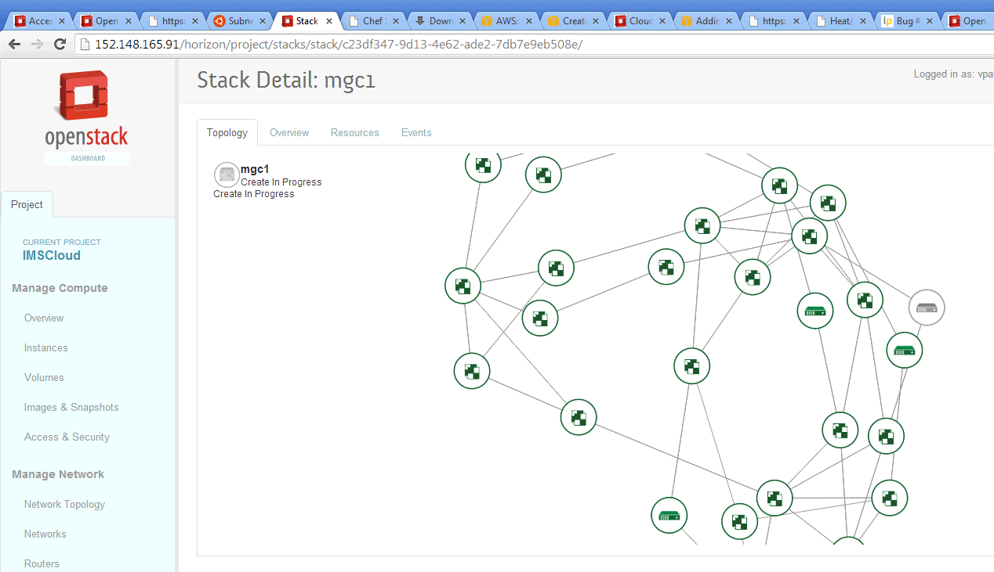
Launch Stack and Wait to “Complete”
Cloud Orchestration
Metadata

Slide 7
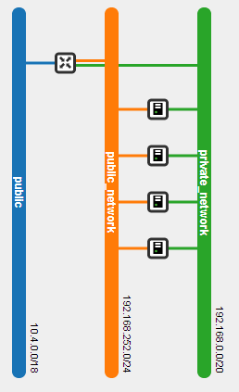
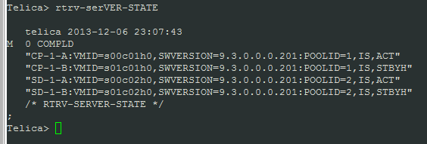
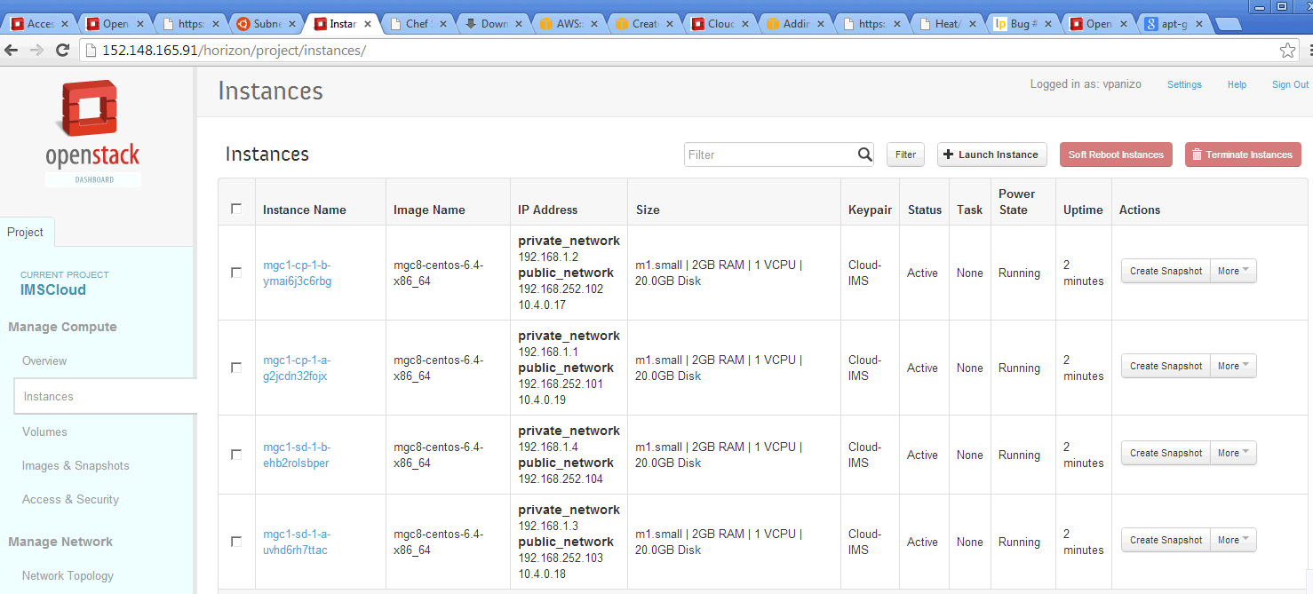
Installation Complete
Metadata

Slide 8
The end
TBD –Enhance the Heat template for monitoring, healing/recover, auto scaling, etc.

