Slide 1
L18: Accessibility

Slide 2
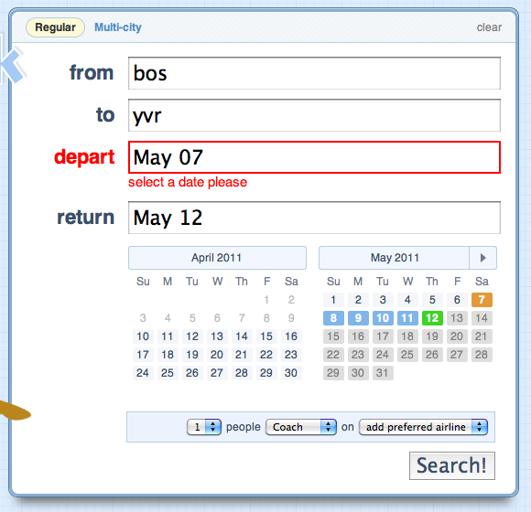
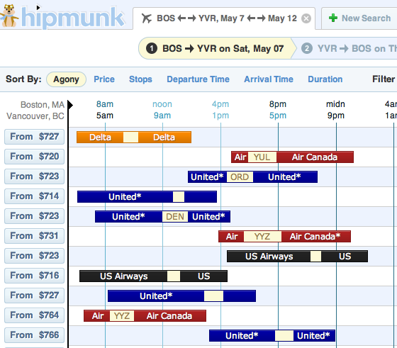
UI Hall of Fame or Shame?
Notes:
For today’s hall of fame and shame, let’s talk about Hipmunk.com, a flight searching web site. Let’s discuss:
simplicity
error handling
graphic design and use of visual variables
efficiency

Slide 3
Today’s Topics
Kinds of impairments
Assistive technology
Accessibility guidelines
Notes:
Today’s lecture is about accessibility, which generally means making it possible for users with impairments to use a graphical user interface. We’ll talk about the kinds of impairments we’ll be concerned with; the technology (both software and hardware) that help users deal with them; and some guidelines for designing UIs for accessibility.
MIT has a new course on assistive technology (6.811 Principles and Practices of Assistive Technology) that covers these topics in greater depth, and includes a design project in which you work on solving a problem a particular client with a disability.

Slide 4
Diversity of Ability
Visual impairments
Color perception
Acuity (“legal blindness”)
Total blindness
Hearing impairments
Often varies with frequency
Motor impairments
Tremor and spasms
Muscle weakness and fatigue
Paralysis
Cognitive impairments
Notes:
We’ll focus on physical impairments for this lecture, specifically problems in vision, hearing, or motor control, because that’s how “accessibility” is generally understood. But note that there are other impairments that are relevant to making a user interface usable by a wide spectrum of people. Some have cognitive disabilities, like difficulty learning or paying attention. Others have difficulty reading, either because they never learned or because they read a language different from yours. (We’ll talk about this last one in the internationalization lecture coming up.)
We’ve talked about one form of vision impairment already: color blindness. Even more common than that, of course, is impaired visual acuity, i.e. inability to focus clearly. For most people, visual acuity problems can be corrected with glasses or contact lenses, but some have uncorrectably bad vision. Roughly a million Americans are legally blind (unable to read even the biggest letter on an eye chart, even with corrective lenses). Perhaps 10% of them are totally blind, unable to sense light at all.
Hearing impairments affect the ability to sense sound intensity, and range in a spectrum from reduced sensitivity to complete loss. Hearing impairments often depend on sound frequency; a person may hear lower frequencies well, but not high frequencies.
Motor impairments come in many different forms, and have many different causes. Sufferers of cerebral palsy experience uncontrollable tremors and spasms, making it difficult to make fine motor movements. Muscular dystrophy and multiple sclerosis can make muscles weak, and sufferers may tire easily when doing repeated or large muscle movements. Neural damage can cause complete paralysis of limbs.

Slide 5
Impairments Affect Everybody
Aging
Reduced visual acuity
Hearing loss
Arthritis
Overexposure
Noise-induced hearing loss
RSI
Situational disabilities
Driving a car
Walking down the street
In a noisy environment
Notes:
But physical impairments, or their effects, aren’t limited to people with congenital diseases or trauma. Aging causes all three kinds of impairments. We’ve already discussed some of the impacts of aging on color vision. Older adults may also have reduced acuity, reduced hearing, and reduced mobility (specifically arthritis, which involves tremors, pain, and fatigue).
Overuse can also cause impairment to younger people, as if aging prematurely. Most people don’t blind themselves by staring at the sun, but some lose their hearing prematurely by working in extremely loud environments (or listening to iPods?). Repetitive stress injury (RSI) is a motor impairment caused by excessive computer use (among other activities), with symptoms including pain, numbness, and weakness.
Finally, all of us can experience situational disabilities: temporary conditions of ourselves or our environment that effectively cause impairment. For example, when you’re driving a car, your hands and eyes are occupied with the driving task, so with respect to an in-dashboard computer, you’re experiencing visual and motor impairments. Similarly, when you’re walking down the street, your visual abilities are diminished (because you have to watch where you’re going), and your ability to do fine motor control is reduced as well (because every step jars your entire body). In a noisy environment (say, the deck of an aircraft carrier), you can’t hear. When the sunlight is glaring on your laptop screen, you can’t see.
The take-away message from this is that impairments affect everybody, and vision, hearing, and motor lie on a spectrum of ability that varies widely between users and over time. So we should take them into account when we’re designing.

Slide 6

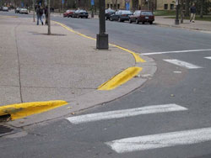
Universal Design
Equitable use
Flexibility in use
Simple & intuitive
Perceptible information
Tolerance for error
Low physical effort
Size and space for approach and use
Notes:
Universal design is a school of thought that takes this fact explicitly to heart, by seeking to design for all users, across as much of the spectrum of capability as possible. Contrast this with the attitude that is implicit in this class, and in most actual design, where we mainly design for the typical user, and then (8 weeks into the course?) discuss how to make it “accessible” to everybody else. Universal design challenges us to think about supporting a wide range of capability from the start.
The proponents of Universal Design (http://www.design.ncsu.edu/cud/) have put forth seven guiding principles, listed here. Several are already familiar to us (simplicity, learnability, visibility, errors), and several are more relevant mainly to physical design (effort, size, space). But the first principle is the heart of the universal design philosophy: equitable use. As much as possible, all users should have the same interface, so that groups with differing abilities are not stigmatized. (If the identical interface isn’t possible, then provide equivalent interfaces.)
Good universal designs are not dumbed down to make them universal; you shouldn’t sacrifice efficiency or flexibility for typical users in order to enable users with reduced ability. Instead, a good universal design has features that make the design better for everyone. Classic examples are kitchen tools with fat, textured handles (like the vegetable peeler shown here); not only are they easier for arthritis sufferers to grip, they’re more comfortable and less error-prone for typical users too. Similarly, a sidewalk curb cut not only enables wheelchair users, but also parents with strollers, travellers with luggage, and people pushing carts. Even walkers may find the ramp more convenient than a step.
It’s not always clear how to find a universal design, but it’s a goal worth striving toward.

Slide 7
Assistive Technology
Output
Screen magnifier
Screen reader
Braille display
Screen flashing on sound
Pointing
Eye or head tracker
Puff-and-sip
Mouse keys
Typing
Onscreen keyboards
Sticky keys
Speech recognition
Notes:
For using computers, users with physical impairments use a variety of assistive technology, some hardware, some software.
Screen magnifier software magnifies part of the display to make it easier to read, which helps users who have reduced acuity but are not totally blind. Screen readers help the totally blind, by reading the contents of the display aloud as speech. For totally blind users who know Braille, a screen reader can be connected to a Braille display, which lets them read the screen privately (and quietly) and probably faster as well.
For hearing-impaired users, graphical user interfaces pose fewer problems, because far less information is conveyed by auditory cues. System sounds (like beeps) may be translated into a screen flash; videos may include closed captioning.
On the input side, there are alternative pointing devices. Eye gaze or head pose tracking can move the mouse cursor around the screen without the use of the hands. Puff-and-sip devices (in which the user blows or sucks a tube) can be used to click a button, often in combination with a mouth-driven joystick. Users with less extreme motor impairments may use touchpads or trackballs, which are less tiring than mice because they require smaller movements. The mouse cursor can also be moved around by keyboard keys; Windows and Mac both have this feature built-in.
Note that users of screen readers are not likely to use a pointing device at all, because they can’t see a mouse cursor or targets on the screen. So totally blind users typically use a keyboard exclusively.
For keyboard input by severely motor-impaired users, a pointing device can be combined with an onscreen keyboard. Keyboard driver software can often be adjusted to make it easier to use, e.g. turning off autorepeat so that keys don’t have to be released quickly, or making modifier keys (like Shift and Control) “sticky” so that the user doesn’t have to hold down multiple keys at once.
Speech recognition offers another way to give both command and text input without using the hands.

Slide 8
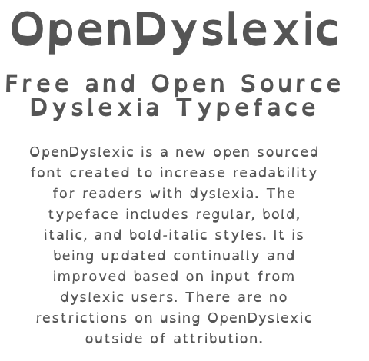
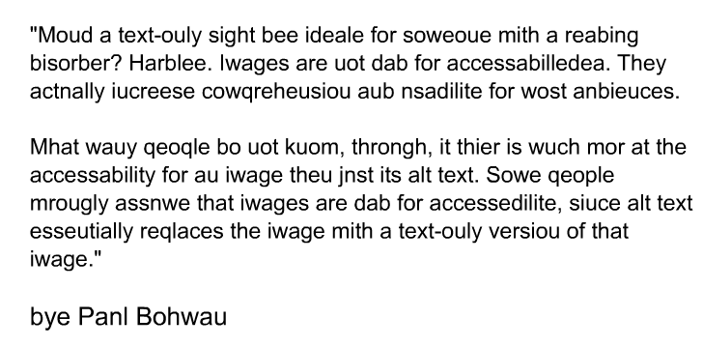
Dyslexia
Source: webaim.org/simulations/dyslexia-sim.html
Source: opendyslexic.org
Notes:
(contributed by Christy Swartz, spring 2012)
Dyslexia is a cognitive impairment that affects reading – people with dyslexia tend to see some letters rotated, or switched with other letters. It's a small population (although, it is estimated that a large number of people who have reading difficulties actually have dyslexia, which has no effect on intelligence, only reading ability), but nonetheless should be kept in mind when designing websites.
A simulation of dyslexia can be found at http://webaim.org/simulations/dyslexia
If anyone wants to take a look at a site that is a fantastic example of good accessibility for dyslexics, here it is: http://www.headstrongnation.org/ This site has a built in screen reader. Dyslexics have a very hard time reading long chunks of text, so they use screen readers often, but, as you can imagine, screen readers are designed for blind people, and not dyslexics, who can easily point a mouse. So this site allows you to select a chunk of text and the site will read it to you.
Also, fonts are inherently bad for dyslexics; many letters, if rotated, can appear to be other letters (p and d, for example), and makes it very difficult for dyslexics to untangle them. There are now several fonts that are more readable for people with dyslexia. The first, Dyslexie, is explained in a youtube video (http://www.youtube.com/watch?v=VLtYFcHx7ec). Recently, a free font called OpenDyslexic (http://opendyslexic.org) has become available. A key idea in both fonts is to strengthen the lower part of each letter, increasing the stroke thickness near the baseline, so that the letter feels “weighted” at the bottom – less symmetrical, and less likely to be mentally rotated by the reader.

Slide 9
Accessibility Guidelines
Section 508
W3C Accessibility Initiative
Notes:
Now let’s discuss some specific guidelines for creating accessible interfaces. Most of these guidelines are targeted at making your interface amenable to assistive technology, e.g. helping a screen reader do a better job of translating the display into text.
The guidelines that follow are summarized from two sources. Section 508 is an accessibility standard for web sites and software created by US government agencies or government contractors. Anybody who wants to sell software to the US government must follow the Section 508 rules, which cover both desktop software and web sites. The W3C Accessibility Initiative is a group in the World Wide Web Consortium that has produced a list of (voluntary) accessibility guidelines for web sites.
Section 508 rules:
http://www.section508.gov/index.cfm?FuseAction=Content&ID=12#Software
W3C guidelines:
http://www.w3.org/TR/WAI-WEBCONTENT/

Slide 10
Support Keyboard Access
Pointing interactions should have keyboard alternatives
Menus should be controllable by the keyboard
Forms and links should be navigable by keyboard
Needed by motor-impaired and vision-impaired
Notes:
Since some users will be less able or unable to use a pointing device (e.g. users with screen readers), an accessible interface should support keyboard alternatives for all interactions. Menus should be controllable by the keyboard, either using accelerators or by allowing navigation around the menu. Similarly, the user should be able to move the keyboard focus around a form or activate a link in a web page by keyboard alone.

Slide 11
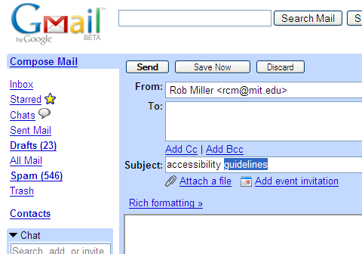
Provide Text to Screen Readers
Screen readers need to automatically transform the display into spoken language
image
labels
widget labels
widget contents
clearly labeled links and buttons
current selection
Notes:
An accessible interface should be amenable to screen reading. All visual content should have textual alternatives; i.e., images should have captions or labels describing or naming their contents, so that screen reading software can articulate it.
Widgets, like textboxes and checkboxes, should have labels associated with them. This association can’t be merely visual (i.e. “From:” happens to be next to the textbox), but programmatically available to the screen reader, so that the screen reader can ask for the label of that textbox and get “From address” or something similar back. The interface that screen readers use to access this information is called an “accessibility API”; we’ll talk about the APIs for Java and HTML later in this lecture.
Screen readers also need to find out: the current value of a textbox or other widget; the widget with the keyboard focus; and the location of the text selection in a textbox.
For web pages with hyperlinks, the links should be clearly labeled with the identity of the target page, not something vague like “click here”. This is because users of screen readers don’t necessarily read the entire display linearly, from start to end. This would be painfully inefficient. Instead, they skip through, scanning the page aurally much as users with normal vision would scan it visually. A screen reader can be directed to read all the links, skipping over other text, so the links should be self-descriptive.

Slide 12
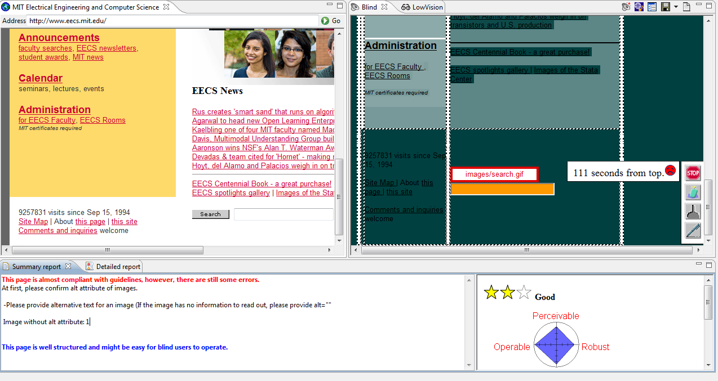
aDesigner
Notes:
IBM Research Tokyo has produced an interesting tool called aDesigner (for “accessibility Designer”) that allows sighted designers to visualize the screen-reader usability of a web page. Here it is in action – the original web page is shown on the left, and a “screen reader equivalent” of the web page is shown on the right. The screen reader version is intended to simulate the experience that a blind user of a screen reader would have when using the web page. It replaces images with their alt text. It also darkens the background of text proportionally to the minimum time it would take to reach the text (assuming the usual navigation features in screen readers: jumping from header to header, and jumping from link to link, and listening to text). Hovering over the text shows a popup with the actual time (here, “111 seconds from top” for the search box at the bottom of this web page).
aDesigner is freely available, built on top of Eclipse, but only runs on Windows. (http://www.eclipse.org/actf/downloads/tools/aDesigner/)

Slide 13
Don’t Rely on Sound Alone
Flash as well as beep
Closed captioning for videos
Notes:
For the sake of hearing-impaired users, don’t rely on sound as the only channel by which some bit of information is delivered. To get the user’s attention, don’t just beep; briefly flash a window or the screen as well. Videos should include closed-captioning information.

Slide 14
User Control Over Colors and Fonts
Allow user to choose high-contrast colors
Allow user to enlarge fonts
Don’t rely on color alone
Notes:
Users with impaired vision may prefer to use high-contrast colors, so allow the user to change the color scheme if necessary. Similarly, allow the user to enlarge the font size for easier readability.
We’ve already discussed not relying on color as a sole indicator for conveying information, because of color blindness. Use secondary cues too.

Slide 15
Accessibility APIs
javax.accessibility
Swing widgets implement Accessible
getAccessibleContext() returns an object with labels, descriptions, content, selections for the widget
Platform-specific accessibility APIs are similar
HTML accessibility features
alt and title attributes
<label> element
accesskey attribute
aural CSS
Notes:
Java and HTML both offer built-in ways to make your interface more accessible.
The Java Accessibility API provides an interface for screen readers to inspect a Swing interface. All built-in Swing widgets implement it, so by using widgets, you get accessibility to screen readers for free. The API has one method, getAccessibleContext(), which returns an object containing information about the widget, such as a label for it, description, its current value, its current text selection, etc. Major desktop systems (Windows, Mac, Gnome, KDE) have their own equivalents for this API, and Java has a bridge that allows your Swing interface to be inspected through the platform-specific API.
In HTML, probably the most well-known accessibility feature is the alt attribute on images, which specifies a caption or description of the image for the sake of a screen reader. Other elements (like frames) have a title attribute for the same purpose. Textboxes, checkboxes, and other form controls can be programmatically labeled by the <label> element.
For keyboard operation of a web page, HTML offers the accesskey attribute, which can be added to links and form controls among other elements. For example, accesskey=“c” specifies that Alt-C (or some other browser-specific modifier) should navigate to or invoke the element. Unfortunately it’s difficult to avoid conflicts between accesskeys specified by the web page and shortcuts used by the browser itself, or by the user’s screen reader. Needless to say, screen reader users depend heavily on these shortcuts, and a web page that overrides them will create serious, painful mode errors. Some experts deprecate the accesskey attribute, favoring other forms of keyboard navigation around a page instead (see Jukka Korpela, “Using accesskey attribute in HTML forms and links”, http://www.cs.tut.fi/~jkorpela/forms/accesskey.html; also “Using Accesskeys - Is it worth it?”, http://www.wats.ca/show.php?contentid=32).
Finally, CSS allows specification of audio styles for a screen reader, so that volume and pacing and pitch can be designed by a web page author.

Slide 16
Picoquiz
Which of the following are examples of situational disabilities? (choose all good answers):
Walking down the street
RSI (repetitive stress injury)
Arthritis
Standing in a crowded, moving subway car
Color blindness
Notes:
To answer the picoquiz questions in this lecture, go to: http://courses.csail.mit.edu/6.831/2013/picoquiz?lectureId=18

Slide 17
Summary
Accessibility is a universal problem
Support alternative input (e.g. keyboards)
Support alternative output (e.g. screen readers)

