Slide 1
Introduction of a Biologically Plausible Color Descriptor to a Neurodynamical Model of the Primary Visual Cortex
Sean Thomas Connolly
Master Thesis Defense
September 2014
Advisor: Xavier Otazu

Slide 2
Introduction of a Biologically Plausible Color Descriptor to a Neurodynamical Model of the Primary Visual Cortex

Slide 3
Introduction of a Biologically Plausible Color Descriptor to a Neurodynamical Model of the Primary Visual Cortex
how can color
be represented
as data?

Slide 4
Introduction of a Biologically Plausible Color Descriptor to a Neurodynamical Model of the Primary Visual Cortex
how does the brain
represent color?
how can color
be represented
as data?

Slide 5
Introduction of a Biologically Plausible Color Descriptor to a Neurodynamical Model of the Primary Visual Cortex
how does the brain
represent color?
how does the brain
process color?
how can color
be represented
as data?

Slide 6
Introduction of a Biologically Plausible Color Descriptor to a Neurodynamical Model of the Primary Visual Cortex
how does the brain
represent color?
how does the brain
process color?
how can color
be represented
as data?
…at a very early stage
of visual processing.

Slide 7
Overview
What is color?
Color in biology
Color descriptor(s)
Neurodynamical model
Results
Conclusions
Discussion

Slide 8
Color.
u
V

Slide 11
Color
Does Not
Exist*
Light has wavelength.
*physically
Light sources have spectral power distributions.
Objects have spectral reflectance properties.
Organisms perceive color.
Notes:
This is what we are introducing to our model: color, a perceptual phenomenon.

Slide 12
The perceived color of an object is defined by the illuminant, the object’s physical properties, and its context
…let’s see how.
Notes:
This is a non-sequitur from previous slides.
BUT, we just saw this with the two green bars: the background heavily defined the PERCEIVED color.

Slide 13
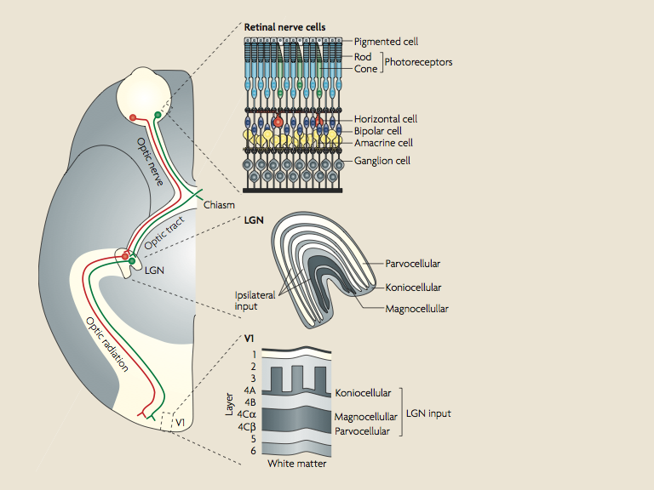
Response to Light
Signal Combination
Long & Medium
Wavelength Cones
Short
Wavelength Cones
Rods
Solomon, S. and Lennie, P.
“The machinery of colour vision”
Nature, 2007, Vol. 8.
Notes:
Dorsal view of one hemisphere w/ cross section of retina, LGN, and V1.
- Signal grows ever more complicated – information is being derived.
- Color in context at the retina already, optic nerve/tract/radiation are like highways, LGN function is not well understood (time processing), but signal is integrated deeply at V1
- Still strongly retinotopic at V1

Slide 14
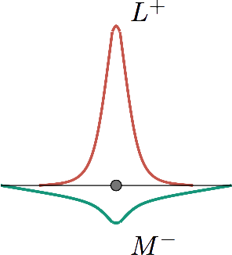

Receptive Fields
Notes:
ON/OFF receptive fields in the visual pathway describe color: opponency between cones gives the opponent color process

Slide 15
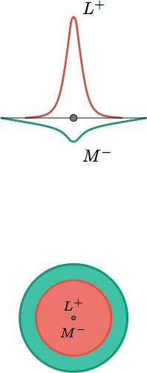
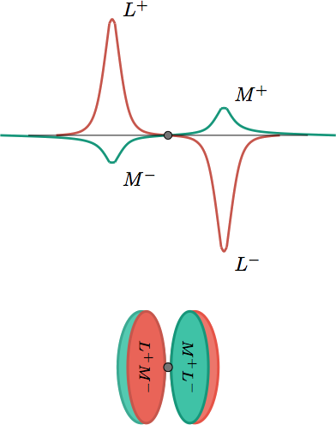
Double-Opponent Neurons
Single-Opponent
Neurons

Slide 16
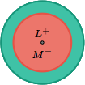

Single-Opponent & Double-Opponent Stimulus Response Patterns
activity
activity

Slide 17
Single-Opponent & Double-Opponent Characteristics
 | Single-Opponent Cells | Double-Opponent Cells
Cone Opponency: | Yes | Yes
Spatial Opponency: | No | Yes
Achromatic Selectivity: | Yes | Yes
Chromatic Selectivity: | Yes | Yes
Orientation Selectivity: | No* | Yes
Spatial Frequency Selectivity: | Yes | Yes

Slide 18
Single-opponent neurons respond best to regions of color.
Double-opponent neurons respond
best to the boundaries between.
(context)

Slide 19
Opponent processing of single and double-opponent receptive fields will describe color, in it’s context, in a biologically plausible manner.

Slide 20
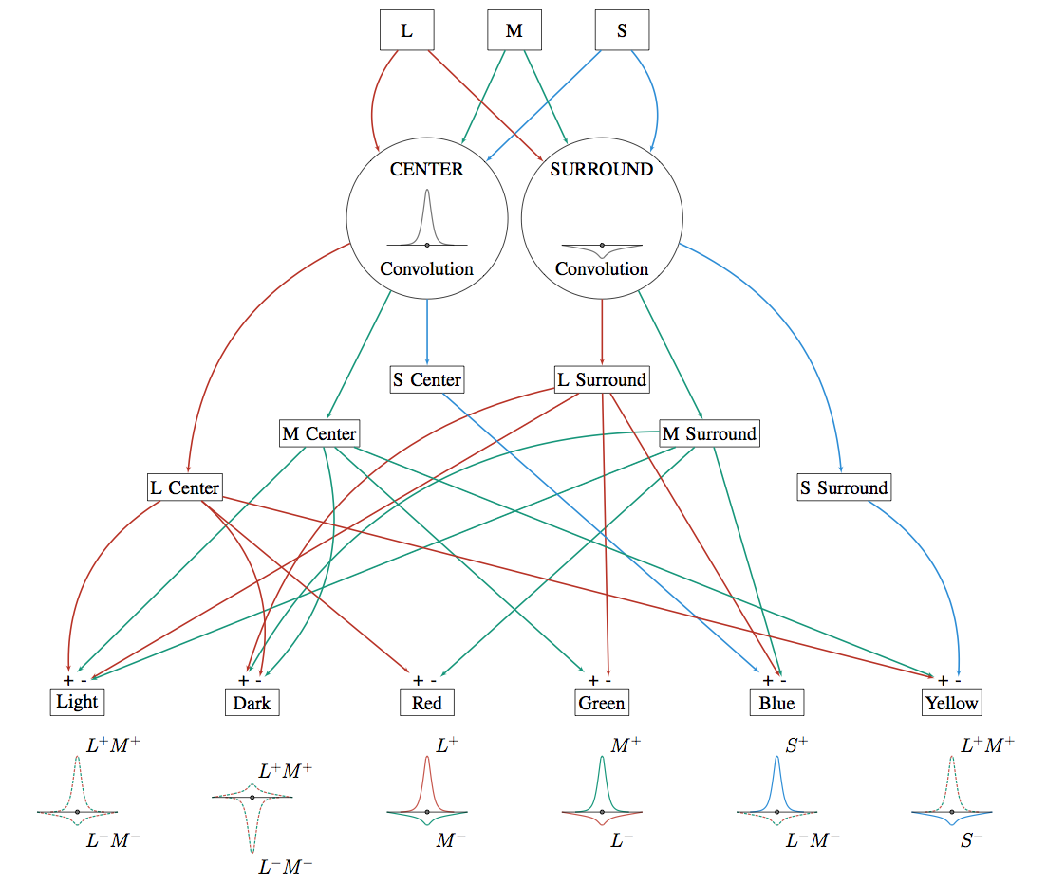
Color Descriptor:
Convolution
&
Opponent
Processing

Slide 21
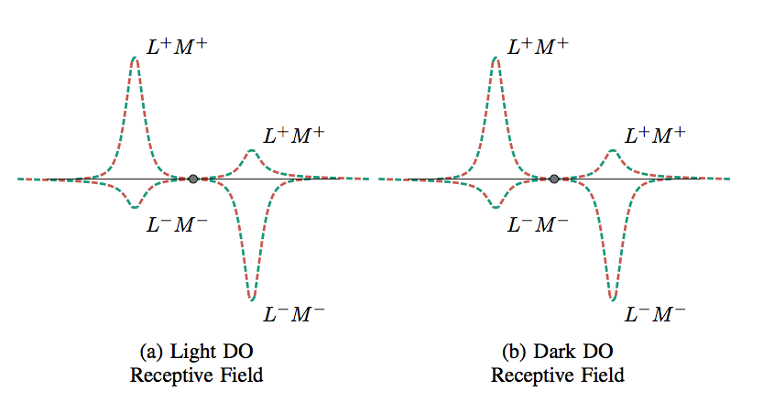
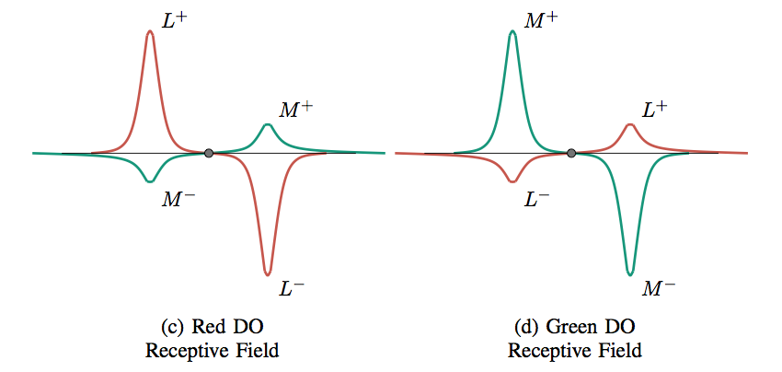
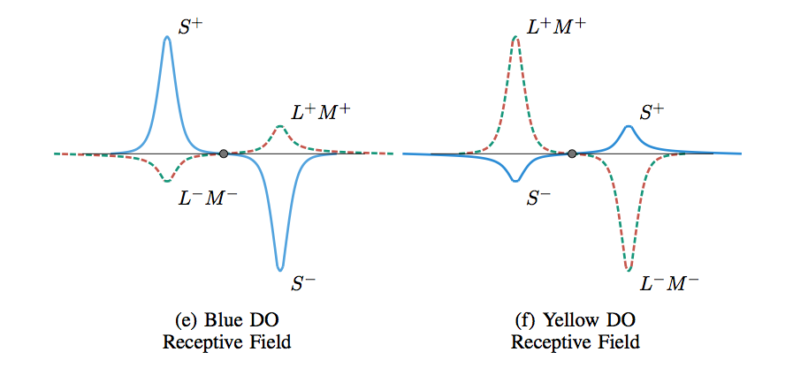
Double-opponent
receptive fields
modeled with
off-center
Gaussians.
Notes:
Most color preferring DO cells are not purely chromatic, they respond to brightness changes also. Perhaps brightness should be added to the chromatic components.

Slide 22
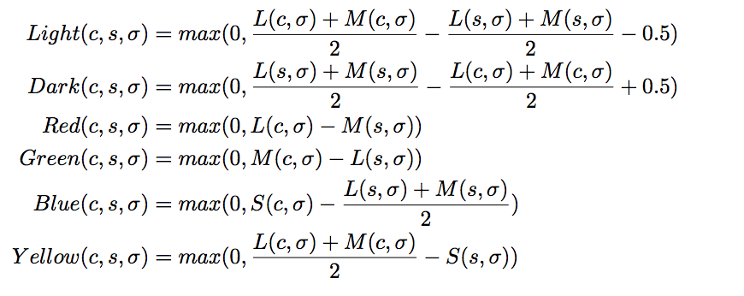
Opponent color processing…
(scale)

Slide 23
Neurodynamical Model Penacchio et al. 2013 (based on work by Z Li 1998)
Model of the
dynamic interactions
between neurons
over time.

Slide 24
Neurodynamical Model Penacchio et al. 2013 (based on work by Z Li 1998)
..of a 5-dimensional matrix:
positions x & y, decomposed
Into 6 color channels
at s scales
and 4 orientations.

Slide 25
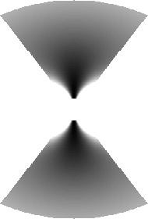

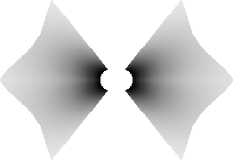
Receptive fields specific to cells’
orientation selectivities.
-
+

Slide 26

Receptive fields specific to cells’
(a)chromatic selectivities.
+
-

Slide 27
Receptive fields specific to cells’
(a)chromatic selectivities.
to | from | Light | Dark | Red | Green | Blue | Yellow
Light |  | + | - | + | + | + | +
Dark |  | - | + | + | + | + | +
Red |  | + | + | + | - | + | +
Green |  | + | + | - | + | + | +
Blue |  | + | + | + | + | + | -
Yellow |  | + | + | + | + | - | +

Slide 28
Results.
Input images were scaled to ~150px wide.
3 scales (spatial frequencies) were used.
Each experiment was run for 20 time steps,
with 10 iterations of neural interaction at each step.
We averaged neural activity at each time step.
Subtracted opponent color channels from each other.

Slide 29

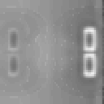

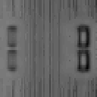
Light⁺
Dark⁻
Red⁺
Green⁻
Blue⁺
Yellow⁻

Slide 30

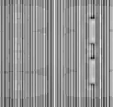
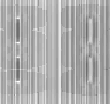
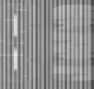
Light⁺
Dark⁻
Red⁺
Green⁻
Blue⁺
Yellow⁻

Slide 31




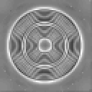
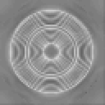
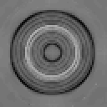
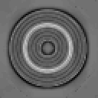
Light⁺ Dark⁻
Red⁺ Green⁻
Blue⁺ Yellow⁻

Slide 32




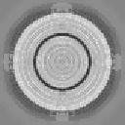
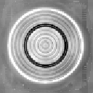


Light⁺ Dark⁻
Red⁺ Green⁻
Blue⁺ Yellow⁻

Slide 33
Conclusions
Color Description
Biologically plausible representation of color in V1.
Better understanding of light & dark receptive fields needed.
Tweaking of receptive field dimensions suggested.
Neurodynamical Model
Biologically plausible model of feature processing in V1.
Analysis of inter-color connections/weights needed.
Way forward..
Systematic analysis of behavior:
Analysis of evolution of neurodynamical model.
Analysis of effects of parameters.
Comparison with psychophysical metrics.

Slide 34
Discussion

