Slide 1
“Most studies of CNVs have detected an enrichment of genes involved in sensory perception, immune response and cell adhesion within polymorphic sequences. This observation has been used to argue for the action of positive selection.”
Daphnia populations are affected by similar selective regimes in the wild – so is there a connection between ecologically relevant genes and CNVs?
Specifically, are genes involved with immunity affected by CNVs? And are they evolving at higher rates?
Conrad & Hurles, 2007; Nguyen et al., 2006

Slide 2
Major goals of Aim 2
Measure which genes are being influenced by CNVs within Daphnia pulex species.
Hypothesis: Immune-related genes will be enriched with CNVs relative to the genome-wide background.
Characterize the rate of evolution of CNVs across species.
Hypothesis: Evolutionary rate (i.e., positive selection) of CNVs will be highest for immune-related genes.

Slide 3
CNV dataset
1,000 clones spanning 2 continents and 5 countries.
Identified CNVs using read depth variation.
I have identified polymorphic within-species CNVs.

Slide 4
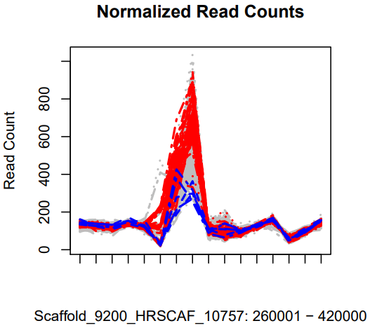
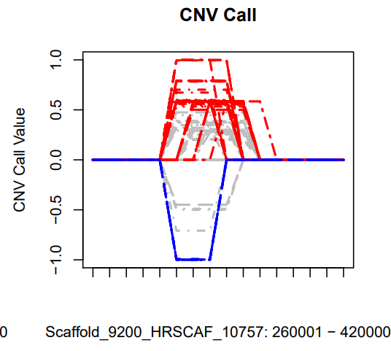
Candidate CNV region with both a deletion and duplication that is polymorphic within European D. pulex.
~8% of samples have this duplication (in red).
Duplication
Deletion

Slide 5
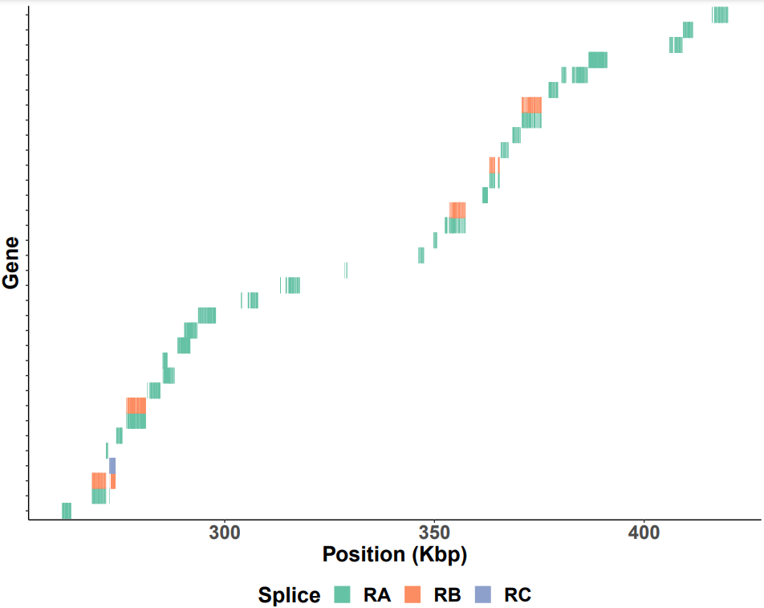
Gene ontologies
Integral membrane components
Serine-type endopeptidase activity
Chymotrypsin proteinase (digestion)
Genes

Slide 6
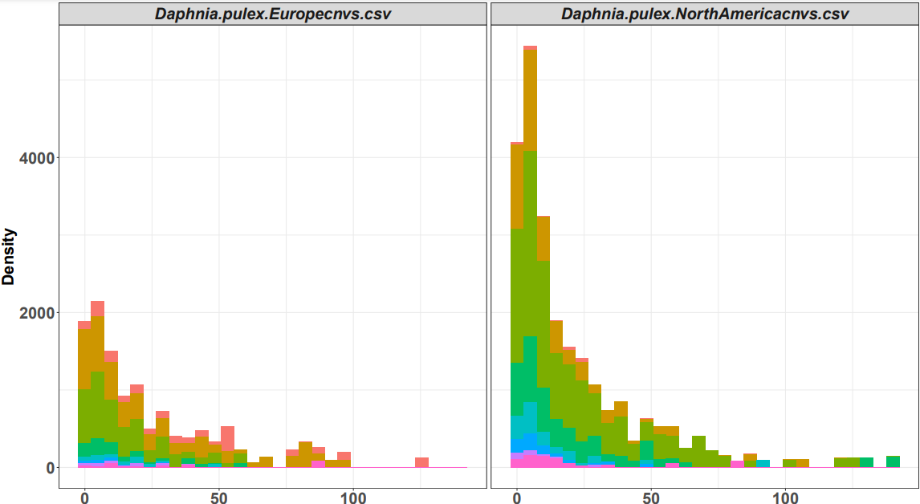

European D. pulex
North American D. pulex
Next Steps
Characterize which genes contain CNVs.
Identify hotspots associated with immune function.
Calculate rates of sequence evolution (dN/dS) across CNV regions & gene classes.
Many rare polymorphic CNVs.
High purifying selection.
Could be evidence for recent birth of CNVs.
CNV frequency
Deletions
Copies

Slide 7
 |  | 2022 | 2023 |  |  | 2024
 | Goals | Fall | Spring | Summer | Fall | Spring | Summer
Aim 2: | Characterize CNVs
Copy Number Variants | Measure selection
 | Validation experiments (long range sequencing)
 | Write paper

