Slide 1
2022 BAS Annual Case Competition
Team 36: Hannah Mok, Jury Camillo, Connor Chia, Mohammad Ameen

Slide 2
Agenda
Workbook Overview
Reserving Methods
Data Analysis
CAT Reserving
Notes:
Workbook: TOC, triangles, reserving calculations, summary table
Difference bw reserving methods
Analysis for each LOB and ultimate loss selections
Recommendation for which LOB should be standardized and why
Cat reserving and challenges
Review the workbook we created using the claim data provided
Discuss the five reserving methods we used and their pros and cons
From there, we’ll move on to data analysis for each line of business and their estimations for ultimate loss based on the reserving methods we reviewed
And finally, we’ll cover catastrophe reserving and the challenges that come with it

Slide 3
Workbook Overview
1

Slide 4
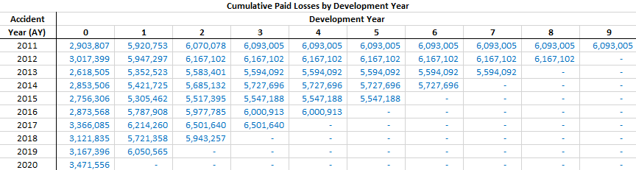
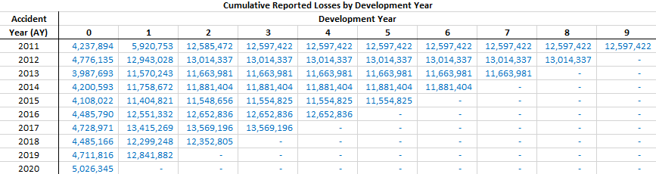
Annual Cumulative Reported and Paid Dollar Triangles (Personal Auto Physical Damage)
Figure 1
Figure 2
Notes:
For all of our loss triangles, we first created an incremental loss triangle in order to construct a cumulative loss triangle. As seen in figure 1 showing annual cumulative paid losses
We also separated all triangles by their respective line of business by calculating their reserves separately rather than aggregating them from the start because combining all three lines of business would probably not provide the adequate reserves
For the reported loss triangles as seen in figure 2, we used the initial reserve because at the time of the initial reserve, there are no paid claims, so the reported loss would just equal the case reserves

Slide 5
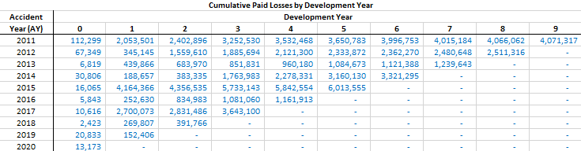
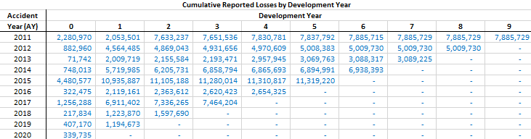
Annual Cumulative Reported and Paid Dollar Triangles (Personal Auto Liability)
Figure 3
Figure 4

Slide 6
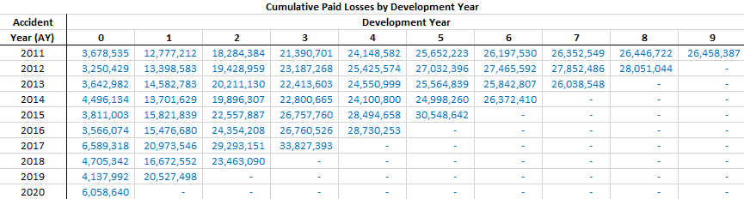
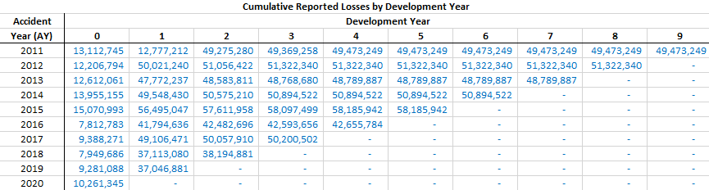
Annual Cumulative Reported and Paid Dollar Triangles (Homeowners Property)
Figure 5
Figure 6

Slide 7
Reserving Methods
2
Notes:
Next we’ll move on to reserving methods and their characteristics

Slide 8
Paid Chain Ladder Method
Benefit:
“Hard” data; no estimates involved
Disadvantage:
May generate large, volatile loss development factors & take longer to develop to ultimate
Notes:
Citation: https://www.youtube.com/watch?v=KANe-_28j0E&t=299s
Payment patterns and link ratios from the Paid chain-ladder cannot predict the liability for large claims, which have a significant impact on the outcome of an account year.

Slide 9
Reported Chain Ladder Method
Benefit:
Uses all available information
Disadvantage:
Uses case reserves, which are estimates, to develop estimates of ultimate losses

Slide 10
Expected Method
Benefit:
Preliminary estimation of risk
Disadvantage:
Risk profile of clients not considered
Notes:
Benefits:
With the help of a ratio and analysis, an insurer can determine in advance what amounts of claims or losses will be incurred, and will set aside a portion of the premiums to settle the probable claims.
With the help of the ELR, the premium amount to be paid by a customer or policy holder of a new product or policy may be determined, keeping in mind the probability of settlement in the number of cases, depending on whether a certain incident occurs or not.
As a result of comparing the amount arrived at per the ELR with the actual settlement or loss, the insurance company can assess the performance of old products and determine whether to continue the line or to abandon it.
Disadvantages:
With regard to economic, social, and geographical diversity, each customer or type of customer has a different risk profile. That is not taken into account in this method of loss estimation probability.
As a result of natural disasters, such as pandemics, floods, earthquakes, etc., the claims scenario may change overnight without any reference to prior occurrences or non occurrences of the same events. Calculating advance losses cannot take this into account.

Slide 11
Bornheutter-Ferguson Method
Benefit:
More stable in response to changing data than the Chain-Ladder method
Disadvantage:
Relies on accuracy of expected loss ratio
Notes:
Benefits:
Suitable for new or volatile lines of business
Compatibility between the loss development method and the expected loss ratio method
Avoids overreaction to unexpected incurred losses to date
Can be used with no internal loss history
Easily accessible and simple
Disadvantages:
Assumes that case development is unrelated to reported losses
Less responsive to losses incurred to date

Slide 12
Case Outstanding Method
Benefit:
It turns client observations into useable data
Disadvantage:
In most LOBs, case outstanding do not provide sufficient information about pure IBNR
Notes:
Disadvantages: There is a lack of industry benchmark data for accident year applications of this method

Slide 13
Data Analysis
3

Slide 14
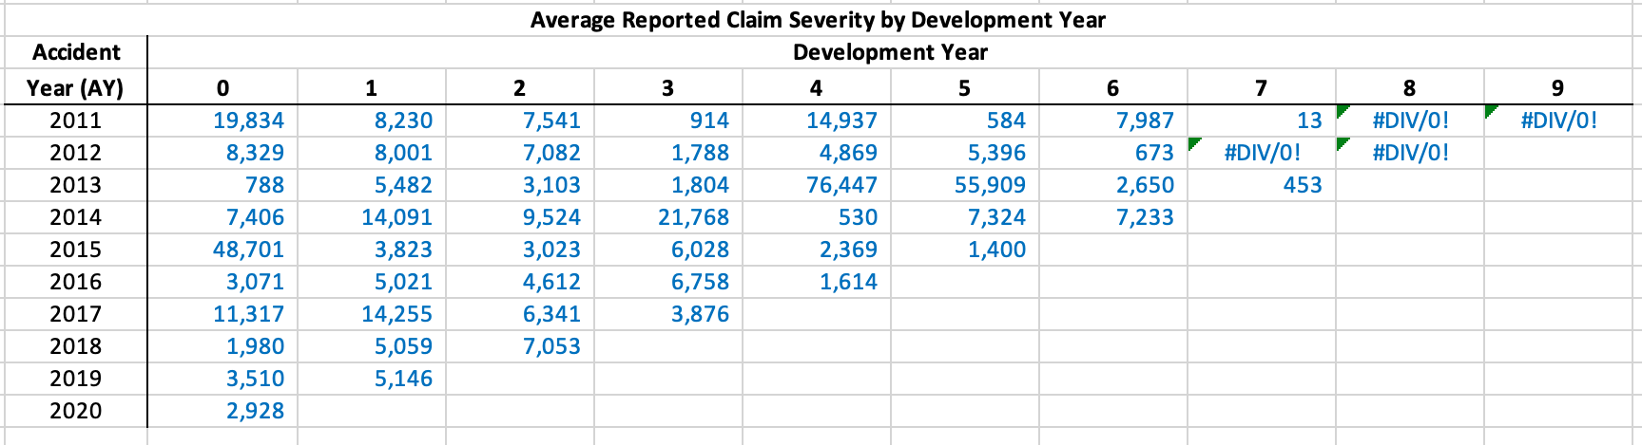
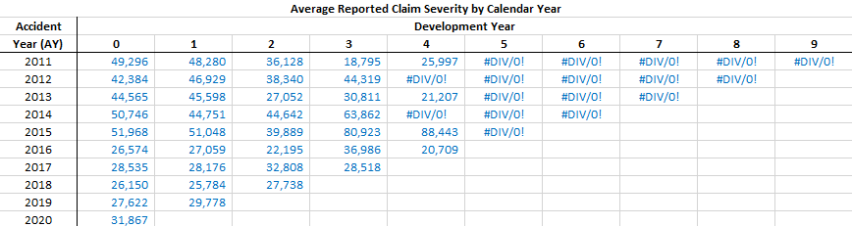
Unusual Changes in Data Triangles
Average Claim Severity for Liability seems to be decreasing until around year 4
In the claim severity for homeowner, the data for 2012 appears to end before the data in 2013 which is unusual because 2012 would need more time to mature which would often result in more data
There is a huge increase in value for physdam reported starting at 2013

Slide 15
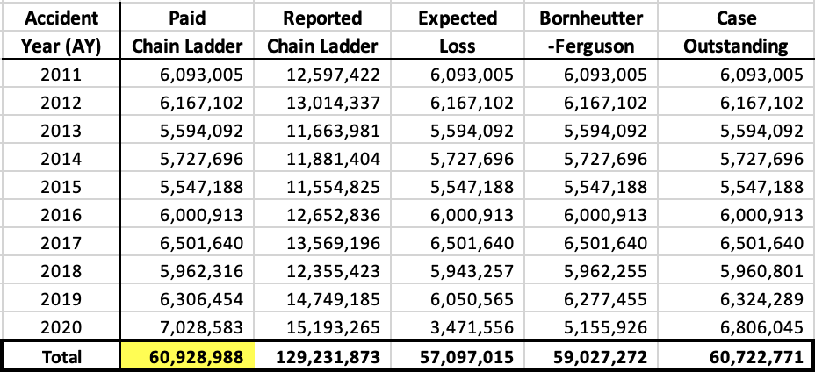
Estimated Ultimate Losses:
Personal Auto Physical Damage
4 of 5 of reserving methods give similar estimates.
Selected: Paid CL estimate since it uses historical patterns.

Slide 16
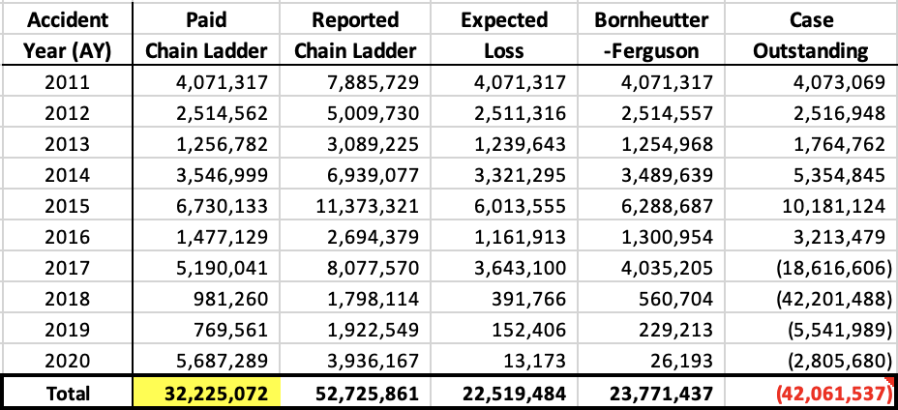
Estimated Ultimate Losses:
Personal Auto Liability
Ult losses are unusually small from 2018 - 2020 especially in EL and BF methods
Selected: Paid CL estimate since it uses historical patterns.
*Note: Normally would use Bornhuetter-Ferguson since data patterns are not stable and BF method incorporates both historical and new data, but initial impact of COVID-19 would skew results.

Slide 17
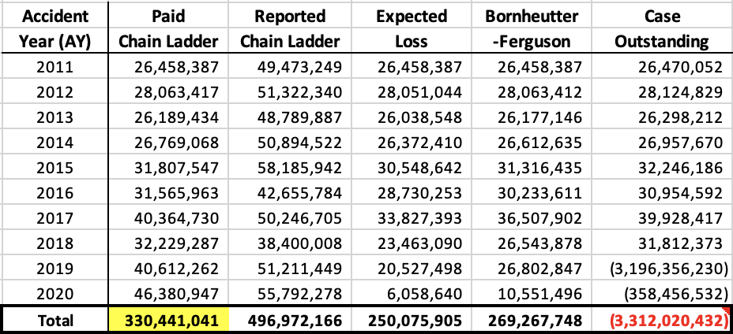
Estimated Ultimate Losses:
Homeowners Property
Ult losses are unusually small for 2020 especially in EL and BF methods
Selected: Paid CL estimate since it uses historical patterns.
*Note: Normally would use Bornhuetter-Ferguson since data patterns are not stable and BF method incorporates both historical and new data, but unusual outlier would skew results.

Slide 18
Which methods should be standardized?
Line of Business to standardize: personal auto physical damage
Methods:
1. Paid chain ladder works best for well organized data making it an ideal method for calculating ultimate loss for this data
2. The case outstanding method would be ideal for calculating future values given the well organized set up for this data
3. Finally, combining the aspects of both paid chain ladder and case outstanding would prove that Bornhuetter-Ferguson method would also be ideal for this data considering this method bases both past and future outcomes of the data

Slide 19
CAT Reserving
4

Slide 20
CAT Reserving
Why is it done separately?
Catastrophic reserving is specifically for extreme circumstances like earthquakes or a pandemic, so this reserve is set aside to be available when a given event occurs. Furthermore, this helps to alleviate and control the long term agenda for cataclysmic events.
Notes:
Citation: “Casualty Actuarial Society.” 2012 Casualty Loss Reserve Seminar: Index of Handouts, 6 Sept. 2012, https://cas.confex.com/cas/2012clrs/webprogram/uploadlistall.html.
1. Location and access – based on the location and the scale of a catastrophe, the speed at which information can be gathered and communicated can be severely limited;
2. Length of the event – can lead to a great deal of uncertainty, particularly for estimating business interruption claims;
3. Legality – If a claim settlement is disputed, where a trial takes place can vary. Based on the legal environment of the country that the claim is tried in, outcomes may be unexpected;
4. Currency – If there is a considerable gap between the accident date and the date at which the loss is paid/settled, changes in F/X rates can have a significant impact on the amount of loss in corporate currency.

Slide 21
Challenges of CAT Reserving
1. Location and access – based on the location and the scale of a catastrophe, the speed at which information can be gathered and communicated can be severely limited;
2. Length of the event – can lead to a great deal of uncertainty, particularly for estimating business interruption claims;
3. Legality – If a claim settlement is disputed, where a trial takes place can vary. Based on the legal environment of the country that the claim is tried in, outcomes may be unexpected;

Slide 22
Thank You!

Slide 23
Appendix

Slide 24
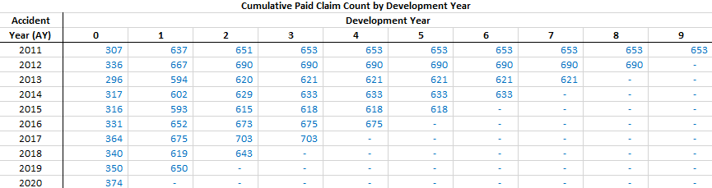
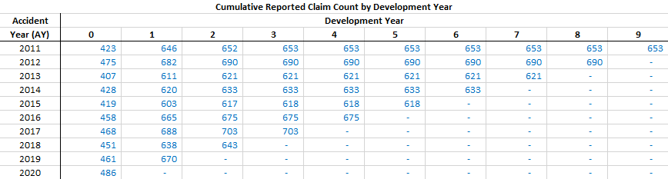
Annual Cumulative Reported and Paid Claim Count Triangles (Personal Auto Physical Damage)
Figure 7
Figure 8

Slide 25
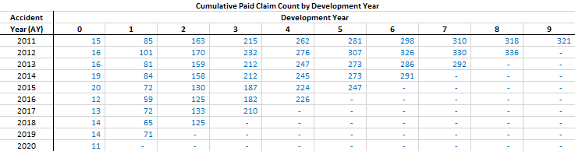
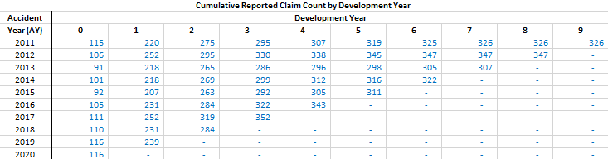
Annual Cumulative Reported and Paid Claim Count Triangles (Personal Auto Liability)
Figure 9
Figure 10

Slide 26
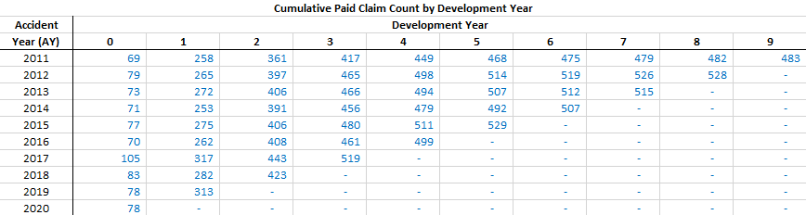
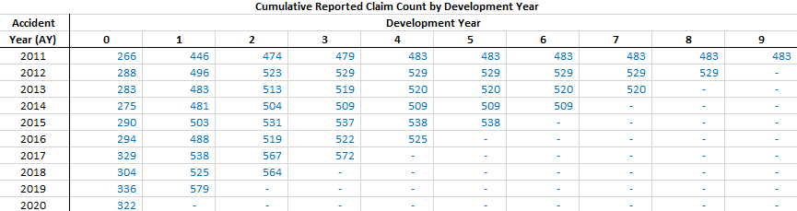
Annual Cumulative Reported and Paid Claim Count Triangles (Homeowners Property)
Figure 11
Figure 12

Slide 27
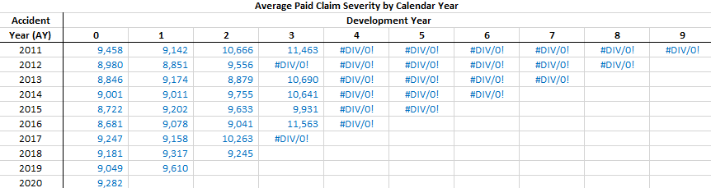
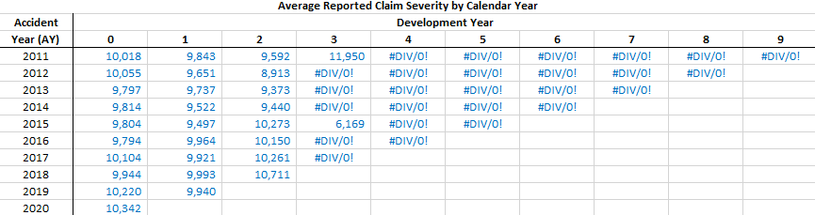
Annual Average Paid and Reported Claim Severity Triangles (Personal Auto Physical Damage)
Figure 13
Figure 14

Slide 28
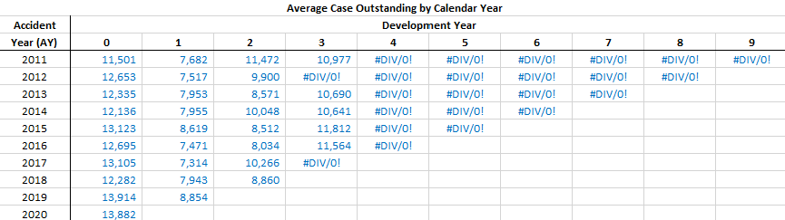
Average Case Outstanding Triangle (Personal Auto Physical Damage)
Figure 15

Slide 29
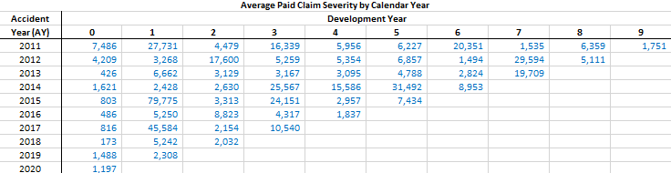
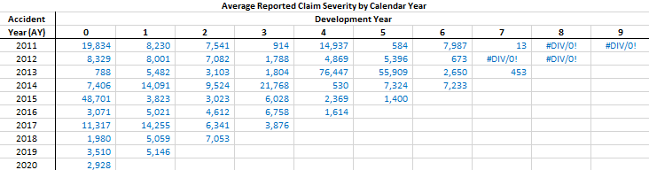
Annual Average Paid and Reported Claim Severity Triangles (Personal Auto Liability)
Figure 16
Figure 17

Slide 30
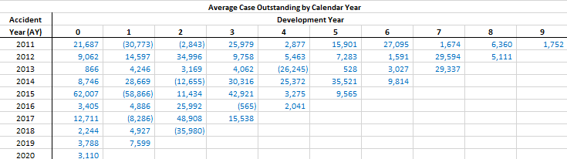
Average Case Outstanding Triangle (Personal Auto Liability)
Figure 18

Slide 31
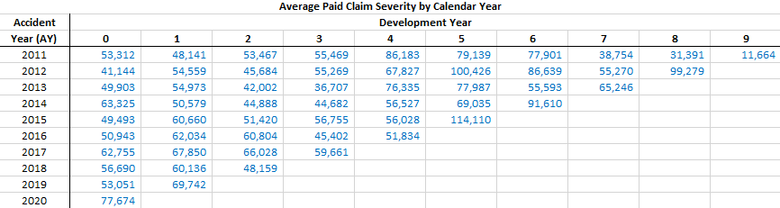
Annual Average Paid and Reported Claim Severity Triangles (Homeowners Property)
Figure 19
Figure 20

Slide 32
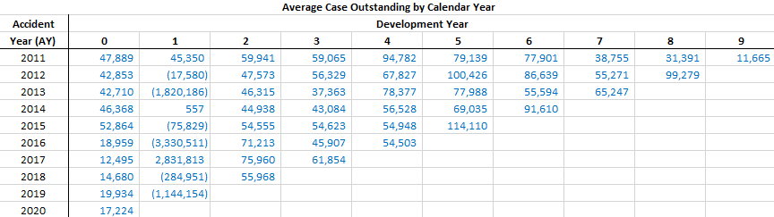
Average Case Outstanding Triangle (Homeowners Property)
Figure 21

