Slide 1
A Brief Introduction
Background, Motivation, and Experience
Connor Churko
5/29/2026

Slide 2

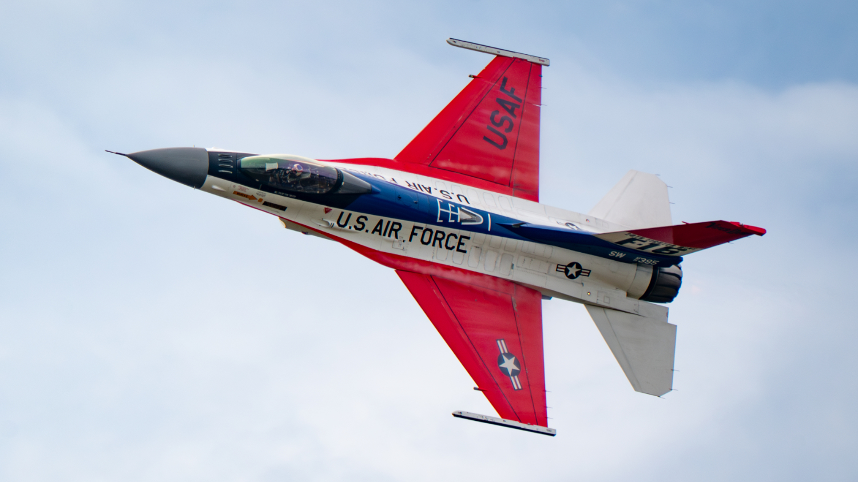

About Me
Education BS: Physics/Astronomy (University of Maryland) MS (Exp. 2027): Aerospace Engineering (Georgia Tech) | Professional University of Maryland Research System Engineering Group, Inc (now Axient) Northrop Grumman Corporation
Motivation
Solving problems
Seeing solutions come to life
The Air Show “Propaganda”

Slide 3
Technical Experience
Systems Engineer | Northrop Grumman
Propulsion Lead Leading integration of 100 lbf thrust class turbojet into group 3 UAS from prime side Working across multiple teams and companies to manage engine level requirements, risk, and suppliers Owner of supplier cycle model analysis Supporting development of engine test plans given cycle analysis and risk assessments Owner of vehicle mission level AFSIM model integrating NPSS cycle model
Mission Level MS&A Lead AFSIM developer for theater level mission modeling Evaluating kinetic and non-kinetic kill chains, electronic warfare performance, and single aircraft navigation and range analyses | Antenna Subsystem I&T Hands-on bench work integrating multi-level control, firmware, software, and RF hardware Owner of python post-processing data analysis algorithm used for flight test | RF Modeling Owner and sole developer of MATLAB based RF modeling tools used for antenna calibration, radar signature generation, and data visualization\analysis

Slide 4
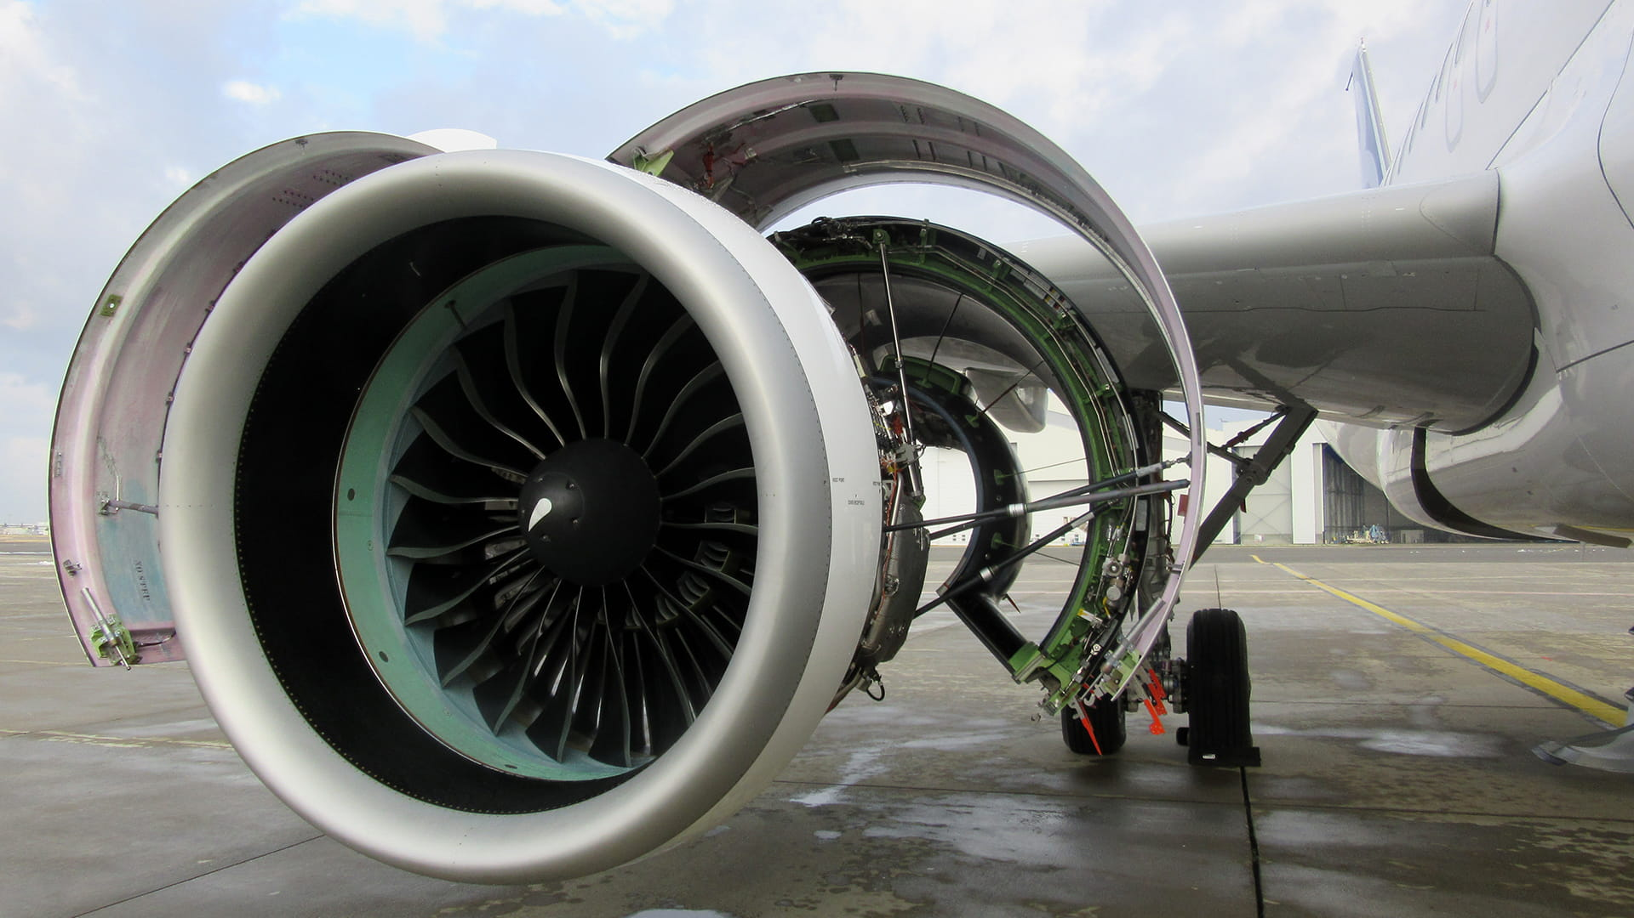
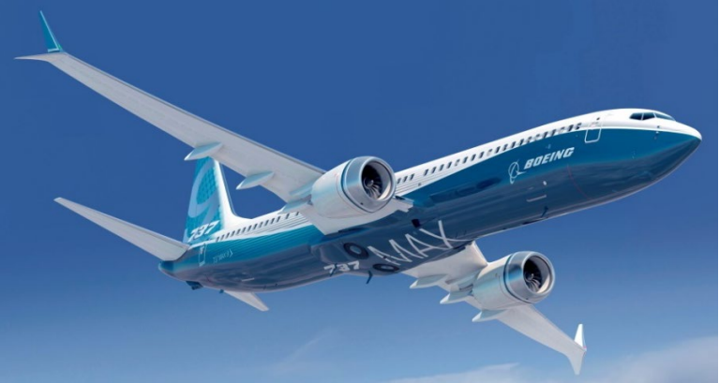
Thermodynamic Cycle Design using NPSS
Development and Performance Analysis of a Separate Flow Turbofan
Connor Churko
Georgia Tech Aerospace Engineering
5/29/2026

Slide 5
Overview
Provided a specified engine design architecture for a single-aisle passenger aircraft and a pre-defined mission, develop an NPSS model for a separate flow turbofan engine and optimize to maximize aircraft range.
Assumptions from provided parameters and simulation inputs have been backed out to provide additional context.

Slide 6
NPSS Development Process
SFTF NPSS Model Development
Engine Optimization Parameter Definitions
  Objective Function
  Design Variables
  Constraints
  Requirements
On-Design/Off-Design
  Engine Sizing, Engine Deck Generation
FLOPS Execution
  Aircraft Model, Mission Performance Evaluation
Iteration

Slide 7
Requirements
TOC = Top of Climb
TO = Take-off
Type | Value | Purpose | Driver(s)
Max Fan Diameter | 79.0 inches | Reduce engine weight/size requirements for vehicles | CmpFan Cross Sectional Area. Driven by current competition of industry trade space
Max Engine Weight | 6500 lbs | Reduced weight increases vehicle range | Fan pressure ratio (Pt2.1/Pt2)
Max Tt3 | 1660 °R [1200 °F] | Reduce compressor thermal degradation | Material Selection (Rene N5 + TBC)
Minimum Thrust | 5500 lbf (TOC) >22000 lbf (TO) | Produce sufficient thrust for a small turbojet engine | Driven by current competition of industry trade space.
Max Tt4 | 3050 °R (TOC) [2590 °F] 3250 °R (TO) [2790 °F] | Reduce turbine thermal failure modes | Material Selection (Rene N5 + TBC)
Max Tt41 | 3175 °R (TO) [2715 °F] | Reduce turbine thermal failure modes | Material Selection (Rene N5 + TBC)
Thrust Rating Structure | T41 (>10kft) = 2690 °R [2230 °F] T41 (<10kft) = 3000 °R [2540 °F] | Optimizes engine fatigue, supports efficiency over flight envelope | Material Selection, intended engine efficiency, vehicle performance

Slide 8
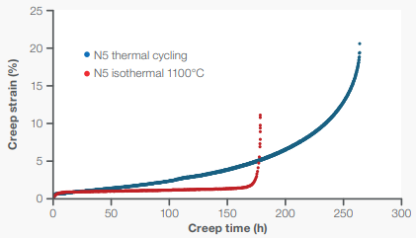
Assumptions
Materials
Materials selected represent typically choices for hot section turbofan components. Given high-pressure turbine temperature limits, assume thermal barrier coatings (TBCs) are integrated to reduce thermal creep and fatigue.
Assuming components materials are Rene N5 (HPC) and Rene N5 + TBC (HPT), thermal requirements as described previously may be fulfilled.
Material | Creep Resistance (°F) | Melting Point (°F)
Rene N5 | 2012 | 2453
TBC | +392 [1] | +392 [1]
Creep resistance curve for Rene N5 at 2012°F [2]

Slide 9
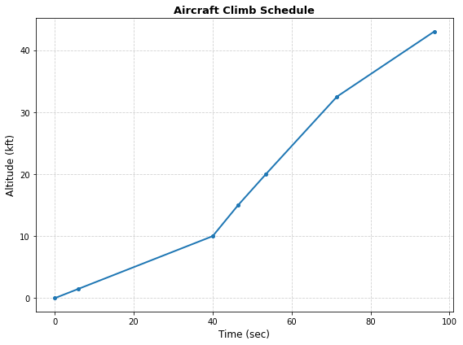
Assumptions
Aircraft (B737 Max 8)
Aircraft assumptions are detailed in the FLOPS program to analyze mission performance and range calculations.
FLOPS is highly detailed. Assumptions listed below are higher level for reference.
Characteristic | Parameter
Wingspan (ft) | 130.0
Fuselage Length (ft) | 124.75
Fuselage Width (ft) | 12.33
Fuselage Depth (ft) | 13.17
Engine Nacelle Length (in) | 8.86
Engine Nacelle Diameter (in) | 8.59
Operating empty weight (lbs) | 93845.10
Aircraft climb schedule to cruise altitude generated using FLOPS parameters

Slide 10
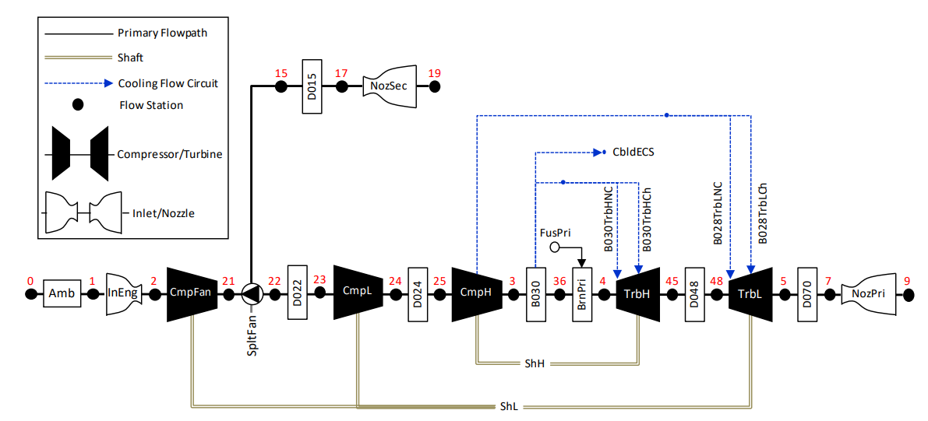
NPSS Model Architecture
Separate Flow Turbofan
NPSS Architecture Schematic for SFTF model file (.mdl)

Slide 11
NPSS Model Architecture
Element Definitions (1)
Cold Section
Hot Section
Connected to Hot/Cold Element
FlightConditions (Amb):
W1 = 122.683 lbm/sec
alt = 30000 ft
MN = 0.78
Duct (D022):
Fl_O.MN = 0.30
dPqPbase = 0.005
BrnPri
Inlet (InEng):
FL_O.MN = 0.6
Ram Recovery:
Mach = { 0.000, 0.025, 0.100, 0.200, 0.250, 0.300, 0.400, 0.500, 0.600, 0.700, 0.900 }
etar = { 0.993, 0.996, 0.995, 0.993, 0.9925, 0.992, 0.998, 0.998, 0.997, 0.997, 0.997 }
Compressor (CmpL):
FL_O.MN = 0.40
Map Design Params:
Alpha = 0.00
RlineMap = 1.80
NcDes = 1.0
PRdes = 1.30
effDes = 0.90
Bleed (B030):
FL_O.MN = 0.30
BleedOutPort (B030_CH):
fracW = 0.055
BleedOutPort (B030_NC):
fracW = 0.080
Compressor (CmpFan):
FL_O.MN = 0.45
Map Design Params:
Alpha = 0.00
RlineMap = 1.60
NcDes = 0.90
PRdes = 15.0
effDes = 0.89
BleedOutPort (CbldECS):
fracW = 0.045
Duct (D024):
Fl_O.MN = 0.35
dPqPbase = 0.015
Compressor (CmpH):
FL_O.MN = 0.30
Map Design Params:
Alpha = 0.00
RlineMap = 2.00
NcDes = 0.985
PRdes = 20.00
effDes = 0.8650
InterStageBleedOutPort (B028_NC):
fracBldWork = 0.45
fracBldP = 0.5000
fracBldW = 0.065
Splitter (SpltFan):
BPR = 1.8687
Fl_01.MN = 05
Fl_02.MN = 0.5
InterStageBleedOutPort (B028_CH):
fracBldWork = 0.45
fracBldP = 0.5000
fracBldW = 0.065
D015

Slide 12
NPSS Model Architecture
Element Definitions (2)
Cold Section
Hot Section
Connected to Hot/Cold Element
FuelStart (Fuel):
Tfuel = 518.67
LHV = 18580.0
Turbine (TrbH):
Fl_O.MN = 0.30
Map Design Params:
effDes = 0.9200
Map = 5.280
GeomDes = 1.0
MapDes = 4.800
NcDes = 100.0
Burner (BrnPri):
FL_O.MN = 0.6
FAR = 0.035
effBase = 0.997
dPqPBase = 0.035
Fl_O.MN = 0.10
InterStageBleedOutPort (B030TrbHNC):
Pfract = 1.0
diaPump = 0.0
Duct (D048):
Fl_O.MN = 0.40
dPqPbase = 0.005
B030
InterStageBleedOutPort (B030TrbHCh):
Pfract = 0.0
diaPump = 0.0
Nozzle (NozPri & NozSec):
switchType = "CONIC"
switchCoef = "CV"
Cang = 0.997
Table DischargeCoeff( real PR ) {
PR = {1.0, 1.08, 1.25, 1.6, 2, 2.25, 2.5, 3.0, 4.0, 5.0, 7.0}
CdTh = {0.89, 0.907, 0.922, 0.945, 0.96, 0.966, 0.968, 0.97, 0.9725, 0.974, 0.975}
PR.interp = "linear"}
Subelement CDTH S_CdTh {}
Table VelCoeff( real PR ) {
PR = {1.0, 2.1, 2.6444, 3.1889, 3.7333, 4.2778, 4.8222, 5.3667, 5.9111, 6.4556, 7.0}
Cv = {0.9962, 0.9952, 0.9936, 0.9886, 0.9825, 0.9757, 0.9691, 0.9631, 0.9574, 0.952, 0.947}
PR.interp = "linear"}
Subelement CVELOCITY S_Cv {}
PsExhName = "Amb.Ps"
Turbine (TrbL):
Fl_O.MN = 0.35
Map Design Params:
effDes = 0.9300
Map = 5.010
GeomDes = 1.0
MapDes = 5.500
NcDes = 100.0
InterStageBleedOutPort (B028TrbLNC):
Pfract = 1.0
diaPump = 0.0
Duct (D070):
Fl_O.MN = 0.60
dPqPbase = 0.01
InterStageBleedOutPort (B028TrbLCh):
Pfract = 0.0
diaPump = 0.0
Duct (D015):
Fl_O.MN = 0.30
dPqPbase = 0.02
Shaft (ShH):
ShaftInputPort HPC, HPT
HPX = 0.0
Nmech = 8600.0
Shaft (ShL):
ShaftInputPort FAN, LPC, LPT
HPX = 0.0
Nmech = 2200.0
SpltFan

Slide 13
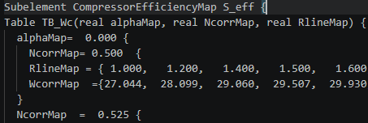
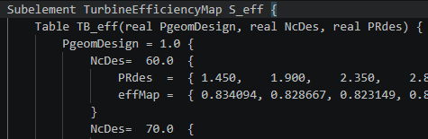
NPSS Model Architecture
Turbomachinery Map Integration
The compressor and turbine maps are added to the corresponding element definition in the model file. Maps are defined as a subelement consisting of tables, each with nested data for corrected speed, corrected flow, pressure ratio, and efficiency.
Compressor Map
Turbine Map
Table (Wc, PR, eff)
Table (Wp, eff)
Alpha
Geometry (Swirl)
Nc
Nc
R-line
Wc, PR, eff
PR
Wc, eff
A python script is used to parse each nested block using regular expressions. Once separated, data is zipped together and plotted across common speed lines and R-lines. The efficiency contour is made with linear interpolation across the grid of corrected flow and pressure ratios.

Slide 14
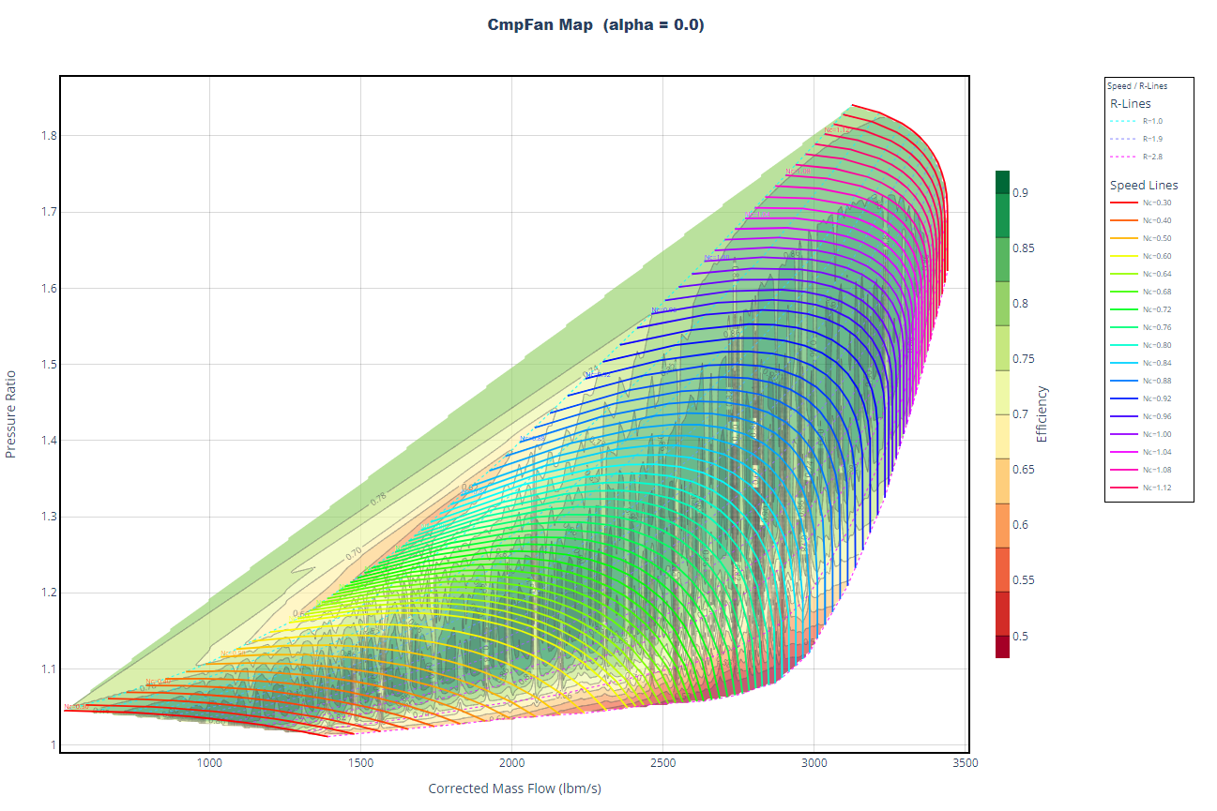
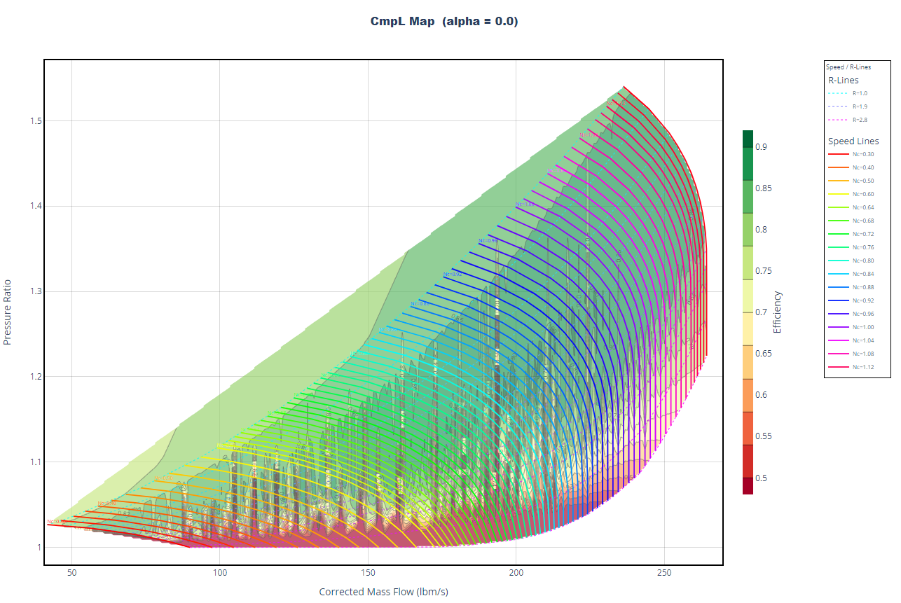
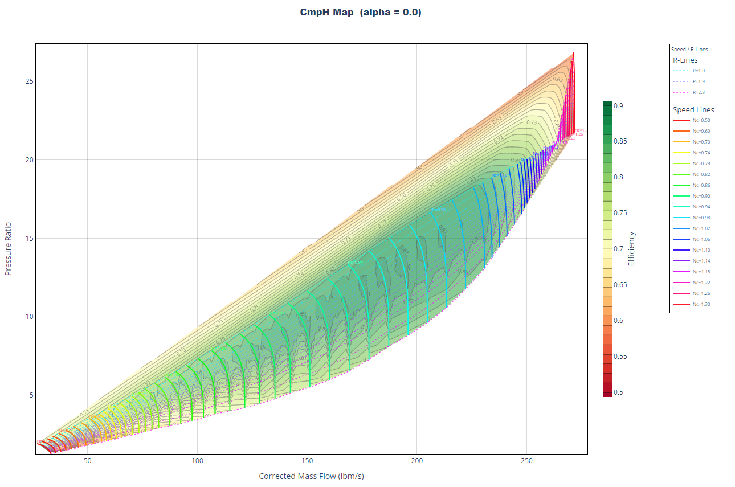
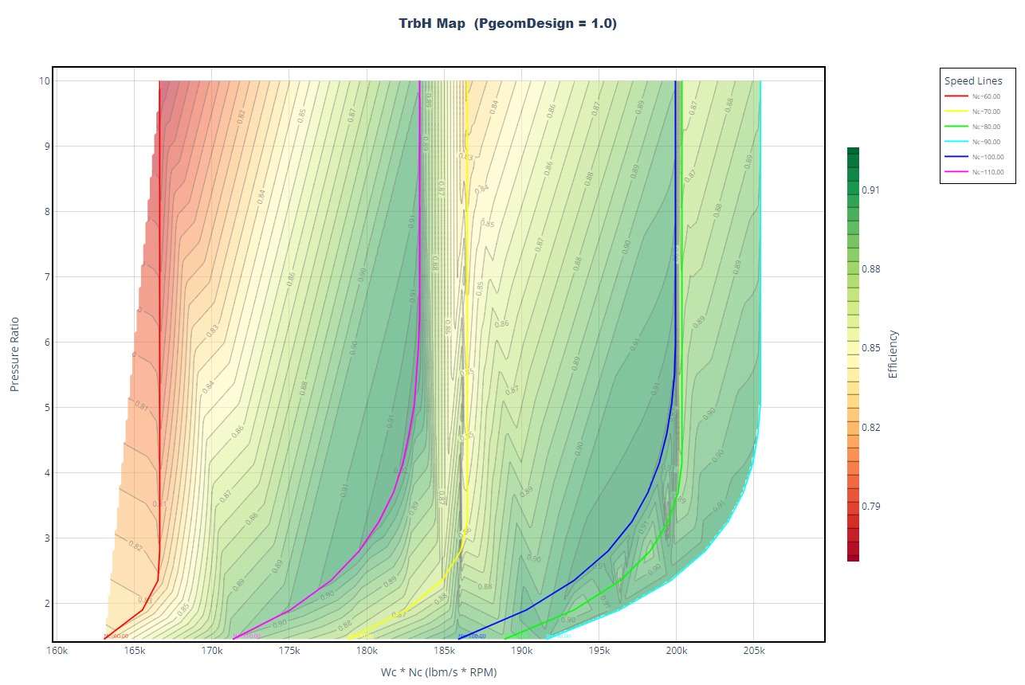
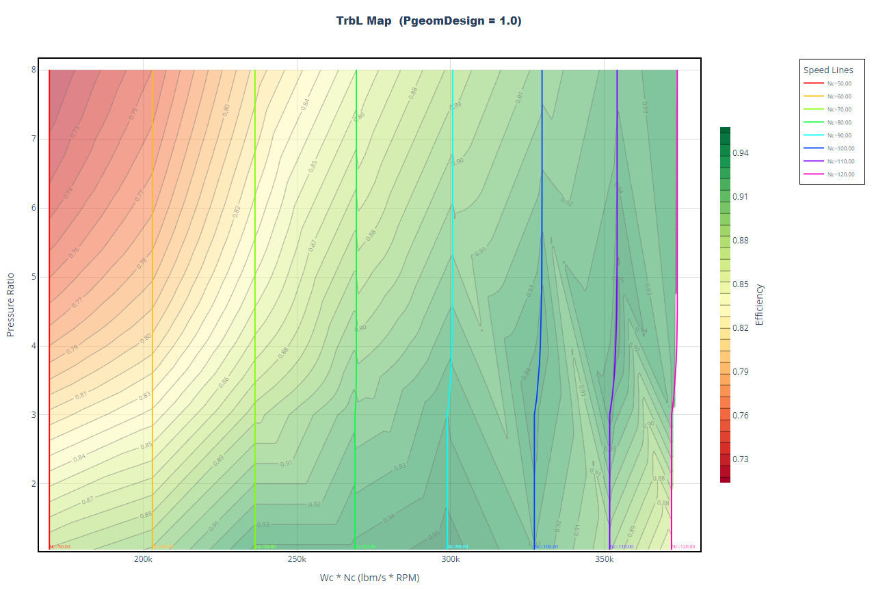
NPSS Model Architecture
Turbomachinery Maps
The full efficiency maps are generated using linear interpolation across a grid of corrected flows and pressure ratios. The only data available in the NPSS compressor map exists on the plotted speed lines and r-lines. The turbine maps are defined to linearly interpolate on more limited datasets with no extrapolation.
CmpFan
CmpL
CmpH
TrbH
TrbL

Slide 15
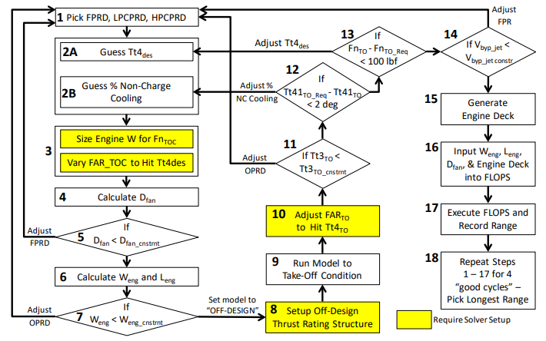

The Optimization Problem
The NPSS model is optimized manually to determine the set of design variables which maximum cruise range.
Design variables:
  Pressure ratios for the fan, LPC, and HPC which effect the technology curves for each compressor and the extraction ratio.
  %non-chargeable cooling
  Design Tt4
$${ηdes}_{CmpFan}=−1.60 PRdes_{CmpFan}^{2}+4.59 PRdes_{CmpFan}−2.39$$
$${ηdes}_{CmpL}=−0.0265 PRdes_{CmpL}^{2}+0.0599 PRdes_{CmpL}+0.816$$
$$η{des}_{CmpH}=−0.00024206 PRdes_{CmpH}^{2}+0.0048033 PRdes_{CmpH}+0.90$$
$$Extraction Ratio \left(\frac{{Pt}_{D015}}{{Pt}_{D070}}\right)=1.33333 PRdes_{CmpFan}−0.40$$
Optimization algorithm flowchart

Slide 16
Solver Setup
On-Design
Off-Design
On-design analysis typically sizes the engine given a specific operating conditions or “design point”. In this case, the design point is defined as the top of climb or cruise condition.
Off-design analysis uses the sized, engine on-design parameters to calculate engine performance across an entire flight envelope.
The engine is stepped down from top of climb to take-off conditions in order to satisfy provided requirements. The flight envelope may then be analyzed resulting in a full engine deck.
Top of Climb (Cruise): M0.80/35kft/0dTs
Solver Setup
Independents | Dependents
W1 | Design Net Thrust
FAR | Design Tt4
BPR | Design Extraction Ratio
Take Off: M0.0/0.0kft/+27dTs
Solver Setup
Independents | Dependents
FAR | Thrust Rated Tt41
Solvers are implemented using the “autoSolverSetup()”, “addIndependent”, and “addDependent” functions given the independent and dependent variable definitions.

Slide 17
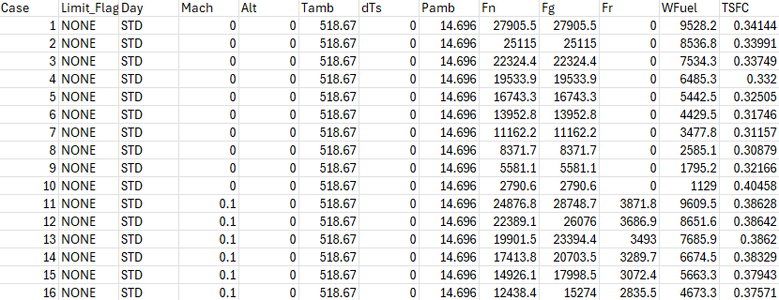
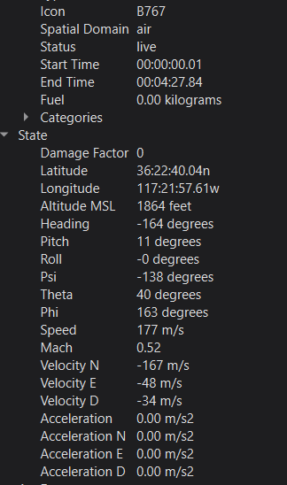
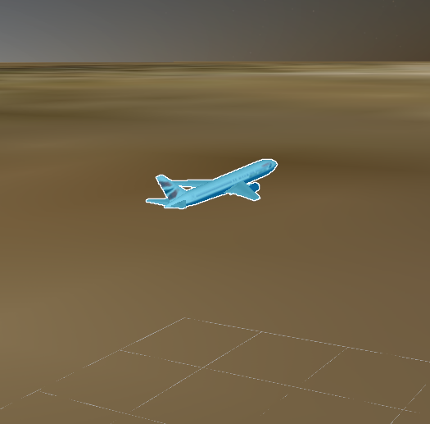
Engine Deck
The engine deck is the main output of the NPSS model. For the scope of this project the parameters of interest are thrust and TSFC across the full flight envelope to inform the FLOPS model.
Engine Deck Operating Envelope:
  Mach [0.0 : 0.1 : 0.9]
  Altitude [0.0 : 5.0 : 45.0] kft
The engine deck is used in industry to inform a customer of engine performance for validation of engine test activities and provide inputs for higher level vehicle or mission modeling.
  dTs or MIL-STD-210A/C non-standard days, as well as potential limit flags may enhance a customers understanding of the engine operating envelope.
Visual from AFSIM mission modeling evaluating vehicle performance with NPS fuel tables
  Excerpt from example generated engine deck

Slide 18
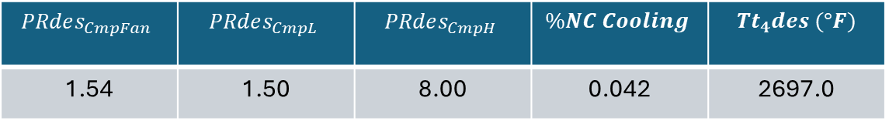
Optimization Deck
Variable | Design 1 | Design 2 | Design 3 | Design 4
FPRD | 1.650 | 1.600 | 1.575 | 1.540
LPCPRD | 1.500 | 2.000 | 1.850 | 1.500
HPCPRD | 8.000 | 12.500 | 14.000 | 8.000
OPRD | 19.4055 | 39.203 | 39.9797 | 18.1118
BPRD | 7.36354 | 7.45388 | 7.90782 | 9.37468
FAR_{TOC} | 0.0255093 | 0.022257 | 0.0223166 | 0.0261687
Tt4_{des} at TOC | 2689 | 2721 | 2725 | 2697
% NC Cooling | 0.042 | 0.0485 | 0.049 | 0.042
TOC Mass Flow | 321.648 | 344.174 | 353.642 | 362.653
Fn_{TOC} | 5500 | 5500 | 5500 | 5500
D_{fan} | 74.1487 | 77.0824 | 78.1935 | 78.8923
W_{eng} | 2413.66 | 4804.36 | 4905.07 | 2291.41
L_{eng} | 90.353 | 105.812 | 106.419 | 89.3428
FAR_{TO} | 0.0329294 | 0.0282849 | 0.0282425 | 0.0334835
Tt41_{TO} | 3174.45 | 3174.1 | 3173.42 | 3173.28
Tt4_{TO} | 3250 | 3250 | 3250 | 3250
Tt3_{TO} | 1352.45 | 1640.47 | 1643.05 | 1317.42
Fn_{TO} | 22019.8 | 22080.8 | 22022.6 | 22006.9
Range | 3147.1 | 2983.5 | 3042.8 | 3440.7
$$PRdes_{CmpFan}$$ | $$PRdes_{CmpL}$$ | $$PRdes_{CmpH}$$ | $$\%NC Cooling$$ | $${Tt}_{4}des (°F)$$
1.54 | 1.50 | 8.00 | 0.042 | 2697.0
Modeled Max Range = 3440.70 nmi Boeing B737 MAX 8 Max Range = 3500 nmi [3]
Given only four manually optimized runs, the maximum range for the theoretical B737 MAX 8 is within 2% of the reported true range.
Note:
Access to NPSS via Georgia Tech virtual machine was lost due to end of semester restricting further optimization to improve range.
Next stage of work planned to develop a python script running from command line to streamline workflow. (NPSS → Engine Deck → FLOPS → Optimization Deck)

Slide 19
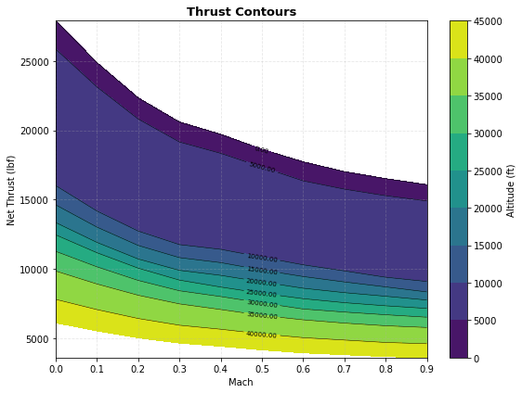
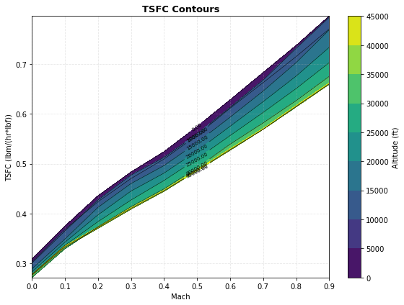
Engine Performance
The above thrust and TSFC contour plots were developed in python.
Performance trends:
  Thrust and TSFC decrease as altitude increases.
  TSFC increases significantly with Mach number while thrust is less strongly related.
At higher altitudes, air density decreases thus decreasing inlet mass flow limiting exit velocity.
While thrust lowers, less fuel flow is required to sustain the same thrusts at higher altitudes, improving engine TSFC.

Slide 20
Conclusions
Fan pressure ratio increased fan diameter and engine weight. A low-pressure ratio to minimize weight with sufficient Tt2 was important to maximize range.
Push LPC to minimum.
HPC was design variable to tune for highest desired range
  Increasing compressor pressure ratio increases downstream temperature (following the isentropic equation). If OPR is too high, the engine will hit the Tt4 faster, thus limiting the performance available for the design.
NC Cooling near constant across designs, less vital to controlling Tt4 under limit requirement.

Slide 21
Turbojet NPSS Design
Objective:
Based on the shown separate flow turbofan NPSS model, develop a model for a 100-lbf thrust class, single spool turbojet to fit new requirements using known high-pressure compressor and turbine models.
Roadmap:
- Implement SFTF HPC and HPT to reuse maps and Reynolds effect modeling
Update FLOPS for smaller platform or use AFSIM to estimate range
Implement numerical optimization algorithm on PR_cmpH and other design variables
Implement control algorithms to design on desired shaft speed
Add transient designs

Slide 22
Application to Mach Industries
-

Slide 23
References
[1] Strangman T. E., Thin Solid Films, 127:1985, 93--105, 'Thermal barrier coatings for turbine airfoils’.
[2] ThermoFisher Scientific, et al., Novel analysis of single crystal Rene N5 superalloy, 2025.
[3] Boeing. (n.d.). 737 MAX. Boeing Commercial Airplanes

Slide 24
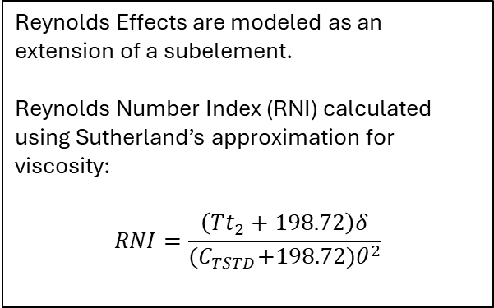
NPSS Model Architecture
High Pressure Compressor
Reynolds Effects are modeled as an extension of a subelement.
Reynolds Number Index (RNI) calculated using Sutherland’s approximation for viscosity:
$$RNI=\frac{\left(Tt_{2}+198.72\right)δ}{{(C}_{TSTD}+198.72)θ^{2}}$$
Note: The full efficiency map was generated using linear interpolation across the grid on corrected flows and pressure ratios. The only data available in the NPSS compressor map exists on the plotted speed lines and r-lines.

Slide 25
NPSS Model Architecture
High Pressure Turbine
Reynolds Effects:
Reynolds Number Index calculated using Sutherland’s approximation for viscosity
The turbine map efficiency contours are calculated via linear interpolation over Wc*Nc and pressure ratio. The turbine map implemented in NPSS also linearly interpolates on PgeomDesign, NcDes, and Prdes.

Slide 26
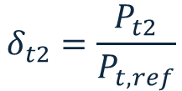
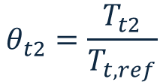
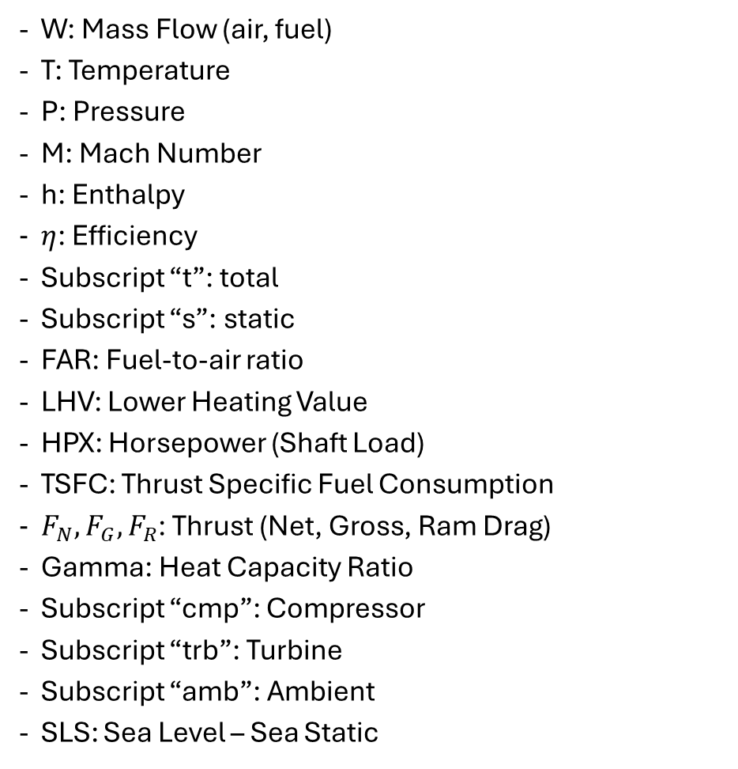
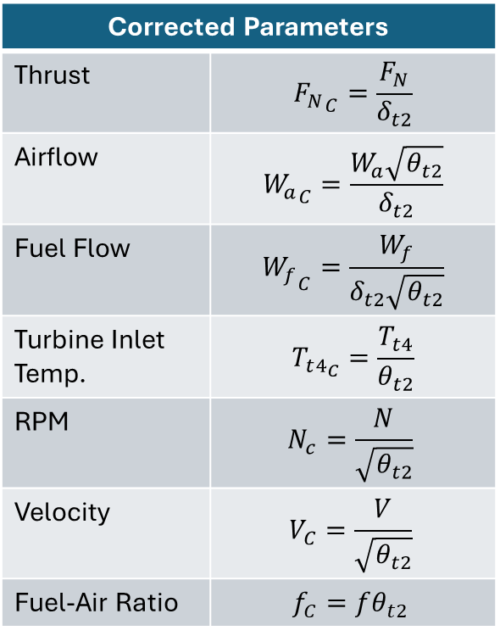
Reference
W: Mass Flow (air, fuel)
T: Temperature
P: Pressure
M: Mach Number
h: Enthalpy
$η$: Efficiency
Subscript “t”: total
Subscript “s”: static
FAR: Fuel-to-air ratio
LHV: Lower Heating Value
HPX: Horsepower (Shaft Load)
TSFC: Thrust Specific Fuel Consumption
$F_{N}, F_{G}, F_{R}$: Thrust (Net, Gross, Ram Drag)
Gamma: Heat Capacity Ratio
Subscript “cmp”: Compressor
Subscript “trb”: Turbine
Subscript “amb”: Ambient
SLS: Sea Level – Sea Static
Corrected parameters are used to normalize engine performance parameters across flight conditions.
Corrected Parameters
Thrust | $${F_{N}}_{C}=\frac{F_{N}}{δ_{t2}}$$
Airflow | $${W_{a}}_{C}=\frac{W_{a}\sqrt{θ_{t2}}}{δ_{t2}}$$
Fuel Flow | $${W_{f}}_{C}=\frac{W_{f}}{δ_{t2}\sqrt{θ_{t2}}}$$
Turbine Inlet Temp. | $$T_{t4_{C}}=\frac{T_{t4}}{θ_{t2}}$$
RPM | $$N_{c}=\frac{N}{\sqrt{θ_{t2}}}$$
Velocity | $$V_{C}=\frac{V}{\sqrt{θ_{t2}}}$$
Fuel-Air Ratio | $$f_{C}=fθ_{t2}$$
$$θ_{t2}=\frac{T_{t2}}{T_{t,ref}}$$
$$δ_{t2}=\frac{P_{t2}}{P_{t,ref}}$$
- Subscript “ref” refers to reference or SLS conditions.

Slide 27
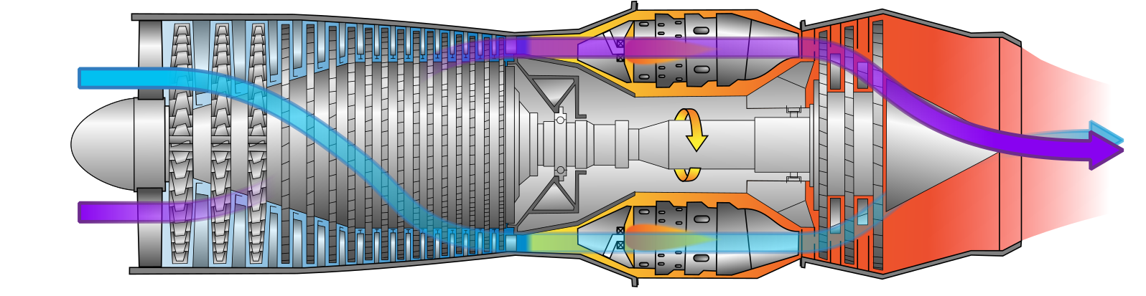
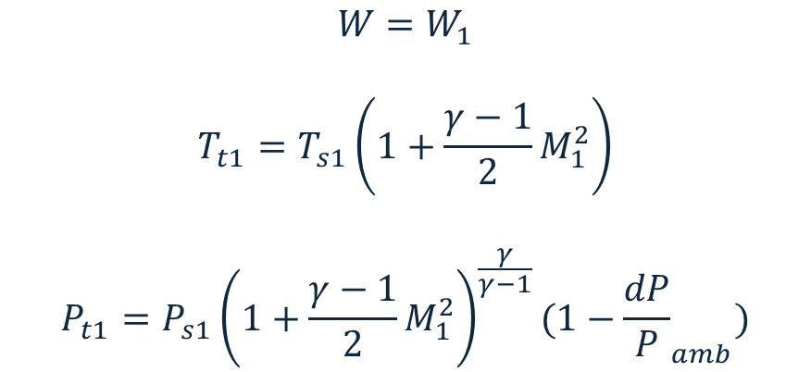
Freestream Air
Station 0
Freestream air is assumed to be a perfect gas with properties following the Standard Atmosphere (1976).
$$W=W_{1}$$
$$T_{t1}=T_{s1}\left(1+\frac{γ−1}{2}M_{1}^{2}\right)$$
$$P_{t1}=P_{s1}{\left(1+\frac{γ−1}{2}M_{1}^{2}\right)}^{\frac{γ}{γ−1}}(1−{\frac{dP}{P}}_{amb})$$

Slide 28
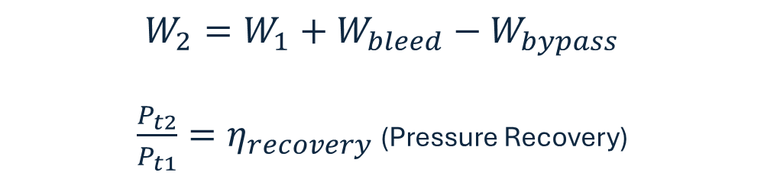
Inlet
Station 1
The engine inlet alters incoming flow for efficient engine performance. Flow speed is increased in subsonic flight and decreased during supersonic flight.
Supersonic flight will cause shockwaves around and within inlet, so design must handle such interactions.
$$W_{2}=W_{1}+W_{bleed}−W_{bypass}$$
$\frac{P_{t2}}{P_{t1}}=η_{recovery}$ (Pressure Recovery)

Slide 29
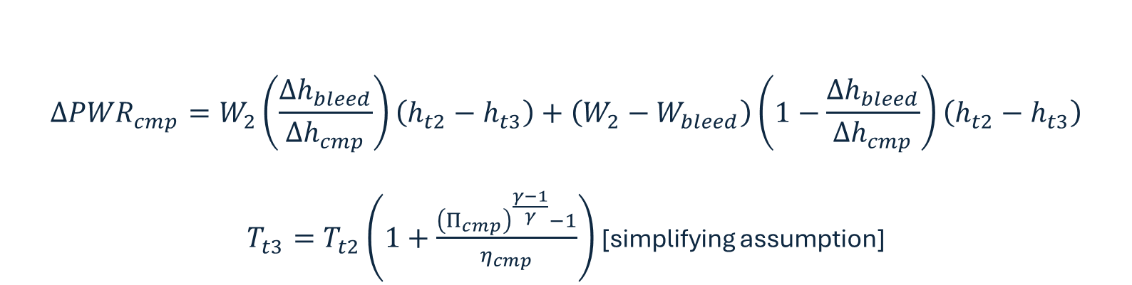
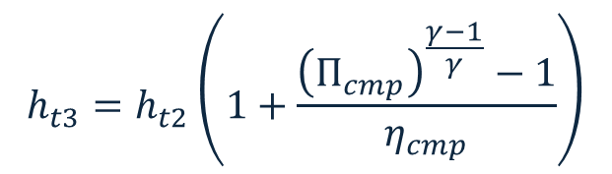
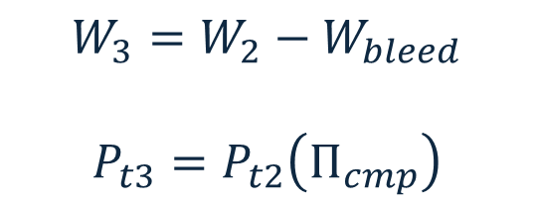
Compressor
Stations 2-3
Compressor rotors add kinetic energy to mass flow increasing total pressure.
Compressor stators slow mass flow increasing static pressure.
$$W_{3}=W_{2}−W_{bleed}$$
$$P_{t3}=P_{t2}\left(Π_{cmp}\right)$$
$$h_{t3}=h_{t2}\left(1+\frac{{\left(Π_{cmp}\right)}^{\frac{γ−1}{γ}}−1}{η_{cmp}}\right)$$
$$ΔPWR_{cmp}=W_{2}\left(\frac{Δh_{bleed}}{Δh_{cmp}}\right)\left(h_{t2}−h_{t3}\right)+\left(W_{2}−W_{bleed}\right)\left(1−\frac{Δh_{bleed}}{Δh_{cmp}}\right)\left(h_{t2}−h_{t3}\right)$$
$T_{t3}=T_{t2}\left(1+\frac{{\left(Π_{cmp}\right)}^{\frac{γ−1}{γ}}−1}{η_{cmp}}\right)$ [simplifying assumption]

Slide 30
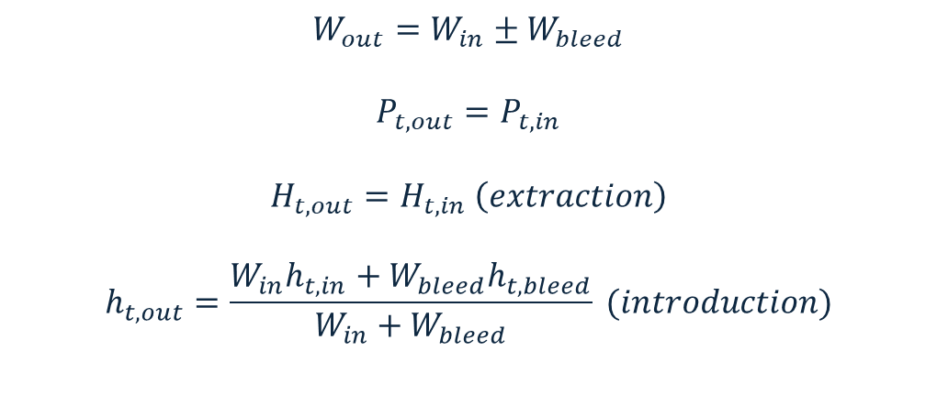
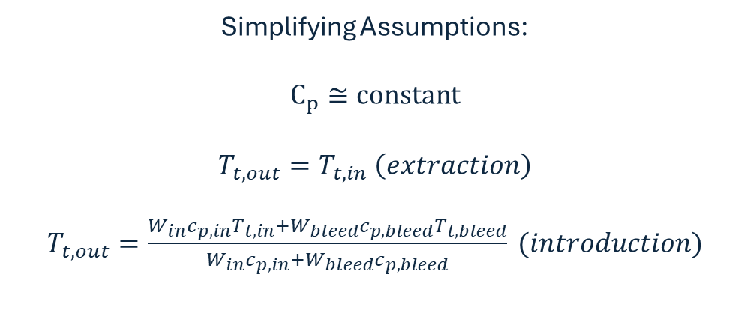
Bleed
Stations B0XX
A duct which extracts flow from the primary flow and/or reintroduces it back into an existing flow stream.
$$W_{out}=W_{in}±W_{bleed}$$
$$P_{t,out}=P_{t,in}$$
$$H_{t,out}=H_{t,in} \left(extraction\right)$$
$$h_{t,out}=\frac{W_{in}h_{t,in}+W_{bleed}h_{t,bleed}}{W_{in}+W_{bleed}} (introduction)$$
Simplifying Assumptions:
$$C_{p}≅constant$$
$$T_{t,out}=T_{t,in} \left(extraction\right)$$
$T_{t,out}=\frac{W_{in}c_{p,in}T_{t,in}+W_{bleed}c_{p,bleed}T_{t,bleed}}{W_{in}c_{p,in}+W_{bleed}c_{p,bleed}} (introduction)$

Slide 31
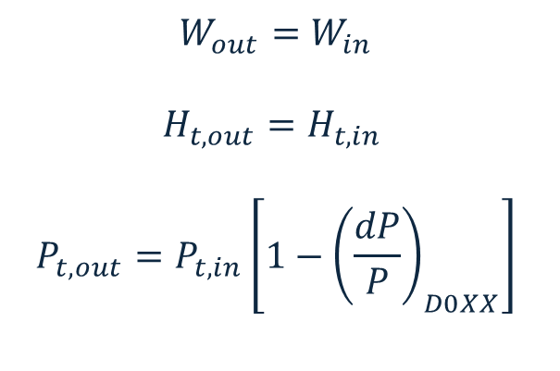

Duct
Stations D0XX
Transfers flow between elements accounting for pressure losses.
$$W_{out}=W_{in}$$
$$H_{t,out}=H_{t,in}$$
$$P_{t,out}=P_{t,in}\left[1−{\left(\frac{dP}{P}\right)}_{D0XX}\right]$$
Simplifying Assumptions:
$$C_{p}≅constant$$
$$T_{t,out}=T_{t,in}$$

Slide 32
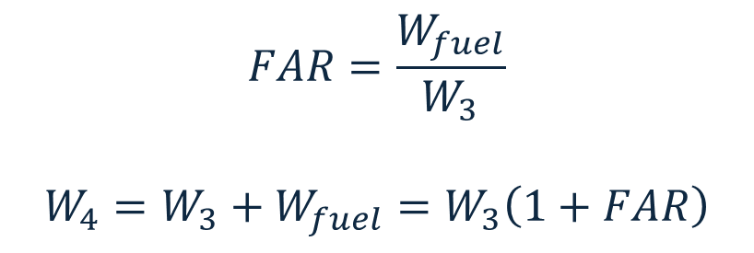
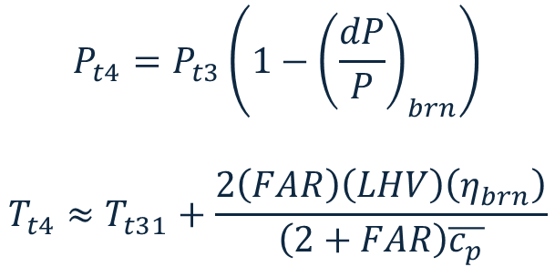
Burner/Combustor
Stations 3-4
The burner adds heat to the air flow by mixing fuel into the flow and combusting the mass flow with an ignition device.
  Typically, the device is electric or pyrotechnic for ignition. After ignition, the burners stay lit in closed loop control.
$$FAR=\frac{W_{fuel}}{W_{3}}$$
$$W_{4}=W_{3}+W_{fuel}=W_{3}\left(1+FAR\right)$$
$$P_{t4}=P_{t3}\left(1−{\left(\frac{dP}{P}\right)}_{brn}\right)$$
$$T_{t4}≈T_{t31}+\frac{2\left(FAR\right)\left(LHV\right)\left(η_{brn}\right)}{\left(2+FAR\right)\overline{c_{p}}}$$

Slide 33
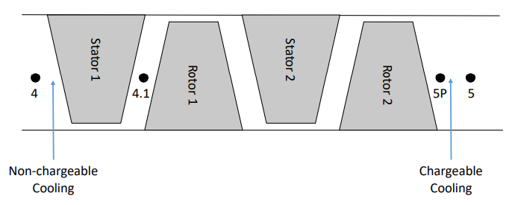
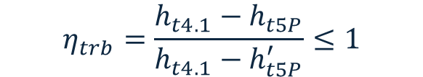
Turbine Overview
Stations 4-5
The turbine extracts work from the flow and converts into mechanical energy as flow expands.
Turbines are connected to compressors via shafts and often generators to produce power.
Non-Chargeable (NC) Cooling
$$η_{trb}=\frac{h_{t4.1}−h_{t5P}}{h_{t4.1}−h_{t5P}^{′}}≤1$$
Chargeable (CH) Cooling
Cooling air flow will be introduced into the turbine, often from ducted from the compressor or splitter upstream.
  Non-chargeable (NC): Cools the air mass flow
  Chargeable (CH): Cools metal

Slide 34
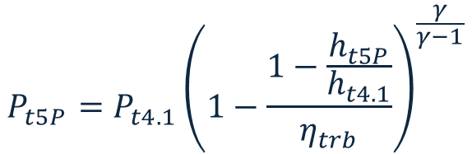
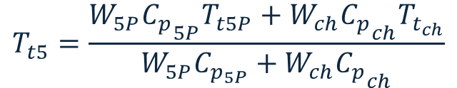
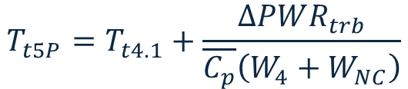
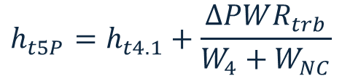
Turbine
Stations 4-5
$$W_{5}=W_{4}+W_{NC}+W_{CH}$$
$$ΔPWR_{trb}=−ΔPWR_{cmp}−ΔPWR_{shaft}−HPX=(W_{4}+W_{NC})(h_{t4.1}−h_{t5P})$$
$$h_{t5P}=h_{t4.1}+\frac{ΔPWR_{trb}}{W_{4}+W_{NC}}$$
$$T_{t5P}=T_{t4.1}+\frac{ΔPWR_{trb}}{\overline{C_{p}}\left(W_{4}+W_{NC}\right)}$$
$$P_{t5P}=P_{t4.1}{\left(1−\frac{1−\frac{h_{t5P}}{h_{t4.1}}}{η_{trb}}\right)}^{\frac{γ}{γ−1}}$$
$$T_{t5}=\frac{W_{5P}{C_{p}}_{5P}T_{t5P}+W_{ch}{C_{p}}_{ch}T_{t_{ch}}}{W_{5P}C_{p_{5P}}+W_{ch}{C_{p}}_{ch}}$$
- Subscript “P” denotes state before chargeable cooling

Slide 35
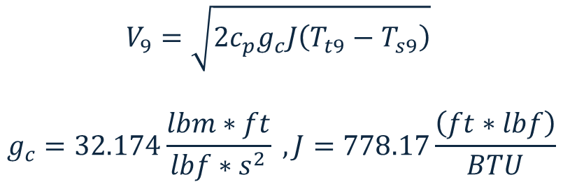
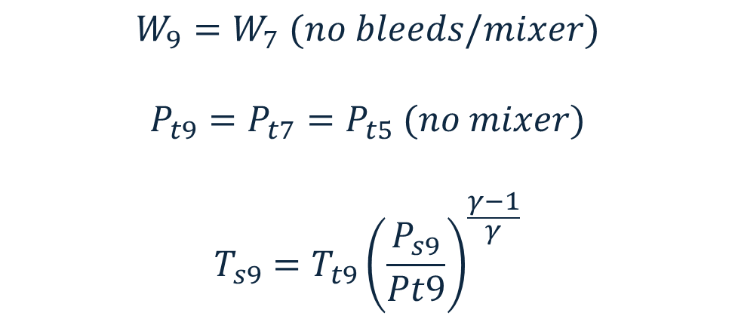
Nozzle
Stations 7-9
The nozzle expands or contracts to change exit velocity air and produce thrust.
$$W_{9}=W_{7} (no bleeds/mixer)$$
$$P_{t9}=P_{t7}=P_{t5} (no mixer)$$
$$T_{s9}=T_{t9}{\left(\frac{P_{s9}}{Pt9}\right)}^{\frac{γ−1}{γ}}$$
$$V_{9}=\sqrt{2c_{p}g_{c}J\left(T_{t9}−T_{s9}\right)}$$
$$g_{c}=32.174\frac{lbm∗ft}{lbf∗s^{2}} , J=778.17\frac{\left(ft∗lbf\right)}{BTU}$$

Slide 36
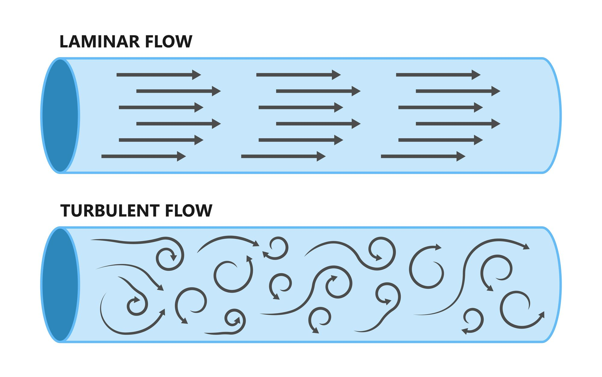
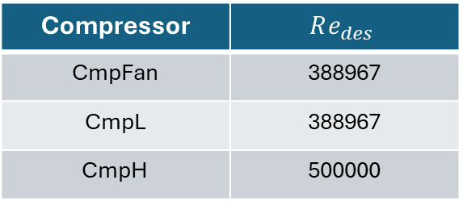
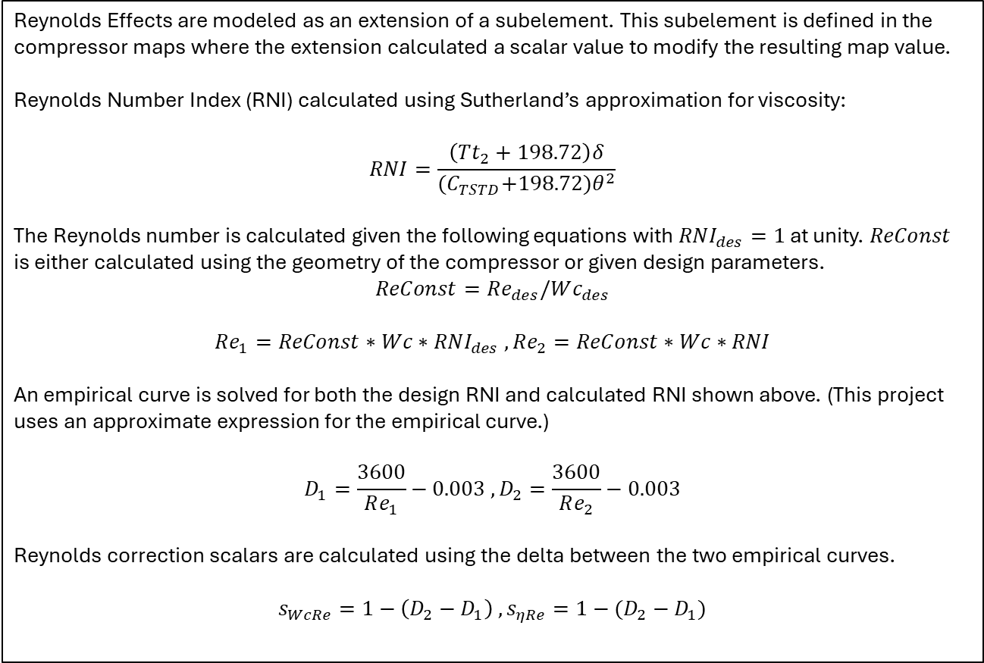
NPSS Model Architecture
Reynolds Effects (Compressor)
Reynolds Effects are modeled as an extension of a subelement. This subelement is defined in the compressor maps where the extension calculated a scalar value to modify the resulting map value.
Reynolds Number Index (RNI) calculated using Sutherland’s approximation for viscosity:
$$RNI=\frac{\left(Tt_{2}+198.72\right)δ}{{(C}_{TSTD}+198.72)θ^{2}}$$
The Reynolds number is calculated given the following equations with $RNI_{des}=1$ at unity. $ReConst$ is either calculated using the geometry of the compressor or given design parameters.
$$ReConst=Re_{des}/Wc_{des}$$
$$Re_{1}=ReConst∗Wc∗RNI_{des} , Re_{2}=ReConst∗Wc∗RNI$$
An empirical curve is solved for both the design RNI and calculated RNI shown above. (This project uses an approximate expression for the empirical curve.)
$$D_{1}=\frac{3600}{Re_{1}}−0.003 , D_{2}=\frac{3600}{Re_{2}}−0.003$$
Reynolds correction scalars are calculated using the delta between the two empirical curves.
$$s_{WcRe}=1−\left(D_{2}−D_{1}\right) , s_{ηRe}=1−(D_{2}−D_{1})$$
Compressor | $$Re_{des}$$
CmpFan | 388967
CmpL | 388967
CmpH | 500000
Although Reynolds effects were not explicitly included in this project, process shown to demonstrate how implementation might occur.

Slide 37
NPSS Model Architecture
Reynolds Effects (Turbine)
Reynolds effects for the turbine are modeled using sockets nested within classes that extends turbine subelement.
TrbH Element (.mdl)
TurbineNeppMap_mod (S_map) → TurbineEfficiencyMap (class)
  Calculates inputs for nested sockets (S_eff, S_TurbRe)
  TurbineEfficiencyMap (S_eff)
    Calculates efficiency based on Nc, Wc, PR
  TurbineReynoldsEffects_mod (S_TurbRe) → TurbineReynoldsEffects_mod (class)
    Performs calculations for corrections based on Reynolds number.

