Slide 1
How Predictable Is March Madness?
Analyzing Upsets & Seed Performance in the NCAA Tournament
Connor Correnti • Andrew Lynch • Mike Zeghibe
CSC 485 | Spring 2026 | NCAA Tournament Data 2008–2025
Data: NCAA Tournament Historical Results (Kaggle) | ~1,070 games | Tools: R, ggplot2, dplyr

Slide 2
Agenda
01
Background & Research Question
Why March Madness? Why does it matter?
02
Win % by Seed
Do higher seeds really win more?
03
Upset Frequency by Round & Matchup
Which matchups and rounds are most chaotic?
04
Trends Over Time & NIL Era Impact
Has the tournament gotten less predictable?
05
Statistical Deep Dives
ANOVA, seed importance, and bracket chaos
06
Conclusion
How predictable is March Madness?

Slide 3
Background & Research Question
March Madness draws 100M+ viewers annually with billions wagered on brackets
Research Question
1
"How predictable is March Madness, and have upset rates changed over time?"
2
68 teams seeded 1–16 compete in a single-elimination format across 6 rounds
3
Higher seeds (lower numbers) should win — but frequently don't
Which seed matchups produce the most upsets?
4
Perfect brackets are essentially impossible due to frequent upsets
Which round is most chaotic?
Have upset rates changed over time?
Does seeding matter as much in later rounds?

Slide 4
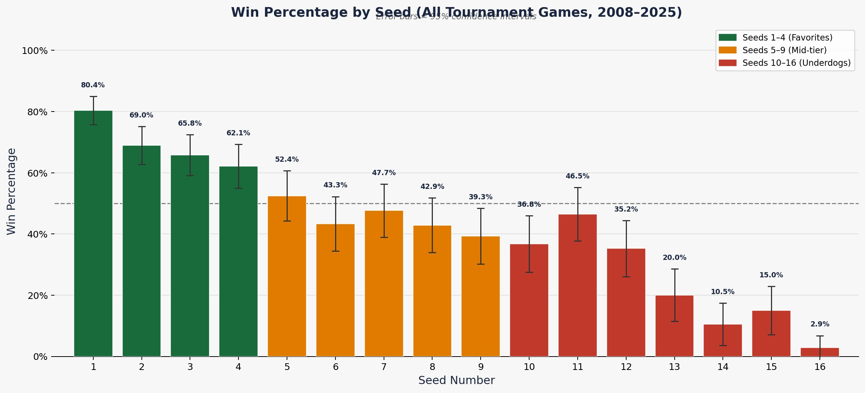
Finding 1: Win % by Seed
80.4%
1-seed win rate
Highest in tournament
62.1%
4-seed win rate
Floor of 'top tier'
46.5%
11-seed win rate
Nearly a coin flip
Seeds 1–4 consistently dominate (62–80% win rate). Seeds 5–12 are far less predictable — Seed 11 wins nearly half its games.

Slide 5
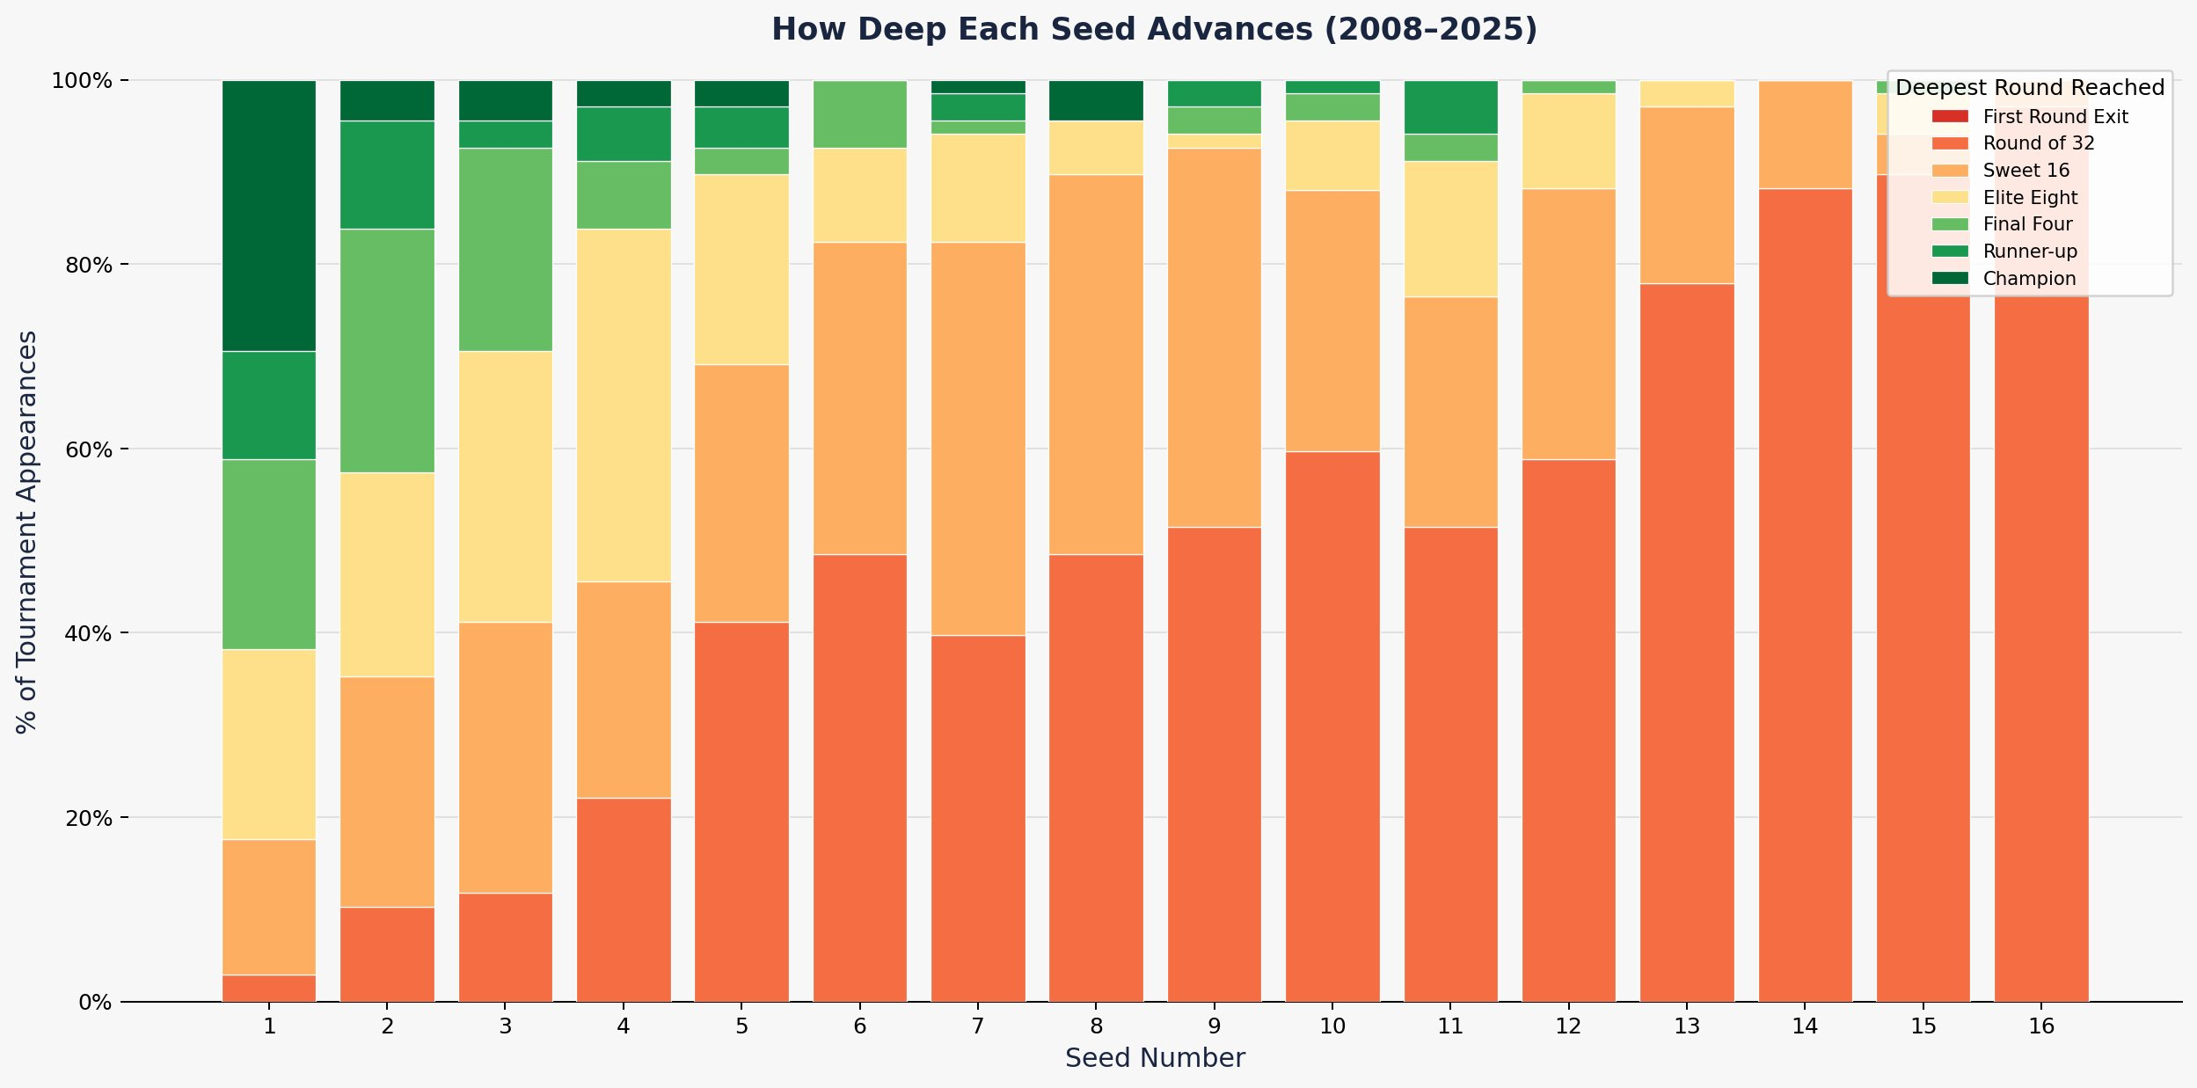
Finding 1b: How Deep Each Seed Advances
1-seeds reach the Final Four ~40% of the time. Seeds 11–12 occasionally reach the Elite Eight, confirming the volatility of mid-range matchups.

Slide 6
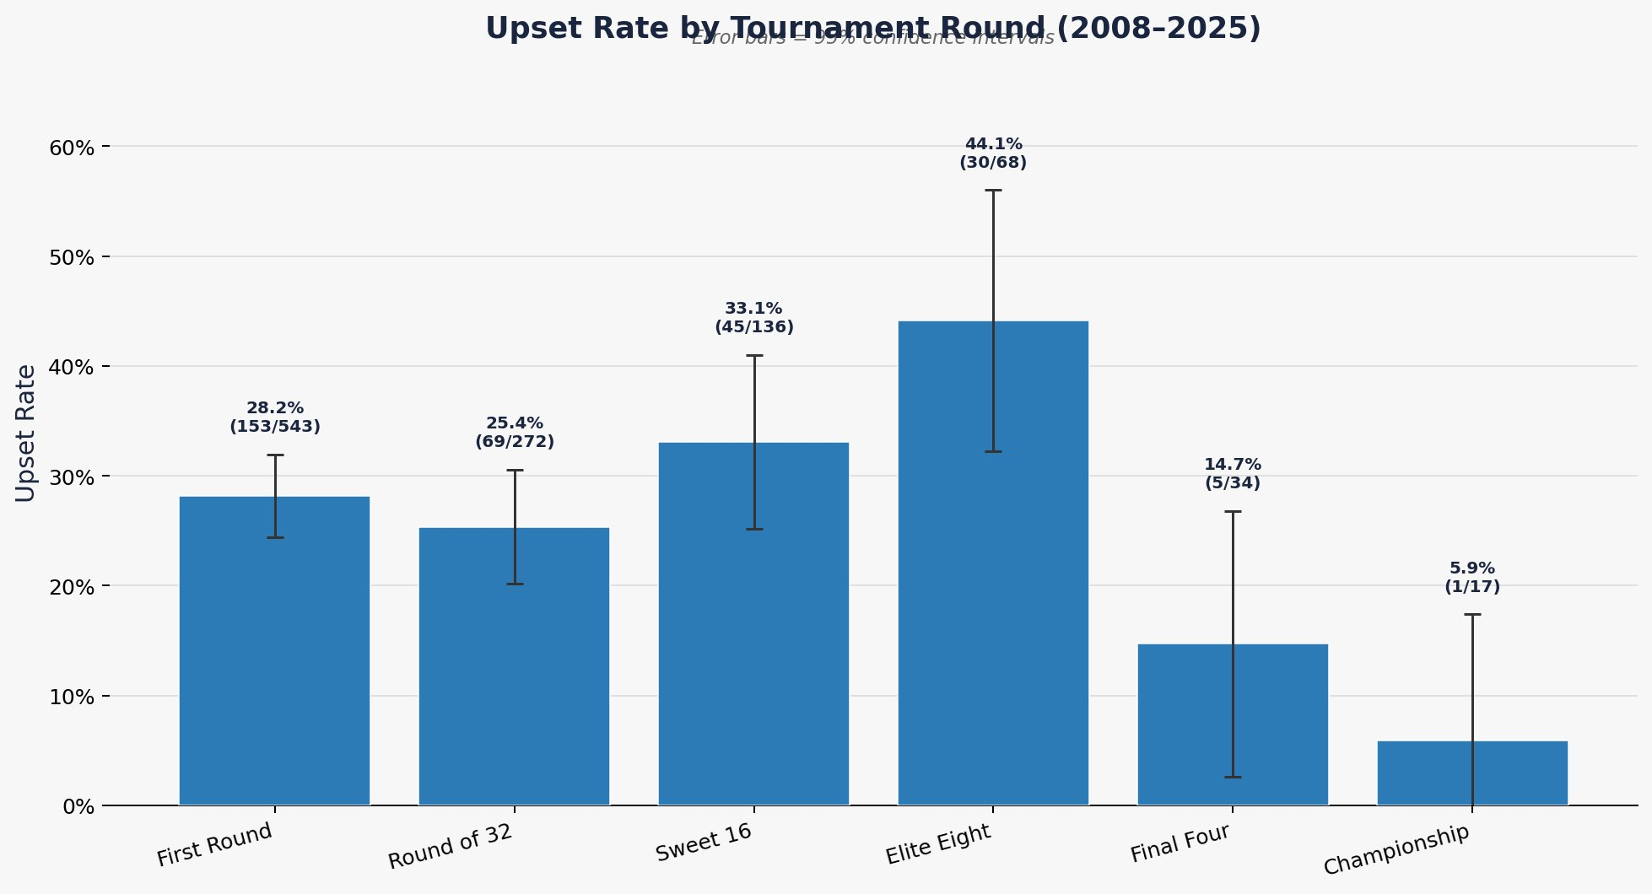
Finding 2: Upset Rate by Tournament Round
44.1%
Elite Eight
Highest upset rate — all remaining teams are proven winners
28.2%
First Round
Most total upsets (153) due to sheer volume of games
5.9%
Championship
Favorites dominate the final stage

Slide 7
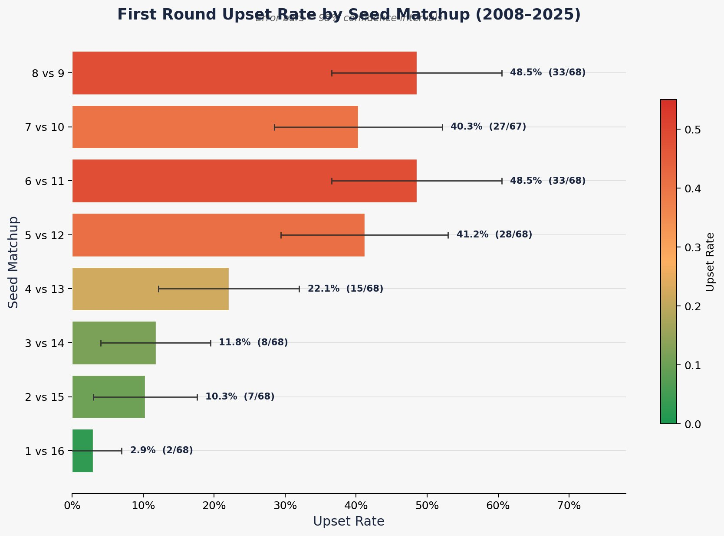
Finding 2b: First Round Upset Rate by Matchup
Most Volatile Matchups
6 vs 11
48.5%
Essentially a coin flip
8 vs 9
48.5%
Near-random outcome
5 vs 12
41.2%
Classic Cinderella territory
7 vs 10
40.3%
Highly unpredictable
4 vs 13
22.1%
Occasional upset risk
1 vs 16
2.9%
Strongest chalk in bracket

Slide 8
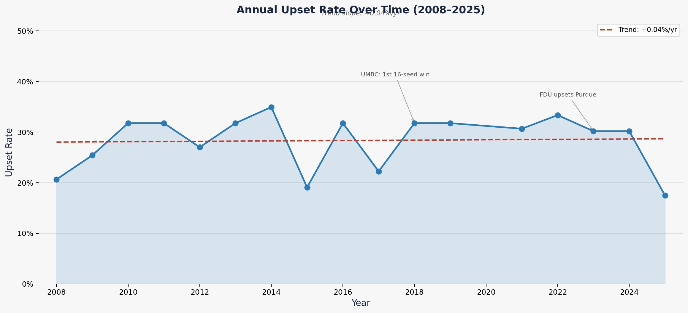
Finding 3: Upset Rate Over Time (2008–2025)
Trend slope: +0.04%/yr (p = 0.883 — not significant)
Range: ~17%–35%
2025 lowest in 20 years

Slide 9
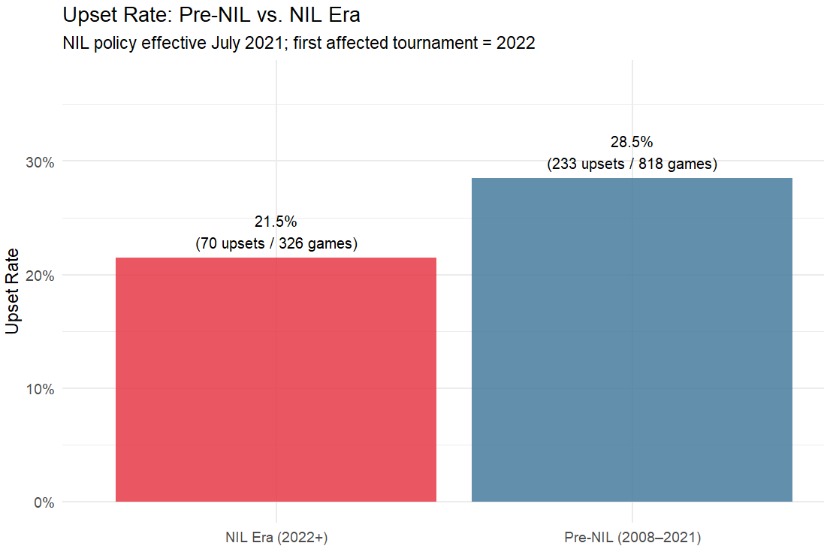
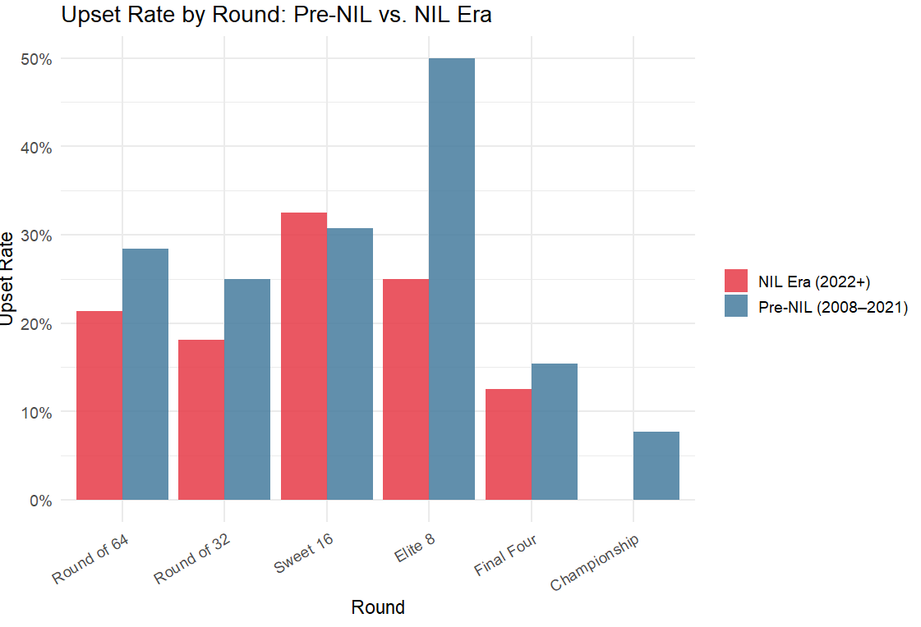
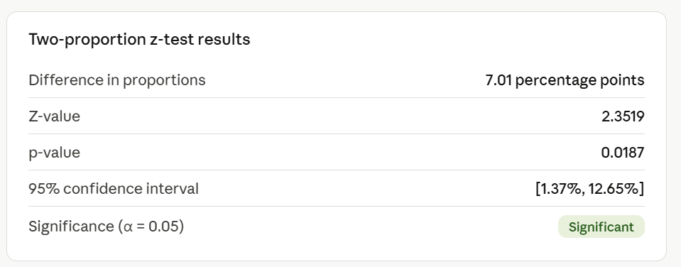
Finding 3b: NIL Era vs. Pre-NIL Upset Rates
NIL Era (2022+): 21.5% upset rate vs. Pre-NIL (2008–2021): 28.5%. The NIL era shows lower upset rates across nearly every round — top programs may be better at retaining star talent.

Slide 10
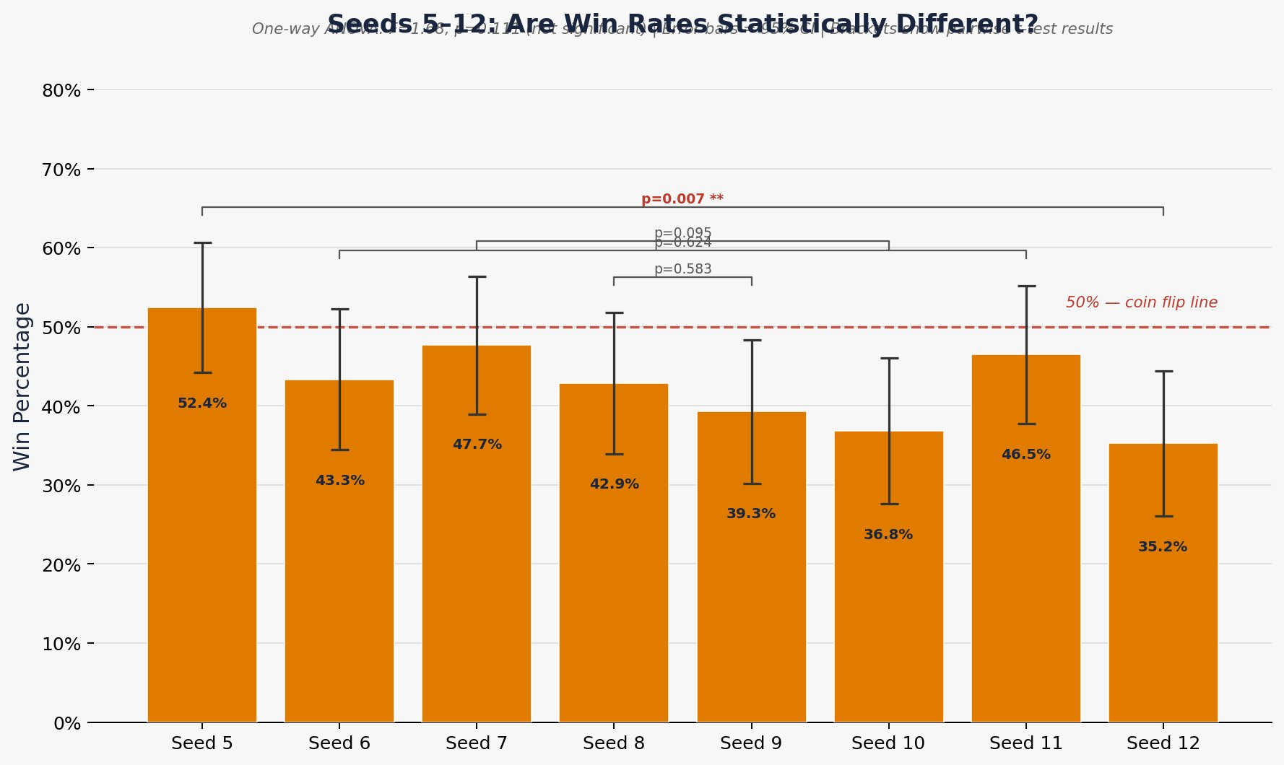
Statistical Deep Dive: Are Seeds 5–12 Actually Different?
ANOVA Results
Seed 5 vs 12
p = 0.007 **
SIGNIFICANT
Seed 6 vs 11
p = 0.623
Not significant
Seed 7 vs 10
p = 0.094
Borderline
Seed 8 vs 9
p = 0.583
Not significant

Slide 11
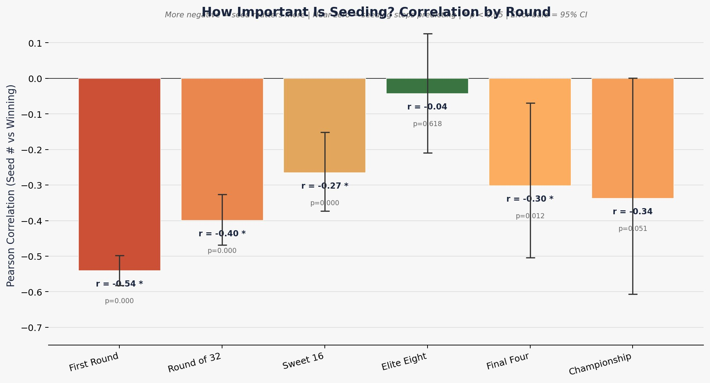
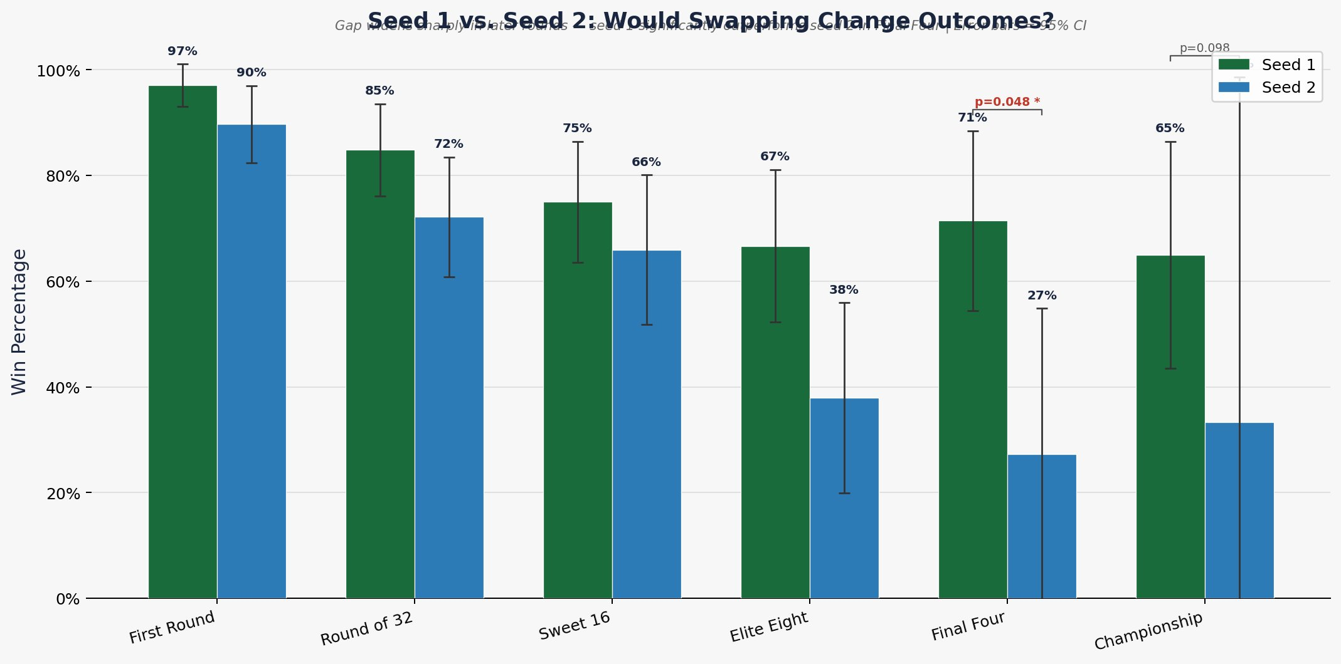
Statistical Deep Dive: Seeding Importance & Seed 1 vs. Seed 2
Seeding importance weakens as the tournament progresses — r = –0.54 in Round 1 drops to –0.04 in the Elite Eight (not significant), then recovers slightly in the Final Four and Championship.
Seed 1 vs. Seed 2 gap is statistically significant only in the Final Four (p = 0.048). At the Championship, the gap widens numerically (65% vs. 33%) but remains non-significant (p = 0.098) due to small sample size.

Slide 12
Real-World Examples That Align With the Data
16
2018
16
2023
15
2022
UMBC over Virginia
FDU over Purdue
Saint Peter's → Elite Eight
First-ever 16-seed win in tournament history
Only the second 16-seed victory ever
Deepest run by a 15-seed ever
11
2018
11
2024
Loyola Chicago → Final Four
NC State → Final Four
Sister Jean became a national story
Won 5 consecutive elimination games

Slide 13
Conclusion: How Predictable Is March Madness?
Partially Predictable at the Top
✓
Seeds 1–4 win 62–80% of games. Bracket structure genuinely reflects team quality.
Highly Volatile in the Middle
✗
Seeds 5–12 produce 40–48% upset rates. 6 vs 11 and 8 vs 9 are essentially coin flips.
Round Matters Most
↑
Elite Eight: highest upset rate (44.1%). Championship: most predictable (5.9%). Chaos peaks mid-tournament.
No Significant Time Trend
~
Upset rates fluctuated 17–35% since 2008 with no statistically significant trajectory.
"March Madness is partially predictable at the extremes — but fundamentally chaotic in the middle rounds where games are decided."

