Slide 1
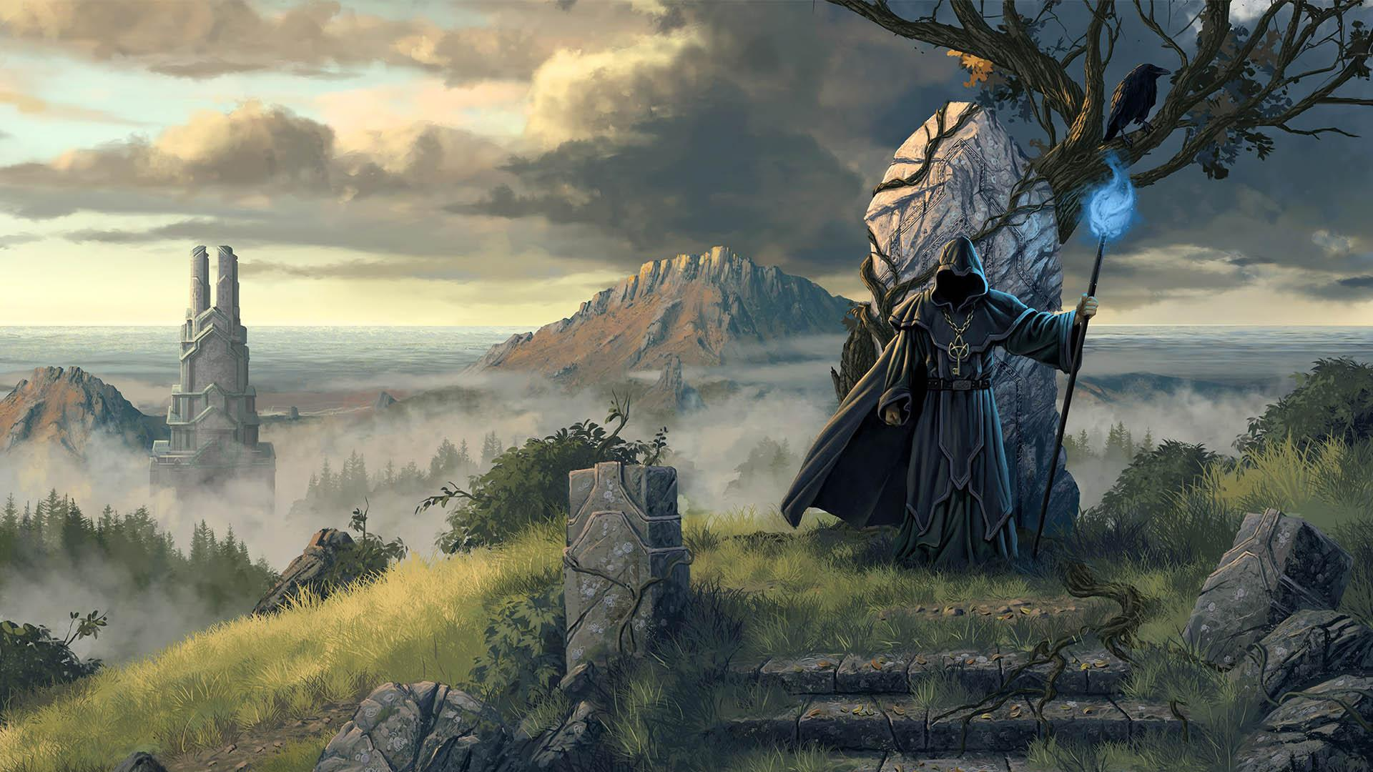
Almageddon
By: Connor Davenport
*Please refer to the notes of each slide for a more in-depth description of what is being depicted*
Notes:
Greetings traveler, and welcome to Almageddon, the Card Game! For centuries, the Magus Court has held the tradition of the annual wizard games! You have been cultivating the power of the natural elements for years now, and it is finally time to test your strength. Will you succumb to the power of your foes, or will you emerge victorious and become the Champion Wizard in this years competition?

Slide 2
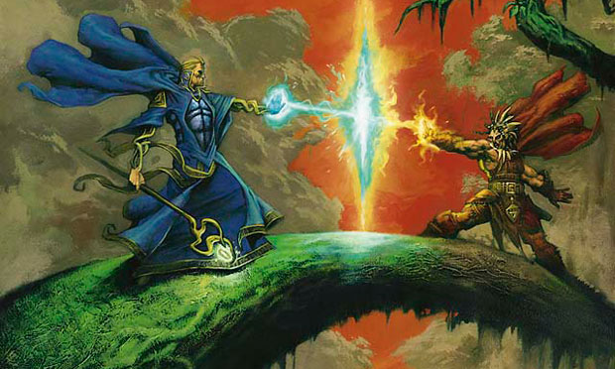
5 card hands
5 card hands
Life Points: 5,10,20
Life Points: 5,10,20
20,40,80 cards in decks
20,40,80 cards in decks
Notes:
Almageddon is a card game that requires you to strategically play your cards in order to damage your opponent and bring their life points to zero. So far, the game is a player (you) vs. a computer who plays cards each turn at random. There are three different game lengths that can effect the strategy to which you play, that vary by changing the life points and deck sizes. Each player will start the game with 5 cards in hand. Both players play 2 cards at the same time, and the elements will deal damage depending on whether they are countered or not. Each player will then draw 2 cards from their deck to replenish their hand to 5, and repeat. Rules on how the elements/spells interect will be described on the next slide.

Slide 3



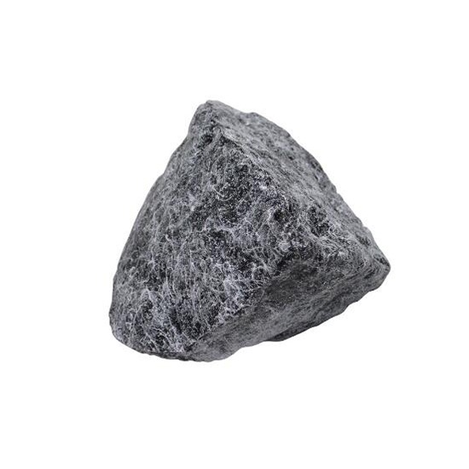
Defends Against:
Fire
Water
Earth
Wind
Notes:
Similar to the classic game rock, paper, scissors, some of the cards that you play will counter others. Rather than an element defeating another, however, an element that counters another will simply negate the damage of the spell. The diagram depicts the a basic counter chart. Water negates the damage of fire, fire negate the damage of earth, earth negates the damage of wind, and wind negates the damage of water.

Slide 4
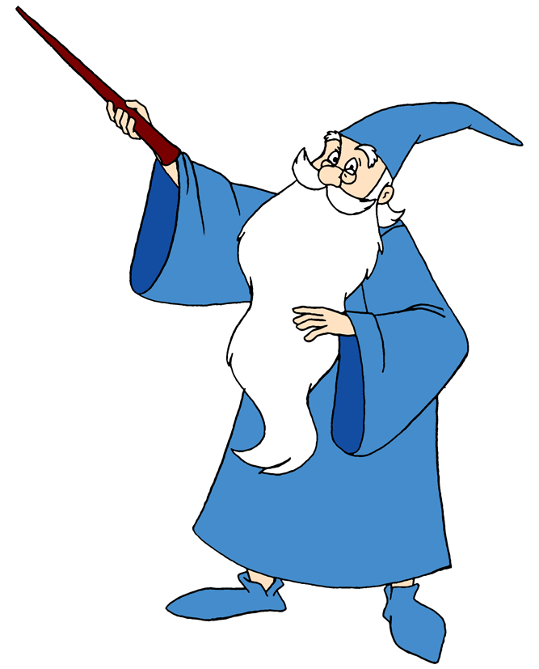
Spells and their counters
Spells:
Fireball (Fire)
Hydroblast (Water)
Rockslide (Earth)
Gust (Wind)
Ice Beam (Water + Earth)
Lightning Strike (Fire + Wind)
Typhoon (Wind + Water)
Steam Blast (Water + Fire)
Lava Burst (Earth + Fire)
Tornado (Earth + Wind)
Counters to each Element:
2,5,7,8
4,6,7,10
1,6,8,9
3,5,9,10
4,6,7,10,1,8,9
2,5,7,8,3,9,10
3,5,9,10,4,6,7
4,6,7,10,2,5,8
1,6,8,9,2,5,7
1,6,8,9,3,5,10
Notes:
The list to the left includes the different cards that can be drawn from your deck, with the element type in parenthesis next to it. The list to the right includes the spells that counter the particular spell in the same row. For instance; Fireball gets countered by Hydroblast (spell 2), Ice Beam (spell 5), Typhoon (spell 7), and Steam Blast (spell 8). The term counter in the context of the game means that all damage that spell can deal is negated. Another detail to notice is that some spells have a higher chance to be countered due to the fact that they are a combination of two elements. Because of this, the first four spells (Fireball, Hydroblast, Rockslide, and Gust) only deal 1 damage. The Other 6 spells (Ice Beam, Lightning Strike, Typhoon, Steam Blast, Lava Burst, and Tornado) deal 2 damage each if they land a successful hit. The strategy for the game then becomes knowing how to get the damage in, whether it be saving up one of a particular type of elemental type, and when to play defensively by tring to play as many element types to block your opponents on coming attacks.

