Slide 1
Imperial Credit Predictions
How accurately can we predict the monthly imperial credits?
Ryan Brennan, Connor Davis, John Moore

Slide 2
Data
40 years of monthly imperial credit data
Each data point represents a month within a year
How accurately can we predict the next year worth of Imperial Credits?

Slide 3
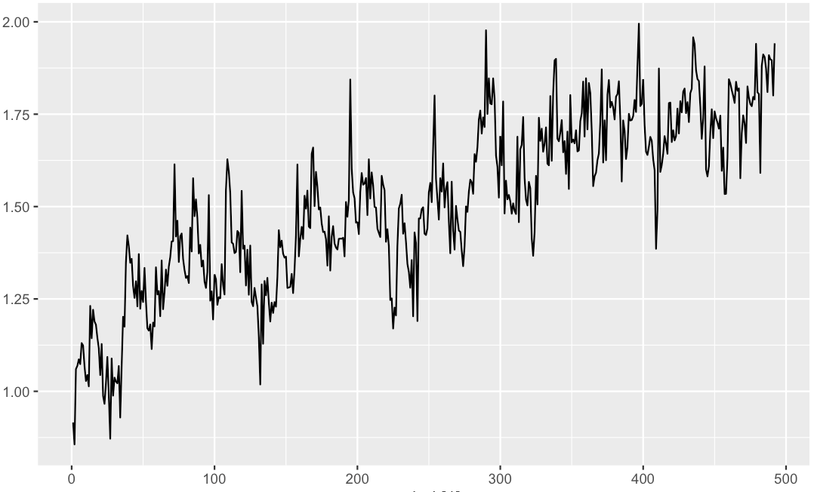
Monthly Credits in Millions
Credits have steadily increased over time
Not much correlation between the months
No real seasonality in our model
Plenty of variation over time
Could have a good month (or bad) at any time
Imperial Credits (In millions)
Monthly Data
(Each period represents a month)

Slide 4
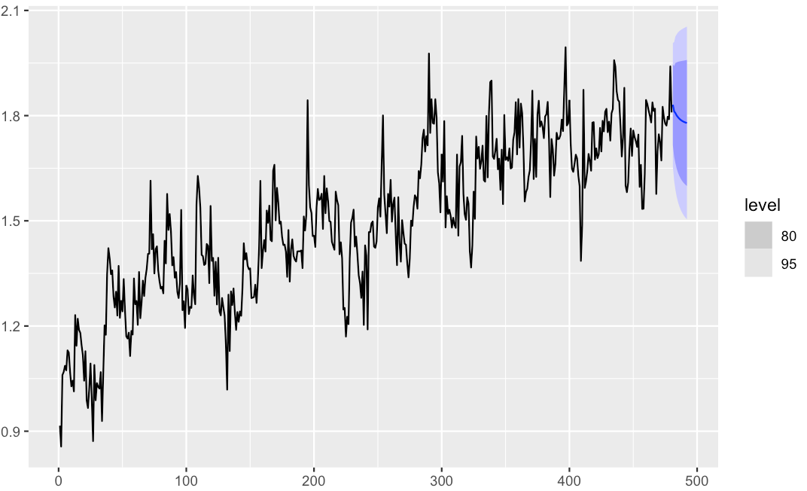
Forecast of Monthly Credits
Expect the credits to decrease over the next 12 periods (1 Year)
Even though we see a positive trend over time, we expect credits to decrease over the next year
Imperial Credits (In millions)
Monthly Data
(Each period represents a month)

Slide 5
Conclusions
Our training model predictions were roughly .113 (in millions) off from our real data
1
Our Credits are steadily increasing over time
2
Over the next year we expect our Imperial credits to decrease
3

Slide 6
Questions?
Thank you for your time!

