Slide 1
AI Autocomplete
Connor Brown
CSPB 4830 – Natural Language processing
Spring 2025

Slide 2
Problem Overview
Building an application for autocompletion of written text
Autocomplete increasingly relevant in digital communication
Benefits: Faster typing, improve accuracy, reduced errors
Assists in structuring documents more effectively

Slide 3
Motivation and Goals
Objective: Create an AI application capable of accurately predicting and finishing user text
Specific Goals:
Achieve word level accuracy of at least 15%
Generate text completions that are contextually appropriate

Slide 4
Dataset Description
OpenAI’s WebText corpus: collection of web documents
Working with 10,000 document subset due to computational constraints
No cleaning or preprocessing – want to maintain authentic language patterns
Ideally use 80/20 split for training/testing

Slide 5
Approach Overview
Main model used: GPT-2 (Generative Pre-trained Transformer)
Fine-tuning pre-trained model rather than training from scratch
Create two general systems: Trainer and Evaluator

Slide 6
Tools and Techniques
Model: GPT-2
Google Firebase Studio with Nix environment
Key Libraries:
Datasets (data loading and processing)
NLTK & Rouge_Score (evaluation metrics)
NumPy & Scikit-Learn (data manipulation)
PyTorch (underlying ML framework)
Transformers (for model implementation)

Slide 7
Experiments and Analysis
Initial Approach: Multifile Object-Oriented design
Failed due to computational resources limitations
Revised Approach: Simplified application design
Two core modules: trainer and evaluator
Training Parameters:
Batch size: 4-8
Epochs: 1-3
Dataset: 1000 samples from Webtext
Training time: ~2 hours on available hardware

Slide 8
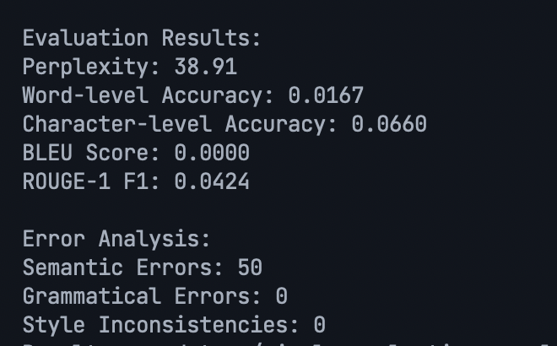
Results
Model performs below expectations, likely due to:
1. Limited training data
2. Insufficient training epochs
3. Memory/time constraints

Slide 9
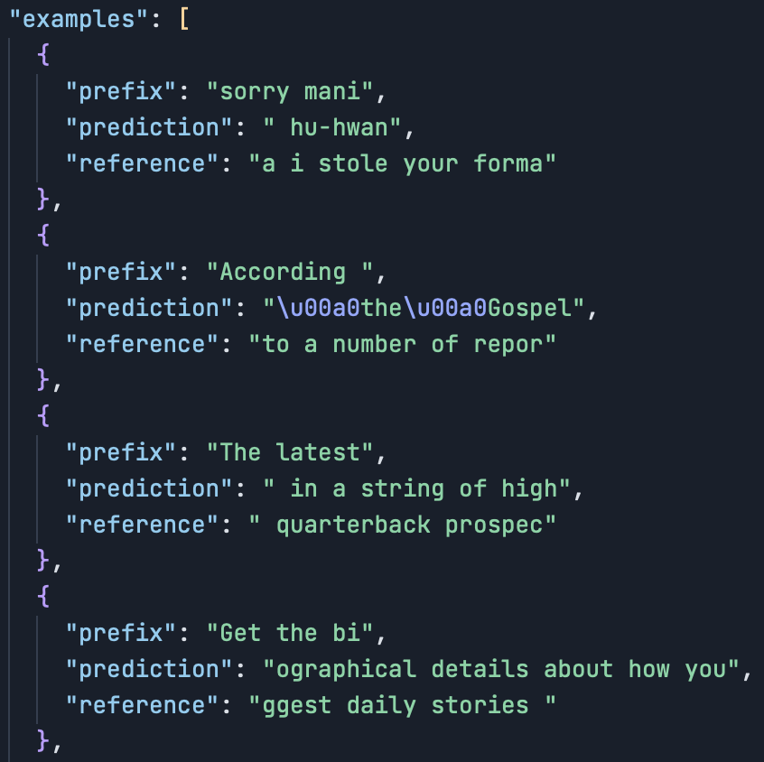
Examples

Slide 10
Challenges and Lessons Learned
Challenge 1: Writing code with AI assistance
Requires careful review – less at a time is better
Challenge 2: Debugging AI-written code
Tracing unusual/incomplete implementation patterns
Challenge 3: Development Limitations
No GPU access, memory constraints
Lessons Learned: ML is CPU-intensive and use AI carefully
Start simple and scale up

Slide 11
Conclusion and Future Work
Project is on right track - just needs more resources
Next steps:
Work in GPU-enabled environment for faster training
Scale to larger datasets (full WebText corpus)
Increase model size and training duration
Future work:
Implement a GUI for interactive testing

