Slide 1
Attrition Data Analysis
Findings and Recommendations
Analysis by: Connor Dobbs
Notes:
Employees don’t leave companies, they leave people

Slide 2
Agenda
Trends in Turnover, Income, Job Roles
Predicting Attrition
Recommendations and Next Steps

Slide 3
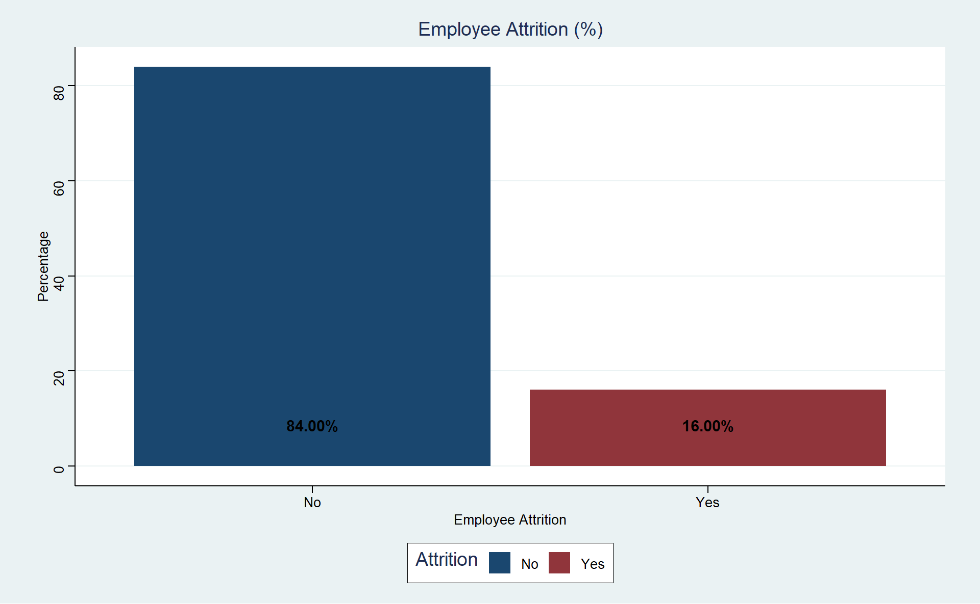
Attrition
Overall attrition rate is 16%

Slide 4
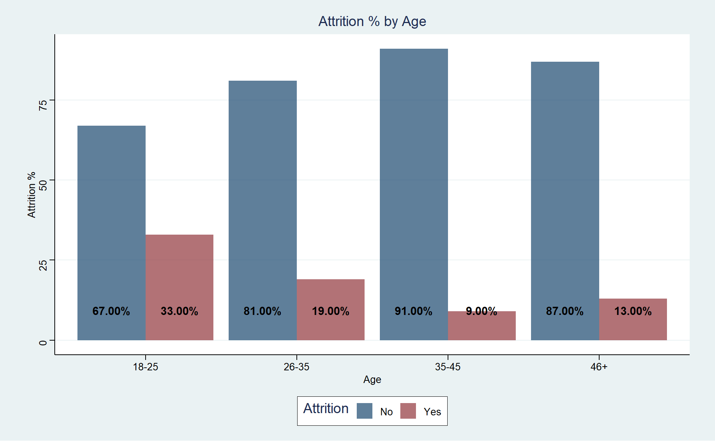
Attrition - Generation
Early Career Professionals more than double the average

Slide 5
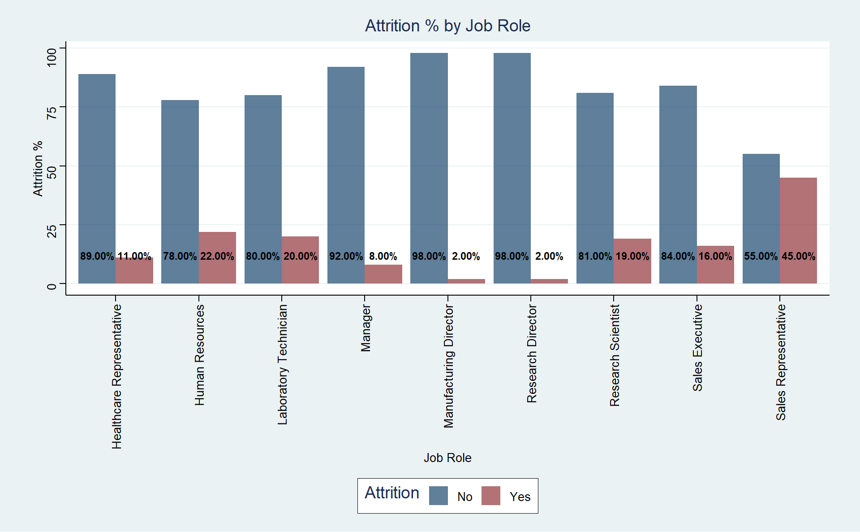
Attrition – Job Roles
Sales Reps with almost triple the average rate at 45%
Directors with a remarkably low turnover rate

Slide 6
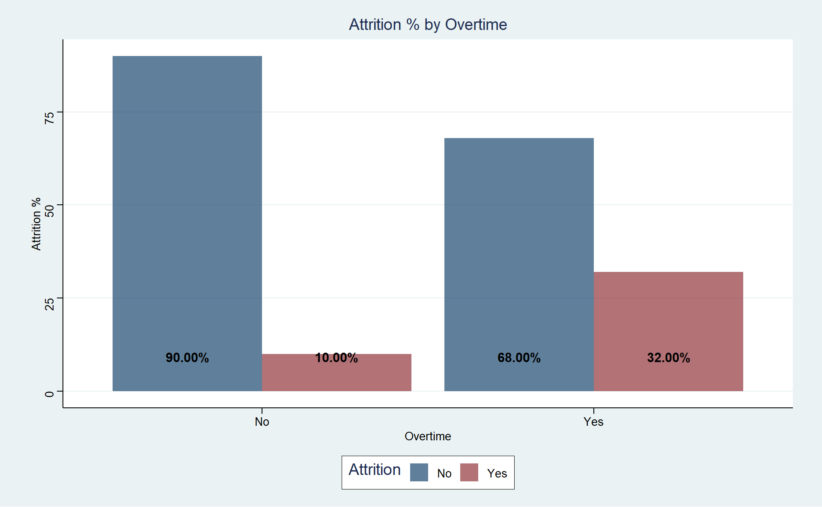
Attrition – Exempt Status
Non-Exempt employees double average attrition with 32% turnover

Slide 7
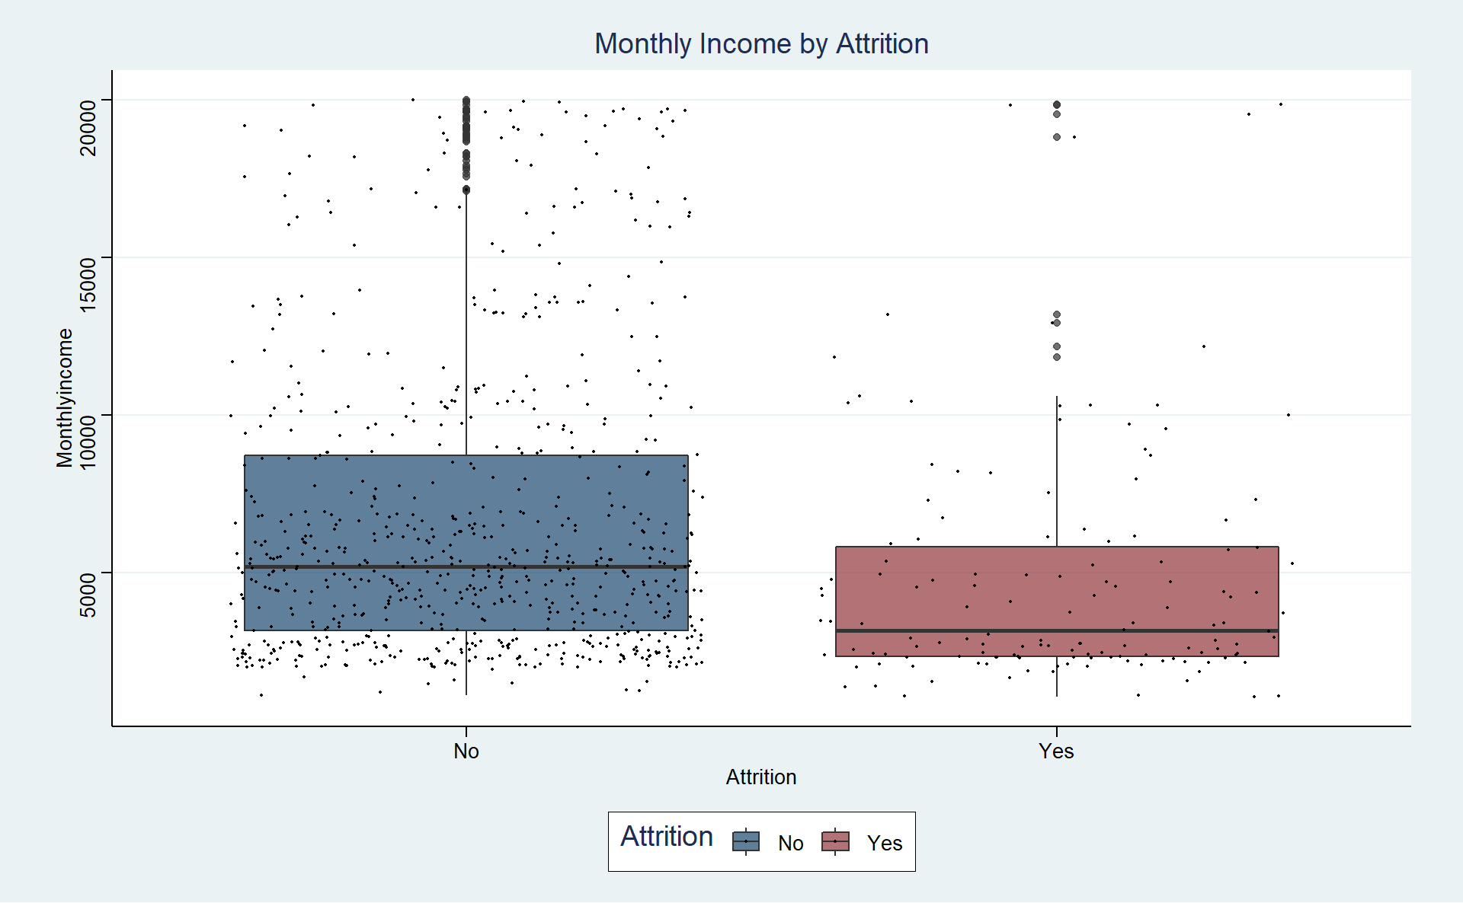

Attrition – Income
Min and Max salaries similar between two groups
However, density is much lower in the higher income brackets for those who leave
Average monthly income for those who leave the company ~$2000 less than those who have stayed
Statistically significant difference (p-value < .0001 for 95% CI t-test)

Slide 8
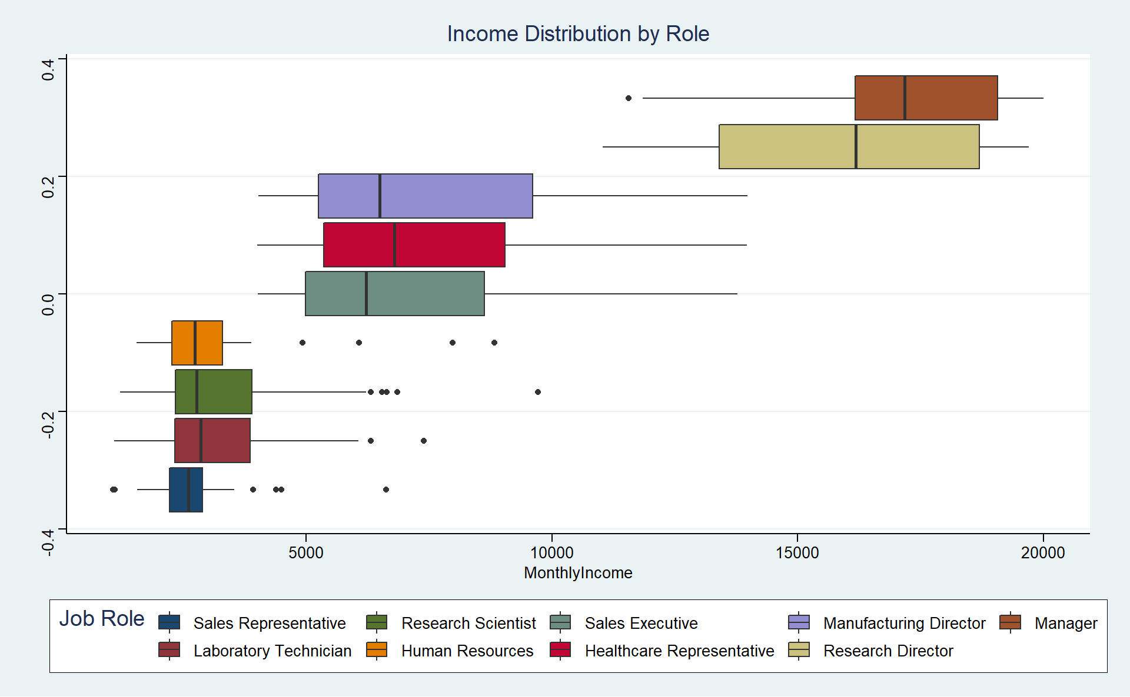
Income Prediction
~94% of variability in income explained can be explained by changes in Job Role and Job Level
Work experience and business travel contribute to where in these “brackets” someone falls
Note Sales Reps in the lowest income bracket
RMSE < $1000 with linear regression on these variables

Slide 9
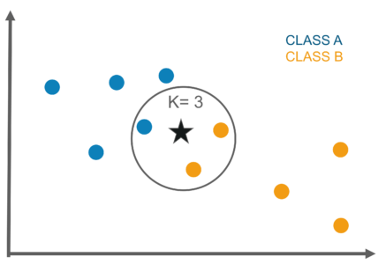
Prediction
Able to identify those who left the company with 80% specificity
Overall accuracy was about 88%
Goal for model was to optimize ability to identify attrition risk employees
Done by comparing them to other employees who were most similar (KNN method)

Slide 10
So, what next?
Investigate role specific turnover trends, particular sales reps
Improve retention strategy for early career professionals
Provide more flexibility in ability to reward high performing employees with job level or role improvements (income) without restricting by age/experience
Skill growth opportunities, work-life balance, and inclusive cultures identified by Pew Research as other strong drivers for younger members of the workforce
Use KNN model to identify attrition risk employees

Slide 11
Questions?
Additional questions can be directed towards
dobbs@smu.edu
Github Documentation:
https://github.com/connordobbs/CaseStudy2DDS
YouTube Presentation:
https://youtu.be/1VtWZ5UeXA4

Slide 12
Sources
Logos from:
https://www.fritolay.com/
Research on youth employee trends by HBR citing Pew Research Center:
https://hbr.org/2020/06/what-your-youngest-employees-need-most-right-now
KNN Example Picture:
https://www.edureka.co/blog/k-nearest-neighbors-algorithm/

