Slide 1
God Knows How
to Reach You
Connor Frey
Notes:
[Title up while you walk up.]

Slide 2
“Let the redeemed of the LORD
tell their story.”
PSALM 107:2
Notes:
[Read Psalm 107:2.] “Let the redeemed of the LORD tell their story.” That’s what I’m here to do tonight.

Slide 3

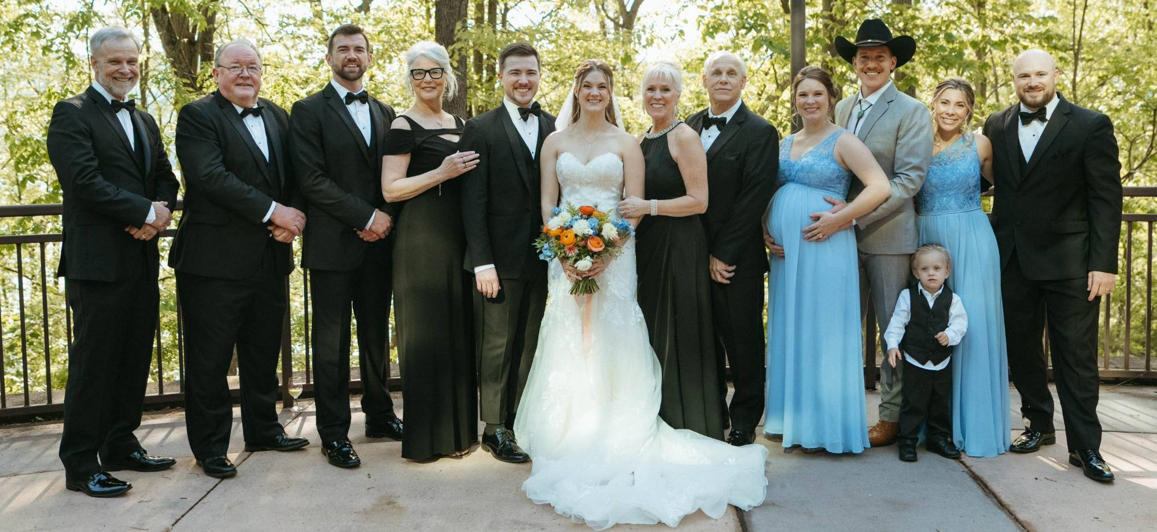








Hi, I’m Connor
Supply chain consultant
I solve network design problems
How many facilities? How big? Where?
Online since May 2024
In person since Feb 2025
Came because Skylar did
Sunday Night coordinator since June 2026
Notes:
Hey guys, I’m Connor. I grew up in Maplewood, New Jersey, and now I live in Fairfax. Skylar and I met at Stevens, stayed friends for years, started dating in April 2024, and got married this May. I’ve got one brother, Spencer, out in California.
I started watching Grace online in May 2024, because Skylar had been coming here, and I came in person the next February. This June I became the Sunday Night Service Coordinator.
By day I’m a supply chain consultant at St. Onge. I help companies figure out how many facilities they need, how big, and where. Off the clock: ukulele, Minecraft, D&D, Star Wars, lifting, and time at Beaver Lake.

Slide 4
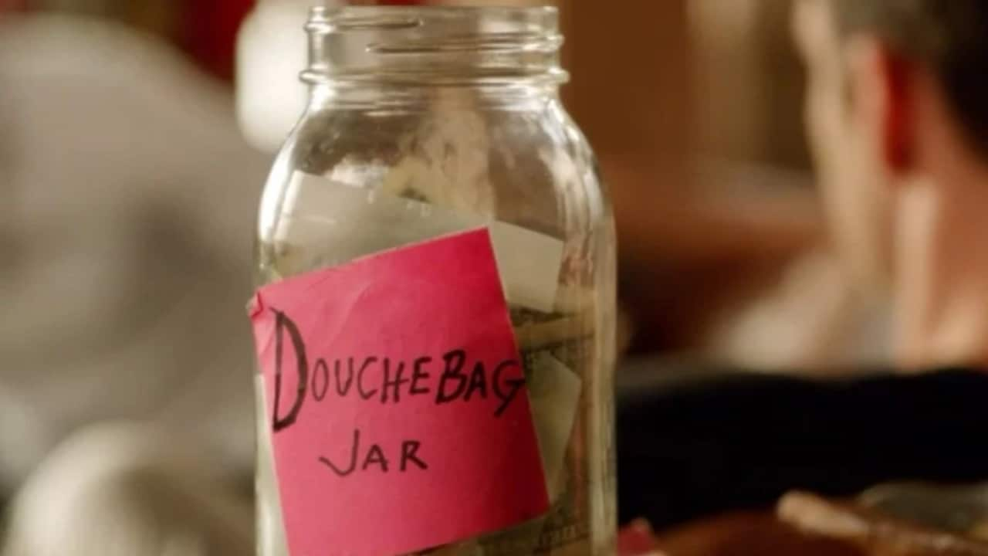
Notes:
Before I get into it, you need to know about the douchebag jar. If you’ve seen New Girl, you know how it works: say something that makes you sound like a douchebag, and you put a dollar in the jar.

Slide 5
My story is all about
sex, drugs, and rock and roll.
Notes:
My story is all about sex, drugs, and rock and roll.

Slide 6
My story is all about
sex, drugs, and rock and roll.
Notes:
[Jar slide. Pause for the laugh.]

Slide 7
God was real to me from the very start.
“Mom, I have the love of Jesus in my heart.”
4–5
Notes:
God was always real to me. I just spent about ten years running from him.
It started in my mom’s car. She’d play children’s hymns, songs like “I’ve Got the Joy.” One day I told her, “Mom, I have the love of Jesus in my heart.”

Slide 8





FAMILY
CULTURE
CHURCH
Church choir
Sunday school
Family fractured
Graphic images, way too young
8
Notes:
Growing up, I sang in the church choir and went to Sunday school.
But around eight, my family started to fracture. And around the same time, I saw graphic images, way too young.

Slide 9








FAMILY
CULTURE
CHURCH
Divorce final
Dad tore down Mom
Porn, then shame
Stopped going to church with Mom
WHAT I TOLD MYSELF
“If God is so loving, he doesn’t care what I do.”
13
Notes:
By thirteen, the divorce was final, and my dad started tearing down my mom. She was the one who’d given me my faith. When she got torn down, my faith went with her.
And I wanted sex. Porn was right there on a laptop, and every time it cost me shame. Everything around me said that’s how you grow up. I wanted to prove I was a big man.
At church, sex was a hard no, wrapped in shame. So at thirteen I stopped going with my mom, and I decided if God is so loving, he doesn’t care what I do. I wasn’t running from God. I was running from his authority.
Looking back, the shame didn’t stop anything. It just pushed God out.

Slide 10



INSTANT GRATIFICATION
Chasing casual sex, with unfortunate success
16
Notes:
By sixteen I was on every dating app there was, chasing casual sex, with unfortunate success. Instant gratification, and I was in charge.

Slide 11
INSTANT GRATIFICATION
Chasing casual sex, with unfortunate success
16
Notes:
[Jar slide. Pause for the laugh.]

Slide 12
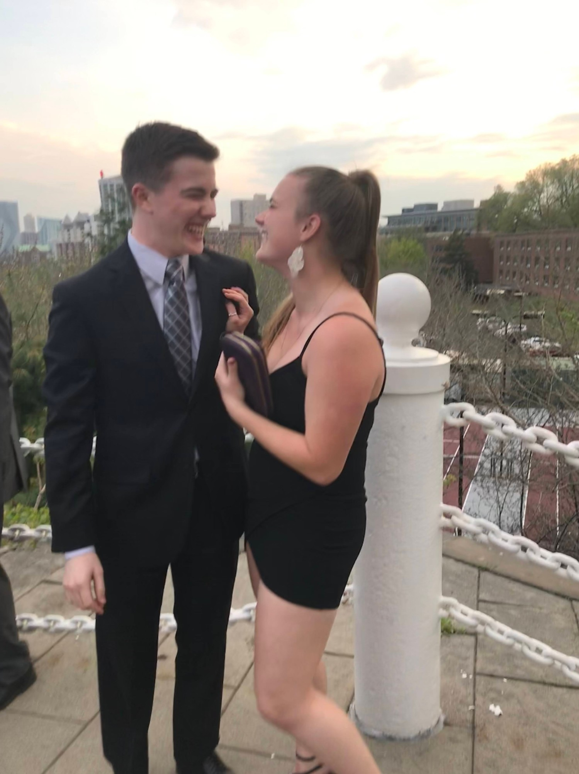

STEVENS INSTITUTE OF TECHNOLOGY
Met Skylar
Became friends
18
Notes:
What I couldn’t see was that God was already working. At eighteen, I met Skylar at Stevens, and we became friends.

Slide 13
Just friends.
We went out. She We decided we should be just friends.
19
Notes:
At nineteen we went out, and she decided… okay, we decided we should just be friends.

Slide 14


NUMBING
Weed, from about 19
Vaping
Who I thought I was: “a cool guy who likes to have fun.”
19
Notes:
Around nineteen I started smoking weed, then vaping. Pretty soon it was just about numbing out.
By twenty-three, if you’d asked me who I was, I’d have said a cool guy who likes to have fun.

Slide 15

The pact.
We’d get married someday. We always argued about the age.
21
Notes:
Around twenty-one, after college, Skylar and I made a pact that we’d get married someday. We always argued about the age.

Slide 16
The pact.
We’d get married someday. We always argued about the age.
21
Notes:
[Jar slide. Pause for the laugh.]
Years later, in therapy, I saw it for what it was. The pact and casual sex were both safety nets. They kept me from going after what I really wanted, which was a stable relationship.

Slide 17

HOURS ON THE PHONE WITH SKYLAR, PER MONTH
23.5
19.8
73
HOURS
258
CALLS
Biggest day: March 28
4 h 21 min · the night we ended the pact
8.1
6.1
6.0
4.9
4.3
Oct
Nov
Dec
Jan
Feb
Mar
Apr
23
Notes:
But Skylar and I never stopped talking. From October to April, we spent seventy-three hours on the phone. By March, it was twenty hours a month.
In March, I told her we should end the pact. No more safety net. That’s when she told me she’d been interested in me. We talked for over four hours that day.
She’d also told me her future husband would be a Christian. So yes, God got my attention through a girl. I know how that sounds.
God knew exactly how to reach me.

Slide 18



EVERY NATION NEW JERSEY
“I once was lost, but now am found,
was blind, but now I see.”
24
Notes:
At twenty-four, Skylar and I started dating, and I went to Every Nation New Jersey. Pastor Adam opened every service the same way: “God has a word for you.” Then worship started, a big room full of people making music together. I’d spent years looking for that, even in a New Jersey chorus where I was the youngest by forty years.
Early on, maybe my very first Sunday, the song right after Pastor Adam was “Amazing Grace (My Chains Are Gone),” and my voice shook. I already knew that song.

Slide 19


“God has a word for you.”
PASTOR ADAM BURT, EVERY NATION NEW JERSEY
THERAPY
HOW I GREW UP
=
Casual sex was holding me back
What God wanted for me
Maybe I actually know a thing or two about God’s character.
24
Notes:
And God did have a word for me. On purely secular terms, I’d already figured out that casual sex was holding me back. That was exactly what I’d grown up hearing God wanted for me. The two lined up. And I thought, maybe I actually know a thing or two about God’s character.

Slide 20
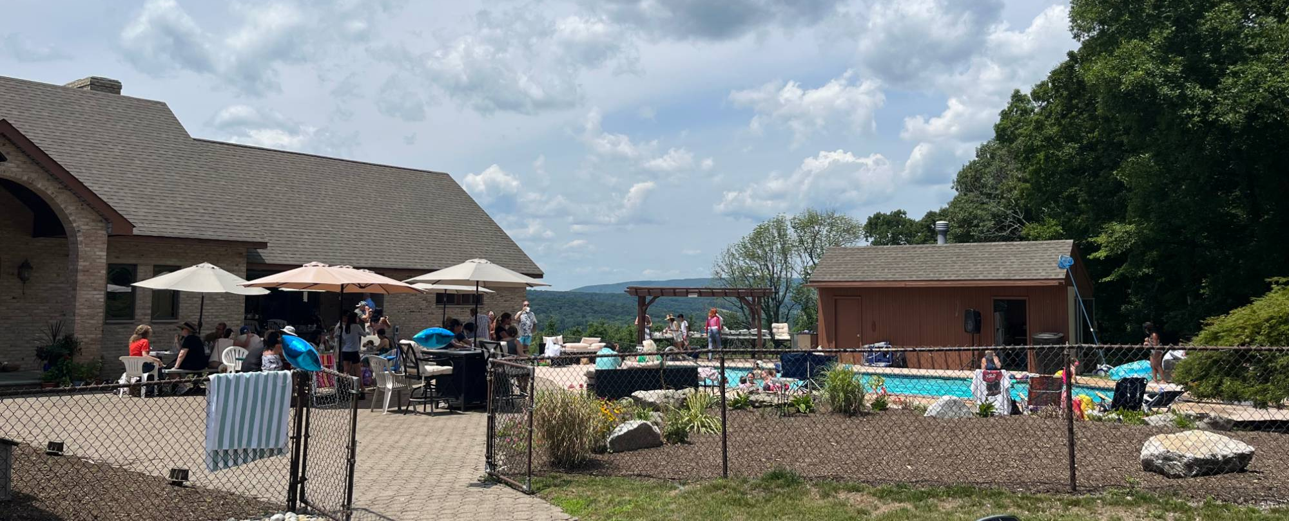

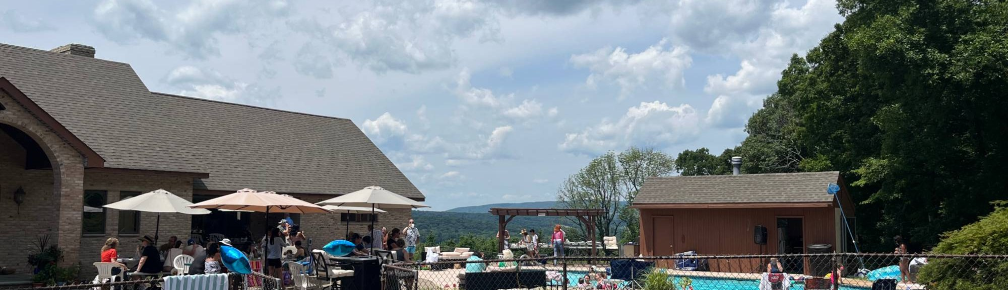

BAPTISM
I wanted to get baptized in Beaver Lake.
Then a fish bit me.
24
Notes:
Then came baptism. I had the perfect plan. Beaver Lake. I was praying about it, and a fish bit me.
I took that as God saying don’t do what you want, do what I want. So I got baptized as soon as I could, the next month, July 2024, with Every Nation New Jersey at Hack’s house.

Slide 21

JUNE 2025
I went to buy weed and felt
completely out of control.
I wanted him in control.
1 year+
no weed
Since December
no nicotine
25
Notes:
And then the big one. June 2025. I went to get weed, and I felt completely out of control, ashamed, far from God, feeding an addiction. That’s when I realized I wanted him in control.
I haven’t smoked since. I quit nicotine in December. I’m still tempted. But by the grace of the Spirit, I’m clean. It took a while.

Slide 22
¹ You have searched me, Lord, and you know me. ² You know when I sit and when I rise; you perceive my thoughts from afar. ³ You discern my going out and my lying down; you are familiar with all my ways. ⁴ Before a word is on my tongue you, Lord, know it completely. ⁵ You hem me in behind and before, and you lay your hand upon me. ⁶ Such knowledge is too wonderful for me, too lofty for me to attain.
⁷ Where can I go from your Spirit? Where can I flee from your presence? ⁸ If I go up to the heavens, you are there; if I make my bed in the depths, you are there. ⁹ If I rise on the wings of the dawn, if I settle on the far side of the sea, ¹⁰ even there your hand will guide me, your right hand will hold me fast. ¹¹ If I say, “Surely the darkness will hide me and the light become night around me,” ¹² even the darkness will not be dark to you; the night will shine like the day, for darkness is as light to you.
PSALM 139:1–12 (NIV)
Notes:
[Read Psalm 139:1–12 aloud.]

Slide 23
God knows how to reach you.
How is he trying to reach you right now?
To answer, you have to know his character.
AT YOUR TABLE TONIGHT
What is something you know is true and important, but tend to forget when life gets stressful or difficult, and what might help you remember it?
Notes:
So guys, here’s what I want you to take home: I ran from God’s authority for ten years, and he still knew exactly how to reach me. For me, it was through a girl.
So how is he trying to reach you right now? That’s a hard question, because to answer it you have to know his character, what he’s like and how he moves.
At your table tonight, John’s question: what’s something you know is true and important, but tend to forget when life gets stressful or difficult, and what might help you remember it? For me, it’s simple. God is in control, and I keep trying to take it back. These days it’s my time. I still want to decide how every hour gets spent. Thanks, guys.

