Slide 1

SUNDAY NIGHT SERVICE
Promotion & Launch Plan
LAUNCHES
Sept 20
Grace Community Church • Arlington, VA
2026
Grace Community Church | Sunday Night Service

Slide 2
LAUNCH OVERVIEW
Promotion ramps up three weeks before launch, spanning digital, on-site, and local community channels.
Aug 30
3 Weeks
Sept 20
PROMO BEGINS
PROMO RUNWAY
LAUNCH DAY
The heavy promotional window is shorter than some events since we don’t need people to register to save a space and we want it to remain top of mind as we get closer to the date. It will be mentioned on stage and appear on our website before August 30.
Grace Community Church | Sunday Night Service

Slide 3





DIGITAL CHANNELS
Social Media
Google Search Campaign
Website
“Coming soon” teaser posts and video building to launch.
Paid search targeting “Sunday Night Service” and related terms if this search term is ranking high with Google. TBD.
New service page for SEO — depending on final launch date for our new website.
Mobile App
SMS
Community Calendars & Social Groups
Push notifications and featured event promotion.
Launch day mention on John’s text group.
Listings on local event calendars and community social groups.
Grace Community Church | Sunday Night Service

Slide 4



ON-SITE & PHYSICAL
QR Code / Tap-to-Info
Front Door Signage
Temporary Pull up Banner
In-service promo & card to capture lead info for interested volunteers. Run for a few weeks.
Updated posted service times reflecting the new Sunday night service. Try a different color for greater visibility
In-building banner advertising the new Sunday Night Service that can remain outside of our front doors for several weeks.
Grace Community Church | Sunday Night Service

Slide 5
3-WEEK PROMO TIMELINE
Pacing from promo kickoff through launch weekend.
1
2
3
4
WEEK 1
WEEK 2
WEEK 3
LAUNCH DAY
Aug 30 – Sep 5
Sep 6 – Sep 12
Sep 13 – Sep 19
Sep 20
Sunday Night Service added to website/mobile app.
Coming soon” social campaign begins with lead capture.
QR / tap lead capture (volunteers) at services
Google Search campaign launches (possibly one week earlier) – check #’s on this keyword.
Announcement video release (social + YouTube)
Custom email sent to congregation – CTA invite someone
Submit to local community calendars
Poster & front door signage installed
Final social reminders & website info updated with any additional info.
Submit to local social groups
Mobile app push reminder by Wednesday
Launch day text alert
Sunday Night Service begins
Greet & capture newcomer info on Tap/QR connect card
Photographer to capture photos for post-launch social posts and future promo.
›
›
›
Grace Community Church | Sunday Night Service

Slide 6
ASSETS NEEDED
Production checklist — deliverables to create ahead of each promo milestone.
Asset | Needed By / Due | Owner | Status
“Coming soon” graphic set | Week 1 / (Aug 14) | North Creek Media | Concept
Google search ad copy & keywords | Week 1 / (Aug 7) | Heather | In Progress
General promotional language | Week 2 / (Aug 7) | Heather / Amanda | In Progress
Announcement video (final cut + captions) | Week 2 / (Aug 14) | Heather (w/Raise Media) | Not started
Congregation email copy | Week 2 / (Aug 7) | Gina | Not started
Poster design (print-ready) | Week 3 / (Aug 14) | North Creek Media | Not started
Front door signage update | Week 3 / (Aug 21) | North Creek Media | Not started
QR / tap card UPDATE | Week 1 / (Aug 21) | Amanda | Not started
Grace Community Church | Sunday Night Service

Slide 7
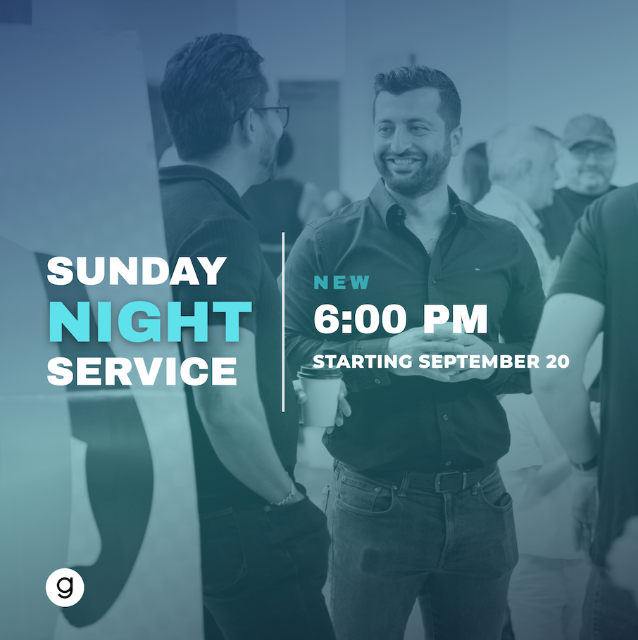
CONTENT
Social Media Post/Stories
New Sunday Night Service
Starting Sept 20
Lead Gen for email reminder
Start during Week 1 (Runs August 30 – September 20).
This is the design concept I will pass along to North Creek Media. Colors and fonts will be correct in the final artwork.
Grace Community Church | Sunday Night Service

Slide 8

CONTENT
Script
Share ‘Why’ behind the new service time.
Emphasis how it will meet a need and impact lives.
Clear call-to-action: bring a friend, spread the word.
Publish during Week 2 (Sep 6–12).
Announcement Video
Short scripted video of Connor and Simba announcing the new service.
Distribute on social and YouTube.
Grace Community Church | Sunday Night Service

Slide 9
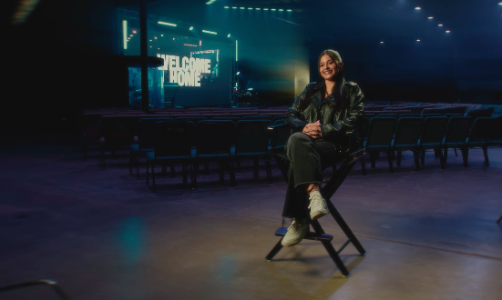
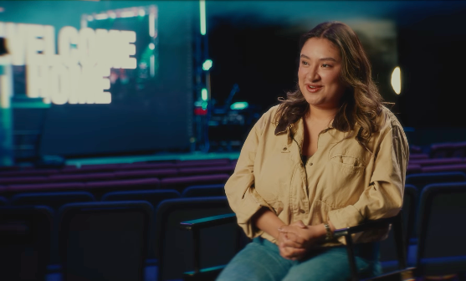
CONTENT
Announcement Video
Suggested video set up via Raise Media. Both Connor and Simba (together) on high top stools with our auditorium behind.
Grace Community Church | Sunday Night Service

Slide 10

CONTENT
Email Text
Custom Email to Congregation
Explain why we're adding the service.
Clear call-to-action: bring a friend, spread the word.
Send during Week 2 (Sep 6–12).
Grace Community Church | Sunday Night Service

Slide 11
Positioning Statement (Internal)
For young adults, working professionals, and anyone drawn to a fresh worship rhythm, our Sunday Night Service delivers a vibrant, conversational, and relational experience that helps people explore faith in a relaxed setting. It strengthens our church’s mission by opening new pathways to connection and discipleship.
Grace Community Church | Sunday Night Service

Slide 12
Internal Promo
Something new is starting at Grace this September.
On September 20 at 6pm, we're launching a Sunday night service. Expect worship, a message, and more time to get to know the people around you. This service is built around the idea that great teaching and community go hand in hand. If you've been looking for a different way to connect at Grace, or a reason to finally check it out, there's no better time to start than the beginning. Invite a friend and mark your calendar.
Grace Community Church | Sunday Night Service

Slide 13
External Language
Primary
New rhythm, same service. Join us for Sunday Night Service beginning September 20 at 6pm.
New rhythm, same Grace. Join us for Sunday Night Service beginning September 20 at 6pm.
Grace Community Church | Sunday Night Service

Slide 14
LAUNCH TACTICS BY OWNER
Production checklist — deliverables to create ahead of each promo milestone.
Asset |  | Owner
Website Events Page Calendar & Home Rotator |  | Gina
Website Custom Page |  | Amanda
Social Campaign |  | Amanda
YouTube Promo |  | Heather
QR Page Design |  | Amanda
Tap Card Set Up |  | Heather
Featured Email |  | Gina
Community Calendars |  | Gina
Grace Community Church | Sunday Night Service

Slide 15
LAUNCH TACTICS BY OWNER
Production checklist — deliverables to create ahead of each promo milestone.
Asset |  | Owner
Orders |  | Gina
Google Search |  | Heather
App Push Notifications |  | Heather
SMS Text |  | John
App Featured Post |  | Gina
Local Social Groups |  | Heather
Banner Set up |  | Heather
Front Door Decal |  | Derek
Grace Community Church | Sunday Night Service

Slide 16
TBD
Confirm launch date for the new website.
Confirm launch date for Tap cards.
Grace Community Church | Sunday Night Service

