Slide 1

PLANNING LUNCH
Sunday Night Service
WE START
Sept 20
Sunday, August 30 · 11:00 AM
6:00 PM
Grace Community Church | Sunday Night Service

Slide 2











SERVICE TIMELINE
CONNECTION OPPORTUNITY
6:00
6:20
6:25
6:50
7:00
7:20
Worship
Scripture
Message
QOTN
Peer Discussion
Off-ramp
about 20 min
2–5 min
about 25 min
about 10 min
about 20 min
room open to 8:00
Grace Community Church | Sunday Night Service
Notes:
Title is the point: the shape repeats every week, the clock does not. The run-of-show templates run anywhere from ~75 to ~105 minutes depending on worship length and how big the follow-up is; 90 is what marketing advertises, not a promise to the room.
'Connection Opportunity' is Connor's framing (8/22) -- the bracket makes 6:50-7:20 read as one purpose in two parts, not as 'talking'.
The order shown is the LAUNCH-WEEK order: question first, then discussion. It flips at week 5 (Oct 18). That flip is variable two on the experiment slide.

Slide 3




OUR NIGHT STARTS AT 5:00
5:00
BY 5:30
5:30
6:00
7:20
Call time
Sound check done
Doors open
Service
Off-ramp
All Volunteers
Audio
Band
Greeters
Ushers
Name tag table
Hosts
Slides
Audio
Security
Room leads
Reset crew
Grace Community Church | Sunday Night Service
Notes:
5:00 is the one number here nobody has agreed to -- derived from the held Jean Paul draft (soundcheck done, doors 5:30) plus the Planner's 5:00 call. Sound check moved out to 5:30 at Connor's direction (8/22). Say it as a proposal and let the room correct it.
The briefing after the huddle is Connor's addition (8/22) and does not exist in the pre-service huddle note as anything but a huddle.

Slide 4
01
HOSTS & QOTN
Grace Community Church | Sunday Night Service

Slide 5






THE HOST DOES FOUR THINGS
START OF SERVICE
QOTN
Start the night
Read the passage
Watch Top Questions
Set up the question
Welcome people. Set the mood.
The whole thing, out loud, before the message.
Read a few of the new ones out loud. React to them.
Say last week's top question in your own words. The speaker answers it.
Grace Community Church | Sunday Night Service

Slide 6








LIFECYCLE OF A QUESTION
LAST SUNDAY
DURING THE WEEK
MIDWEEK
SUNDAY, 6:50
The room votes. One question wins.
Staff work out how to answer it.
John texts out the question as a tease.
Host sets it up. Speaker answers, 10 to 12 minutes.
Grace Community Church | Sunday Night Service

Slide 7

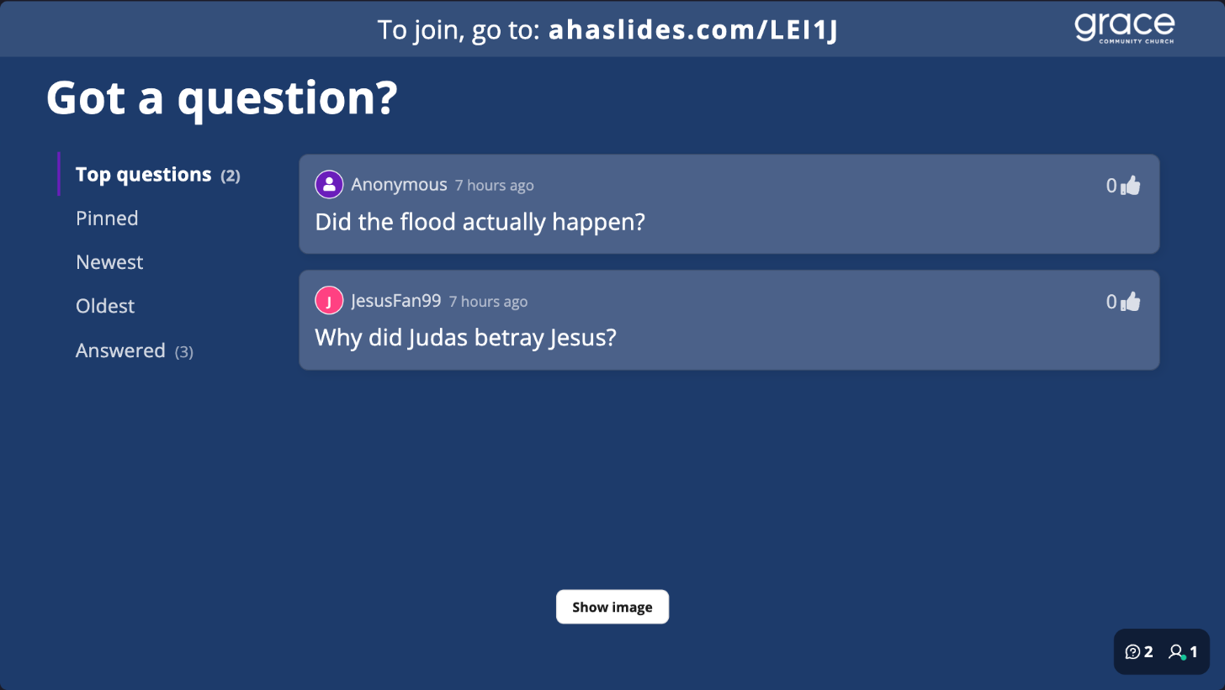
THIS IS WHAT THE ROOM SEES
Grace Community Church | Sunday Night Service
Notes:
Straight screenshot, nothing added -- Connor's instruction. Taken 2026-08-21 from 'Sunday Night Service - Q&A Test 2' (AhaSlides presentation 9884906, join code THRA9) with the QR panel toggled on. Two presenter-only hover buttons were painted out; nothing else changed. The board is empty because the four submitted questions are still pending, which is the next slide's whole point.

Slide 8

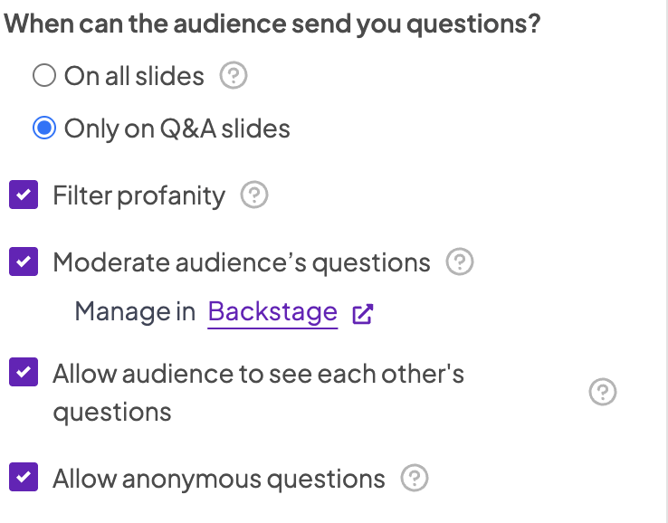
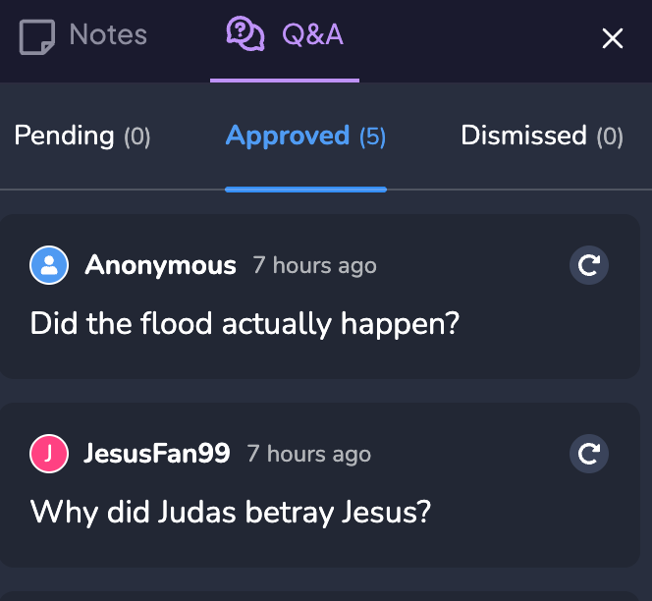
QUESTIONS ARE SCREENED FROM THE AV BOOTH
WHAT THE BOOTH DOES
Green check puts it on the screen
Red X and it never appears
Ten approved, four waiting, one killed
The filter stars out bad words on its own — most of them
Grace Community Church | Sunday Night Service
Notes:
Real capture, 2026-08-21, same presentation. Four questions from the Noah's Ark test queue, left pending on purpose -- the queue is still live if you want to work it in the room. The fourth (older hymns) is the off-topic one, so the room can see what the red X is for.
Do NOT project Backstage during a service: it shows raw text unmasked. The 8/18 capture proved the profanity filter misses concatenated display names.

Slide 9
02
SERVICE
Grace Community Church | Sunday Night Service

Slide 10
TWO THINGS WE DON’T KNOW YET
WHERE PEOPLE TALK
WHEN THE QUESTION GETS ANSWERED
Two side rooms, or everyone stays in the auditorium?
The speaker answers first, or people talk first?
We do not know which works better here, so we try all four combinations.
Grace Community Church | Sunday Night Service
Notes:
The step-in slide for the 2x2. Say the two questions out loud and stop. Do not name the grid yet.
Where people talk: two side rooms (Brandon Geddes and Simba Kanjanda lead one each) or everyone stays in the auditorium.
When the question gets answered: the speaker answers the question of the night first, or people talk first and the answer lands after.
Icons are the same glyphs the service timeline uses for Peer Discussion and QOTN, so the room has seen them once already.

Slide 11
SO WE TRY ALL FOUR COMBINATIONS
1
BREAKOUT ROOMS + QUESTION FIRST
The speaker answers, then we split into rooms
2
STAY IN PLACE + QUESTION FIRST
The speaker answers, then we talk where we sit
3
BREAKOUT ROOMS + DISCUSSION FIRST
We split into rooms and talk, then the speaker answers
4
STAY IN PLACE + DISCUSSION FIRST
We talk where we sit, then the speaker answers
Every Sunday night is one of these four.
Grace Community Church | Sunday Night Service
Notes:
The bridge slide. Read it as a list of four nights, not as a diagram — that is the whole point of the format.
Each row shows its two ingredients on the left and what the night actually looks like on the right. The tags are the same words the next slide uses as its axes, so the grid arrives already decoded.
The order is the grid's reading order: 1 and 2 are the top row, 3 and 4 are the bottom. Rooms and stay-in-place alternate every row; the flip from question-first to discussion-first happens between 2 and 3.
Do not put dates on this slide. The next slide does dates.

Slide 12
TWO WEEKS ON EACH COMBINATION
BREAKOUT ROOMS
STAY IN PLACE
WEEKS 1–2
WEEKS 3–4
QUESTION FIRST
Sept 20 · Sept 27
Oct 4 · Oct 11
WE START HERE
WEEKS 5–6
WEEKS 7–8
DISCUSSION FIRST
Oct 18 · Oct 25
Nov 1 · Nov 8
Brandon and Simba lead one room each.
Grace Community Church | Sunday Night Service
Notes:
Axes flipped at Connor's direction: where people talk is now across the top, when the question gets answered runs down the side. Week numbers are the big type, dates secondary.
Animations were tried and REMOVED 2026-08-23 -- the hand-written timing XML broke the file in PowerPoint. Do not re-add them from python-pptx; if the build-on-click is wanted, add it by hand in PowerPoint.
Straight off the 8-Week Plan grid. Worth knowing if anyone presses: weeks 3-4 got the no-setup combination on purpose, because Oct 4 has a guest worship lead (Rhett Walker) and Oct 11 has nobody confirmed. And in weeks 5-8 the night ends on a talking head rather than on conversation -- if stay-rate drops then, check that before blaming rooms.
⚠️ The room leads are Brandon GEDDES and Simba Kanjanda. An earlier draft said Brandon Brys -- wrong. Last name dropped from the slide at Connor's direction, but if anyone asks in the room, it is Geddes.

Slide 13
WE COUNT THE ROOM TWICE
6:00
7:20
HOW MANY CAME
HOW MANY STAYED
Ushers enter the count, the same way the morning services do.
This is the number that tells us whether the connect time worked.
The same two numbers every week for eight weeks.
Grace Community Church | Sunday Night Service
Notes:
6:00 is the usher count. Kay Carter-Corker built the Sunday-night capture on 8/28 and switches it on for September; ushers scan a QR, pick the service, type the number. Identical to 9:00, 10:15 and 11:30.
7:20 is the new one and it is the experiment's scoreboard: how many stayed for the question of the night and the peer discussion. Connor asked Kay for it on 8/28 and she took the ask. WHERE that number is stored is not built yet, and it is deliberately kept off the homepage adult-attendance total so the 6 PM service is not double-counted. Do not promise a tool in the room.
The gap between the two numbers is what tells you whether rooms beat staying in place.

Slide 14




FUTURE EXPERIMENTS
FOOD
LAYOUT
SERVICE ORDER
YOUR IDEAS
Grace Community Church | Sunday Night Service
Notes:
Labels only, at Connor's direction 8/23 -- this slide is a prompt for the room, not a briefing. The detail lives here in the notes.
FOOD: held out of weeks 1-8 so a pizza effect cannot be mistaken for a rooms effect; that reason expires 11/8. Pizza is the likely start. Callie Taylor owns it (John, 8/12).
LAYOUT: Connor, 8/22 -- 'we aren't touching the curtains or moving the chairs... to start.' We can experiment once we see attendance, and capacity decides what shapes are even possible. Setup labour was the original reason round tables were ruled out, so a different shape brings that cost back.
SERVICE ORDER: the launch-week order is question then discussion, and it already flips at week 5 (Oct 18) -- that is variable two on the experiment slide. Everything after week 8 is open: where worship sits, whether scripture stays before the message, how long the off-ramp runs.
YOUR IDEAS is the live one. Consistent groups is the deferred second experiment already named in the 8-Week Plan, so if nobody raises it, raise it. Streaming is deliberately not here -- it is a decision, and it lives on the next-steps slide.

Slide 15
NO SUNDAY NIGHT WITHOUT THESE JOBS
BEFORE & AFTER
PRODUCTION
THE ROOM
UP FRONT
Setup
Worship
Volunteer captain
Speaker
Room ready before 5:30
One or two on stage, about 20 minutes
Runs the crew so nobody has to ask
The message, and the answer to the question
Reset
Audio
Ushers
Host pair
Put it back after 8:00
Sound check by 5:30, and mics all night
The rows, and communion misses
Welcome, read the passage, run the Q&A
Room leads
Slides & screening
Greeters
One each when we open the rooms
The words, and what reaches the screen
The door, name tags, communion
Off-ramp activity
Team leads
Whatever we do after 8:00
One each for the greeter, usher and connection teams
Grace Community Church | Sunday Night Service
Notes:
Twelve jobs in four groups, at Connor's direction 8/23: Speaker sits with the Host pair, the three room jobs sit together, and Worship, Audio and Slides sit together as production. Worship and Audio came back on; 'approvals' is now 'screening', which is the word the AV-booth slide uses.
No names on this slide by design; the grid is the ask. Where the seats stand: audio is Jean Paul and slides is Mike Vacca (confirmed). Setup and reset land on Connor through December. Room leads are Brandon Geddes and Simba Kanjanda. Four host pairs were decided but only Will Gralley has been asked. Speaker is John most weeks. Volunteer captain and off-ramp activity have nobody at all -- those are the two real asks in this room.
Security is Brian Sulc and is not recruited from this room, so it is off the grid. The livestream needs no one: two fixed cameras.

Slide 16
WHAT THE FEEDBACK FORM ASKS
1
Is tonight your first time at the Sunday Night Service?
2
How was each part of tonight? Worship · message · Q&A · conversation time
3
Did you have a real conversation with someone you didn’t already know?
4
Did you submit or vote on a question tonight?
5
Did you know what was happening and what to do next?
6
How likely are you to come back next Sunday night?
7
Are we missing anything? One thing to change, or one thing to keep.
+
Your idea. What else should the form ask?
Contact details sit at the end. It is not anonymous — say so if anyone asks.
Grace Community Church | Sunday Night Service
Notes:
CALL IT THE FEEDBACK FORM IN THE ROOM. Connor, 2026-08-24: it is not a connect card, it is an online feedback form. That is the volunteer-facing name and this slide follows it.
⚠️ THE NAMING IS SPLIT AND SOMEONE WILL NOTICE. The thing itself is Kay Carter-Corker's Rock connect card. The URL is trygrace.org/sundaynightserviceconnectcard, the Rock group is called 'Sunday Night Service Connect Card Group', and answers land in Rock report 219. Connor merged the cancelled Google feedback form onto it 2026-08-19 -- 'two birds one stone'. So the deck says feedback form and the link says connect card. If that matters, the fix is a vanity URL from Kay, not a slide edit.
⚠️ NOT a Google Form. Kay built this 8/18; Derek approved the question set 8/20.
Q7 is highlighted at Connor's direction as 'Are we missing anything?' -- ⚠️ that exact phrasing is NOT what is live on the form. The live wording is 'One thing we should change, or one thing we should keep?' Both are on the slide so it reads as the catch-all without misquoting the card. If Connor wants the form reworded, that is an ask to Kay.
⚠️ The teal '+ Your idea' row is a prompt for THIS ROOM, not an eighth question on the live form. Say so, or someone will go looking for it.
Q3 is the one the whole design rests on -- track the percentage answering 'Yes' and watch it move by format.
Two things still open: Kay has not relabelled Q2 from a 1-5 scale to 'Not for me / Not my favorite / It was fine / Really enjoyed it / Loved it', and her two test submissions ('Trixie Fake-Carter-Corker', 8/19) are still in the live group and need deleting before launch.
⚠️ OPEN: the QR code. Nobody has established how the QR destination switches between the morning card and the evening form -- Connor to ask Heather Noble (2026-08-24).
ANONYMITY IS SPENT and that was a deliberate trade -- Derek's argument won it. Volunteers must not tell anyone the form is anonymous.

Slide 17




OFF-RAMP ACTIVITIES
Small groups
Dancing next door
Sunday night football
Game night
Your idea
Grace Community Church | Sunday Night Service
Notes:
SMALL GROUPS is the one that matters and the one with a real date. Connor, 8/22: likely ramping up for this time slot in January. That lines up with the vault -- the ask to Alexis Hendrickson to steer young-professional small groups out of this service is On Hold and date-locked to 2026-12-01, so a January start is the natural consequence, not a new plan.
Worth naming out loud: the eight-week run ends 11/8 and the groups item does not wake until 12/1. That is a three-week gap right after the warmest moment this service will ever have, which is exactly the hole the off-ramp bucket exists to name.
Inspira: CONFIRMED 2026-08-22 -- their Ballston Quarter listing gives Suite 2220, Level M2, and ARLnow says 'on the second level of Ballston Quarter at 4238 Wilson Blvd, across from Onelife Fitness.' Grace is also on the 2nd floor of 4238 Wilson. Same floor. Connor also confirmed Inspira and the 'country dance people' who emailed John in June are the same outfit.
Football is John's idea (8/12). STILL OPEN: distribution rights to show NFL on the auditorium screens were never researched. Do not promise it.
Game night is Derek's model (6/23): spot who is magnetic, let them host something small, put it on the events page.

Slide 18
03
WORSHIP
Grace Community Church | Sunday Night Service

Slide 19





WORSHIP IS SMALLER AND SLOWER
One or two on stage
About 20 minutes
Two Sundays open
Not the six or eight you see in the morning.
Longer and quieter than a morning set.
Oct 4 is Rhett Walker. Oct 11 has nobody yet.
Grace Community Church | Sunday Night Service

Slide 20
WE WANT TO HEAR FROM EVERYONE
The aim for today: everyone on this slide has a job on September 20.
HOSTING
WORSHIP & PRODUCTION
FACILITIES
ENABLEMENT
Seth Addison
Callie Taylor
John Slye
Steve Coy
Brian Sulc
Krista Slye
Michael Vacca
Connor Frey
Skylar Frey
TBD...👉👈
Simba Kanjanda
Emily Horneffer
Brandon Geddes
Will Gralley
Felipe Gomez
Donovan Bonner
Sean Liesegang
Liz Goodiel
Grace Community Church | Sunday Night Service
Notes:
Connor's ask: open the floor, get delegation, put names on it, hear from everyone. Two questions to work round the room with -- what are we missing, and which job do you want.
READ THE COLOUR, NOT A GROUP. Teal means that person is in the host pool. Connor, 2026-08-24: the current host pairs can 100% mix and match, so there is deliberately no pair list on this slide. That is also the honest answer to John's 8/22 message, which pairs Skylar with Emily rather than with Connor and wants Connor off stage the first couple of weeks -- a pool absorbs that without contradicting anyone. Only Will Gralley has actually been asked to host.
⚠️ Brandon is a BARE first name in the 8/17 source and has NOT been confirmed. Geddes is the probable reading -- he is the Sunday-night core-team Brandon and the one on this roster -- but ask, do not assume.
SEAN LIESEGANG AND LIZ GOODIEL are back on the slide, under LEADING and NOT teal. Connor texted Sean individually and Sean elected to decide on Sunday. Do not announce them as hosts. If Sean says yes on 8/30 they turn teal.
EIGHT OF SEVENTEEN HAVE NO CREW SEAT YET and that is the point of the slide, not a gap in it. Connor and Skylar sit in ENABLEMENT with John and Krista, and both are teal -- the colour crosses buckets on purpose. Where the sorted seats stand: Michael Vacca accepted the screener seat on 8/22 (confirmed), Jean Paul has audio but is not at this lunch, Callie Taylor owns food (held out of weeks 1-8), and Brian Sulc is John's named example of a chunk Connor should hand off.
Two unsorted names to steer toward the open seats: Felipe Gomez volunteered food and logistics help on the 7/30 call, and Donovan Bonner is a Boot Camp leader whose whole pitch is community past the event. Volunteer captain and off-ramp activity still have nobody.
Attendance is in and out: Seth Addison and Steve Coy arrive around 12:00, and Emily Horneffer serves 10:15 nursery so she comes in mid-way through the first block. Run this slide at the end of the worship block and everyone on it is finally in the room at once.

