Slide 1

Sentiment Analysis of Amazon Reviews
Connor Galvin
EECE5644 Machine Learning and Pattern Recognition
Instructor: Jennifer Dy
Northeastern University
April 25, 2018

Slide 2
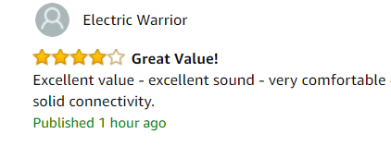

Overview
Goal is to build a model that trains on labeled reviews and predicts the review score of unseen reviews
Sentiment analysis- Using machine learning algorithms to analyze human opinions
Sentiment analysis can help a business to increase sales and revenue by gaining insights to tweak their product catalog
Automate manual reading of individual samples: save time and money
Model

Slide 3
Outline
Training Data
Unigrams, Bigrams, Trigrams
Count Vectorizer
Tf-idf Vectorizer
Model Training
Classifiers
Naïve Bayes
K-neighbors
SVM
SGD
Model Testing
(Test Data)
Metrics
Accuracy, Precision, Recall

Slide 4
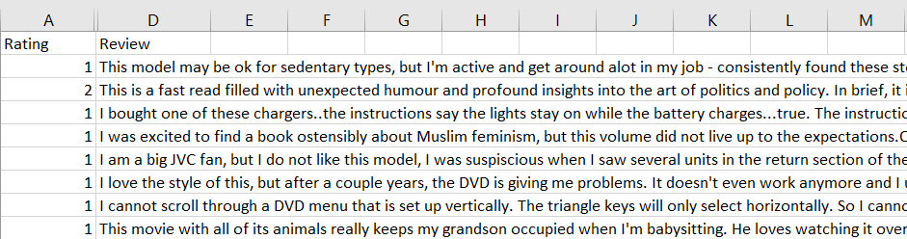
The Data
CSV of 100,000 random reviews on Amazon’s website for a variety of products
All reviews are written in English
Downloaded from Kaggle https://www.kaggle.com/bittlingmayer/amazonreviews
Rating 1 corresponds to negative reviews (1 or 2 stars), Rating 2 corresponds to positive reviews (4 or 5 stars)
I implemented a Train-Test Split of 0.8. Dedicating 80% of reviews to training and 20% of reviews to testing

Slide 5
Feature Selection
Unigrams, Bigrams, and Trigrams
Sentiment analysis cannot be fully modeled by assuming individual words are independent
N-grams can be used to model relationships amongst neighboring words
I found the best performance by including most relevant 20% bigrams and 10% trigrams, using a chi-square association measure from NLTK Python package.
Example Review
“The book is not great”
Unigrams
Trigrams
(the, book, is, not, great)
(the book is, book is not, is not great)
Bigrams
(the book, book is, is not, not great)

Slide 6
Feature Selection
Stop Word Filtering
Stop words are commonly occurring words that do not convey sentiment
Filtering stop words could simplify the data and remove noise
Removing stop words decreases the size of data fed to the model, leading to faster performance
Examples of common stop words: “the”, “it”, “by”, “my”, “a”, “or”, “and”

Slide 7
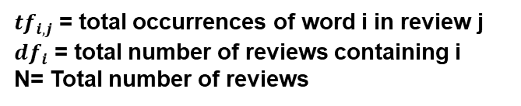

Feature Selection
Count Vectorizer
Converts a collection of text reviews to a matrix of token counts
Simplest way to vectorize the reviews
 | book | great | awful | movie | good
Review A | 2 | 0 | 1 | 0 | 1
Review B | 0 | 2 | 0 | 3 | 1
Review C | 1 | 1 | 0 | 0 | 1
Tf-Idf Vectorizer
Weighs word occurrences according to their frequency in the entire corpus of reviews
$${Tfidf}_{i,j} = {tf}_{i,j} ×log(\frac{N}{{df}_{i}})$$
${tf}_{i,j}$ = total occurrences of word i in review j
${df}_{i}$ = total number of reviews containing i
N= Total number of reviews

Slide 8
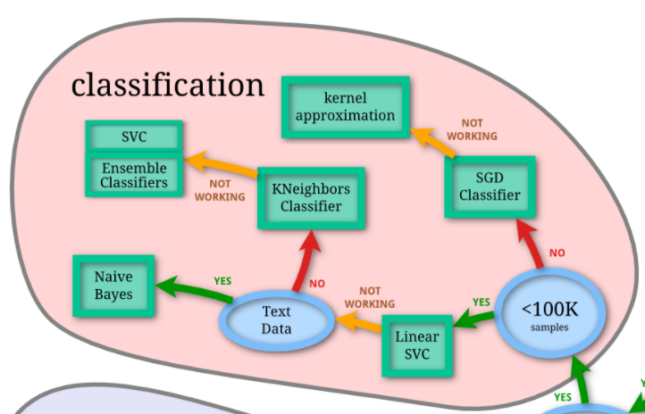
Classifier Models
Naïve Bayes
K Neighbors Classifier
Assumes that the value of a particular feature is independent of the value of any other feature
An object is classified by a majority vote of its neighbors, with the object being assigned to the class most common among its k nearest neighbors
SVM
SGD Classifier
Constructs a hyperplane or set of hyperplanes in a high space, which can be used for classification
Stochastic gradient descent tries to classify by finding minima or maxima by iteration.

Slide 9
Results
Percentage of negative and positive reviews classified correctly with 100,00 train/test samples, including unigrams, top 20% bigrams, and top 10% trigrams. Comparison across classifiers and vectorizers

Slide 10
Results
Percentage of negative and positive reviews classified correctly with 100,00 train/test samples, including unigrams, top 20% bigrams, and top 10% trigrams. Comparison across classifiers and vectorizers

Slide 11
Results
Percentage of negative and positive reviews classified correctly with 100,00 train/test samples, using count vectorization. The Bigram class includes all unigrams plus the top 20 % most relevant bigrams. The Trigram class includes the top 10% most relevant trigrams on top of the bigram class.

Slide 12
Results
Percentage of negative and positive reviews classified correctly using count vectorization and a combination of uni, bi, and trigrams. A train/test split of 80/20 was used for each data point (For the first data point 8,000 reviews used for training, 2,000 for testing)

Slide 13
Conclusion
Results
The more training samples, the higher the accuracy
Tf-idf vectorizer performed marginally better than count vectorizer
Linear SVC classifier performed the best, followed by SGD, Naïve Bayes, and KNN
Including bigrams and trigrams increased accuracy but only when including the ones with the strongest chi-square association measure
The highest accuracy I achieved between positive and negative reviews is 86.6 % using training/testing on 100,000 samples, trigrams, tf-idf vectorizer, and Linear SVC
Reasons for error
Human language is complex- Irony and sarcasm can remain undetected by algorithms
Sentiment is subjective- even humans disagree with each other
The reviews were collected from products across multiple categories, leading to a large variation in language

Slide 14
Questions?

