Slide 1
EEEE-721: Research Assignment General Purpose Computing on GPUs
Connor Goldberg
9 May 2016

Slide 2
Agenda
Introduction
Power Efficiency
Password Recovery for RAR Files
Sorting
String Matching
Computer GO Engine
Conclusions

Slide 3
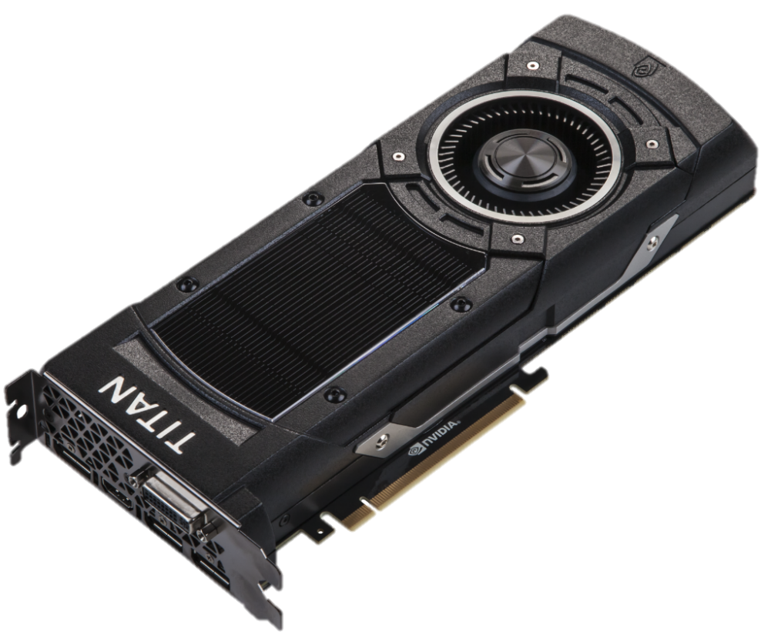
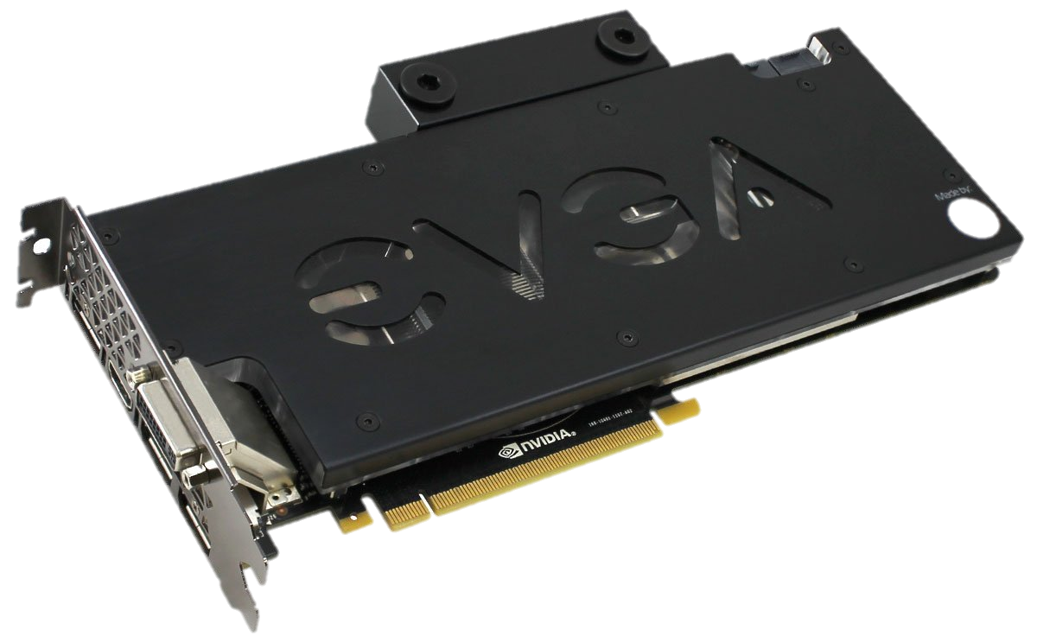
Introduction
[11]
[12]

Slide 4
Introduction
Specs
System Clock: 1152 MHz
Effective Memory Clock: 7010 MHz
Available Memory: 12288 MB GDDR5
CUDA Cores: 3072
Power Consumption: ~600 W
[12]

Slide 5
Introduction
Graphics Processing Unit (GPU)
Introduced in the 1980s
Offloads graphics processing from the CPU
General Purpose Computing on Graphics Processing Units (GPGPU)
High level languages enhanced with APIs (C / C++)
Compute Unified Device Architecture (CUDA) by NVIDIA
OpenCL by Khronos (Originally by Apple)
Substitutes the graphics shader language
Shaders → Thread processors
Single Instruction Multiple Data (SIMD) Programs
Many computation stages connected with highly localized data flow
Kernel – Parallel application consisting of multiple functions
Notes:
The main purpose for a long time was graphics processing
Vertex transforms, lighting/color calculations, etc
Application Programming Interface
CUDA – NVIDIAs API
Data produced by one stage us used in the next
Each stage implemented differently in hardware

Slide 6
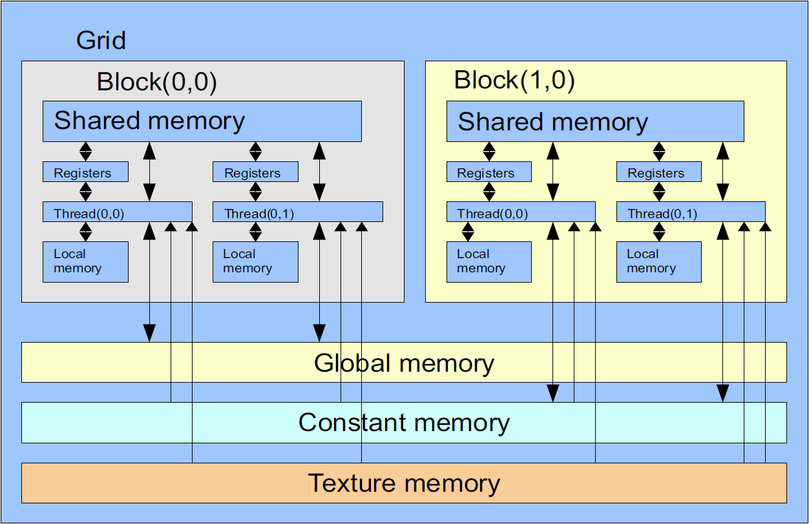
CUDA Model
[1]
Notes:
Texture and Constant memory are cached, but read only
Global memory is not cached but R/W

Slide 7
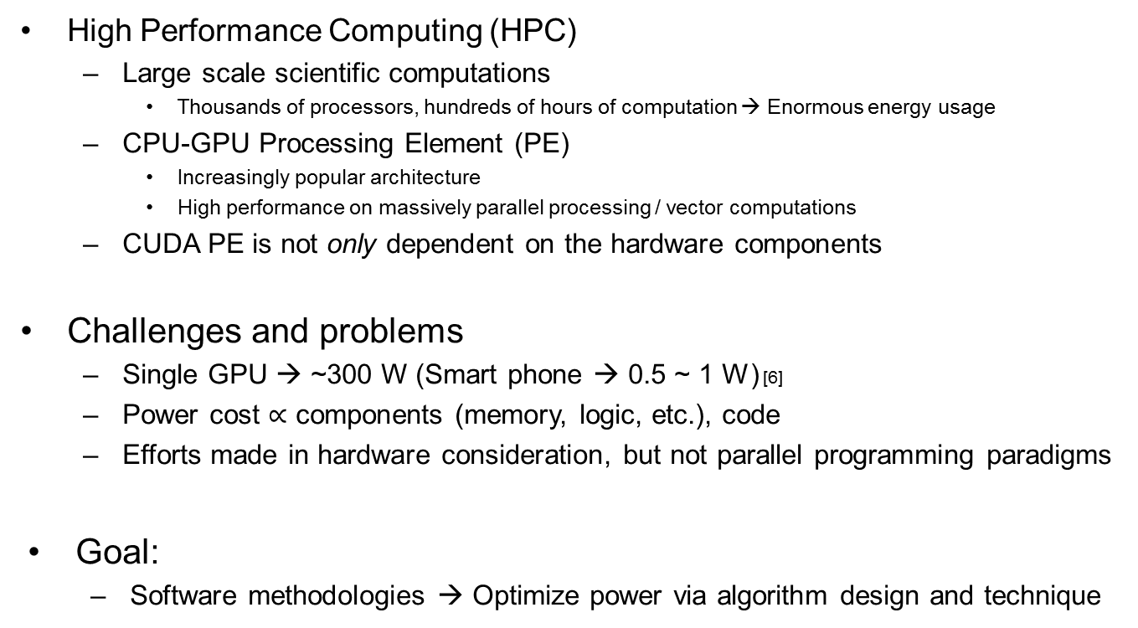
Power Efficiency
High Performance Computing (HPC)
Large scale scientific computations
Thousands of processors, hundreds of hours of computation → Enormous energy usage
CPU-GPU Processing Element (PE)
Increasingly popular architecture
High performance on massively parallel processing / vector computations
CUDA PE is not only dependent on the hardware components
Challenges and problems
Single GPU → ~300 W (Smart phone → 0.5 ~ 1 W) [6]
Power cost $∝$ components (memory, logic, etc.), code
Efforts made in hardware consideration, but not parallel programming paradigms
Goal:
Software methodologies → Optimize power via algorithm design and technique
Notes:
HPC used at schools or labs for research and experiments alike
CPU-GPU, makes use of both CPU and GPU efficiently to complete a task
CUDA PE also depends on the high level applications and the algorithms
Average smart phone ~0.5 – 1 W power consumption during usage [6]
Goal is to explore the different programming and SW techniques that allow for power savings

Slide 8
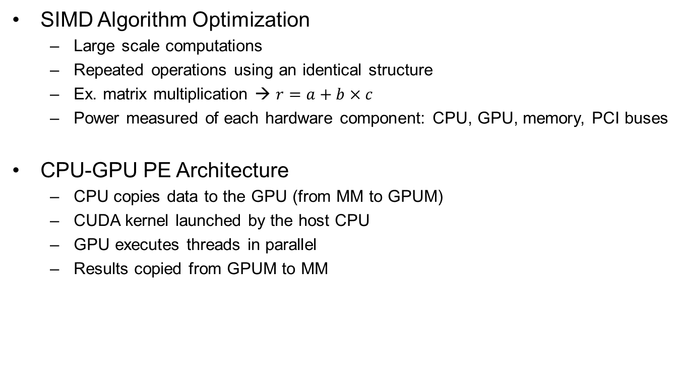
Power Efficiency
SIMD Algorithm Optimization
Large scale computations
Repeated operations using an identical structure
Ex. matrix multiplication → $r=a+b×c$
Power measured of each hardware component: CPU, GPU, memory, PCI buses
CPU-GPU PE Architecture
CPU copies data to the GPU (from MM to GPUM)
CUDA kernel launched by the host CPU
GPU executes threads in parallel
Results copied from GPUM to MM
Notes:
Highly parallelizable because no dependencies on previous operations
SIMD efficient (multiple indices in the same register)
All hardware blocks used in the SIMD computation are measured
A CPU-GPU PE (processing element) contains several hardware components (CPU + 1 or more GPUs)
Kernel is the program that controls the GPU

Slide 9
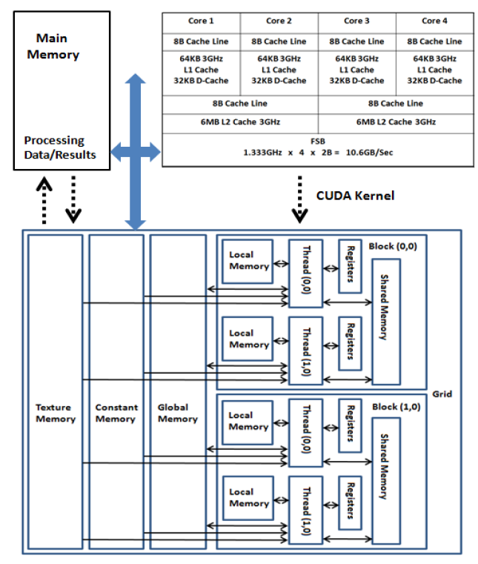
Power Efficiency
[2]
Algorithm Model

Slide 10
Power Efficiency
Matrix multiplication algorithms
Algorithm 1
Only using GPU (CPU free to do other things)
Algorithm 2
Matrix partitioned onto 2 GPUs
Algorithm 3
Matrix partitioned onto 2 GPUs and 1 CPU thread
Algorithm | CPU Energy (mWh) | Execution Speedup (s) | Kernel Speedup (%) | CPU Speedup (%) | Overall Energy Savings (%)
1 | 55 | - | - | - | -
2 | 47 | 0.55 | 39.7 | 21.4 | 6.17%
3 | 54 | 0.52 | 37.2 | 20.1 | 2.32%
[2]
Notes:
Each GPU needs one thread of the CPU to control it
Counter intuitive that more GPUs is more power efficient
They do consume more power, but the speedup outweighs the power consumption

Slide 11
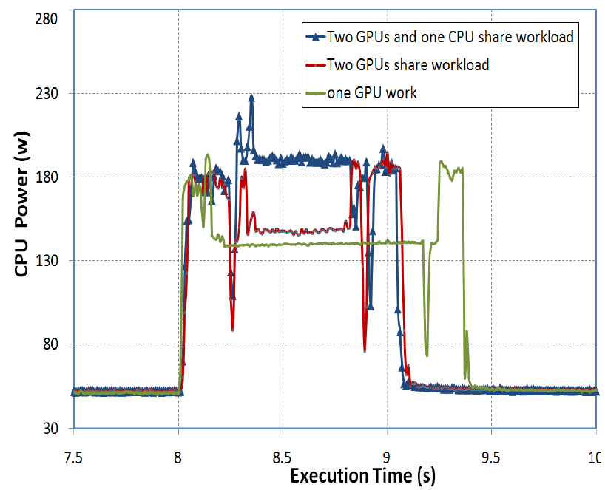
Power Efficiency
[2]
Power Consumption
Notes:
2 GPUs has higher power usage, but shorter time

Slide 12
Power Efficiency
Conclusions
Big overheads for CUDA programs
Kernel initialization becomes significant
Optimization
C functionality to conditionally use the GPU
Notes:
Memory copying and kernel startup
This becomes signification compared to the time it takes for small workloads
The C code will only use the GPU if the matrix is smaller than 500 elements

Slide 13
Password Recovery for RAR Files
Encryption/decryption of RAR files → AES keys
Most time consuming step in the RAR process
Implemented in CUDA
Thread creation and scheduling can be ignored
Memory usage is important
Global, constant, shared, register
AES-128
Key and initial AES vector generated by SHA-1 and a password
Password transformed into Unicode and concatenated with salt
SHA-1 is performed up to 262144 times to generate the key and vector
The most time consuming due to number of SHA-1 computations
Notes:
RAR is just a specific format for compressed data that can be encrypted with a key
Different types of memory for different uses
User entered password
Salt is randomly generated data

Slide 14
Password Recovery for RAR Files
Parallelizing
Each key generation will run on its own thread
If the loop is too large, the OS will stall
Large loop divided, saving state between loops
Memory Usage
Frequently used data → Shared memory (execution resource)
Must be smart about the memory allocation
If shared memory increases, thread execution decreases
Notes:
SHA-1 state is saved while the kernel calls the loop multiple times
Still the disadvantage of storing the state between kernel calls
Shared memory has quick access times
However shared memory is an execution resource
If too much is used, fewer threads can be executed simultaneously → performance loss

Slide 15
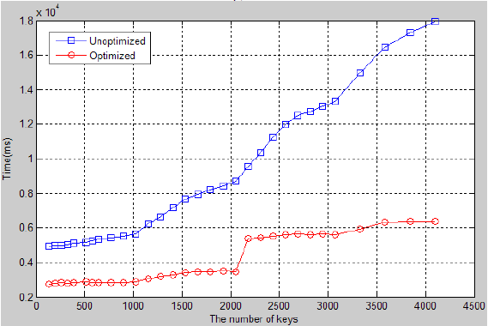
Password Recovery for RAR Files
Performance
Memory optimization
Shared vs. global
Related work
Using multiple GPUs for this task
Using ASICs or FPGAs to accelerate cryptographic algorithms
SHA-1 and MD5 on GPUs
[3]
Notes:
Other hashing algorithms used in crypto

Slide 16
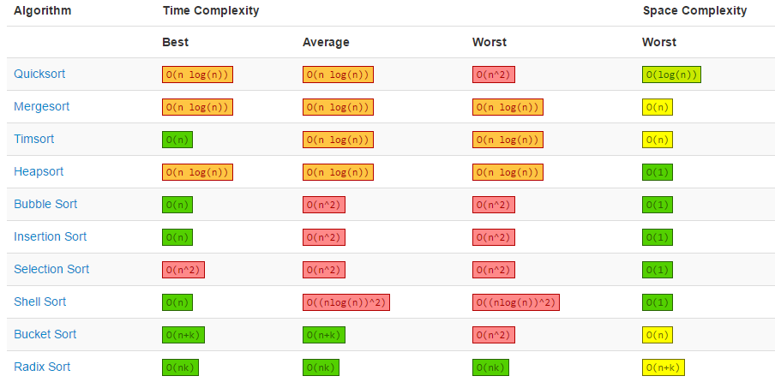
Parallel Sorting
[8]
Notes:
No “best” algorithm, always a catch somewhere whether its worst case, or space complexity
Space complexity is related to physical usage (memory)
This paper compares a parallelized mergesort with the C++ STL Quicksort

Slide 17
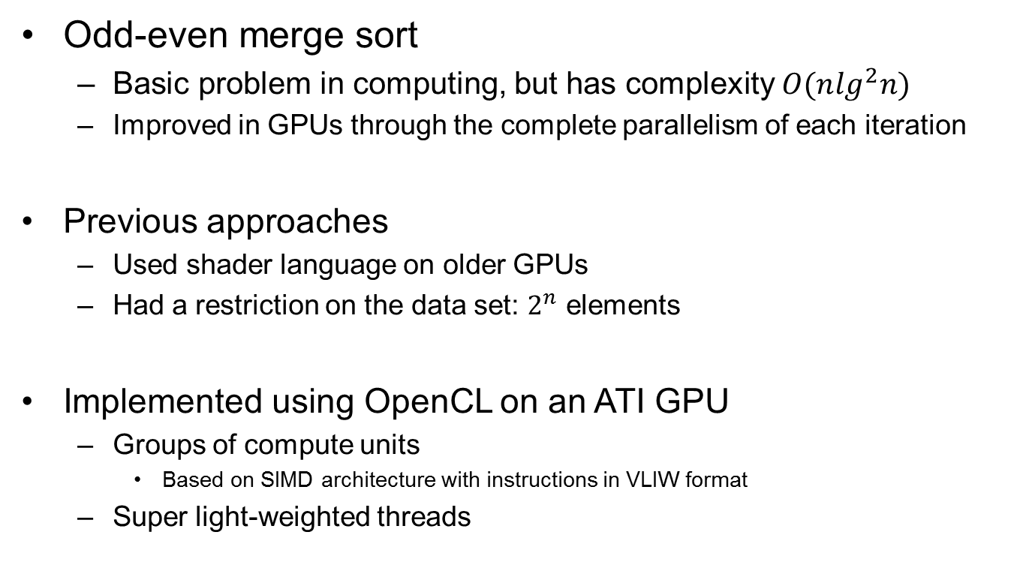
Parallel Sorting
Odd-even merge sort
Basic problem in computing, but has complexity $O(n\lg^{2}n)$
Improved in GPUs through the complete parallelism of each iteration
Previous approaches
Used shader language on older GPUs
Had a restriction on the data set: $2^{n}$ elements
Implemented using OpenCL on an ATI GPU
Groups of compute units
Based on SIMD architecture with instructions in VLIW format
Super light-weighted threads
Notes:
High complexity makes it bad in most cases
Shader language – no advanced memory control or special hardware for general purpose computations
Restriction makes it not suitable for real applications

Slide 18
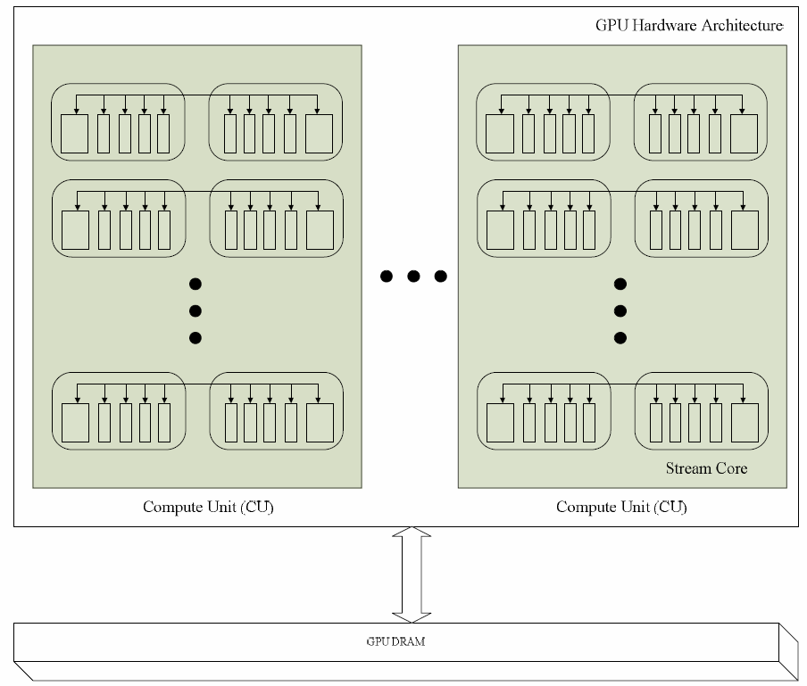
Parallel Sorting
[9]
Simplified ATI GPU Architecture

Slide 19
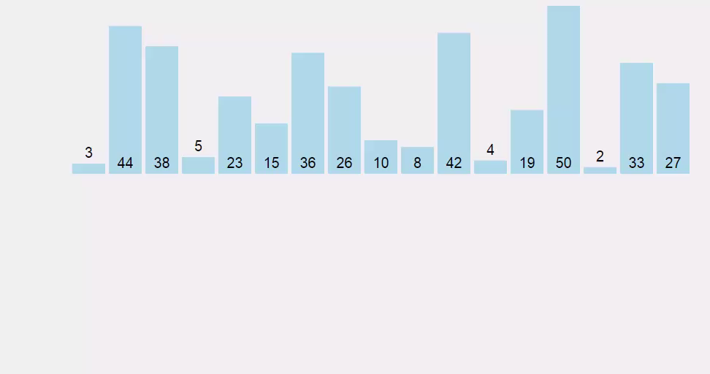
Parallel Sorting
[10]

Slide 20
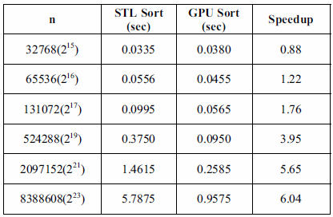
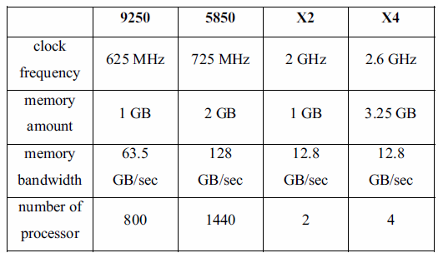
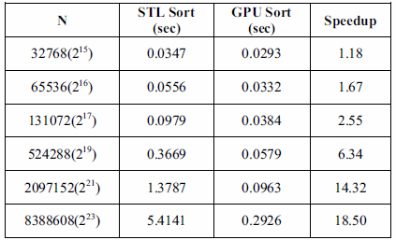

Parallel Sorting
Results compared with C++ STL quick sort
Data generated randomly with a uniform distribution
If $p$ is the number of processors:
Complexity: $O({\left.nlg^{2}n\right.}/p)$ in practice
[4]
Notes:
The # of processors is < doulble, but the speedup is > double!
Speedup increases with data length and also improves with processor count

Slide 21
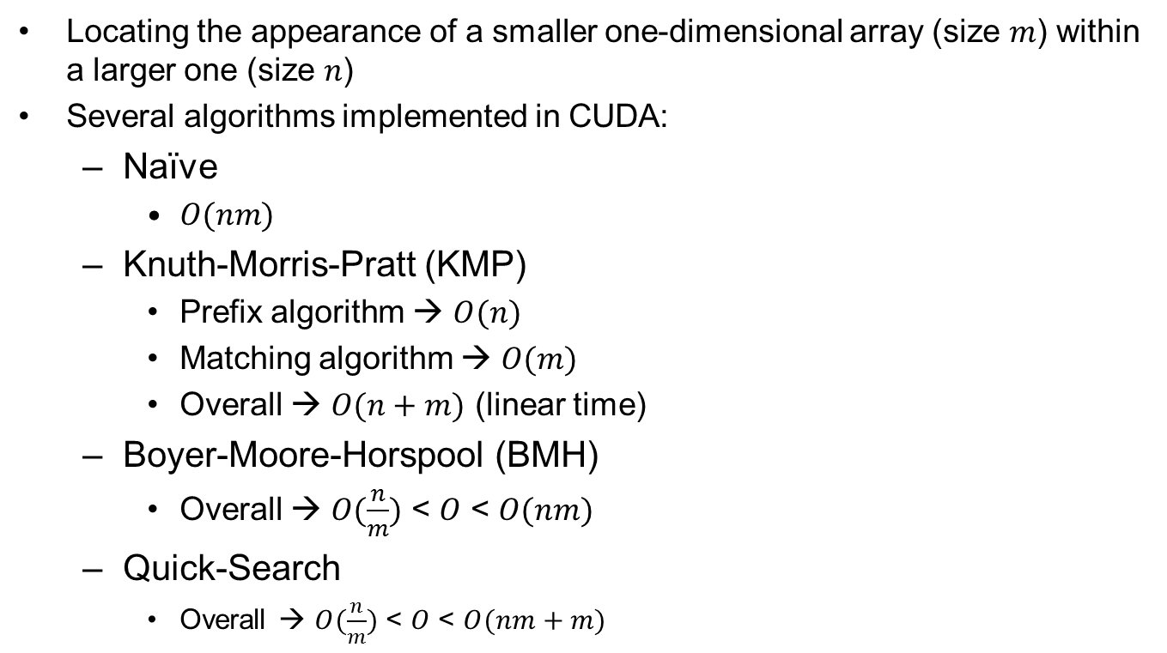
String Matching
Locating the appearance of a smaller one-dimensional array (size $m$) within a larger one (size $n$)
Several algorithms implemented in CUDA:
Naïve
$O(nm)$
Knuth-Morris-Pratt (KMP)
Prefix algorithm → $O(n)$
Matching algorithm → $O(m)$
Overall → $O(n+m)$ (linear time)
Boyer-Moore-Horspool (BMH)
Overall → $O(\frac{n}{m})$ < $O$ < $O(nm)$
Quick-Search
Overall → $O(\frac{n}{m})$ < $O$ < $O(nm+m)$
Notes:
Usually a smaller string inside of a larger string (text)
KMP -> left to right
BMH -> right to left
QS -> simplified BMH for short patterns

Slide 22
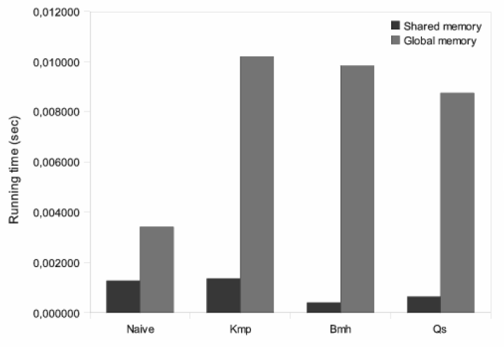
String Matching
[5]
Speed improvement when using shared memory

Slide 23
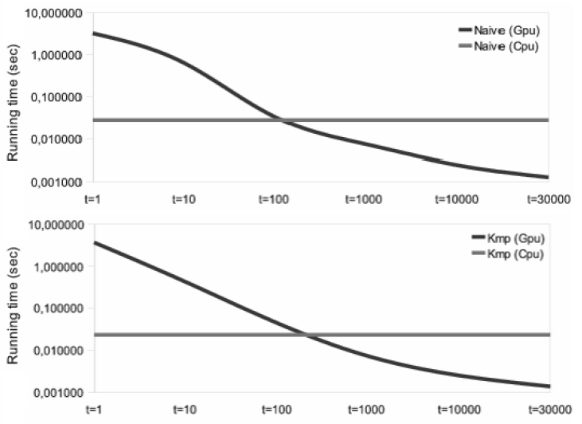
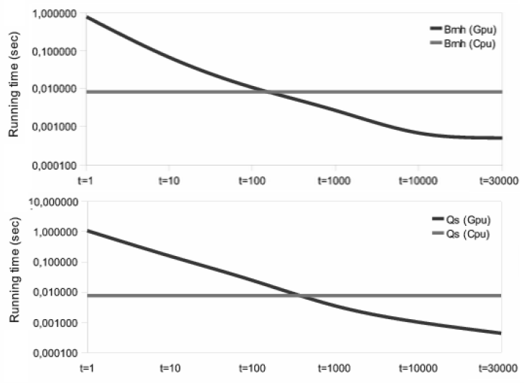
String Matching
[5]
Run time as compared with the CPU for $t$ threads

Slide 24
String Matching
Results
Parallel implementation → Up to 24x faster
Future work
Examine performance on multiple GPUs
Further optimize the parallel implementation
Make better use of GPUs capabilities
Loop unrolling, matrix reordering, smarter shared memory
Notes:
Up to 24x when using large text and small pattern sizes (where the GPU becomes better than the CPU)

Slide 25
Computer GO Engine
[7]
Notes:
18x18 grid

Slide 26
Computer GO Engine
Using a Monte-Carlo Tree Search targeted for a GPU
Tree traversal to evaluate board situations
CPUs fail to have enough computing power to meet the needs for GO’s search space
Thousands to hundreds of thousands of simulations
Takes advantage of the L1 Cache on the GPU (shared memory)
Algorithm
Randomly pick a valid point on the board
Repeat this until there are no valid points left
Return the result
Results
Performance improved greatly compared to CPUs simulations
Notes:
Monte-Carlo algorithm, based on random decisions under certain constraints
Even though so many simulations, order does not matter → Parallel!
Need to parallelize to make up for the lack of AI

Slide 27
Conclusions
GPUs are becoming increasingly popular
The computer gaming market is driving the GPU production rate
The number of APIs and their ease of use is increasing
CUDA’s available language bindings:
C, C++, Java, Lua, MATLAB, C#, Perl, Python, more...
A lot of potential especially with multiple GPUs / CPUs
The limiting factor is the programming
Notes:
Limiting factor on the fundamental understanding/methodology to make parallel programs and how to do it

Slide 28
Main References
[1] | Q. Zhang and Z. Liu, "A parallel design of computer Go engine on CUDA-enabled GPU," 2011 IEEE International Conference on Cloud Computing and Intelligence Systems, Beijing, 2011, pp. 85-88.
[2] | Da Qi Ren and R. Suda, "Investigation on the power efficiency of multi-core and GPU Processing Element in large scale SIMD computation with CUDA," Green Computing Conference, 2010 International, Chicago, IL, 2010, pp. 309-316.
[3] | G. Hu, J. Ma and B. Huang, "Password Recovery for RAR Files Using CUDA," Dependable, Autonomic and Secure Computing, 2009. DASC '09. Eighth IEEE International Conference on, Chengdu, 2009, pp. 486-490.
[4] | K. Zhang, J. Li, G. Chen and B. Wu, "GPU accelerate parallel Odd-Even merge sort: An OpenCL method," Computer Supported Cooperative Work in Design (CSCWD), 2011 15th International Conference on, Lausanne, 2011, pp. 76-83.
[5] | C. S. Kouzinopoulos and K. G. Margaritis, "String Matching on a Multicore GPU Using CUDA," Informatics, 2009. PCI '09. 13th Panhellenic Conference on, Corfu, 2009, pp. 14-18.

Slide 29
Other References
[6] | Aaron Carroll and Gernot Heiser. 2010. An analysis of power consumption in a smartphone. InProceedings of the 2010 USENIX conference on USENIX annual technical conference(USENIXATC'10). USENIX Association, Berkeley, CA, USA, 21-21.
[7] | Katpatuka. 2005. Go-board-animated.gif. https://upload.wikimedia.org/wikipedia/commons/f/f3/Go-board-animated.gif
[8] | "Big-O Algorithm Complexity Cheat Sheet", Bigocheatsheet.com, 2016. [Online]. Available: http://bigocheatsheet.com/. [Accessed: 06- May- 2016].
[9] | AMD Corporation. ATI Stream Computing OpenCL Programming Guide, March 2010.
[10] | "VisuAlgo - Sorting (Bubble, Selection, Insertion, Merge, Quick, Counting, Radix)", Visualgo.net, 2016. [Online]. Available: http://visualgo.net/sorting. [Accessed: 06- May- 2016].
[11] | Core0.staticworld.net, 2016. [Online]. Available: http://core0.staticworld.net/images/article/2015/03/geforce_gtx_titanx_3qtr-100573547-orig.png. [Accessed: 06- May- 2016].
[12] | Amazon, 2016. [Online]. Available: http://ecx.images-amazon.com/images/I/61wR4O5hm3L._SL1200_.jpg. [Accessed: 08- May- 2016].

