Slide 2
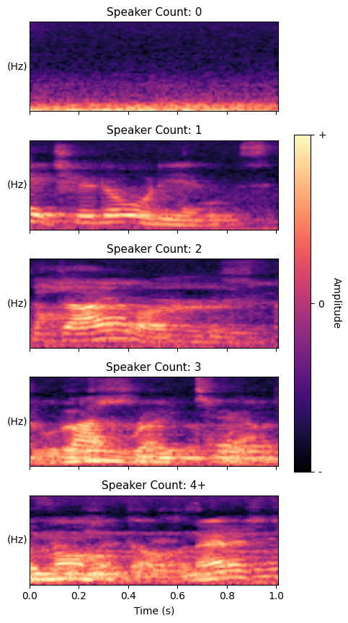
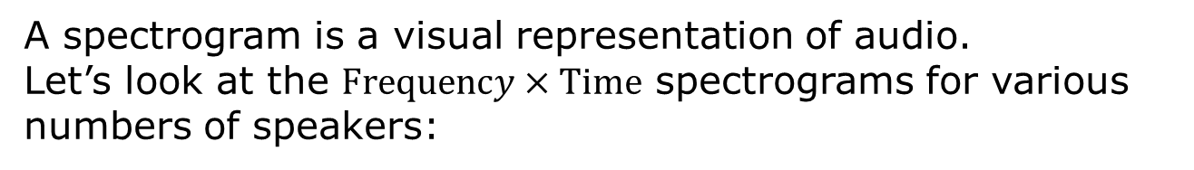
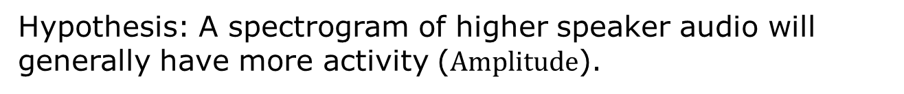
Visualising Speaker Count with Spectrograms
A spectrogram is a visual representation of audio.
Let’s look at the $Frequency×Time$ spectrograms for various numbers of speakers:
Hypothesis: A spectrogram of higher speaker audio will generally have more activity ($Amplitude$).
If the hypothesis is true, a Convolutional Neural Network would be able to learn the differences between these spectrograms

