Slide 2
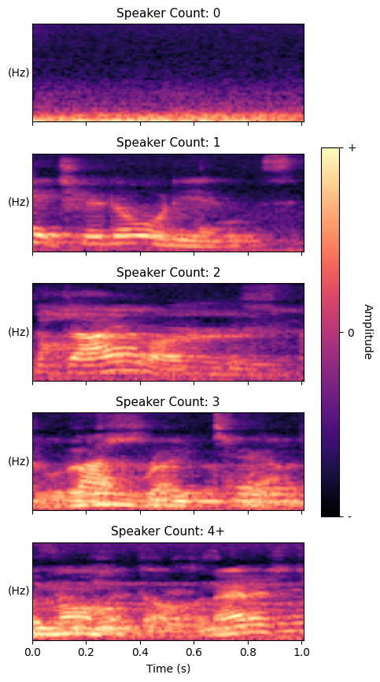
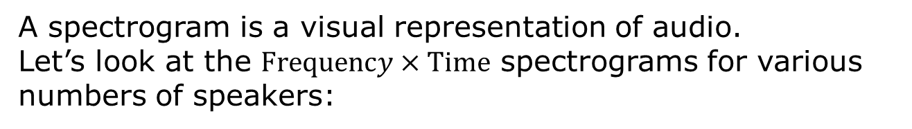
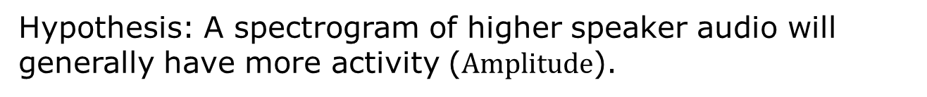
Visualising Speaker Count with Spectrograms
A spectrogram is a visual representation of audio.
Let’s look at the $Frequency×Time$ spectrograms for various numbers of speakers:
Hypothesis: A spectrogram of higher speaker audio will generally have more activity ($Amplitude$).
If the hypothesis is true, a Convolutional Neural Network would be able to learn the differences between these spectrograms

Slide 3
Why speech processing is unsolved
Current landscape (current models / application/ potential)
Limitations → initially wanted to build a pipeline that took real time audio and identified individual speakers and transcribed…(insert initial graph) → limited by no reliable model that …. → currently are models for the other steps…
New hypothesis was to build this missing model →
Limitations
Reasoning for why this model wasn’t there in the first place kind of thing
Single-channel

