Slide 1
CNNs for Speech Processing
Speech Processing in Production
Connor Boyd-Lyon
MSc Data Science, 2025

Slide 2

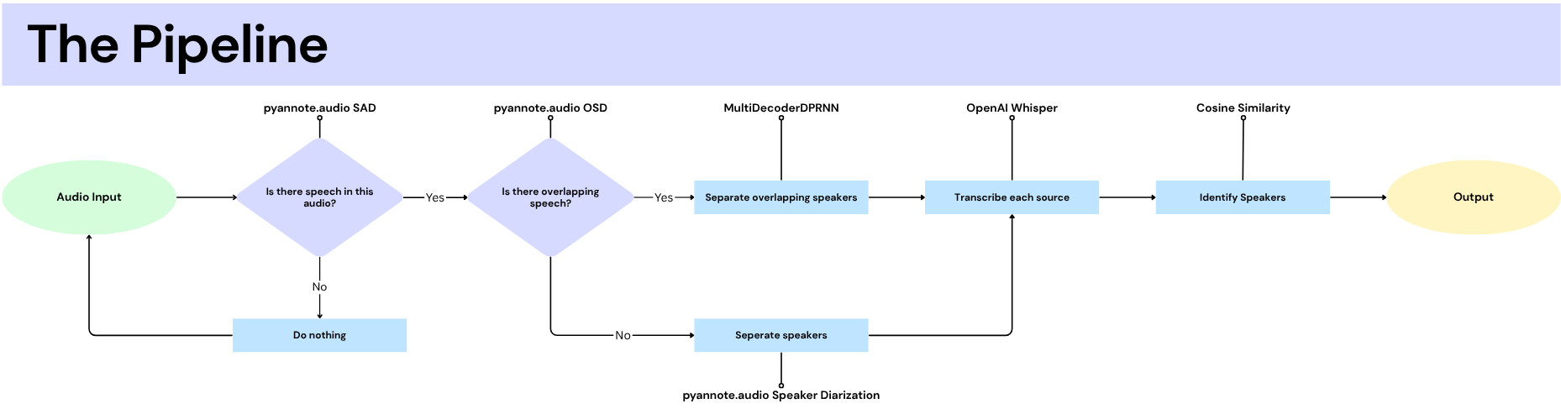
Notes:
This is the typical speech processing pipeline. There are SOTA models available that solve each step, so
(Explain the pipeline: this does ___, that does ___).
By chaining them together we’re able to find out who is speaking and what they are saying, at any time, from a single source. Right?
Actually, it’s not so simple. The speech processing pipeline is idealistic and doesn’t work as well as it’s benchmarks may suggest. Let’s see why.

Slide 3
The speech processing pipeline relies on a perfect input!
Multi-Channel audio – unrealistic
Hard-Coded assumptions
Fragile to domain shift – models fall apart in production
Notes:
1. Most datasets are recorded in many channels. LibriCSS, a popular speech processing dataset, uses 7 channels, which means that 7 microphones were used to give the most spatial information possible.
2. Almost all speech processing models enforce hard-coded assumptions which are often untrue, including speaker count, sample rates and clean segmentation. The models ask for a perfect input and will fail otherwise.
3. Speech Processing is a task that is thought to be ‘solved in research, unsolved in production’. When taking SOTA models into a real-world application, they often fail, because the real-world is not perfect.
The pipeline you see above is unfortunately not possible to achieve, because each of the models have their own issues with complexity, input assumptions, and requirement mismatches. And as I said, most of them don’t work outside of the lab they were made in.

Slide 4

Solving pieces of the pipeline to work in production
This project explores whether speech processing tasks can be solved in real-time, on a single channel.
Research and development led to the creation of three models:
A Voice-Activity detector (VAD) which classifies whether speech is present in audio or not.
A 4 class Speaker Counter which assumes speech is present.
A 5 class Speaker Counter which attempts to predict the number of speakers in a voice clip.
Each model shares a similar architecture that utilises convolutional layers.
… Why convolutional layers?

Slide 5
A Convolutional Neural Network (CNN) for Speech Processing
Many alternative methods were considered:
Alternative Method | Why CNNs are superior
Energy-based methods | Only learns ‘volume’ – CNNs can learn robust patterns to determine the difference between noise (e.g. a door closing) and a voice
Long-Short Term Memory (LSTM) methods | CNNs are faster in inference; crucial for real-time
Transformer-based methods | The current SOTA. Good in concept but is too bulky for a lightweight & real-time solution. Relies on perfect data.
CNNs find themselves in the midground of complexity-accuracy spectrum.

Slide 6
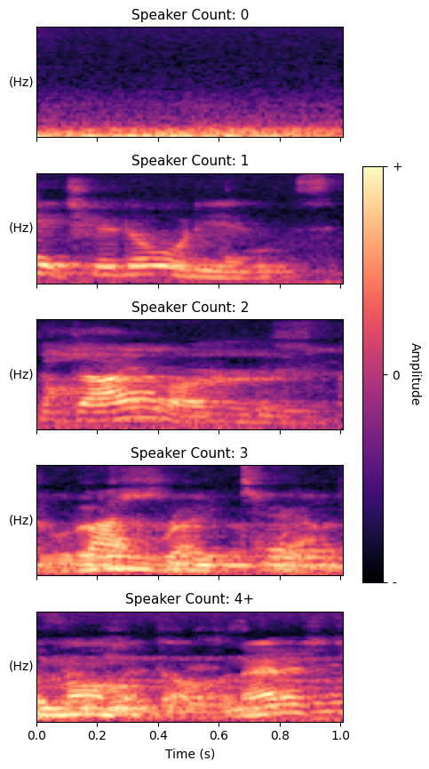
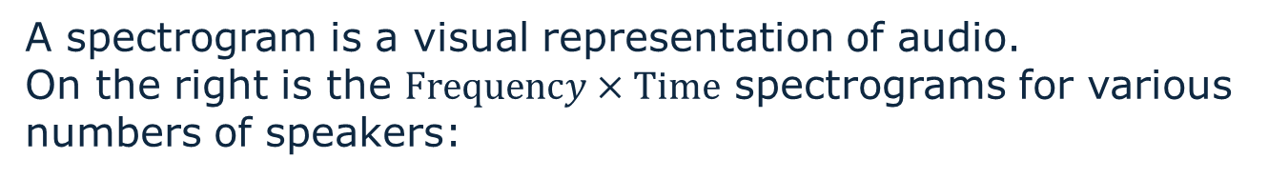
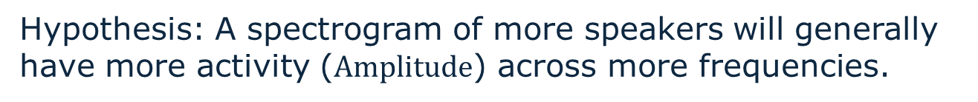
Learning audio features with Spectrograms
A spectrogram is a visual representation of audio.
On the right is the $Frequency×Time$ spectrograms for various numbers of speakers:
Hypothesis: A spectrogram of more speakers will generally have more activity ($Amplitude$) across more frequencies.
If this hypothesis is true, a Convolutional Neural Network (CNN) could be able to classify:
Whether anyone is speaking
How many people are speaking

Slide 7
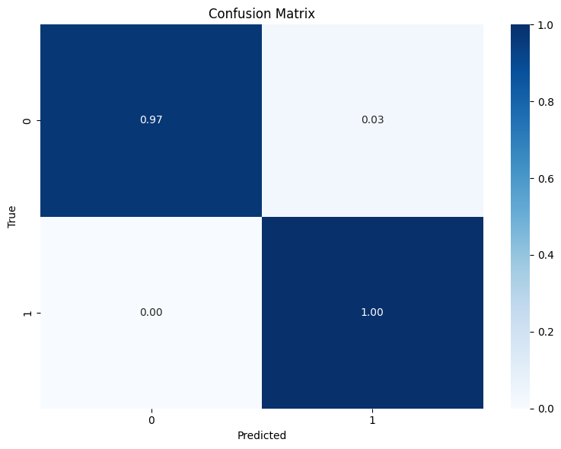
Voice Activity Detection (VAD) via a CNN
→ConvVAD takes a spectrogram as input and gives a binary output.
→It fit the training data easily, even with ~60,000 observations to learn from
→ It has functionality in real-time, despite seemingly overfitting

Slide 8
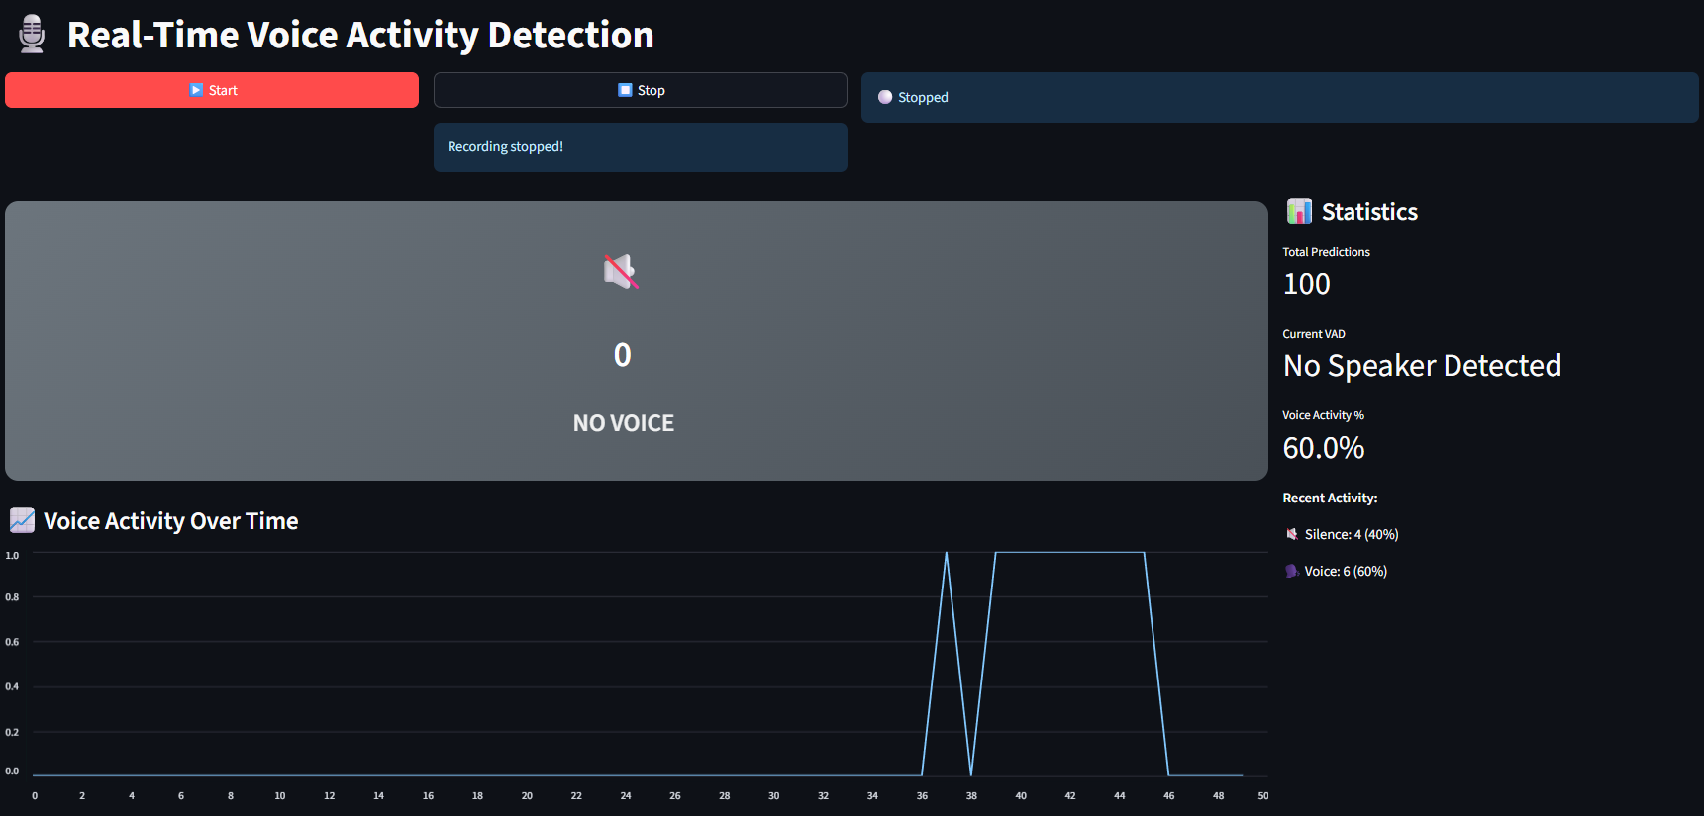
Real-Time Voice Activity Detection (VAD) Demo
Disclaimer: I am not a front-end developer… ☺

Slide 9
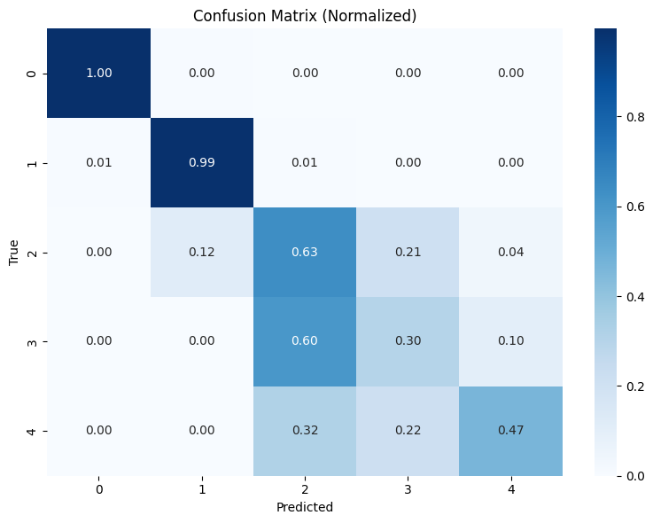
Speaker Counting via a Multi-Class CNN
→ ConvCount takes an audio input and attempts to classify how many speakers are present
The model struggled with higher classes even with ~110,000 observations to learn from (20-25k samples per class)
The model was better at the 0 and 1 class than the other classes – are these the easiest classes to identify?
→ It has very little functionality in real-time
Confusion Matrix for the 0-4+ Speaker Count model
Notes:
This was a much harder task.

Slide 10
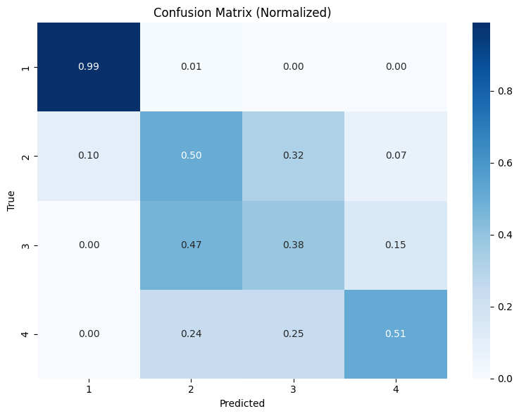
Decreasing the Class Count
→ A second model was made that removes the ‘zero’ class – the model assumes that there is speech in the input.
There wasn’t much improvement though:
The Speaker Counter models did not work as well as planned, what does this mean?
→ Is it the CNNs fault?
→ Or could there be other reasons?
Confusion Matrix for the 1-4+ Speaker Count model

Slide 11
Understanding the issues with the Speaker Count CNN
By interpreting the results it’s clear that the architecture and data is to blame, not the choice of model:
The model did learn patterns from the data.
The results aren’t random; the model has learned.
There are issues with inter-class complexity.
Classes 0 and 1 are easy to learn; classes 2+ are hard. Training for more epochs wasn’t an appropriate solution, as the 0 and 1 class would overfit even more.
The models were likely too simple.
A larger model may be able to learn abstract features that better separate the higher classes.

Slide 12
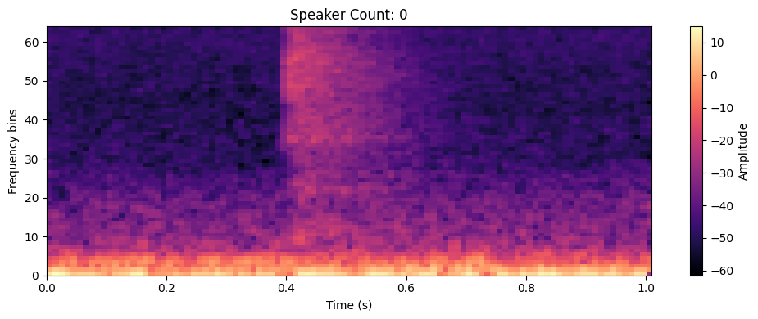
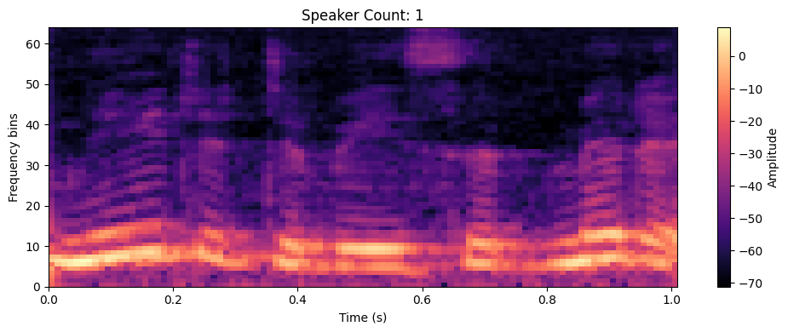
Conclusions
The three models collectively show that:
→ Spectrograms provide rich & learnable information
CNNs can learn this information
CNN-based models are efficient in production
There is a place for solutions that work in real-time, not just laboratory-made models that fail in the real world.
Production ready modelling should be considered proactively, not ad-hoc.
Above: A spectrogram showing a noisy 0 speaker sample.
Above: A spectrogram showing a 1 speaker sample. Notice the harmonics.

Slide 13
Future Work
→ A larger, more diverse speech dataset would prevent overfitting on the VAD model and help many models generalise.
→ A deeper Speaker Counter CNN such as ResNet50* could be applied to achieve SOTA
→ Scalable, low-latency audio analytics via Edge Computing
→ The Speech Processing pipeline in real-time
*ResNet50 (Kaiming et al., 2016) is a seminal CNN architecture with 50 layers. It can learn very complex representations without overfitting or vanishing.
Notes:
More accents, languages, voice types AND more noise types, environments, etc. The VAD model has serious potential.
A better architecture could see much more success with Speaker Counting; I’m keen to see if CNNs can be used to achieve SOTA.
These models, could be applied to smart devices, where analytics can be made on meetings, or for surveillance

Slide 14
Thank you!
Questions are Welcome.
ConvVAD
ConvCount
Connor Boyd-Lyon
MSc Data Science, 2025

