Slide 1


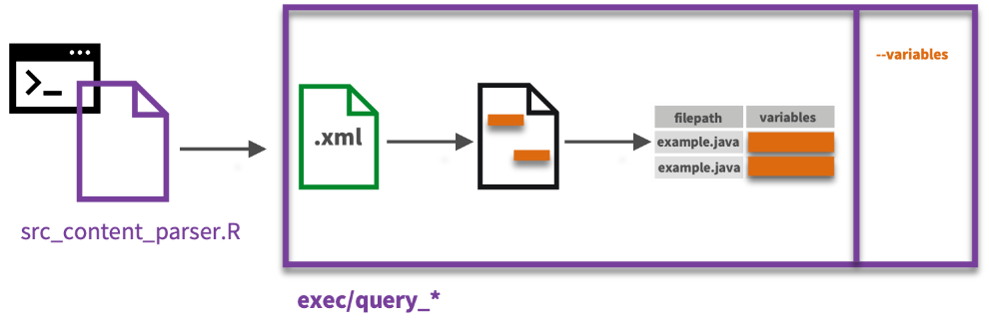
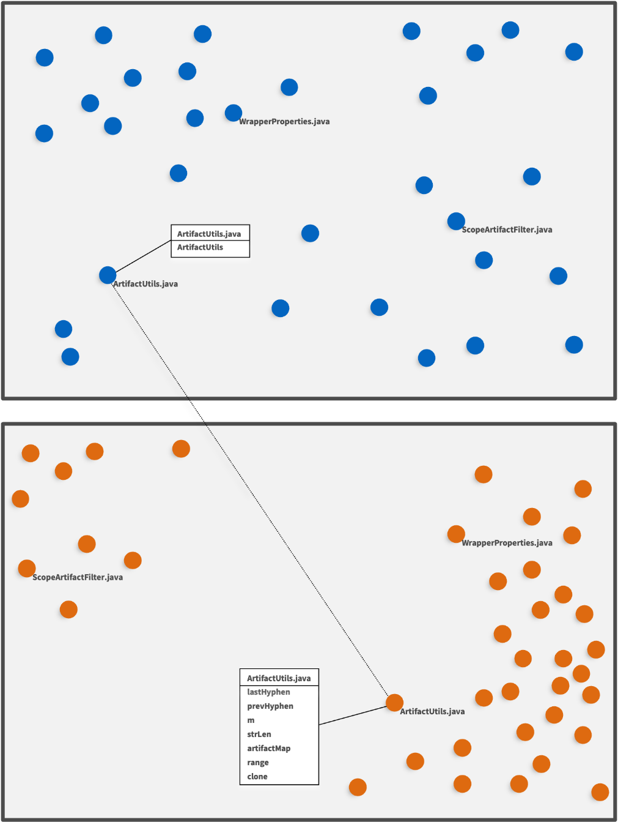


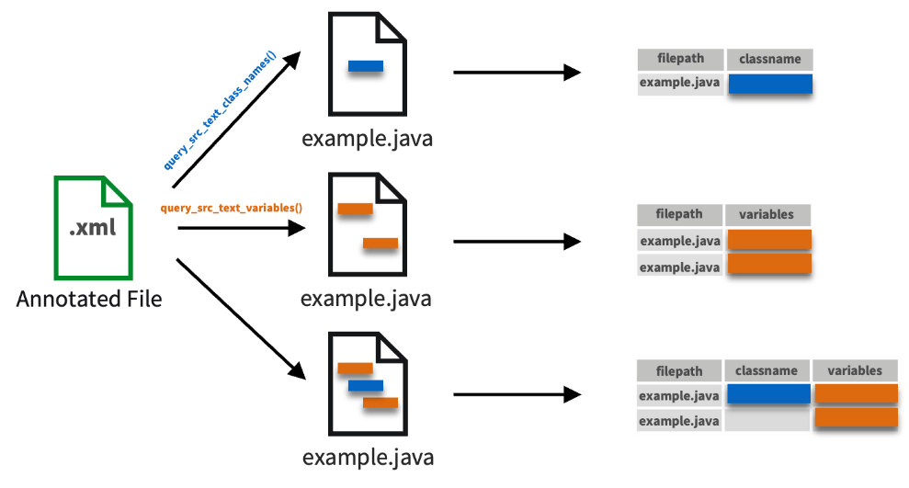
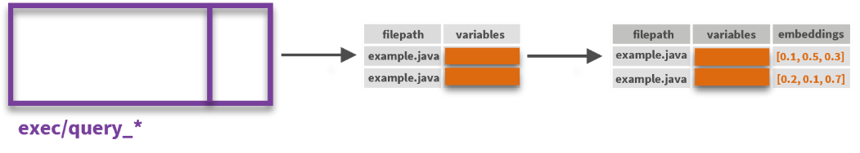
File Similarity by Code Representation : : CHEAT SHEET
About
Exec Scripts
UMAP
Files can be represented differently depending on how we subset their content, such as functions, class names, variables, or documentation. These representations shape the way files are similar to one another, as selected code snippets emphasize different semantic relationships between files. This cheat sheet describes how to use Kaiāulu to represent source code differently for semantic similarity.
Exec scripts act as interfaces between Kaiāulu functions and external tools, exposing Kaiāulu’s capabilities to external sources through the command line. Users can execute scripts for specific queries (e.g., extracting function names or documentation) from the terminal.
UMAP transforms high-dimensional embeddings by reducing dimensionality and fitting on a plane, which allows for visualization of the relationships between files.
Source Code Representation
The Syntax Extractor in Kaiāulu is used to extract selected content from source code using srcML. The srcML tool is used to annotate source code with descriptive tags that help in identifying code elements.
Project
annotate_src_text()
.xml
src_content_parser.R: serves as the main entry point for querying. It takes a flag specifying the query type (e.g., --class-names, --variables) and calls the associated query function. The annotated file is passed as a parameter, determining the contents to be queried.
query_* scripts: implement the logic for specific types of queries, such as extracting class names or variables. Each query focuses on a particular aspect of the code representation.
Source Code
Annotated Source Code
annotate_src_text(): generates an annotated XML file.
XPath queries are used to query the annotated file, and output a table of filenames and the source code element being queried (variable names, function names, file class documentation, etc.)
Embeddings
Word embeddings represent text semantics by mapping words or sentences to a numerical representation. The numerical vector representation can be used for semantic similarity comparisons which would be lost if direct word comparison was utilized.
Query functions: Kaiāulu provides an API for extracting different portions of source code files as structured tables. These representations include variable names, function names, documentation, and more, each capturing specific file elements. Using these tables, we can analyze and transform code into selected representations for further processing.
query_src_text_class_names(): outputs a table of with a class names column, and a file paths column.
query_src_text_namespace(): outputs a table with a namespaces, and a file paths column.
Relevant Notebook: syntax_extractor.Rmd
Beyond the selection of a file representation, different models to convert content to embeddings can also be selected. For example, Java-specific FastText embeddings may be better for source code representations, while a file representation containing only code documentation may benefit from natural language embeddings instead of source code. Other language models may also be more appropriate if the source code is not Java. Kaiāulu parameterizes the pipeline.
The diagrams above show how the representation of code elements, such as class name and variables, impacts the relative positions of files in a UMAP projection. Each representation emphasizes different aspects of the code, resulting in varied groupings and relationships.
This variability demonstrates the importance of selecting the appropriate representation for the specific insights required. By choosing different code elements, similarity analysis can be tailored to answer diverse research questions.
Kaiāulu
CC BY SA Dao McGill, Mark Burgess, Nicholas Beydler, Raven Quiddaoen, Carlos Paradis • Kaiāulu package version 0.0.0.9700 (in development) • Updated: 2024-11
Notes:
Colored file icons for kaiaulu functions showing how source code can be represented in table form
Text explaining files/functions (include a table, look from other cheat sheets)
Execs as boxes wrapping around function. Point is can be accessed from cmd
Explain embeddings: file -> exec -> table -> notebook -> exec outputs -> one col with embedding
make some scripts transparent: choice in representation of code; choice in model. Documentation might make more sense with natural language model?
Diagram representation of UMAP representing files in 2D plane. 2 examples if can. See carlos linkedin.

Slide 2






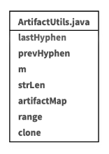
--variables
.xml
filepath
variables
example.java
example.java
src_content_parser.R
exec/query_*
filepath
variables
filepath
variables
embeddings
WrapperProperties.java
example.java
example.java
[0.1, 0.5, 0.3]
exec/query_*
example.java
example.java
[0.2, 0.1, 0.7]
ScopeArtifactFilter.java
ArtifactUtils.java
filepath
classname
 | Make
query_src_text_class_names()
example.java
example.java
.xml
query_src_text_variables()
filepath
variables
WrapperProperties.java
example.java
ScopeArtifactFilter.java
Annotated File
example.java
example.java
filepath
classname
variables
example.java
example.java
example.java
ArtifactUtils.java

