Slide 1




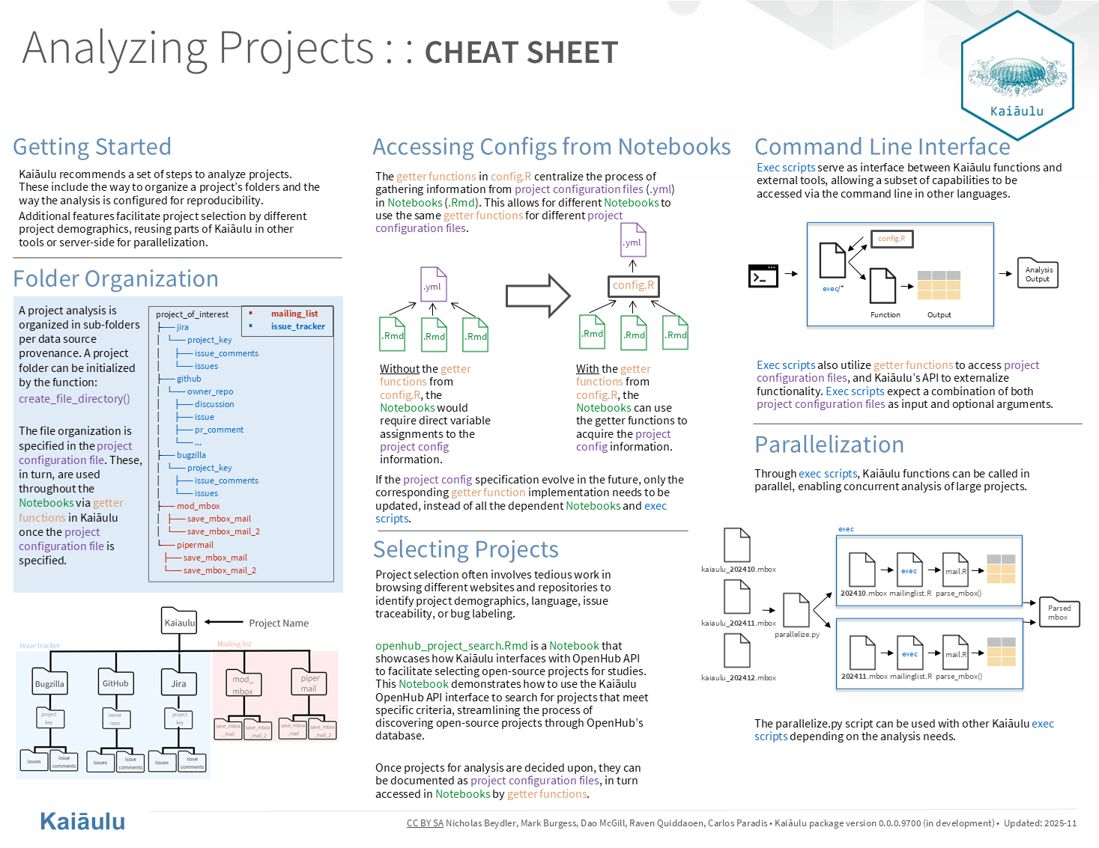
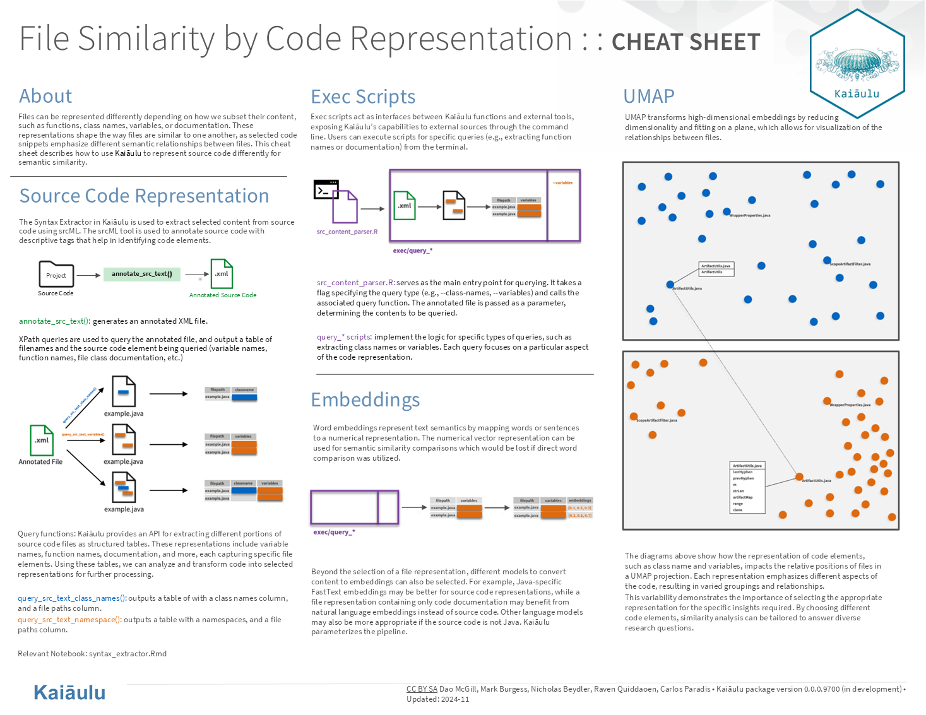
Parallel Systematic Similarity Analysis of Software Repositories
Nicholas Beydler, Mark Burgess, Dao McGill, Raven Quiddaoen
Sponsors: Carlos Paradis & Rick Kazman
github.com/sailuh/kaiaulu
ICS 496, Fall 2024 Information and Computer Sciences Department - University of Hawaiʻi at Mānoa
Introduction
Methodology
Learnings
Kaiāulu is an R package aimed at analyzing the dynamics of growing software development communities and the collaborative artifacts (gitlog, mailing list, files, etc.) they interact with.
Project Management
Agile software development
GitHub Issues and Pull Requests for documented communication and collaboration
Roles
Nicholas: Technical Lead
Mark: Testing Lead
Dao: Communications Lead
Raven: Meeting Scribe
Defining issues and scope according to specifications, and refining solutions through iterative feedback.
Developing clear and concise documentation, providing guidance to users potentially unfamiliar with the technology.
Efficient software configuration management using GitHub improved collaboration, version control, and overall organization during development.
The importance of clearly defined roles in enhancing teamwork and coordination to meet milestone deadlines.
Accomplishments
Reconfigured folder organization for project configuration files at the project level; and created a graphic of the suggested template for folder hierarchy.
Implemented function to create folder organization on user’s local device.
Expanded on Github API endpoints; added new downloaders and refreshers.
Created an interface to extract dependencies from source code using Scitools Understand
Extended testing and documentation of existing tools which analyze project class files and extract Gang of Four Motifs.
OpenHub API interfacing functions to facilitate selecting open-source projects for analysis.
Centralized process for gathering details from project configuration files and decoupled notebooks from direct variable assignments in the configuration files.
Implemented download and refresh of two mailing list data archives (mod mbox and pipermail).
Developed a Python script for the parallelization of Kaiāulu functions via exec scripts.
Extended syntax extraction capabilities by implementing functions for various elements (e.g. classes, variables, functions, etc.) leveraging srcML.
Developed exec scripts to make parsed source code available to other tools.
Utilized the FastText ML model to generate code embeddings for computing semantic similarities between code snippets.
Challenges
Technical understanding of Kaiāulu’s framework
Balancing readability, requirements, and extensibility in writing code
Operating system restrictions (Kaiāulu has been tested on OS X and Ubuntu)
Installation and configuration of third party packages

