Slide 1
Software Analytics Insights
Final Presentation
Dao McGill, Nicholas Beydler, Mark Burgess, Raven Quiddaoen

Slide 2

Kaiaulu | An R package for mining software repositories
➣ An open-source R package for mining software repositories
➣ Helps perform data analysis on software
development artifacts
(gitlog, mailing lists, files, etc.)
➣ First created by Carlos Paradis as part of a PhD dissertation in the ICS program
https://github.com/sailuh/kaiaulu

Slide 3
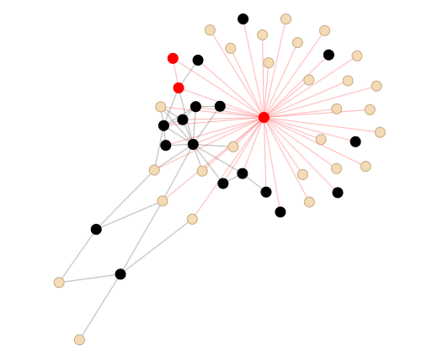
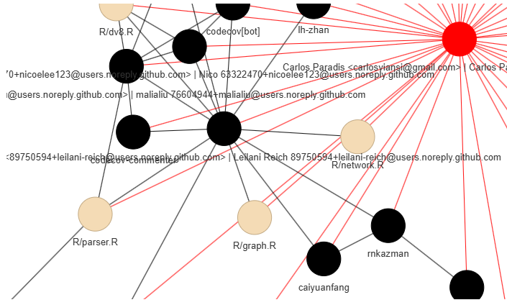
Problem Statement
Understanding Kaiāulu
➣ Kaiāulu is an open source R package designed for mining software repositories to analyze their characteristics, by examining collaborative artifacts such as gitlogs, mailing lists, and files.
Goal
➣ To refactor and extend Kaiāulu’s existing functionality, improving modularity, and introducing more tools for software repository analysis.
Motivation
➣ Software repository analysis tools typically offer features tailored to specific types of analysis with restrictive user interfaces. Kaiāulu aims to provide a flexible user interface composed of generalized functions, with function documentation and notebooks that provide users with abundant examples to customize their analyses.

Slide 4
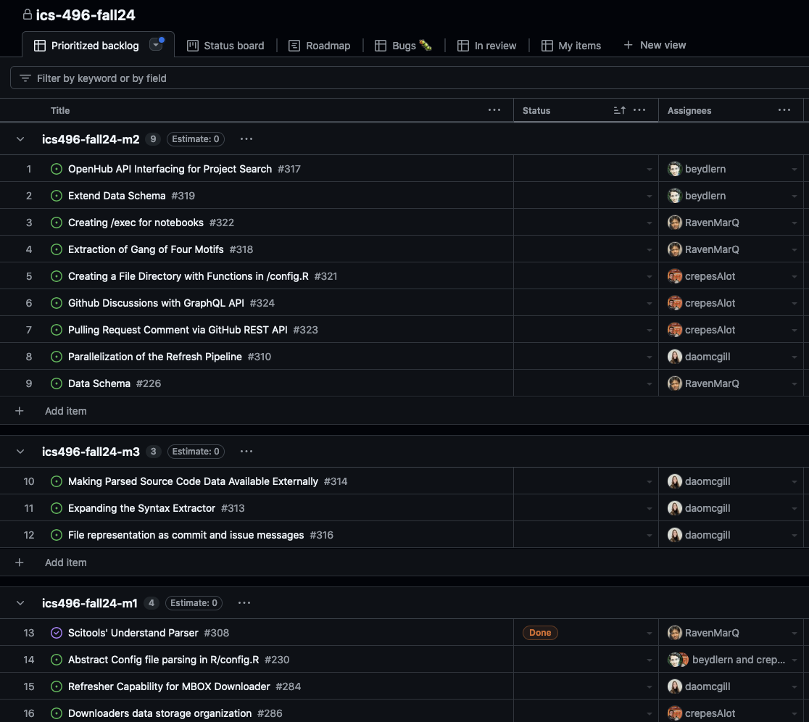
Technical Solution & Implementation
Milestone 1:
➣ Folder organization and config specification:
➣ Getter functions to decouple notebooks
➣ Download and refresh of mailing list archives:
Developed download and refresh functions for Mod Mbox and Pipermail
Wrote exec script for download, refresh and parse of mailing list data
Created notebook for documentation
➣ Extract File & Class Dependencies using third-party tools
Interact with third-party tool API
Write function to extract data via API
Created notebook for documentation

Slide 5
Technical Solution & Implementation
Milestone 2:
➣ Allowing extraction of data using CLI commands
Read through and understand why, what, and how function(s) output data
Wrote exec script with relevant data outputs
➣ Analyze projects for usage of Gang of Four Motifs
Thorough testing of a third-party analysis script with multiple projects and structures to stress test its specificity
Update existing notebook for improved user clarity
➣ Project selection using OpenHub’s database
➣ Extend usage of Github’s API endpoints
➣ Create function to create folder directory for configuration files
➣ Parallelize project analysis
Python parallelization script for adaptation to exec scripts
Python script for parallelization of mbox parsing
Jupyter notebook for documentation

Slide 6
Technical Solution & Implementation
Milestone 3:
➣ Expand the syntax extractor
Functions for file-level docs, class-level docs, classes, variables, functions, imports, packages
Notebook for syntax extraction
Exec script to query and parse source code
➣ Use FastText model to generate vector representations of semantic similarity
Python functions for:
Loading model
Running queries
Tokenization
Generating embeddings
Calculating cosine similarity and similarity matrix
➣ Use UMAP to visualize similarities with dimensionality reduction
Jupyter notebook for UMAP examples of various representations

Slide 7
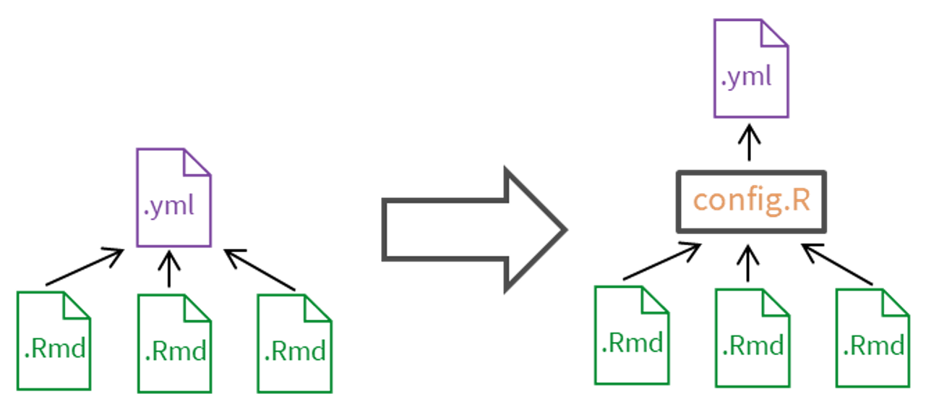
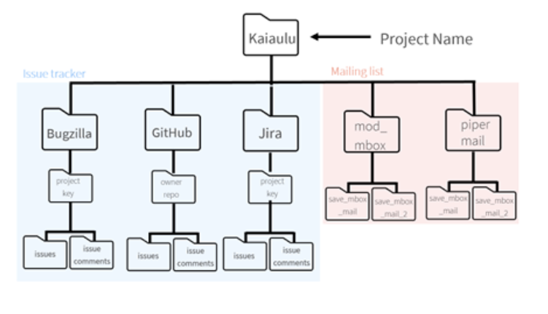
Major Accomplishments (configuration)
➣ Centralized process for gathering details from project configuration (.yml) and decoupled notebooks (.Rmd)
➣ Reconfigured folder organization for project configuration files at the project level
➣ Implemented function to create folder organization on user’s local device

Slide 8
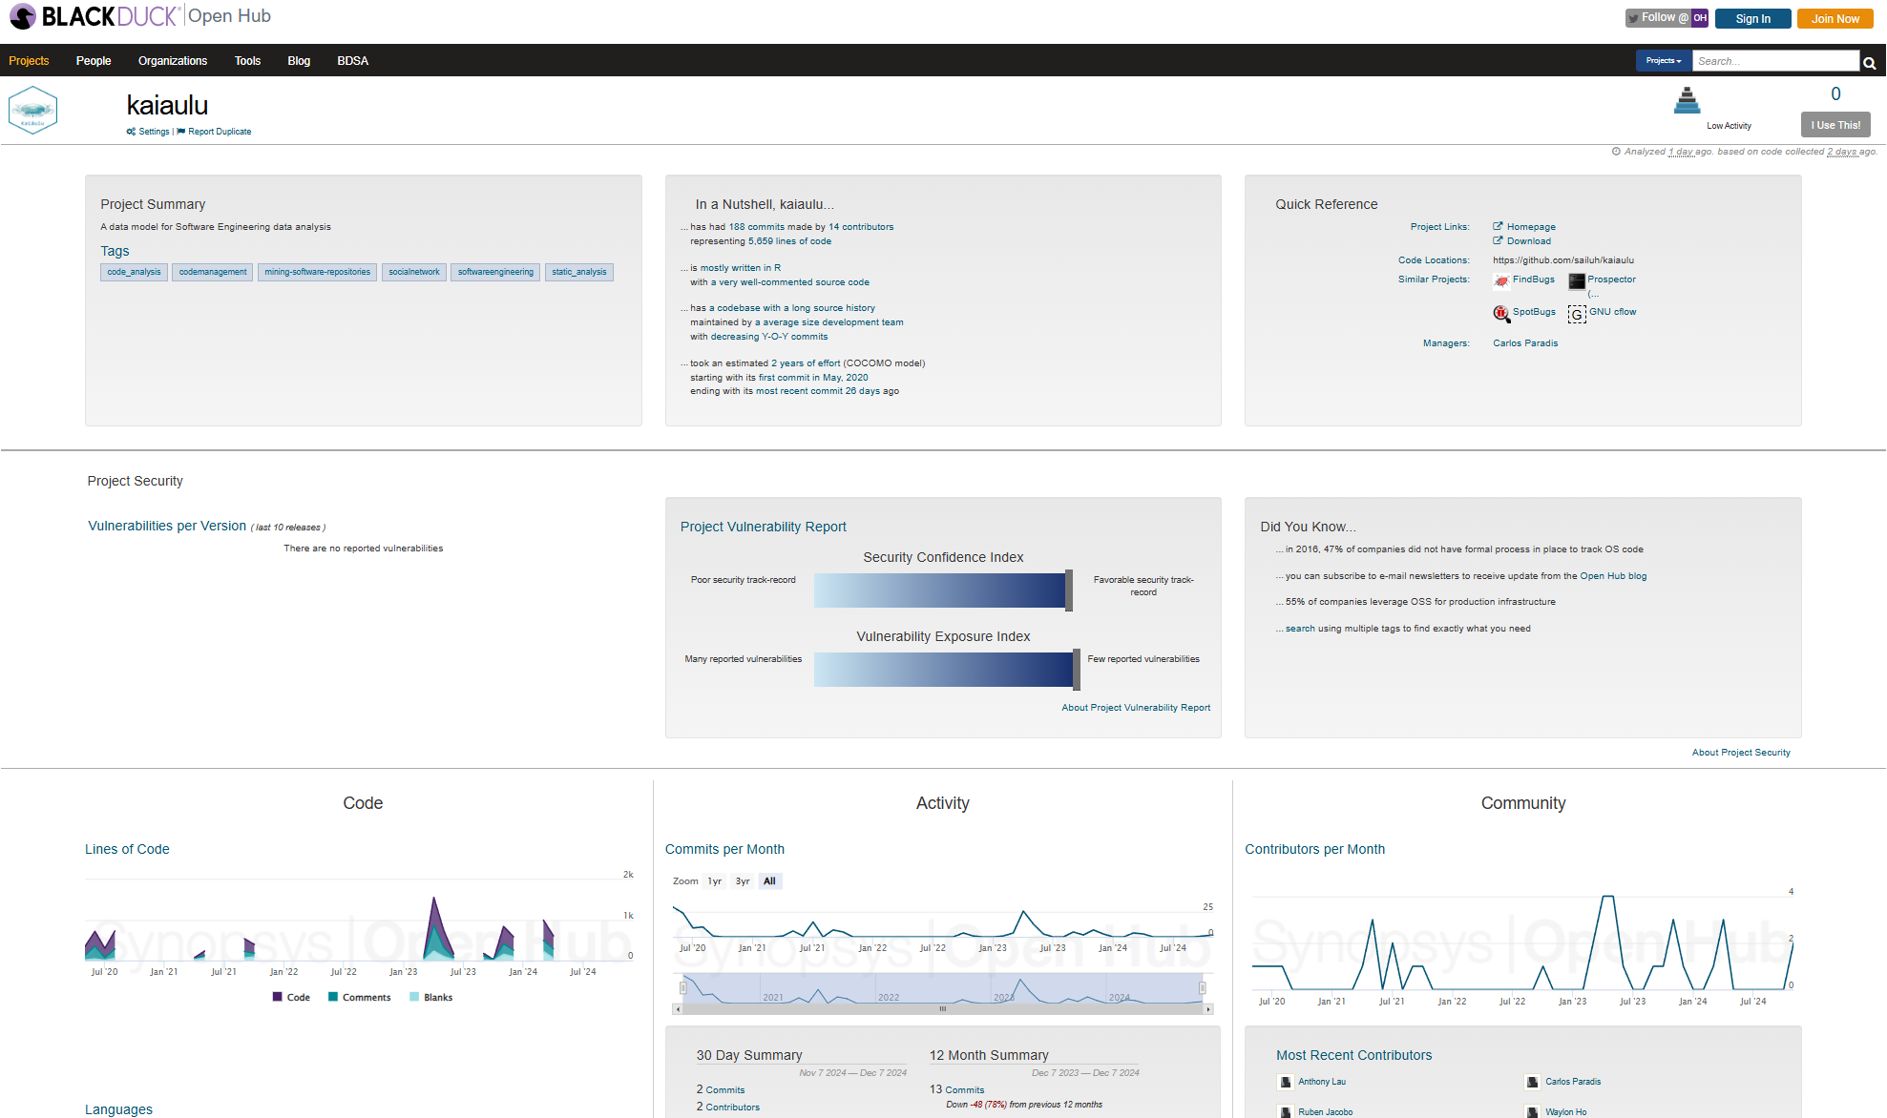
Major Accomplishments (project selection)
➣ OpenHub API interfacing functions to select open-source projects for analysis
➣ Expanded on Github API endpoints
➣ Created an interface to extract dependencies from source code using Scitools Understand
➣ Extended testing of existing tools to analyze project class files and extract Gang of Four Motifs
➣ Implemented download and refresh of two mailing list data archives
➣ Python script for the parallelization of Kaiāulu functions via exec scripts

Slide 9
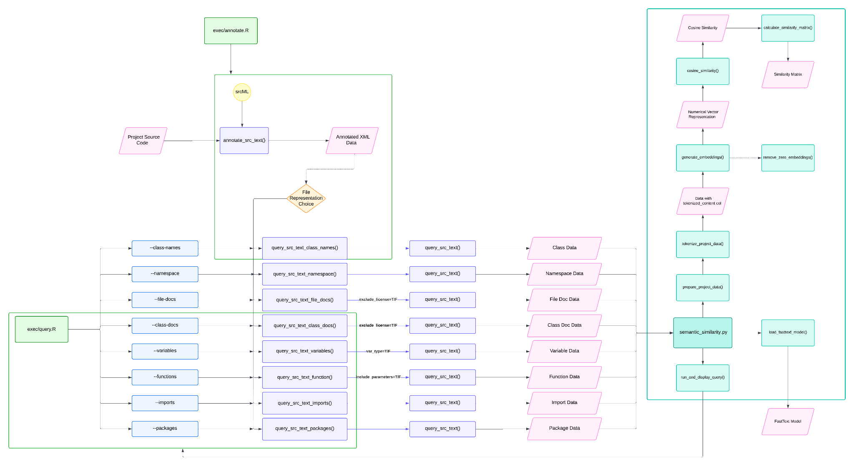
Major Accomplishments (code embedding)
➣ Extended syntax extraction capabilities by implementing functions for various elements
➣ Developed exec scripts to make parsed source code available to other tools
➣ Used the FastText ML model to generate code embeddings for computing semantic similarities

Slide 10
Missing/ Partial Implementation
➣ Not all functionalities are supported to be used via the CLI
➣ Relationships between the outputs of executable scripts have not yet been graphically represented
➣ File representations as commit and issue messages have not been implemented

Slide 11
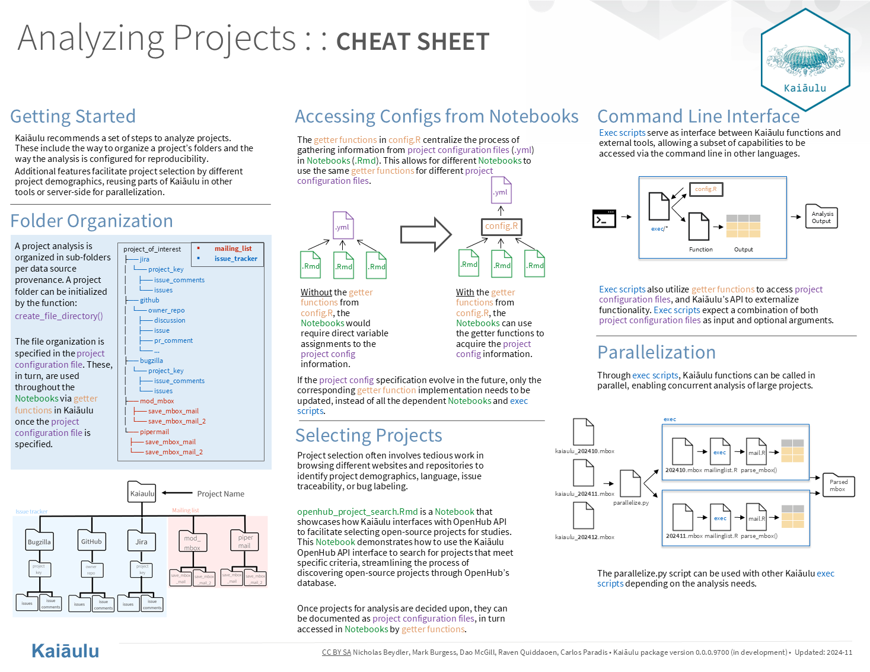

Slide 12
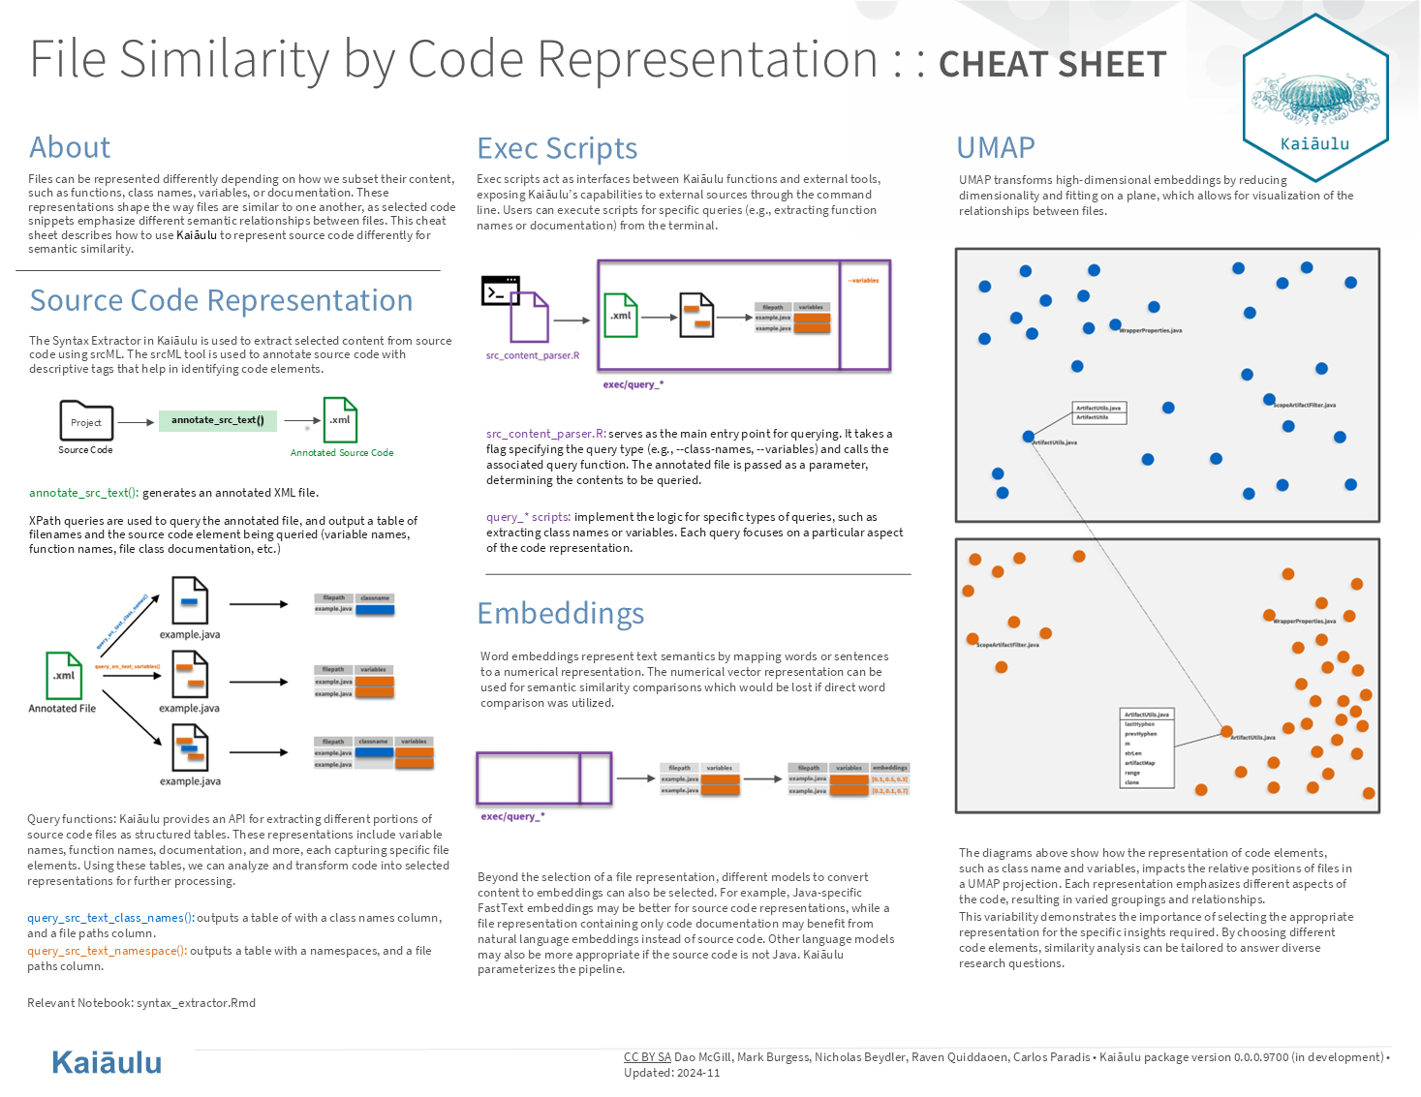

Slide 13
Sponsor Feedback
➣ “The team performed an immense amount of high quality work throughout Kaiaulu codebase, not only in adding new features, but also refactoring major parts of Kaiaulu to more easily accommodate new changes. I appreciate the engagement, enthusiasm, and availability of the group in seeing the work through. – Carlos”

Slide 14
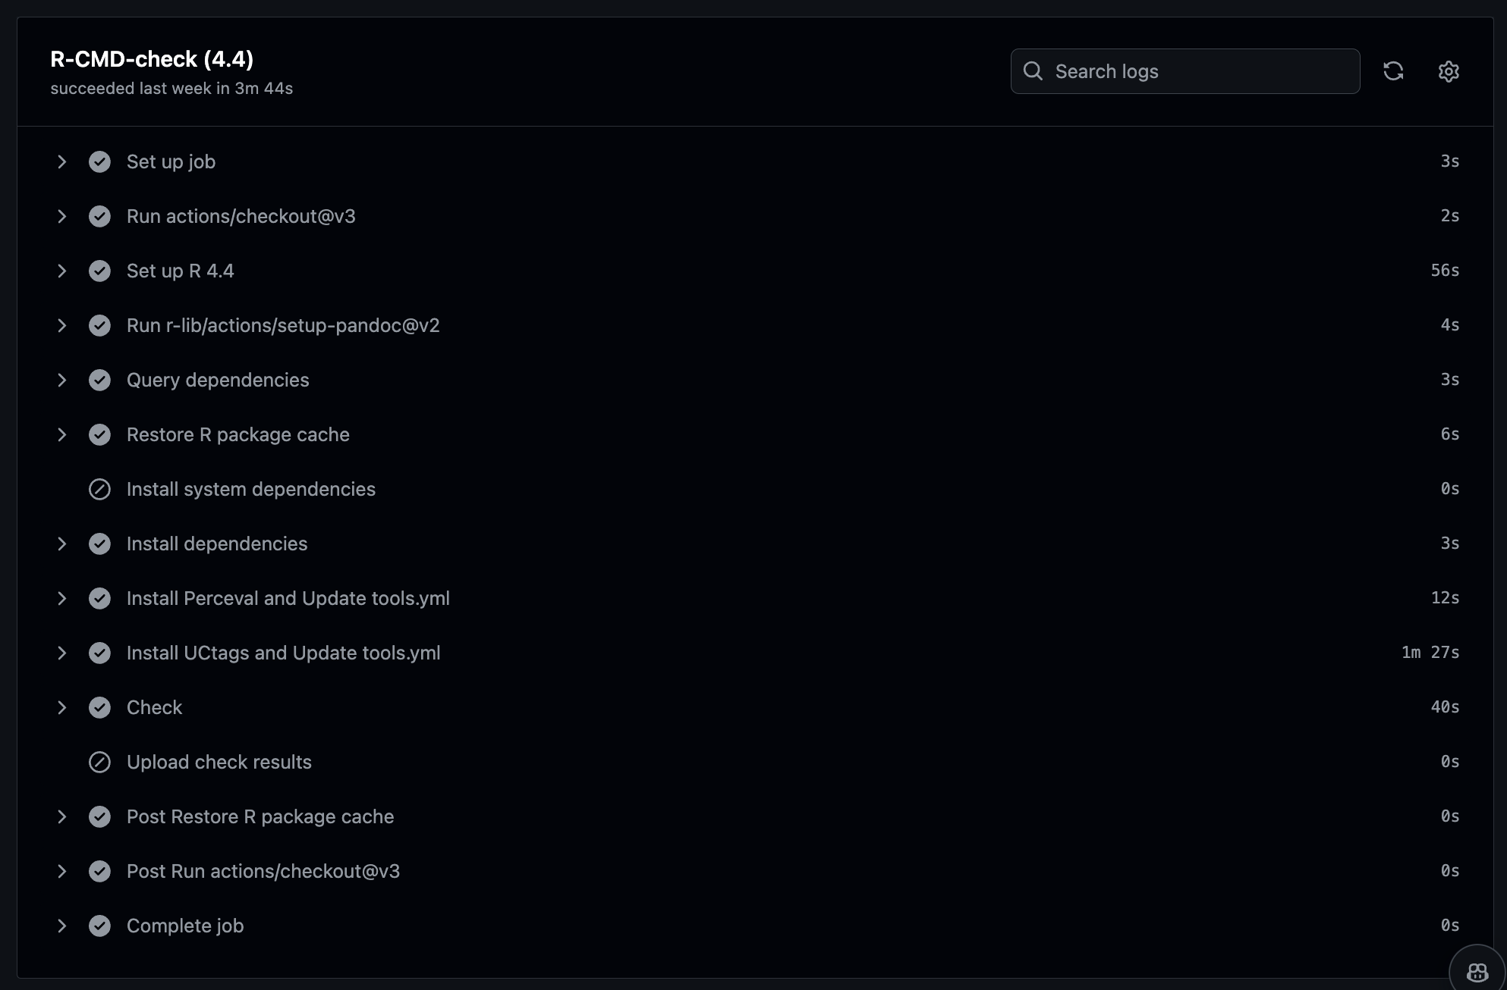
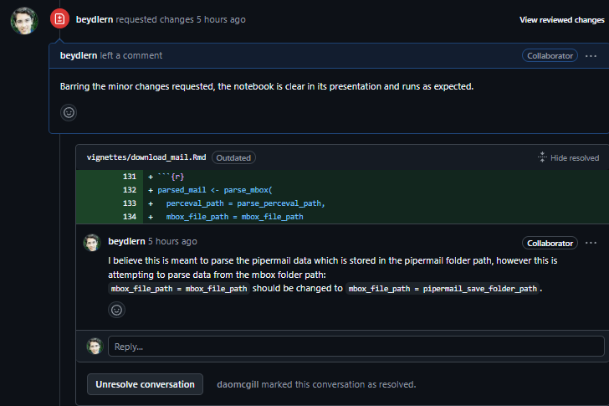
Quality Assurance
➣ Our Quality Assurance Plan aids us in verifying our code for defects.
➣ Code undergoes local checks and units tests, and commits are checked by GitHub Actions.
➣ Our code is reviewed by peers through code review requests, and by our sponsor through pull request reviews.
➣ This review process ensures that reported defects are fixed once spotted and the review comment pointing the defect out is resolved to keep track of closing defect reports.

Slide 15
Project Management and Delivery
➣ Our project management approach is well-established and has remained consistent from the start.
Task Management Tracking:
➣ Github is our task management tracker (assigned issues).
➣ Issue-based PRs to keep track of progress, and allow for easy code review.
Project Artifacts:
➣ The creation of notebooks, the functions we implement, and the executable scripts we develop are the primary coded project artifacts that aim to display the new functionalities introduced to Kaiaulu.
Quality Assurance Plan:
➣ Our code is peer reviewed and reviewed by our project sponsor.
➣ Github Actions and test cases for automated code testing and building.
➣ Consistent communication and iterative feedback within issues and PRs.

Slide 16
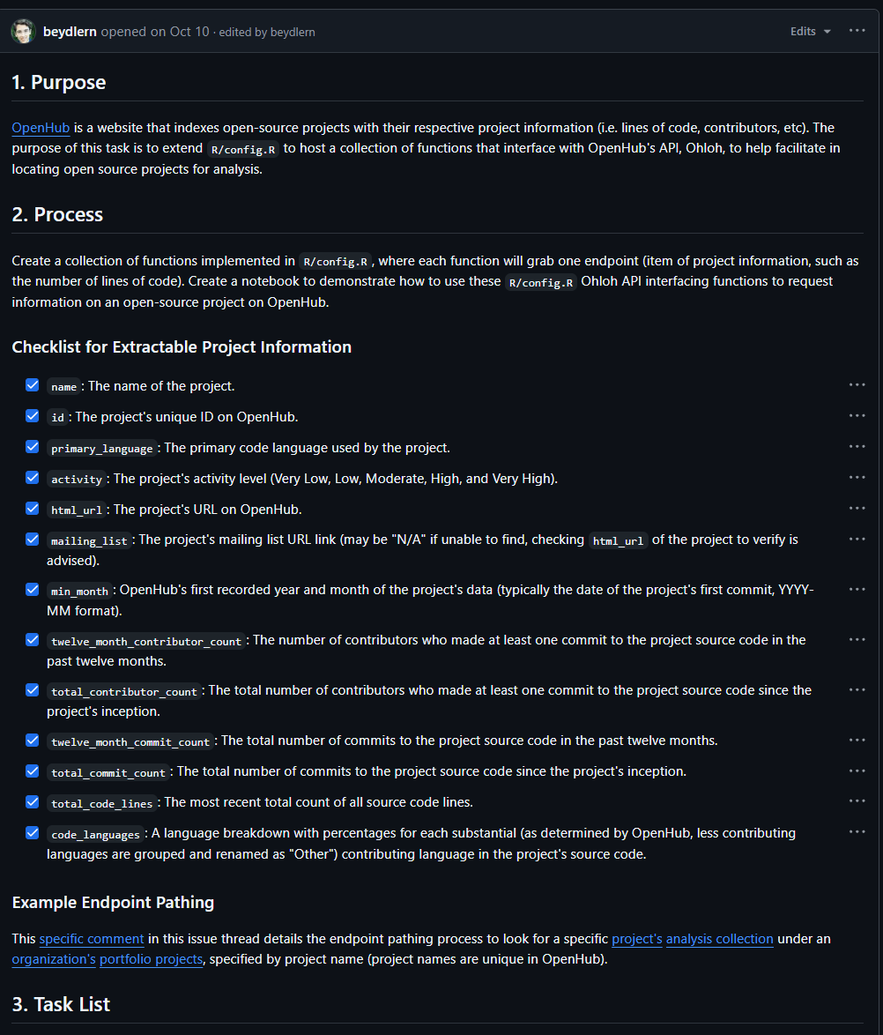
Reflections
Success Highlights
➣ Collaborating with our sponsor to define requirements through issue specifications helped to refine the scope of our tasks to mitigate scope creep.
➣
Areas for Improvement
➣ Documenting messages and conversations under relevant issues
➣ More frequent peer code reviews

Slide 17
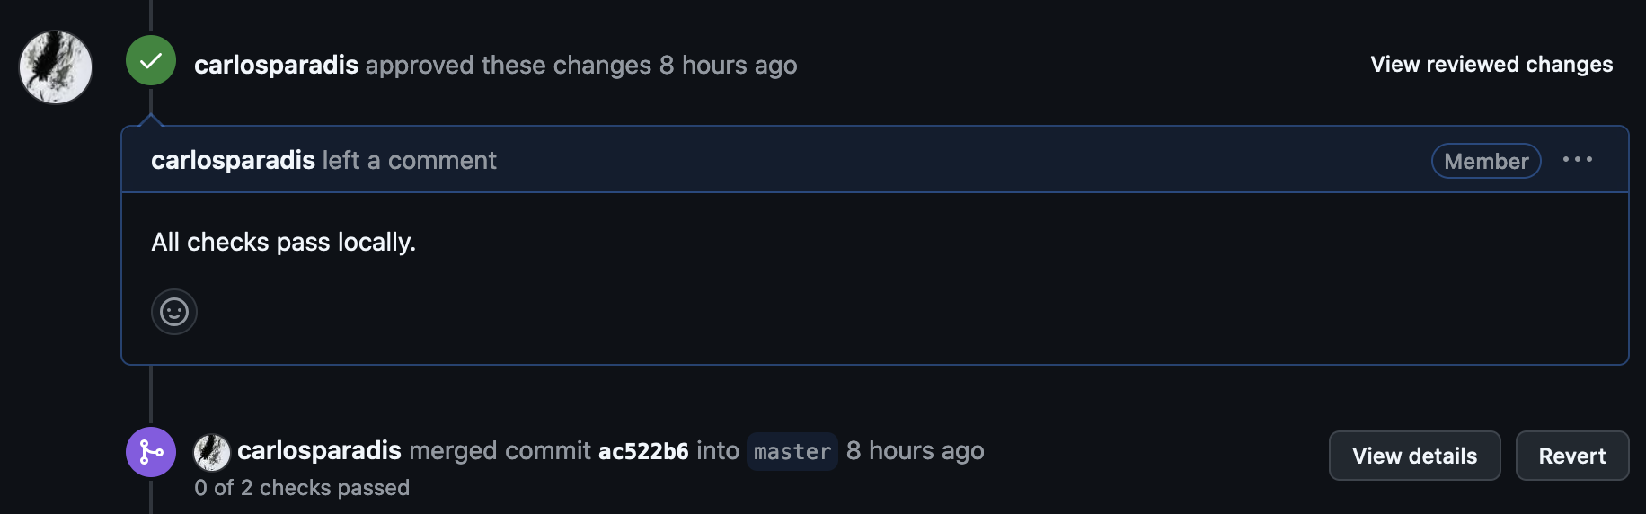
Reflections
Possible Adjustments
➣ To establish clearer task distribution earlier on
➣ Updating code to consolidate changes from individual tasks
Learned and Strengthened Skills
➣ Agile project development
➣ R programming language and RStudio (IDE)
➣ Thorough documentation process of our implementations
➣ The review process using GitHub

Slide 18
Next Steps
Group
➣ Ensure code standard and project specifications are met through pull request code reviews.
Sponsor
➣ Perform a review of our Pull Requests and merge our code to the master branch.

Slide 19


Acknowledgements
Carlos Paradis
➣ Stakeholder/Sponsor/Mentor, Ph.D. in Computer Science from UH Manoa
Rick Kazman
➣ Sponsor, Professor of Information Technology Management at UH Manoa

