Slide 1


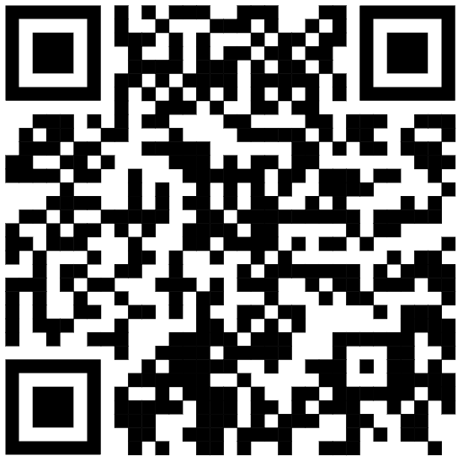

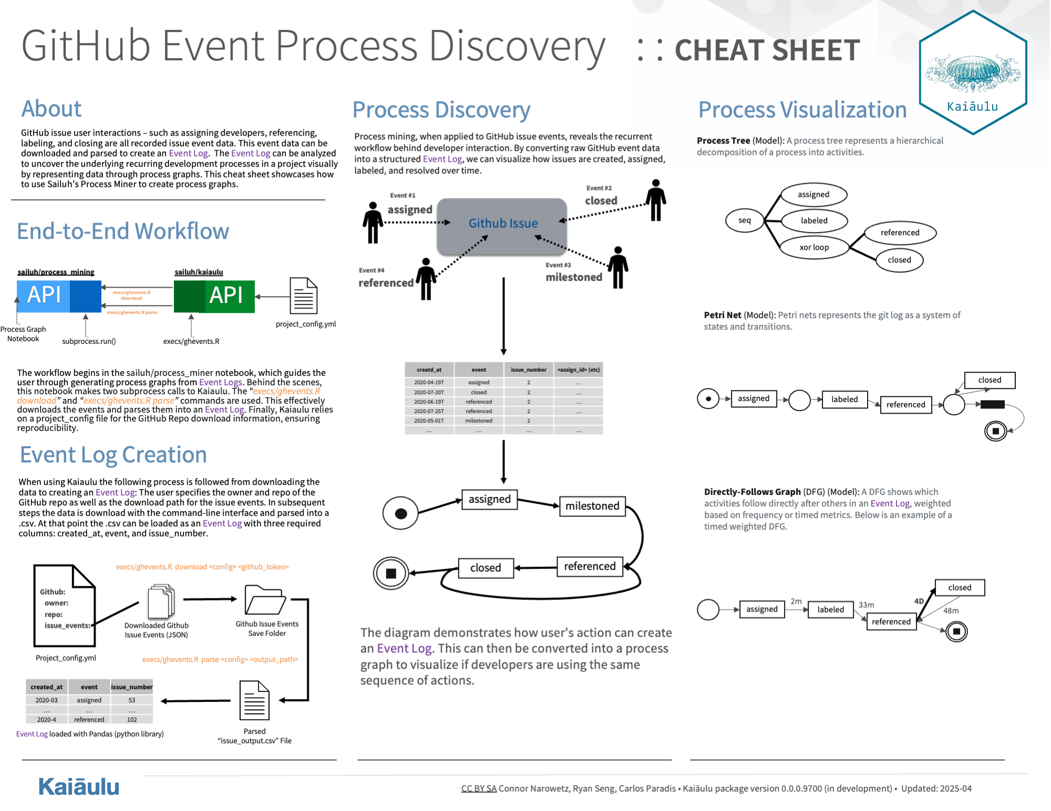
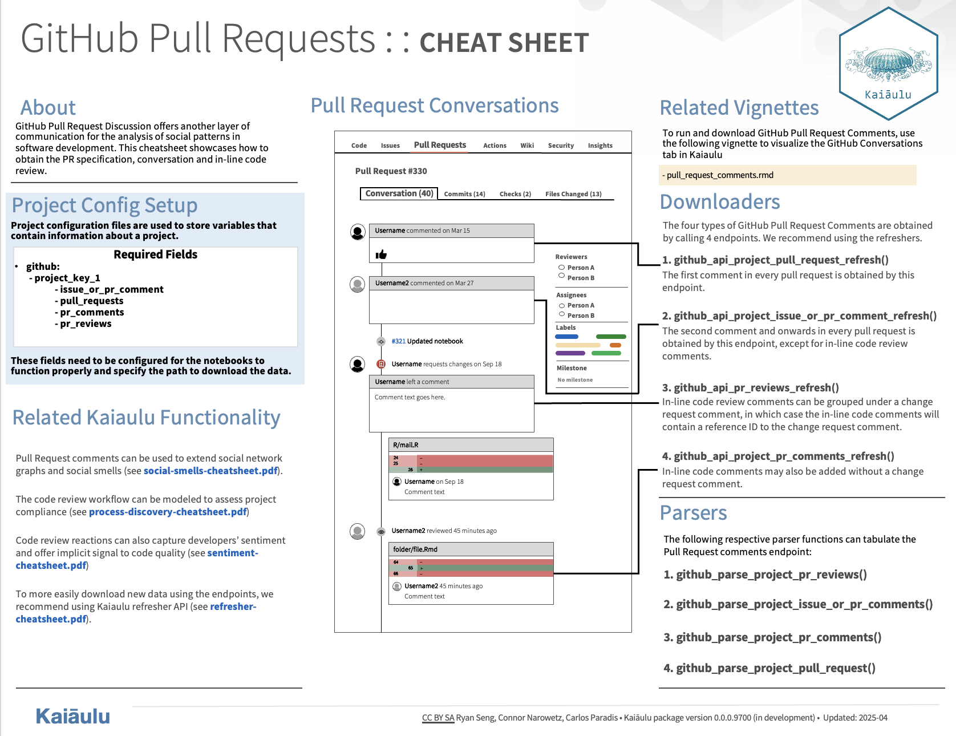
Process Mining and Extending the Kaiaulu API
Ryan Seng, Connor Narowetz
Kaiaulu
Sponsor: Carlos Paradis
ICS 496 Capstone Project – Spring 2025
github.com/sailuh/kaiaulu
Introduction
What is Kaiaulu?
Kaiaulu is an R package and common interface that helps with understanding evolving software development communities, and the artifacts (gitlog, mailing list, files, etc.) which developers collaborate and communicate about. It allows developers to get a better understanding of the software.
Objectives
Create a new Python Process Mining interface to create process graphs from GitHub issue events
Add a new Kaiaulu capability to download Pull Request Code Review Comments and Change Requests
Cleanup and document Python Sentiment Analysis thesis
Create cheat sheets that could serve as a quick-start guide for newcomers on our developments
Document features and endpoints added to Kaiaulu for future development through self-generated docs
Challenges
Unfamiliar with R and had to learn the project’s structure, dependencies, and prior student contributions
New to the GitHub REST API, which is complex and required research to find and use the correct endpoints
No prior experience with PM4Py or process mining techniques
Faced the challenge of learning and integrating several unfamiliar technologies at once
Translating unstructured GitHub event data into a structured event log format required trial and error
Ensuring data quality and consistency across multiple API pulls and file formats (JSON, CSV, etc)
Difficulty understanding and documenting Sentiment Analysis thesis
Solution
Technologies
Python – for scripting, data transformation, and process mining.
Pm4py – provided package for process mining models and algorithms.
R & R Studio – as the development environment for working on Kaiaulu.
GitHub REST API – to fetch GitHub issue events and metadata
Git & GitHub platform – used for version control, project management, issue tracking
Tasks Accomplished
Implemented four GitHub comment endpoints with a refresher function to refresh data requests.
Created GitHub Issue event data download and parser executable CLI to be called by process mining interface on runtime.
Created interface to create multiple different process graphs including Petri Nets, Process Trees, BPMN (Business Process Model and Notion, and Directly-Follows Graphs).
Documented features and created cheatsheets for future development.
Documented and refactored Sentiment Analysis capability thesis.
Learnings & Conclusion
Throughout this project, weI learned to navigate Python and R in the context of a large project, using a new IDE (R Studio). We gained hands-on experience with the PM4Py library and process mining techniques being exposed to new algorithms and models we have never seen before. We also became proficient with the GitHub REST API, overcoming its complexity and working with various endpoints. Additionally, we learned how to work with a large existing code base and architectural practices for organizing code and collaborating effectively. This project significantly deepened our understanding of version control in a collaborative environment, particularly through structured workflows in Git and GitHub. These practices not only improved our technical fluency but also positioned us well for future work involving large-scale data analysis and process mining efforts. Together we believe we contributed successfully to the Kaiaulu R package and acquired critical skills necessary for our futures working with software.

