Slide 1
Stakeholder Presentation
Marketing Analytics Portfolio Project
Connor Valle

Slide 2
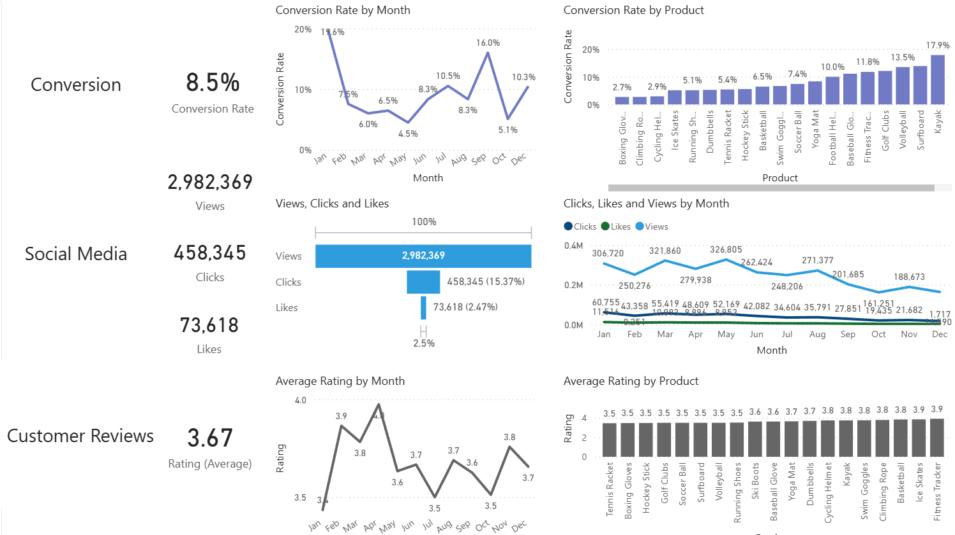
Overview
Falling Conversion Rates: Despite a notable recovery to 15.7% in September, the conversion rate ultimately fell to just 10.2% in December, nearly halving its rate from the start of the year.
Reduced Customer Engagement:
Engagement in overall social media has fallen, with views steadily dropping over the year.
Though views saw an intense reduction, clicks and likes remain at a stable level. Notably, click-through rate stands at ~15%.
Customer Feedback Analysis:
Customer ratings have been mostly consistent, with an average of roughly 3.7 throughout the year.
While that figure is stable, it is far below the target of 4.0. This suggests a need for more targeted improvements in customer satisfaction for products that score on the lower end (e.g., 3.5-3.6).

Slide 3
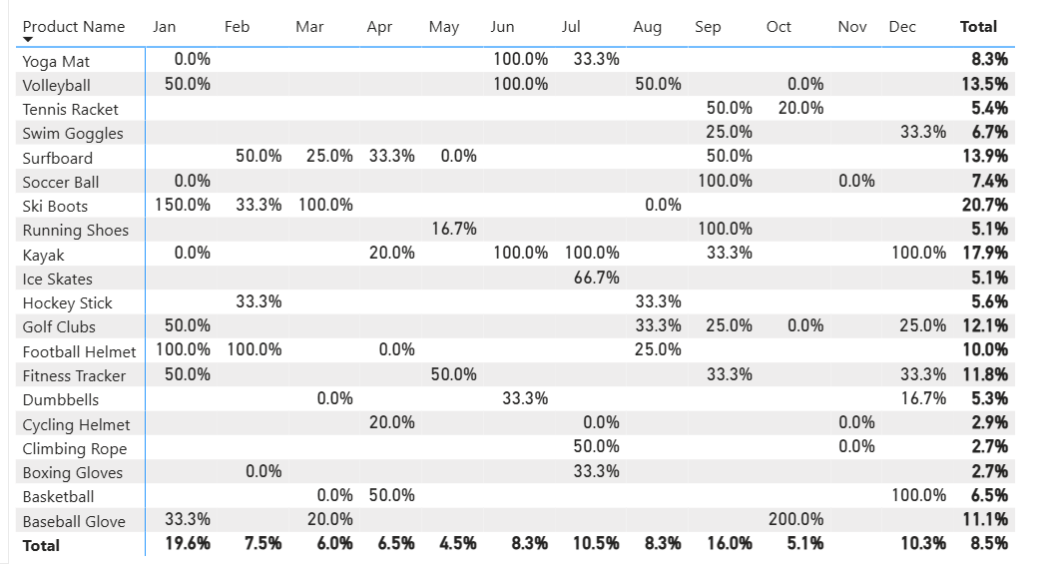
Falling Conversion Rates
General Conversion Rate Trend:
Conversion rates varied throughout the year, with some products performing very well in some months but declining shortly thereafter. This suggests that while some products were able to produce solid seasonal peaks, there lies an opportunity to improve conversion rates in lower-performing months (e.g., March) through aggressive intervention.
Lowest Conversion Month:
May experienced the lowest conversion rate for the year at only 4.5%. A closer look at the product matrix also reveals no strong individual product performance for the month.
These results indicate a need to revisit marketing strategies or promotions during this period to revitalize conversion rate performance.
Highest Conversion Month:
January recorded the highest overall conversion rate at 18.5%, particularly due to the Ski Boots 150% conversion for that month.
A quick glance at 2023’s data also reveals a similar trend, with January being the highest monthly performer.
These discoveries suggest that the company’s products are most successful at the start of the year, possibly induced by seasonal demand and more effective marketing strategies during this period.

Slide 4
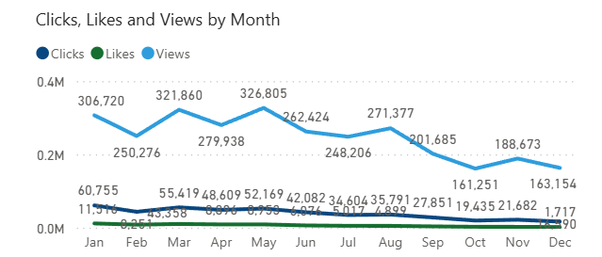
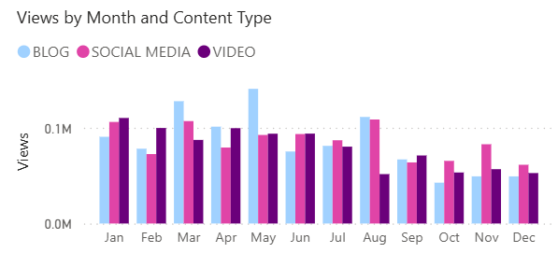
Reduced Customer Engagement
Declining Views:
Views peaked in May and rebounded in August, but declined from August until the end of the year. Audience engagement with the platform reduced significantly in the latter half of the year.
Low Interaction Rates:
Clicks and likes remained low compared to views. This ratio suggests a need for more engaging content that encourages user interaction.
Content Type Performance:
Blog content prompted the most views, particularly in April and July. Social media and video content viewing levels were stable, but neither failed to make significant gains in any particular month over the other(s).
All content types’ engagement declined in the months between September and December.

Slide 5
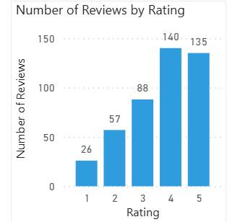
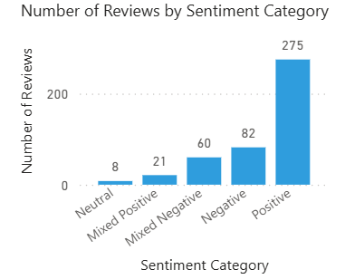
Customer Feedback Analysis
Customer Rating Distribution:
The majority of customer reviews support high ratings, with 140 reviews at 4 stars and 135 reviews at 5 stars, suggesting overall positive feedback on the products. There aren’t too many low-star ratings compared to high-star reviews, with only 26 reviews at 1 star and 57 reviews at 2 stars.
Sentiment Analysis:
Overall, reviews possess a majority positive sentiment, with 275 reviews reflecting a generally satisfied customer. 82 reviews contain negative sentiment, with an even smaller number of mixed and neutral sentiments. There are areas for improvement, especially concerning certain products, but overall, strong customer approval.
Opportunity for Improvement:
Mixed positive and mixed negative sentiments indicate that there are opportunities to create more generally positive reviews. Addressing specific concerns brought up in mixed reviews could enhance customer satisfaction and lead to even stronger customer approval across the board.

Slide 6
Objectives & Actions
Goals
Increase Conversion Rates: Identify factors impacting the conversion rate and provide relevant recommendations to improve it. For example, highlighting key stages where visitors drop off and thereby finding ways to optimize the conversion funnel.
Enhance Customer Engagement/Interaction: Determine which types of content drive the most engagement. This means analyzing interaction levels with different types and styles of marketing content to inform better marketing strategies.
Improve Customer Feedback Scores: Understand common themes in customers’ reviews and provide actionable insights. Things like recurring positive and negative feedback should be used to foster product and service improvements.
Actions
Target High-Performing Product Categories: Focus marketing efforts on products with demonstrated high conversion rates, such as Ski Boots, Kayaks, and Baseball Gloves. Implement seasonal or personalized campaigns during peak months (January, October) to take advantage of these trends.
Revitalize Content Strategy: To reverse declining views and low engagement rates, experiment with more engaging content formats, like interactive videos or user-generated content. Engagement might also be assisted by optimizing call-to-action deployment in social media and blog content, especially during lower-engagement months (September-December).
Address Mixed and Negative Feedback Scores: Implement a feedback loop that analyzes mixed and negative reviews to identify common issues, and subsequently develop improvement plans to address these concerns. Consider follow-ups with those who leave negative reviews to resolve their issues and encourage them to re-rate the product they purchased, thereby moving the overall rating average closer to the 4.0 target.

