Slide 1






Monsters and Metal
Is the New Pokemon game for Switch Too Expensive? Are you looking for a More brootal experience?

Slide 2






Our Team
Connor Valore-Kemmerer
Ian Bunner
Vincent Liang
Nathan Shangkala
Baiyu Zhu
Christina Guan

Slide 3
External Technologies
Productivity:
> Git/GitHub
> Google Drive Office Suite
> Trello
Game Development:
> Unity Game Engine
> Unity Asset Store
> MySQL
> Eclipse/Visual Studio/Vim
> JSON Simple
Document/Presentation Preparation:
> LaTeX
> LibreOffice Suite

Slide 4
Data Structures
> Vectors (no project is complete w/o using some implementation of the list ADT)
> Hash Set (for Detecting New Username Clashes)
> Directed Graph (for Animation State Machine)
>

Slide 5
Professional Development
> Artificial Intelligence- wow, did you just use a cuss … I mean buzz word?
> State Machines- wait, what do you mean you don’t need memory?
> C# Scripting- another language to put on your resume even though you haven’t mastered it
> 3-Dimensional Math/Linear Algebra- raise your hand if you hate math, wow that’s everyone
> Physics- no one understands how real physics works, and even fewer understand how game physics work
> Game Design- why does it seem that STEM and creativity are in near complete complementary distribution?
> Art/Animation- the hardest AND lowest paying part, that doesn’t seem right

Slide 6
Key Courses
Fundamentals:
> MATH 225: Linear Algebra and Differential Equations
> PHYS 151: Fundamentals of
Mechanics and Thermodynamics
> CSCI 104: Data Structures and Object-Oriented Programming
Game Development:
> CTIN 488: Game Design Workshop
> CTIN 484: Intermediate Game
Development
> ITP 380: Video Game Programming

Slide 7



Design And Development Decisions
The Good:
> Formalizing the file structure for the backend early x
> Unity (cross-platform availability/packaging) x
> Meeting Every Week x
> Delegating tasks based on experience
The Bad:
> Passing JSONs instead of using server sockets x
> No dedicated Game Designer/
Writer x
> Not enough pair programming x
> Using Messenger over Slack
The Ugly:
> Using a Game Engine’s non- native language x
> Perforce is the gaming industry standard for version control for a reason (teamwork was severely impeded by merge conflicts)

Slide 8
MultiThreading
> Implementing Auto-Save
> One thread handles the general request for loading data, trading, and login/register
> A separate thread handles unique JSON files for different players to save their records.
> Inherent in Games

Slide 9
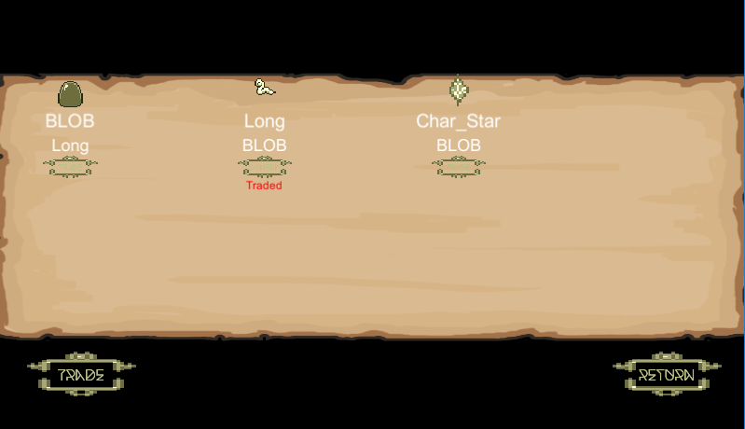
Networking

Slide 10
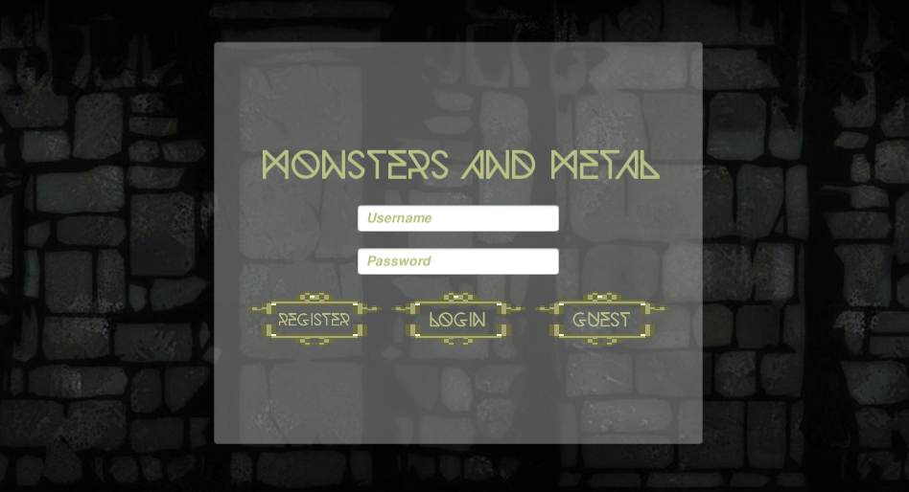
User Login

Slide 11
Thank You!!!!!!!

