Slide 1
NFL Roster Optimization with Evolutionary Solver
Connor Young | Manas Srivastava | Bryten Foongsathaporn | Nick Goldman

Slide 2
Inspiration and Use-Case
Building and managing an NFL roster is a skill that requires both qualitative and quantitative thinking, but the quantitative tools lag behind
GMs must consider a variety of factors and trade-offs in their choices, with the end goal of building the highest overall value team within certain constraints
These constraints, such as salary cap, can be difficult to manually consider in conjunction with player value, especially when intricacies such as signing bonuses come into play
Fantasy GMs and sports bettors face a similar dilemma in their choices
Daily Fantasy apps such as DraftKings host contests where the entrant must select a roster from the available players that meets their salary cap, with the goal of getting the most points
Both of these sound like a classic optimization problem for Evolutionary Solver!

Slide 3
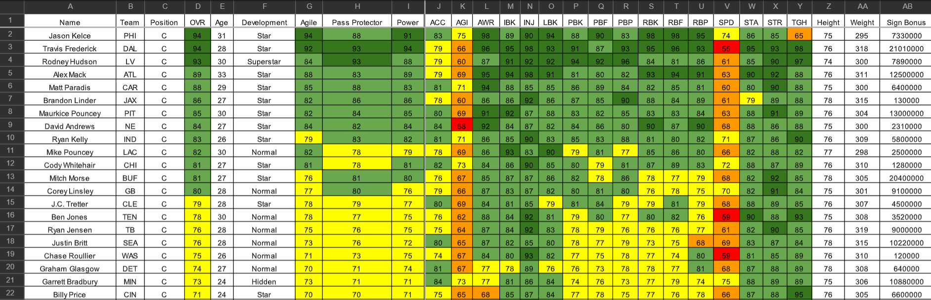
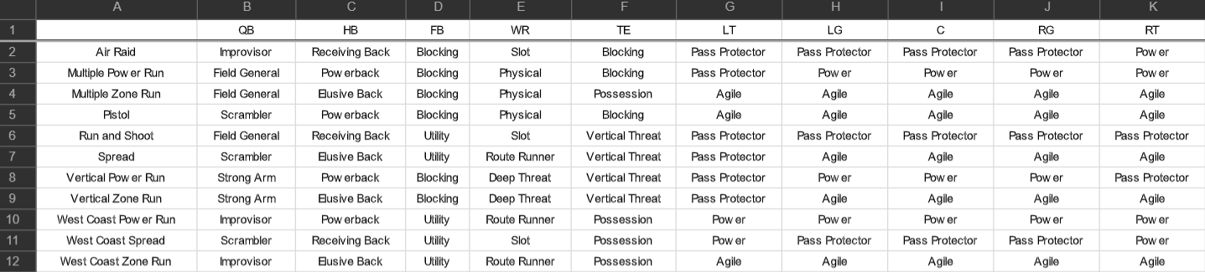
Raw Data Used
Player Ratings from Madden ‘20
Player name
Position
Overall Skill Rating
Age
“Development”
“Archetype” Skill Ratings
Height
Weight
Signing Bonus
Salary
College
Scheme Data
https://drive.google.com/file/d/1lQm0Kn-xJ7whFMaHnBtrRTXJPAQf3H7-/view

Slide 4
Framing the Problem
Lots of choices to make in terms of what exact problem to solve
24- or 48-man roster? How flexible in terms of positional choice?
Ended up choosing 48, made possible by methodology
How do we define “best” roster and what are alternative ways to explore?
Highest overall skill rating
Highest archetypal skill rating based off of 11 different offensive/defensive scheme pairings
Also highest projected points for fantasy - used DraftKings Daily Contest data
What penalties and bonuses should we use?
How do we pick penalties and bonuses that help the solution fit the use-case?
Using penalties to ensure we don’t pick 10 players with a 99 rating and 38 with a 50 rating
Using penalties to ensure we don’t have too many or too few players at a certain position
This is the “art” of the problem and where adaptability exists to different use-cases in real world

Slide 5
Methodology and Process
Originally tried to follow MBA Problem pattern - single variable per person
Excel caps out at 200 decision variables, we have over 2,000 players
Restructured to a decision variable for every roster slot - allowed us to do 48-man roster
New approach required some restructuring of our raw data
Since we were assigning to positional roster slots, we had to restrict our possible decisions for each slot to only players that match that position
This meant indexing each player, but more importantly reordering the rows of players so that each position had an uninterrupted range that we could constrain the variable to
Made extensive use of VLOOKUP to display player info based off decision variable value and use that info to calculate bonuses and penalties
Made use of HLOOKUP in scheme-sensitive choices to identify the player’s skill rating in the archetype relevant for that scheme

Slide 6
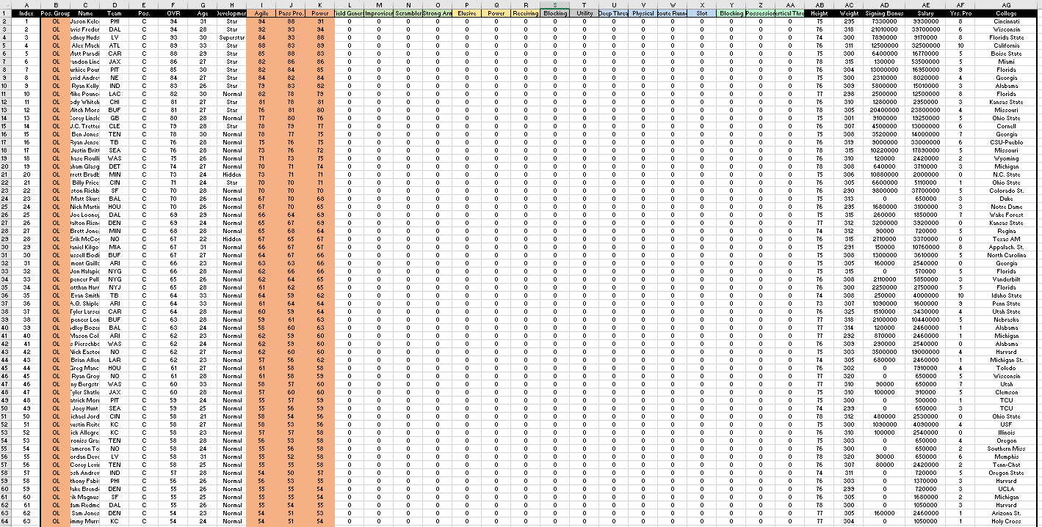
Restructured Data

Slide 7
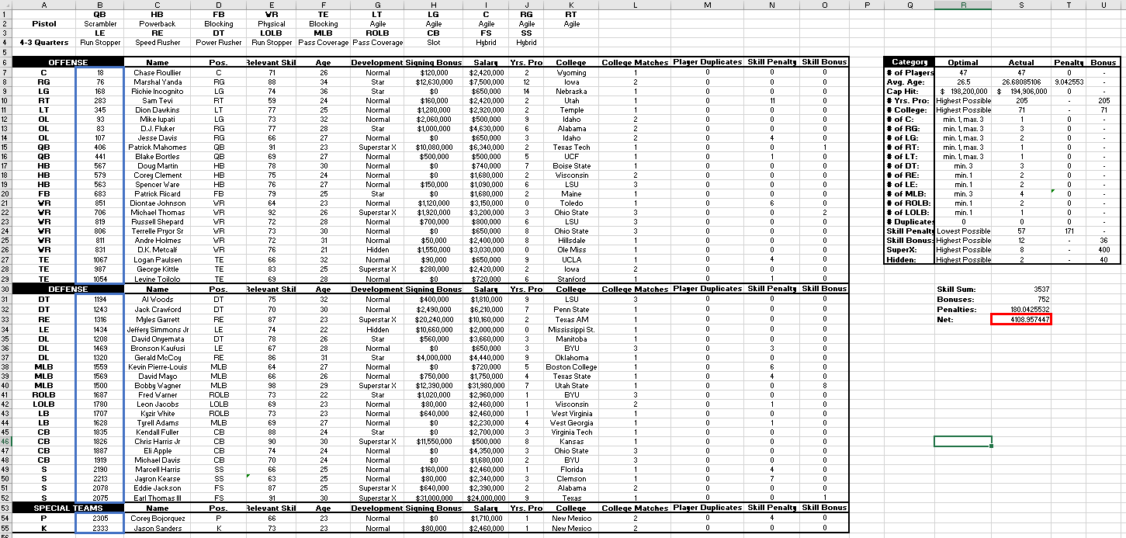
Example Scheme-Sensitive Sheet

Slide 8
Key Decisions, Penalties, Bonuses
Roster Size/Positional - ensures minimum positional requirements and roster size met
Average Age - small penalty for average age differing from 26.5 (average prime)
Salary Cap - large penalty to ensure no exceeding of “hard” cap, included signing bonus
Number of Years Pro - bonus given for veteran experience
Number of College Teammates - bonus given for chemistry and past experience
Number of Duplicates - large penalty to ensure that no players are used more than once
Skill Penalty - small penalty to very low skill players to deter huge skill imbalances on roster
Skill Bonus - small bonus given for extremely high skill players
SuperstarX Bonus - bonus given for players that can be “X-factor” in games
Hidden Bonus - smaller bonus given for players performing above their publicity/salary

Slide 9
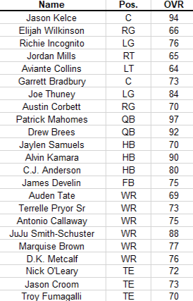
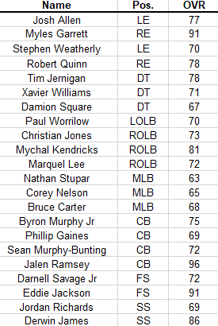

Highest Overall Skill Roster
Special Teams
Offense
Defense

Slide 10
Limitations and Potential Extensions
Model does not take into account current team and league realities
Building a team in the NFL is dependent on player interest, current team roster and cap structure, willingness of other involved teams, and more
Model is not perfectly tailored to provide roster that is ideal playing-wise
Weighting exists to deter choosing very low-skill players, but not to encourage maximizing “1st-string” skill, it just seeks the highest overall across the roster (e.g. don’t need 2 90+ QBs)
Same principle applied to different positions, all are weighted as equally important
This is a problem largely determined and solved by more extensive situational knowledge
Customization of penalties and bonuses for franchises in different stages
Teams in rebuild give higher bonus to hidden players, teams on brink prioritize SuperstarX
Beyond scheme, can give more weight to QB, DE, or any particularly impactful position
Integration of fantasy optimizer with a points prediction model
Could do this through ML or via @Risk simulation

