Slide 1
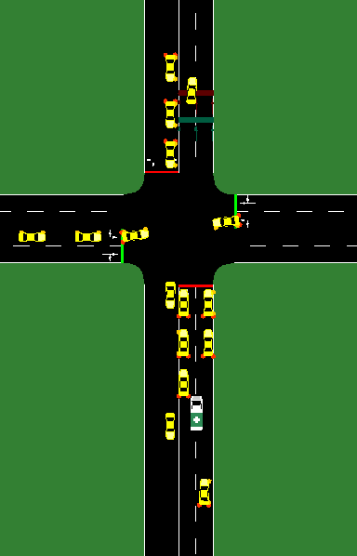




EMS Priority Traffic Control Capstone
Connor Sweeney and Donte DiFrancesco
The University of Pittsburgh School of Computing and Information, CS PhD Program
INTRODUCTION
TOOLS
RESULTS & CONCLUSIONS
EMS (Emergency Medical Service) vehicle travel time should be the top priority on the road.
Adaptable traffic signals (signals that change according to EMS presence) are used to attempt to reduce EMS travel time.
Initial Hurdle
We initially planned on using CityFlow because of its efficient performance with reinforcement learning, however we discovered that it did not have the functionality our research required.
Our first experiment, EMS Travel Time by Priority shows that both Green Corridor and Red Freeze traffic policy implementations decrease the travel time of EMS regardless of traffic congestion.
Our second experiment, Congestion Clearing Time vs. Traffic Density, shows that the policies – which temporarily change the pattern of traffic signals – do not increase congestion after their use.
Objectives
Simulation of Urban Mobility
Develop scenarios that mimic real-world traffic
Gather data about how adaptive traffic signals affect the network
Analyze the data
We transitioned to another program, SUMO because it had fully implemented EMS vehicle functionality.
■ Green Corridor
■ Red Freeze
■ Control
Traffic Signal Policies
Green Corridor
This policy turns all lights for EMS lanes green until the EMS passes
Red Freeze
This policy makes every light red until EMS cuts through the intersection
Simulation intersection with an EMS vehicle lane splitting
Analysis
SUMO – Create simulations
Traci – Modify traffic signal behavior and collect data
Excel – Visualize data
Data Metrics to Analyze
EMS Travel Time
Measured in simulation steps it takes EMS to get from point A to point B
Impact on Congestion
Measured in simulation steps it takes resulting congestion to clear
Collaboration
These results are exciting because they show that not only was our implementation of EMS priority policies able to get EMS vehicles to their destinations faster, but it did not increase resulting congestion. This means that in our simulations, the implementation of EMS priority policies has a net benefit to the performance of traffic systems.
Discord
Trello
GitHub

