Slide 1

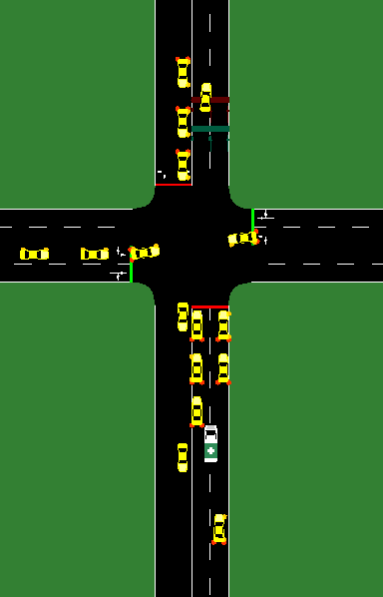



EMS Priority Traffic Control Capstone
Connor Sweeney and Donte DiFrancesco
University of Pittsburgh – School of Computing and Information – CS Capstone Project
INTRODUCTION
TOOLS
RESULTS & CONCLUSIONS
EMS (Emergency Medical Service) vehicle travel time should be the top priority on the road.
Adaptable traffic signals (signals that change according to EMS presence) are used to attempt to reduce EMS travel time.
Initial Hurdle
Our first metric, EMS Travel Time, shows that both the Green Corridor and Red Freeze traffic policies decrease the travel time of EMS vehicle, with the Green Corridor reducing it by 47.25% in heavy traffic.
We initially planned on using CityFlow because of its efficient performance with reinforcement learning, however we discovered that it did not have the functionality our research required.
Objectives
Simulation of Urban Mobility
Develop scenarios that mimic real-world traffic
Gather data about how adaptive traffic signals affect the network
Analyze the data
We transitioned to another program, SUMO, because it had fully implemented EMS vehicle functionality.
■ Green Corridor
■ Red Freeze
■ Control
Traffic Signal Policies
Our second metric, Congestion Clearing Time, shows that the traffic policies – which temporarily change the pattern of traffic signals – do not significantly increase congestion after their use. In fact, the Green Corridor reduces it by 9.92% in heavy traffic.
Green Corridor
This policy activates green lights for the next three signals in the EMS vehicle’s route. The signals resume normal operation after the EMS vehicle passes each intersection.
Red Freeze
This policy makes all lights in the next intersection red while the EMS vehicle is passing through it.
Simulation intersection with an EMS vehicle lane splitting
Analysis
SUMO – Create simulations
Traci – Modify traffic signal behavior and collect data
Excel – Visualize data
Data Metrics to Analyze
EMS Travel Time
Measured in seconds it takes the EMS vehicle to get from point A to point B
Congestion Clearing Time
Measured in seconds it takes resulting congestion to clear
Collaboration
These results are exciting because they suggest that not only was our implementation of EMS priority policies able to get EMS vehicles to their destinations faster but, in most cases, it did not increase resulting congestion. This means that in our simulations, the implementation of EMS priority policies has a net benefit to the performance of traffic systems.
Discord
Trello
GitHub

