Slide 1
Conventional Commits
A standard for commit messages

Slide 2
About
open commit message specification
Message targets: reviewers, developer, toolings
Inspired by angular commit guidelines
First commit 05-04-2016 by Steve Mao (Atlassian, prob.)
Created as demo/ideas project for conventional-changelog -> tooling in mind

Slide 3
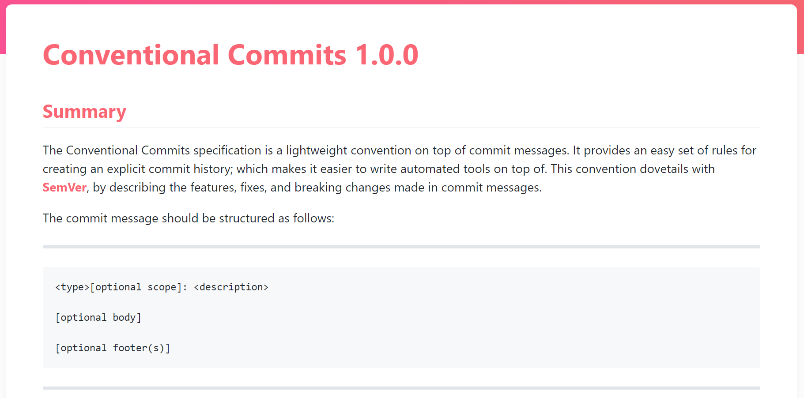

Slide 4
Tooling in mind
We can infer version updates from conventional commits
We can trigger cicd behavior based on conventional commits
We can integrate code insight into jira or similar

Slide 5
Assistance
Conventional commit auto complete & message builder
Commit linting, includes support for allowed types
Changelog and version generators

