Slide 1
Programming III
Limitless Tyres Project

Slide 2
Form Application

Slide 3
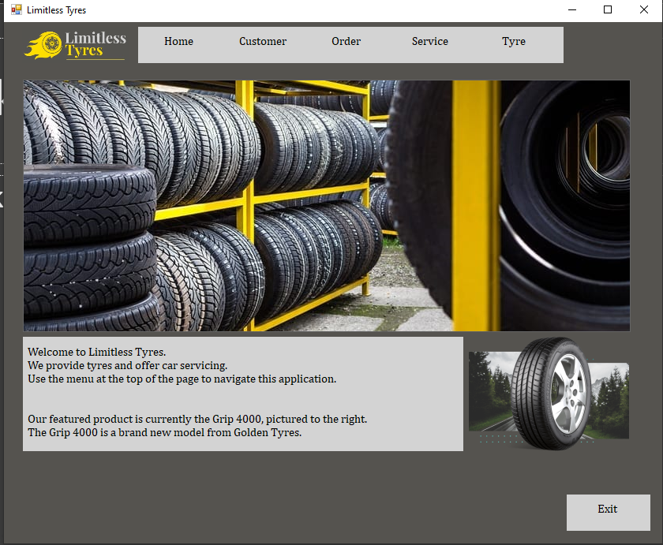
We developed a form application to help Limitless Tyres.
Limitless Tyres sell tyres and provide car servicing.
The form application consist of:
A navigational menu
A home form
A customer form
An order form
A service form
A Tyre form

Slide 4
Reports

Slide 5
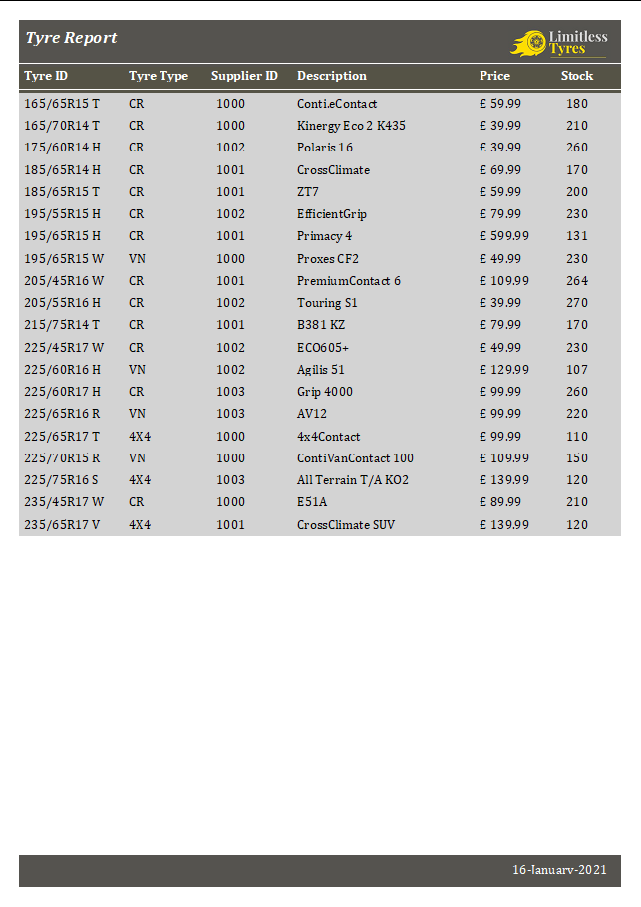
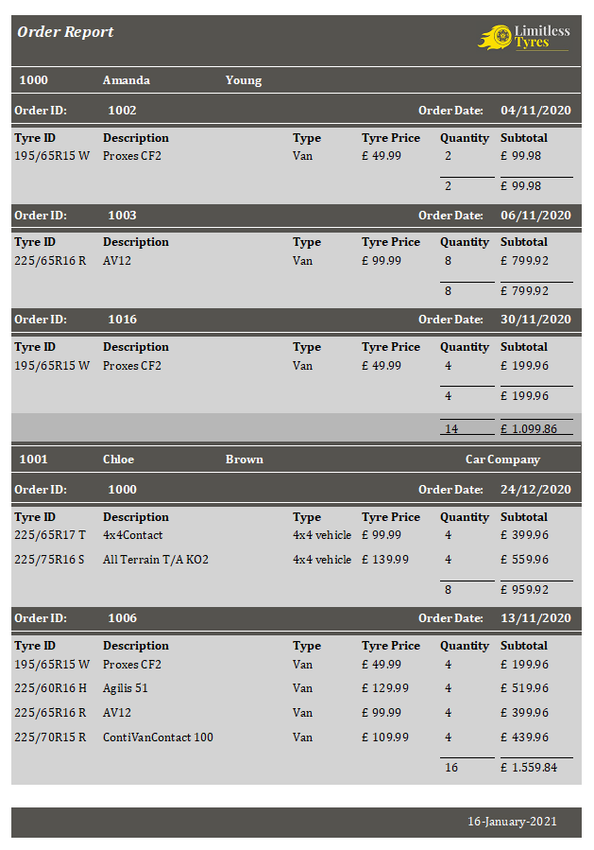

Slide 7
Strengths

Slide 8
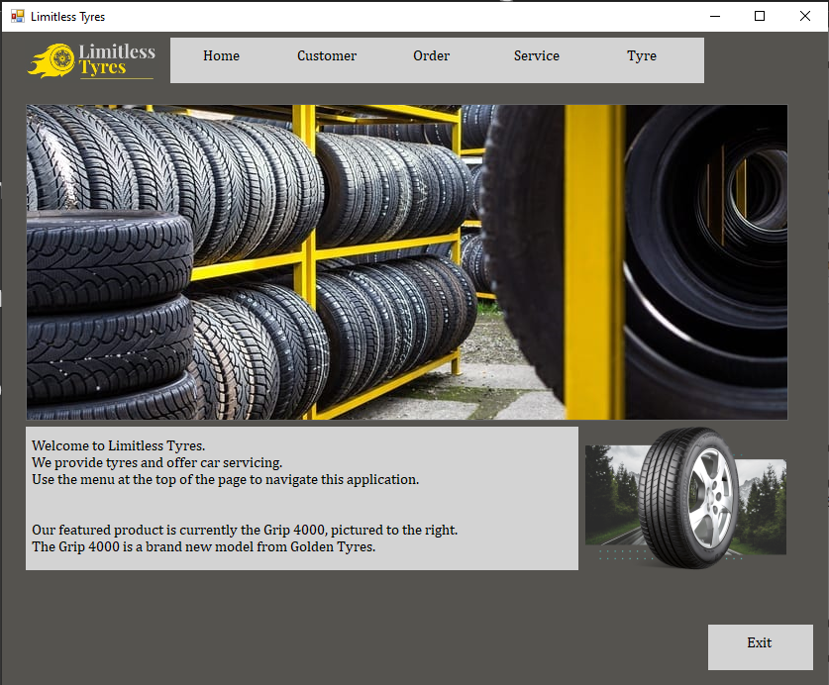
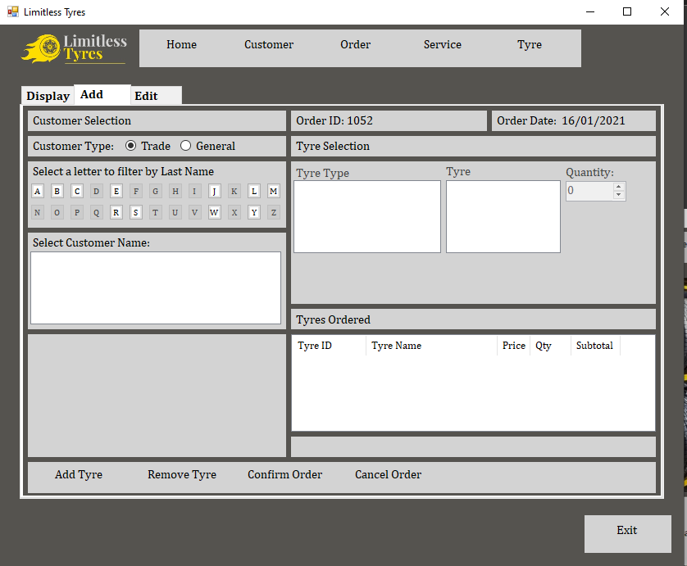
The form application has a professional colour scheme and layout, which is consistent across all parts of the form application.

Slide 9
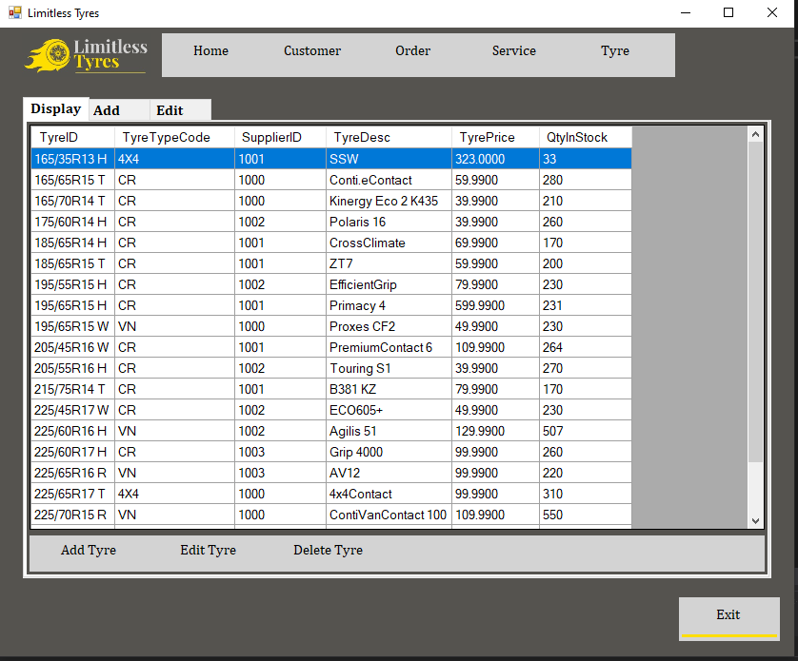
The form application works well with the database that we created with SQL.
E.g. All the tyres in the database are displayed in a data grid view in the display tab of the tyre form.

Slide 10
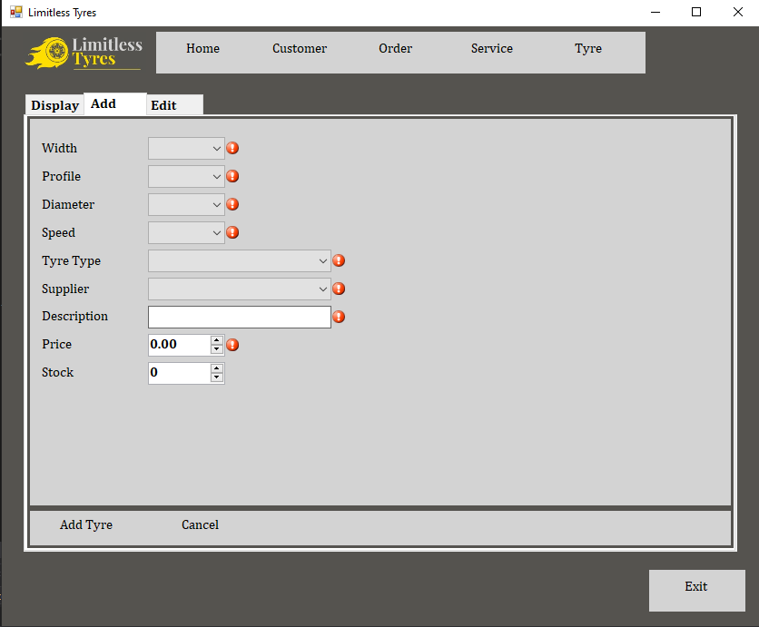
The system makes use of presence checks to ensure that data has been entered.
E.g. The tyre form shown to the right.

Slide 11
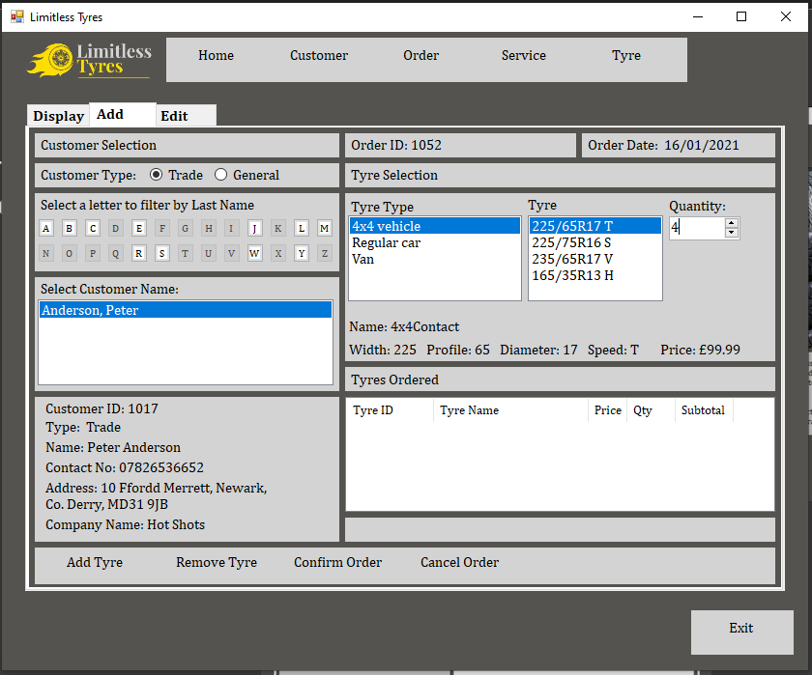
The user is guided through the process of adding an order to the system, which includes selecting a customer, then a tyre type, then a tyre, and then being asked to enter a quantity, making the system more user friendly.

Slide 12
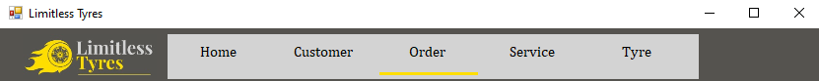
The navigational menu is simple to understand and use, and provides feedback to the user by underlining the button on the navigational menu that the user’s cursor is currently hovering over.

Slide 13
Weaknesses and Improvements

Slide 14
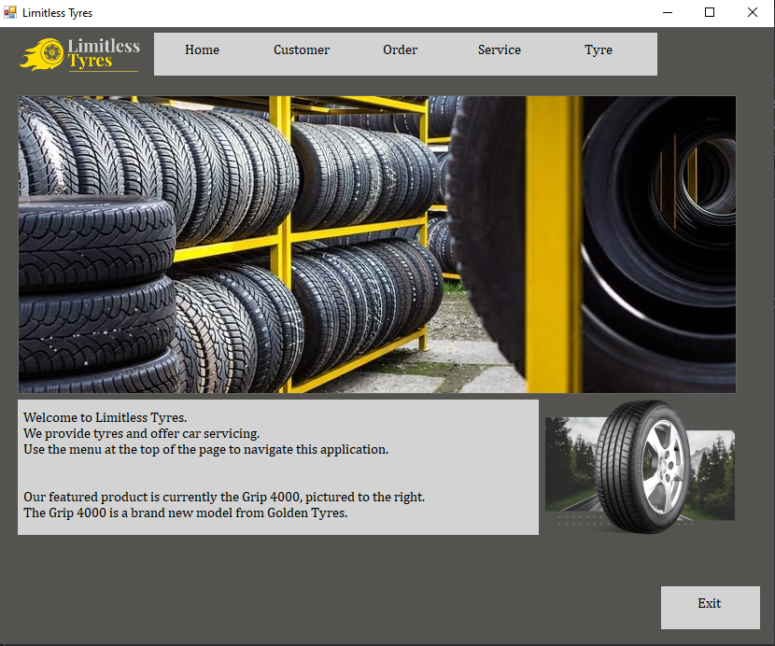
Weakness
The home menu is basic.
Improvement
Replace the single image with a slideshow of images to make the system more dynamic.

Slide 15
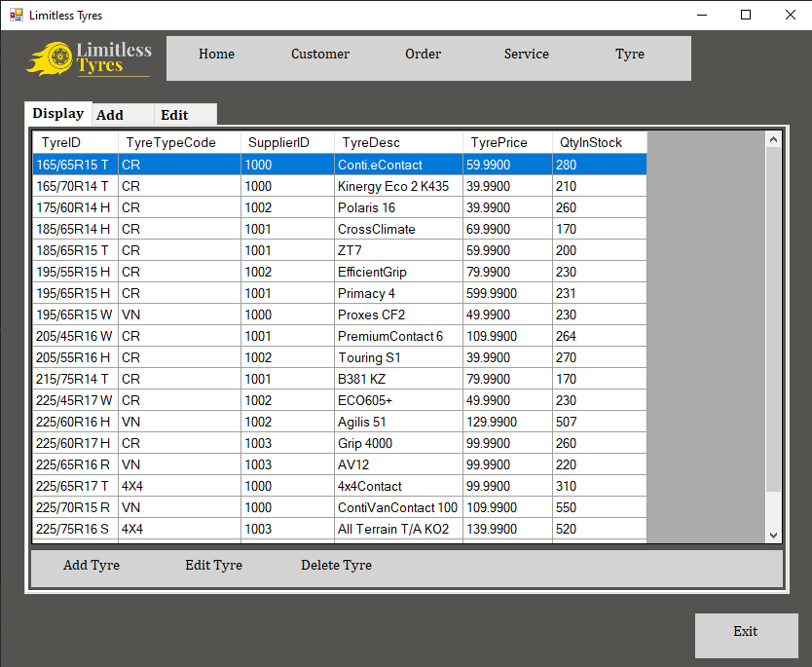
Weakness
There is a navigational menu, showing the different forms that the user can access but there is no indication as to which of these that the user is currently accessing.
Improvement
Make it so that for example, if the user was on the tyre form, the tyre navigational button would be a different colour to indicate this.

Slide 16
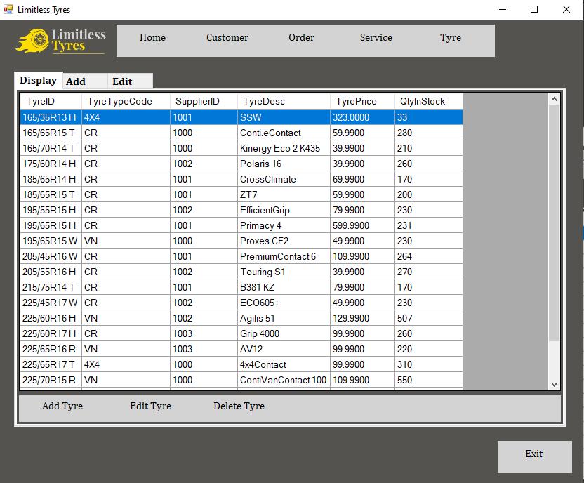
Weakness
On the tyre display tab, only the Tyre Type Code and Supplier ID are displayed, which may be confusing if the user is not aware of the associated Tyre Type Description and Supplier Name.
Improvement
Display the Tyre Type Description and Supplier Name.

Slide 17
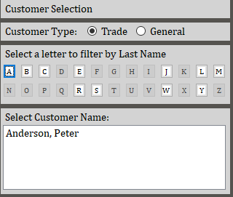
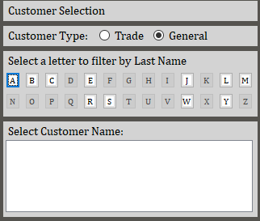
Weakness
In the Order form, when selecting a customer, only alphabetical buttons where customers are present are enabled.
However, if there are General customers present but no Trade customers present, the button will still be enabled even if Trade is selected.
This occurs in both the add and edit tabs of the order form.
Improvement
Make it so that the alphabetical button is only enabled if there is a customer present for that letter for the selected customer type.

Slide 18
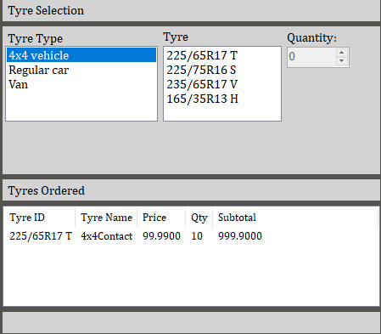
Weakness
In the Order form, in the add tab, tyres that have already been added to the order show up in the tyre list box.
Improvement
Make it so that only tyres that haven’t been added to the order yet show up in the tyre list box.

Slide 19
Working as a Team

