Slide 1
DB Applications
Relational calculus
Notes:
Faloutsos - Pavlo
CMU - 15-415/615

Slide 2
General Overview - rel. model
history
concepts
Formal query languages
  relational algebra
  rel. tuple calculus
  rel. domain calculus
#<number>
Notes:
Faloutsos - Pavlo
CMU - 15-415/615

Slide 3
Overview - detailed
rel. tuple calculus
  why?
  details
  examples
  equivalence with rel. algebra
  more examples; ‘safety’ of expressions
rel. domain calculus + QBE
#<number>

Slide 4
Motivation
Q: weakness of rel. algebra?
A: procedural
  describes the steps (ie., ‘how’)
  (still useful, for query optimization)
#<number>

Slide 5
Solution: rel. calculus
  describes what we want
  two equivalent flavors: ‘tuple’ and ‘domain’ calculus
  basis for SQL and QBE, resp.
  Useful for proofs (see query optimization, later)
#<number>

Slide 6


Rel. tuple calculus (RTC)
first order logic
‘Give me tuples ‘t’, satisfying predicate P - eg:
#<number>

Slide 7
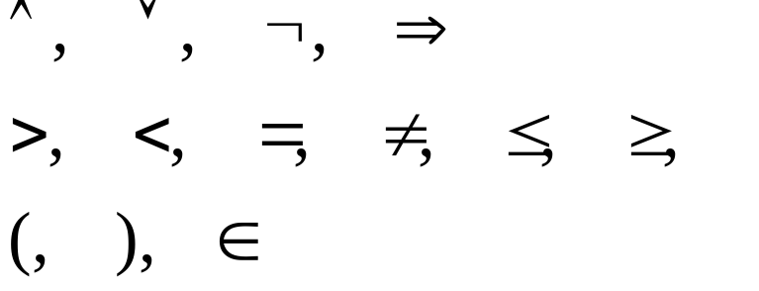

Details
symbols allowed:
quantifiers
#<number>

Slide 8
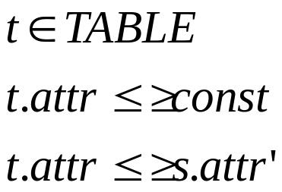
Specifically
Atom
#<number>

Slide 9

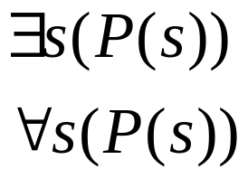
Specifically
Formula:
  atom
  if P1, P2 are formulas, so are
  if P(s) is a formula, so are
#<number>

Slide 10


Specifically
Reminders:
  DeMorgan
  implication:
  double negation:
‘every human is mortal : no human is immortal’
#<number>

Slide 11
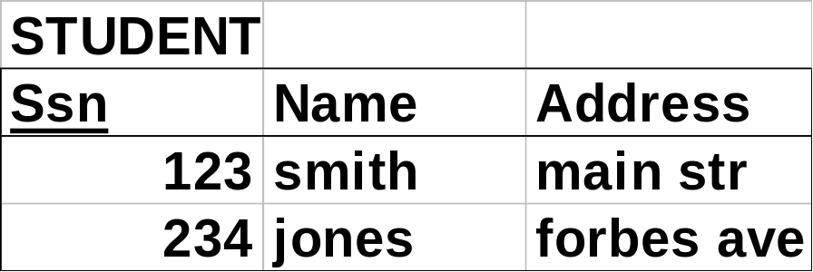
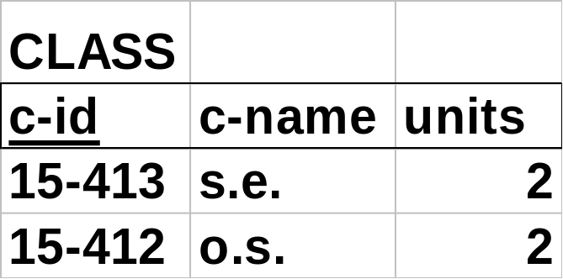
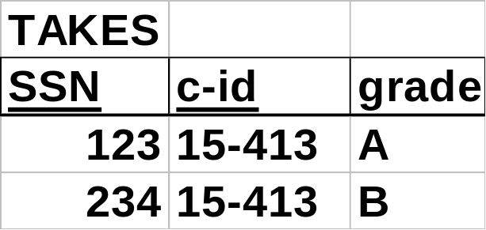
Reminder: our Mini-U db
#<number>

Slide 12
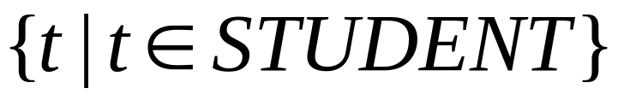
Examples
find all student records
output tuple
of type ‘STUDENT’
#<number>

Slide 13
(Goal: evidence that RTC = RA)
Full proof: complicated
We’ll just show examples of the 5 RA fundamental operators, and how RTC can handle them
(Quiz: which are the 5 fundamental op’s?)
#<number>

Slide 14
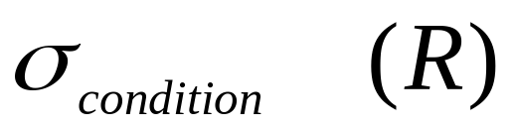
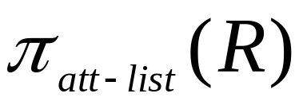
FUNDAMENTAL
Relational operators
selection
projection
cartesian product MALE x FEMALE
set union
set difference R - S
R U S
#<number>
Notes:
Faloutsos - Pavlo
CMU SCS 15-415/615

Slide 15
Examples
(selection) find student record with ssn=123
#<number>

Slide 16
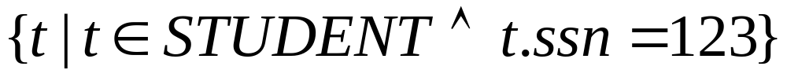
Examples
✔
σ selection
π projection
X cartesian product
U set union
- set difference
(selection) find student record with ssn=123
#<number>

Slide 17
Examples
(projection) find name of student with ssn=123
#<number>

Slide 18
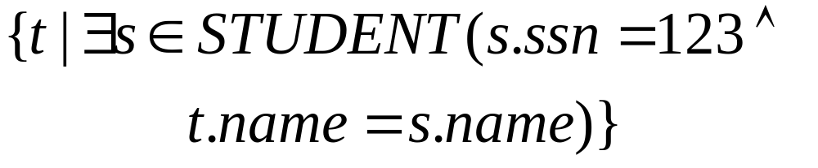
Examples
✔
σ selection
π projection
X cartesian product
U set union
- set difference
✔
(projection) find name of student with ssn=123
‘t’ has only one column
#<number>

Slide 19
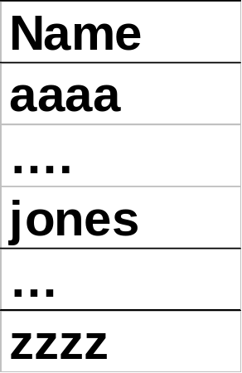
‘Tracing’
t
s
#<number>

Slide 20
Examples cont’d
✔
σ selection
π projection
X cartesian product
U set union
- set difference
✔
✔
(union) get records of both PT and FT students
#<number>

Slide 21
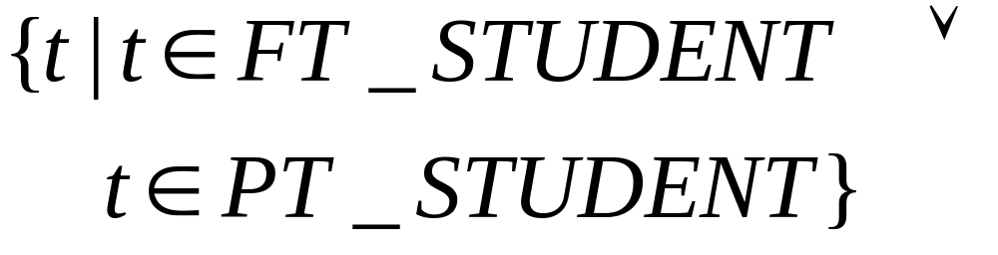
Examples cont’d
(union) get records of both PT and FT students
#<number>

Slide 22
Examples
✔
σ selection
π projection
X cartesian product
U set union
- set difference
✔
✔
✔
difference: find students that are not staff
(assuming that STUDENT and STAFF are union-compatible)
#<number>

Slide 23
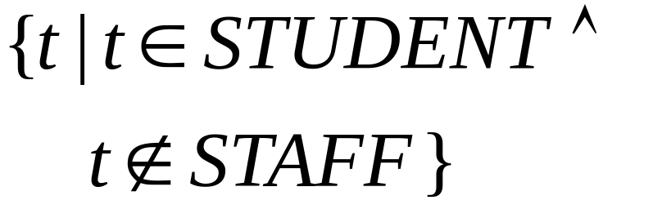
Examples
difference: find students that are not staff
#<number>

Slide 24
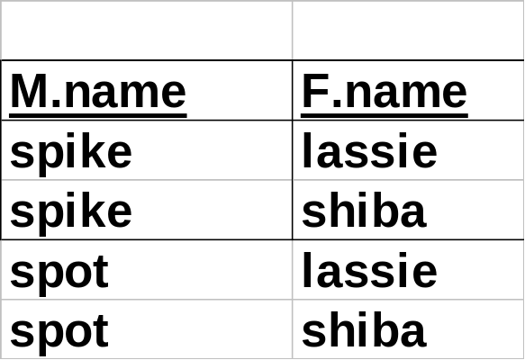
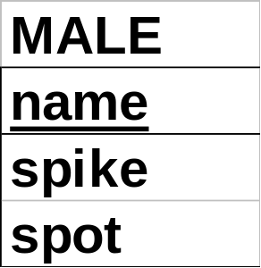
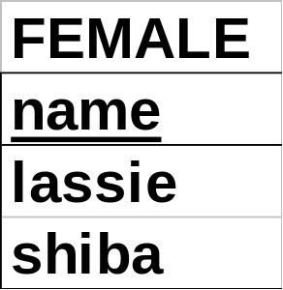
Cartesian product
eg., dog-breeding: MALE x FEMALE
gives all possible couples
x
=
#<number>

Slide 25
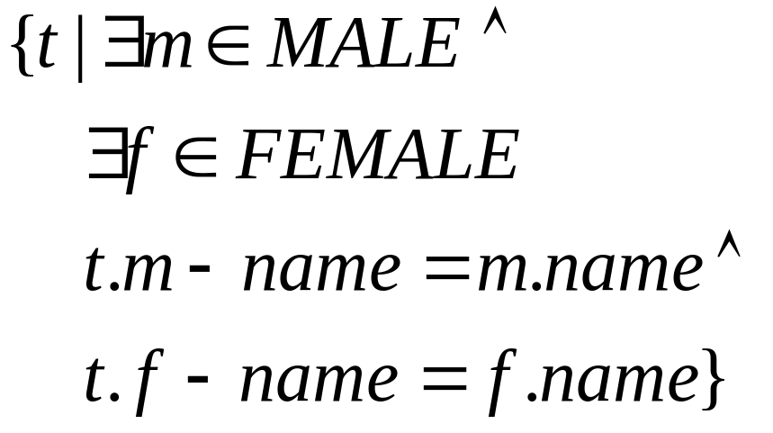
Cartesian product
✔
σ selection
π projection
X cartesian product
U set union
- set difference
✔
✔
✔
✔
find all the pairs of (male, female)
#<number>

Slide 26
‘Proof’ of equivalence
rel. algebra <-> rel. tuple calculus
✔
σ selection
π projection
X cartesian product
U set union
- set difference
✔
✔
✔
✔
#<number>

Slide 27
Overview - detailed
rel. tuple calculus
  why?
  details
  examples
  equivalence with rel. algebra
  more examples; ‘safety’ of expressions
re. domain calculus + QBE
#<number>

Slide 28
More examples
join: find names of students taking 15-415
#<number>

Slide 29
Reminder: our Mini-U db
#<number>

Slide 30
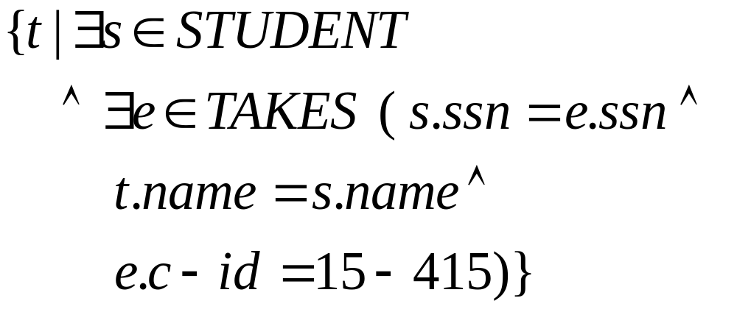
More examples
join: find names of students taking 15-415
#<number>

Slide 31
More examples
join: find names of students taking 15-415
join
projection
selection
(Remember: ‘SPJ’ )
#<number>

Slide 32
More examples
3-way join: find names of students taking a 2-unit course
#<number>

Slide 33
Reminder: our Mini-U db
#<number>

Slide 34
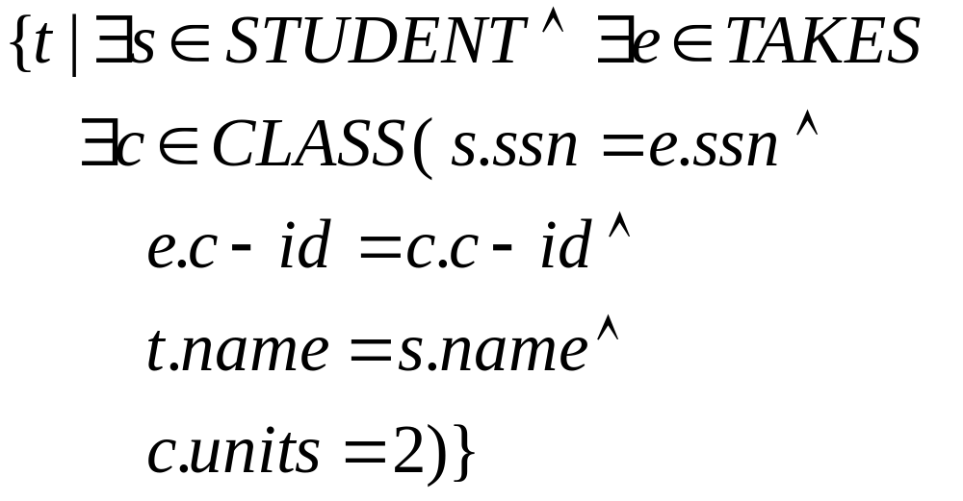
More examples
3-way join: find names of students taking a 2-unit course
join
projection
selection
#<number>

Slide 35
More examples
3-way join: find names of students taking a 2-unit course - in rel. algebra??
#<number>

Slide 36
More examples
3-way join: find names of students taking a 2-unit course - in rel. algebra??
#<number>

Slide 37
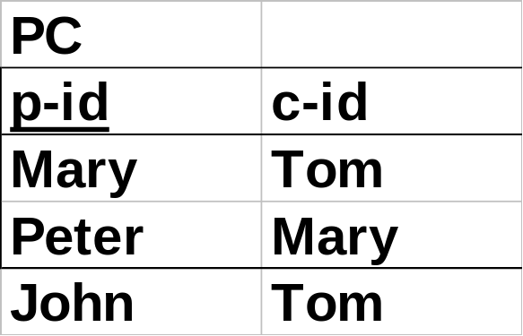
Even more examples:
self -joins: find Tom’s grandparent(s)
#<number>

Slide 38
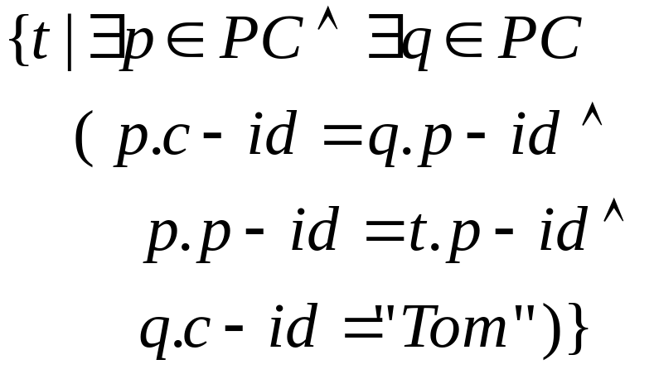
Even more examples:
self -joins: find Tom’s grandparent(s)
#<number>

Slide 39
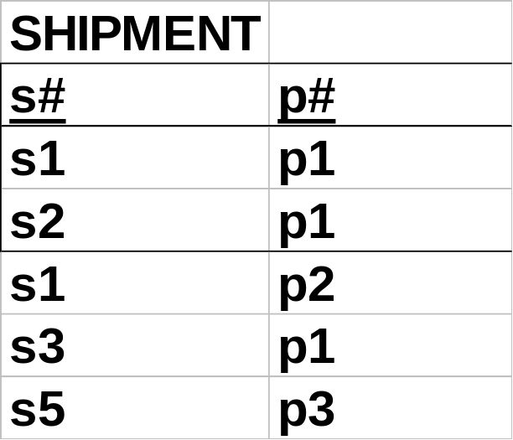
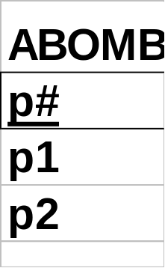
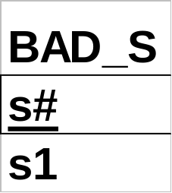


Hard examples: DIVISION
!
find suppliers that shipped all the ABOMB parts
#<number>

Slide 40
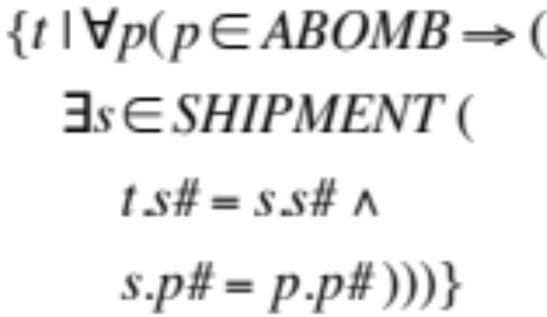
Hard examples: DIVISION
!
find suppliers that shipped all the ABOMB parts
#<number>

Slide 41
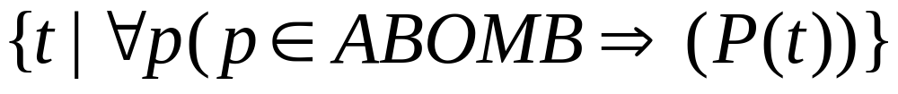
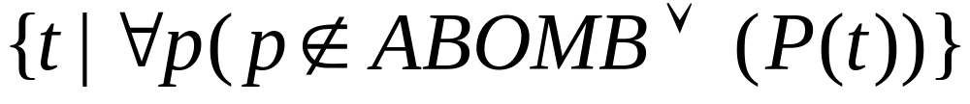
General pattern
!
three equivalent versions:
  1) if it’s bad, he shipped it
  2)either it was good, or he shipped it
  3) there is no bad shipment that he missed
#<number>

Slide 42
General pattern
!
three equivalent versions:
  1) if it’s bad, he shipped it
  2)either it was good, or he shipped it
  3) there is no bad shipment that he missed
a ⇒ b
¬ a ∨ b
#<number>

Slide 43
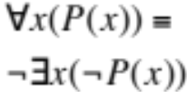
General pattern
!
three equivalent versions:
  1) if it’s bad, he shipped it
  2)either it was good, or he shipped it
  3) there is no bad shipment that he missed
#<number>

Slide 44
a ⇒ b is the same as ¬a ∨ b
b
If a is true, b must be true for the implication to be true. If a is true and b is false, the implication evaluates to false.
If a is not true, we don’t care about b, the expression is always true.
T F
T
T
F
a
F
T
T
#<number>

Slide 45
More on division
find (SSNs of) students that take all the courses that ssn=123 does (and maybe even more)
  find students ‘s’ so that
  if 123 takes a course => so does ‘s’
#<number>

Slide 46
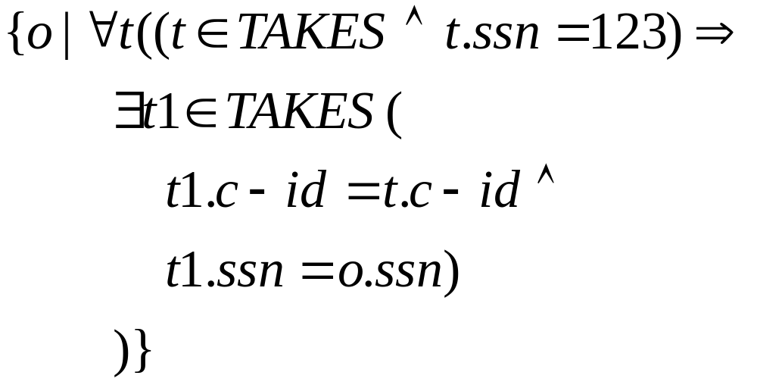
More on division
find students that take all the courses that ssn=123 does (and maybe even more)
#<number>

Slide 47
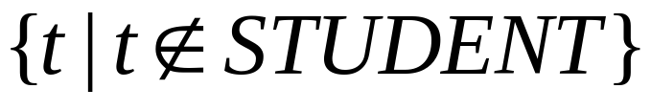
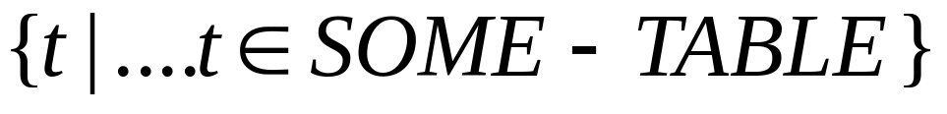
Safety of expressions
FORBIDDEN:
It has infinite output!!
Instead, always use
#<number>

Slide 48
Overview - conclusions
rel. tuple calculus: DECLARATIVE
  dfn
  details
  equivalence to rel. algebra
rel. domain calculus + QBE
#<number>

Slide 49
General Overview
relational model
Formal query languages
  relational algebra
  rel. tuple calculus
  rel. domain calculus
#<number>

Slide 50
Rel. domain calculus (RDC)
Q: why?
A: slightly easier than RTC, although equivalent - basis for QBE.
idea: domain variables (w/ F.O.L.) - eg:
‘find STUDENT record with ssn=123’
#<number>

Slide 51
Rel. Dom. Calculus
find STUDENT record with ssn=123’
#<number>
Notes:
Faloutsos - Pavlo
CMU - 15-415/615
solutions: {<a,b,c>| <a,b,c> in STUDENT}

Slide 52
Details
Like R.T.C - symbols allowed:
quantifiers
#<number>

Slide 53

Details
but: domain (= column) variables, as opposed to tuple variables, eg:
ssn
name
address
#<number>

Slide 54
Reminder: our Mini-U db
#<number>

Slide 55

Examples
find all student records
RTC:
#<number>

Slide 56
Examples
(selection) find student record with ssn=123
#<number>

Slide 57
(‘Proof’ of RDC = RA)
Again, we show examples of the 5 fundamental operators, in RDC
#<number>

Slide 58

Examples
(selection) find student record with ssn=123
RTC:
#<number>

Slide 59
Examples
(selection) find student record with ssn=123
or
RTC:
#<number>

Slide 60
Examples
(projection) find name of student with ssn=123
#<number>

Slide 61
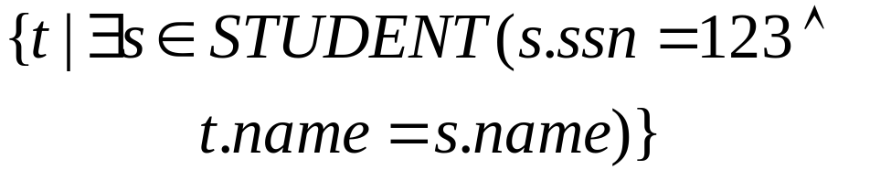
Examples
(projection) find name of student with ssn=123
need to ‘restrict’ “a”
RTC:
#<number>

Slide 62
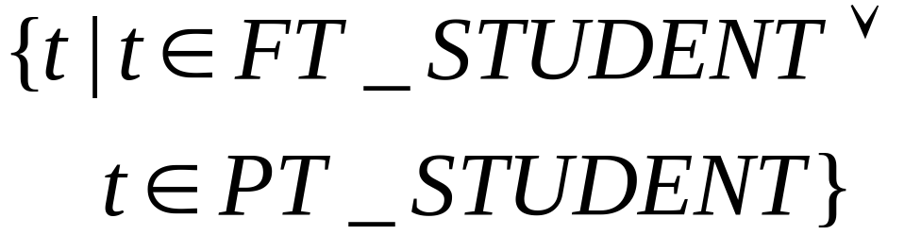
Examples cont’d
(union) get records of both PT and FT students
RTC:
#<number>

Slide 63
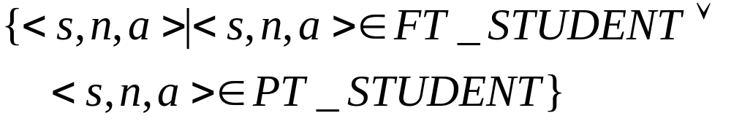
Examples cont’d
(union) get records of both PT and FT students
#<number>

Slide 64
Examples
difference: find students that are not staff
RTC:
#<number>

Slide 65
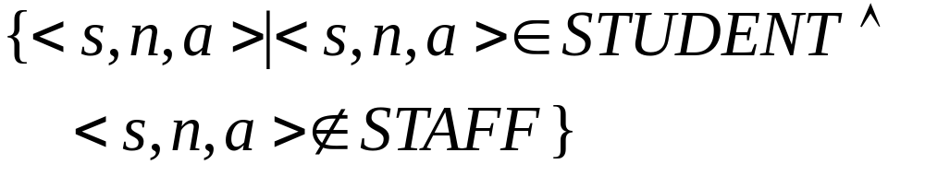
Examples
difference: find students that are not staff
#<number>

Slide 66
Cartesian product
eg., dog-breeding: MALE x FEMALE
gives all possible couples
x
=
#<number>

Slide 67

Cartesian product
find all the pairs of (male, female) - RTC:
#<number>

Slide 68
Cartesian product
find all the pairs of (male, female) - RDC:
#<number>

Slide 69
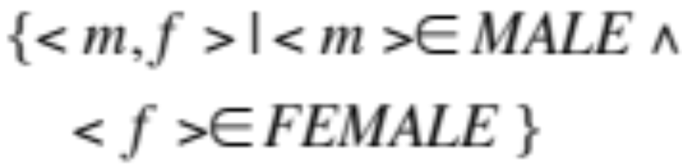
Cartesian product
find all the pairs of (male, female) - RDC:
#<number>

Slide 70
‘Proof’ of equivalence
rel. algebra <-> rel. domain calculus
<-> rel. tuple calculus
#<number>

Slide 71
Overview - detailed
rel. domain calculus
  why?
  details
  examples
  equivalence with rel. algebra
  more examples; ‘safety’ of expressions
#<number>

Slide 72
More examples
join: find names of students taking 15-415
#<number>

Slide 73
Reminder: our Mini-U db
#<number>

Slide 74
More examples
join: find names of students taking 15-415 - in RTC
#<number>

Slide 75
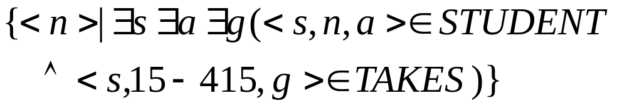
More examples
join: find names of students taking 15-415 - in RDC
#<number>

Slide 76
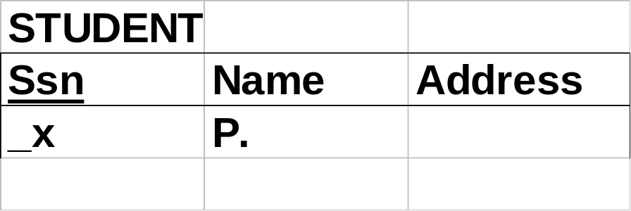
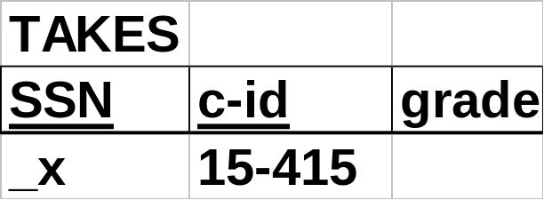
Sneak preview of QBE:
#<number>

Slide 77
Glimpse of QBE:
very user friendly
heavily based on RDC
very similar to MS Access interface and pgAdminIII
#<number>

Slide 78

More examples
3-way join: find names of students taking a 2-unit course - in RTC:
join
projection
selection
#<number>

Slide 79
Reminder: our Mini-U db
_x
.P
_y
2
_x
_y
#<number>

Slide 80
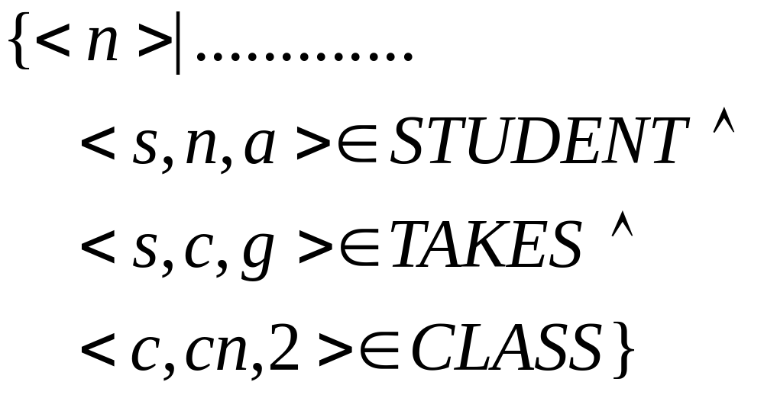
More examples
3-way join: find names of students taking a 2-unit course
#<number>

Slide 81
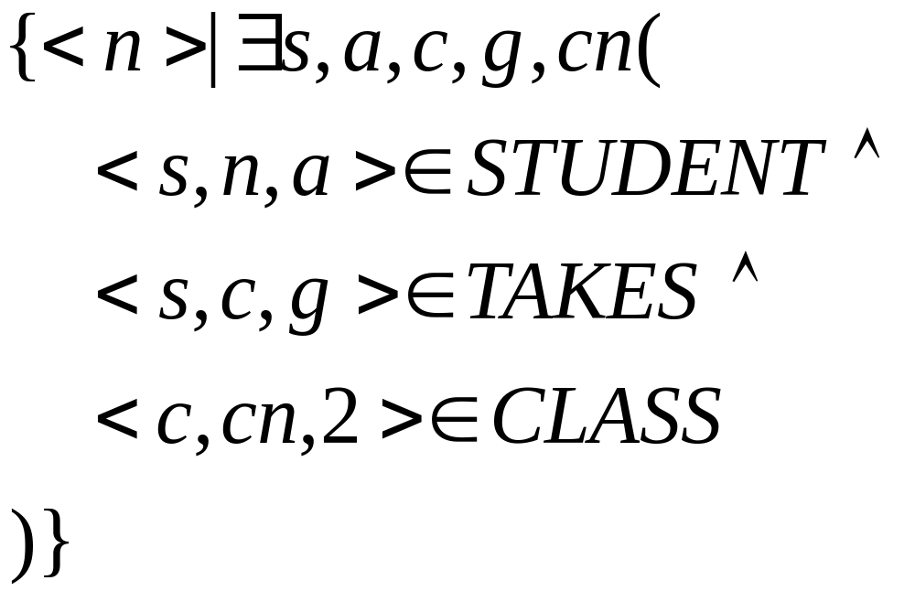
More examples
3-way join: find names of students taking a 2-unit course
#<number>

Slide 82
Even more examples:
self -joins: find Tom’s grandparent(s)
#<number>

Slide 83
Even more examples:
self -joins: find Tom’s grandparent(s)
#<number>

Slide 84

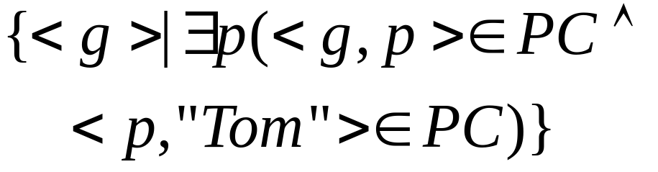
Even more examples:
self -joins: find Tom’s grandparent(s)
#<number>

Slide 85

Even more examples:
self -joins: find Tom’s grandparent(s)
#<number>

Slide 86
Hard examples: DIVISION
find suppliers that shipped all the ABOMB parts
#<number>

Slide 87

Hard examples: DIVISION
find suppliers that shipped all the ABOMB parts
#<number>

Slide 88
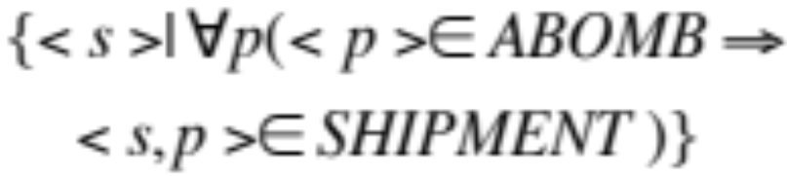
Hard examples: DIVISION
find suppliers that shipped all the ABOMB parts
#<number>

Slide 89
More on division
find students that take all the courses that ssn=123 does (and maybe even more)
#<number>

Slide 90
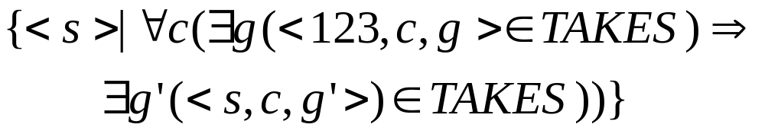
More on division
find students that take all the courses that ssn=123 does (and maybe even more)
#<number>

Slide 91
Safety of expressions
similar to RTC
FORBIDDEN:
#<number>

Slide 92
Overview - detailed
rel. domain calculus + QBE
  dfn
  details
  equivalence to rel. algebra
#<number>

Slide 93
Fun Drill:Your turn …
Schema:
  Movie(title, year, studioName)
  ActsIn(movieTitle, starName)
  Star(name, gender, birthdate, salary)
#<number>

Slide 94
Your turn …
Queries to write in TRC:
  Find all movies by Paramount studio
  … movies starring Kevin Bacon
  Find stars who have been in a film w/Kevin Bacon
  Stars within six degrees of Kevin Bacon*
  Stars connected to K. Bacon via any number of films**
* Try two degrees for starters ** Good luck with this one!
#<number>

Slide 95
Answers …
Find all movies by Paramount studio
{M | M∈Movie ∧
M.studioName = ‘Paramount’}
#<number>

Slide 96
Answers …
Movies starring Kevin Bacon
{M | M∈Movie ∧
∃A∈ActsIn(A.movieTitle = M.title ∧ A.starName = ‘Bacon’))}
#<number>

Slide 97

Answers …
Stars who have been in a film w/Kevin Bacon
{S | S∈Star ∧
∃A∈ActsIn(A.starName = S.name ∧
∃A2∈ActsIn(A2.movieTitle = A.movieTitle ∧ A2.starName = ‘Bacon’))}
S:
name
…
A:
movie
star
movie
star
‘Bacon’
A2:
#<number>

Slide 98
Answers …
two
Stars within six degrees of Kevin Bacon
{S | S∈Star ∧
∃A∈ActsIn(A.starName = S.name ∧
∃A2∈ActsIn(A2.movieTitle = A.movieTitle ∧
∃A3∈ActsIn(A3.starName = A2.starName ∧
∃A4∈ActsIn(A4.movieTitle = A3.movieTitle ∧
A4.starName = ‘Bacon’))}
#<number>

Slide 99
Two degrees:
S:
name
…
A3:
movie
star
A4:
movie
star
‘Bacon’
CU SCS 15-415/615
#<number>

Slide 100
Two degrees:
S:
name
…
A:
movie
star
A2:
movie
star
A3:
movie
star
A4:
movie
star
‘Bacon’
#<number>

Slide 101
Answers …
Stars connected to K. Bacon via any number of films
Sorry … that was a trick question
  Not expressible in relational calculus!!
What about in relational algebra?
  No – RA, RTC, RDC are equivalent
#<number>

Slide 102
Expressive Power
Expressive Power (Theorem due to Codd):
  Every query that can be expressed in relational algebra can be expressed as a safe query in RDC / RTC; the converse is also true.
Relational Completeness:
  Query language (e.g., SQL) can express every query that is expressible in relational algebra/calculus.
  (actually, SQL is more powerful, as we will see…)
#<number>
Notes:
Faloutsos - Pavlo
CMU - 15-415/615

Slide 103
Summary
The relational model has rigorously defined query languages — simple and powerful.
Relational algebra is more operational/procedural
  useful as internal representation for query evaluation plans
Relational calculus is declarative
  users define queries in terms of what they want, not in terms of how to compute it.
#<number>
Notes:
Faloutsos - Pavlo
CMU - 15-415/615

Slide 104
Summary - cnt’d
Several ways of expressing a given query
  a query optimizer chooses best plan.
Algebra and safe calculus: same expressive power
  => relational completeness.
#<number>
Notes:
Faloutsos - Pavlo
CMU - 15-415/615

