Slide 1
DB Applications
File Organizations and Indexing
Notes:
Jun Rao
CSC315
Faloutsos
SCS 15-415

Slide 2
Overview
Review
Index classification
Cost estimation
Notes:
Jun Rao
CSC315
Faloutsos
SCS 15-415

Slide 3
Alternative File Organizations
Many alternatives exist, each good for some situations, and not so good in others:
  Heap files: Suitable when typical access is a file scan retrieving all records.
  Sorted Files: Best for retrieval in some order, or for retrieving a `range’ of records.
  Index File Organizations: (B+ trees)
Notes:
Jun Rao
CSC315
Faloutsos
SCS 15-415

Slide 4
How to find records quickly?
E.g., student.gpa = ‘3’
Q: On a heap organization, with B blocks,
how many disk accesses?
Notes:
Jun Rao
CSC315
Faloutsos
SCS 15-415

Slide 5
Heap File Implemented Using Lists
Data
Page
Data
Page
Data
Page
Full Pages
Header
Page
Free
Page
Free
Page
Free
Page
Pages with
Free Space
The header page id and Heap file name must be stored someplace.
Each page contains 2 `pointers’ plus data.
Notes:
Jun Rao
CSC315
Faloutsos
SCS 15-415

Slide 6
How to find records quickly?
E.g., student.gpa = ‘3’
Q: On a heap organization, with B blocks,
how many disk accesses?
A: B
Notes:
Jun Rao
CSC315
Faloutsos
SCS 15-415

Slide 7
How to accelerate searches?
A: Indices, like:
Notes:
Jun Rao
CSC315
Faloutsos
SCS 15-415

Slide 8
Example: Simple Index on GPA
Directory
2
2.5
3
3.5
Data entries:
1.2*
1.7*
1.8*
1.9*
2.2*
2.4*
2.7*
2.7*
2.9*
3.2*
3.3*
3.3*
3.6*
3.8*
3.9*
4.0*
(Index File)
(Data file)
Data Records
An index contains a collection of data entries, and supports efficient retrieval of records matching a given search condition
Notes:
Jun Rao
CSC315
Faloutsos
SCS 15-415
10

Slide 9
Indexes
Sometimes, we want to retrieve records by specifying the values in one or more fields, e.g.,
  Find all students in the “CS” department
  Find all students with a gpa > 3
An index on a file speeds up selections on the search key fields for the index.
  Any subset of the fields of a relation can be the search key for an index on the relation.
  Search key is not the same as key (e.g., doesn’t have to be unique).
Notes:
Jun Rao
CSC315
Faloutsos
SCS 15-415

Slide 10
Index Search Conditions
Search condition = <search key, comparison operator>
Examples…
(1) Condition: Department = “CS”
  Search key: “CS”
  Comparison operator: equality (=)
(2) Condition: GPA > 3
  Search key: 3
  Comparison operator: greater-than (>)
Notes:
Jun Rao
CSC315
Faloutsos
SCS 15-415

Slide 11
Overview
Review
Index classification
  Representation of data entries in index
  Clustered vs. Unclustered
  Primary vs. Secondary
  Dense vs. Sparse
  Single Key vs. Composite
  Indexing technique
Cost estimation
Notes:
Jun Rao
CSC315
Faloutsos
SCS 15-415

Slide 12
Details
‘data entries’ == what we store at the bottom of the index pages
what would you use as data entries?
(3 alternatives here)
Notes:
Jun Rao
CSC315
Faloutsos
SCS 15-415

Slide 13
Example: Simple Index on GPA
Directory
2
2.5
3
3.5
Data entries:
1.2*
1.7*
1.8*
1.9*
2.2*
2.4*
2.7*
2.7*
2.9*
3.2*
3.3*
3.3*
3.6*
3.8*
3.9*
4.0*
(Index File)
(Data file)
Data Records
An index contains a collection of data entries, and supports efficient retrieval of records matching a given search condition
Notes:
Jun Rao
CSC315
Faloutsos
SCS 15-415
10

Slide 14
Alternatives for Data Entry k* in Index
  Actual data record (with key value k)
123
Smith; Main str; 412-999.9999
  2. <k, rid of matching data record>
$40
Rid-1
$40
Rid-2
…
  3. <k, list of rids of matching data records>
$40
Rid-1
Rid-2
…
Notes:
Jun Rao
CSC315
Faloutsos
SCS 15-415

Slide 15
Alternatives for Data Entry k* in Index
  1. Actual data record (with key value k)
  2. <k, rid of matching data record>
  3. <k, list of rids of matching data records>
Choice is orthogonal to the indexing technique.
  Examples of indexing techniques: B+ trees, hash-based structures, R trees, …
  Typically, index contains auxiliary info that directs searches to the desired data entries
Can have multiple (different) indexes per file.
  E.g. file sorted on age, with a hash index on name and a B+tree index on salary.
Notes:
Jun Rao
CSC315
Faloutsos
SCS 15-415

Slide 16
Alternatives for Data Entries (Contd.)
123
Smith; Main str; 412-999.9999
Alternative 1:
Actual data record (with key value k)
  Then, this is a clustering/sparse index, and constitutes a file organization (like Heap files or sorted files).
  At most one index on a given collection of data records can use Alternative 1.
  Saves pointer lookups but can be expensive to maintain with insertions and deletions.
Notes:
Jun Rao
CSC315
Faloutsos
SCS 15-415

Slide 17
Alternatives for Data Entries (Contd.)
Alternative 2
<k, rid of matching data record>
and Alternative 3
<k, list of rids of matching data records>
  Easier to maintain than Alternative 1.
  If more than one index is required on a given file, at most one index can use Alternative 1; rest must use Alternatives 2 or 3.
  Alternative 3 more compact than Alternative 2, but leads to variable sized data entries even if search keys are of fixed length.
  Even worse, for large rid lists the data entry would have to span multiple pages!
$40
Rid-1
$40
Rid-2
$40
Rid-1
Rid-2
…
Notes:
Jun Rao
CSC315
Faloutsos
SCS 15-415

Slide 18
Overview
Review
Index classification
  Representation of data entries in index
  Clustered vs. Unclustered
  Primary vs. Secondary
  Dense vs. Sparse
  Single Key vs. Composite
  Indexing technique
Cost estimation
Notes:
Jun Rao
CSC315
Faloutsos
SCS 15-415

Slide 19
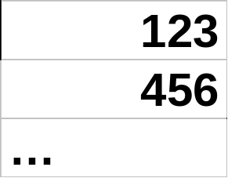
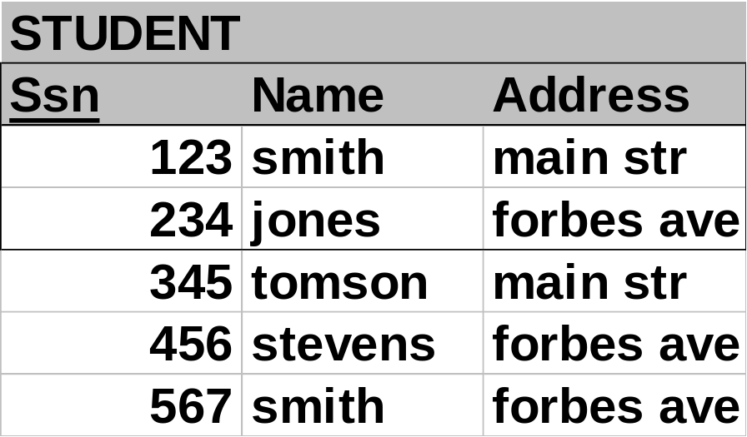
Indexing - clustered index example
Clustering/sparse index on ssn
>=123
>=456
Notes:
Jun Rao
CSC315
Faloutsos
SCS 15-415

Slide 20
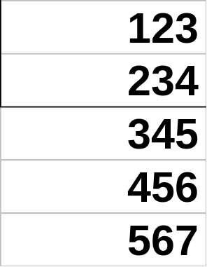
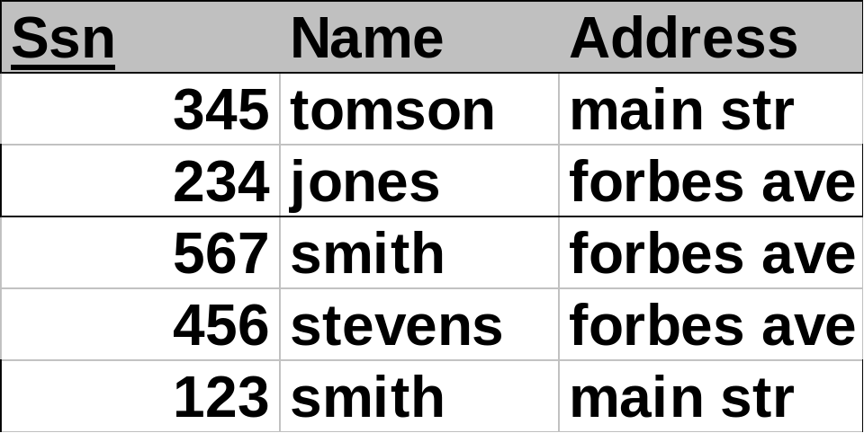
Indexing - non-clustered
Non-clustering / dense index
Notes:
Jun Rao
CSC315
Faloutsos
SCS 15-415

Slide 21
Index Classification - clustered
Clustered vs. unclustered: If order of data records is the same as, or `close to’, order of index data entries, then called clustered index.
Index entries
UNCLUSTERED
CLUSTERED
direct search for
data entries
Data entries
Data entries
(Index File)
(Data file)
Data Records
Data Records
Notes:
Jun Rao
CSC315
Faloutsos
SCS 15-415

Slide 22

Index Classification - clustered
Clustered vs. unclustered: If order of data records is the same as, or `close to’, order of index data entries, then called clustered index.
Index entries
UNCLUSTERED
CLUSTERED
direct search for
data entries
Data entries
(Index File)
(Data file)
Data entries
Data Records
Data Records
Notes:
Jun Rao
CSC315
Faloutsos
SCS 15-415

Slide 23
Index Classification - clustered
  A file can have a clustered index on at most one search key.
  Cost of retrieving data records through index varies greatly based on whether index is clustered!
  Note: Alternative 1 implies clustered, but not vice-versa.
But, for simplicity, you may think of them as equivalent..
Notes:
Jun Rao
CSC315
Faloutsos
SCS 15-415

Slide 24
Clustered vs. Unclustered Index
Cost of retrieving records found in range scan:
  Clustered: cost =
  Unclustered: cost ≈
What are the tradeoffs????
Notes:
Jun Rao
CSC315
Faloutsos
SCS 15-415

Slide 25
Clustered vs. Unclustered Index
Cost of retrieving records found in range scan:
  Clustered: cost = # pages in file w/matching records
  Unclustered: cost ≈ # of matching index data entries
What are the tradeoffs????
Notes:
Jun Rao
CSC315
Faloutsos
SCS 15-415

Slide 26
Clustered vs. Unclustered Index
Cost of retrieving records found in range scan:
  Clustered: cost = # pages in file w/matching records
  Unclustered: cost ≈ # of matching index data entries
What are the tradeoffs????
  Clustered Pros:
    Efficient for range searches
    May be able to do some types of compression
  Clustered Cons:
    Expensive to maintain (on the fly or sloppy with reorganization)
Notes:
Jun Rao
CSC315
Faloutsos
SCS 15-415

Slide 27
Overview
Review
Index classification
  Representation of data entries in index
  Clustered vs. Unclustered
  Primary vs. Secondary
  Dense vs. Sparse
  Single Key vs. Composite
  Indexing technique
Cost estimation
Notes:
Jun Rao
CSC315
Faloutsos
SCS 15-415

Slide 28
Primary vs. Secondary Index
Primary: index key includes the file’s primary key
Secondary: any other index
  Sometimes confused with Alt. 1 vs. Alt. 2/3
  Primary index never contains duplicates
  Secondary index may contain duplicates
    If index key contains a candidate key, no duplicates => unique index
Notes:
Jun Rao
CSC315
Faloutsos
SCS 15-415

Slide 29
Overview
Review
Index classification
  Representation of data entries in index
  Clustered vs. Unclustered
  Primary vs. Secondary
  Dense vs. Sparse
  Single Key vs. Composite
  Indexing technique
Cost estimation
Notes:
Jun Rao
CSC315
Faloutsos
SCS 15-415

Slide 30
Dense vs. Sparse Index
Dense: at least one data entry per key value
Sparse: an entry per data page in file
  Every sparse index is clustered!
  Sparse indexes are smaller; however, some useful optimizations are based on dense indexes.
Ashby, 25, 3000
Basu, 33, 4003
22
Bristow, 30, 2007
25
Ashby
30
Cass
Cass, 50, 5004
33
Smith
Daniels, 22, 6003
Jones, 40, 6003
40
44
Smith, 44, 3000
44
Tracy, 44, 5004
50
Sparse Index
Dense Index
on
Data File
on
Name
Age
Notes:
Jun Rao
CSC315
Faloutsos
SCS 15-415

Slide 31
Dense vs. Sparse Index
Sparse <-> Clustering <-> Alt#1 (full record)
Dense <-> non-clustering
Ashby, 25, 3000
Basu, 33, 4003
22
Bristow, 30, 2007
25
Ashby
30
Cass
Cass, 50, 5004
33
Smith
Daniels, 22, 6003
Jones, 40, 6003
40
44
Smith, 44, 3000
44
Tracy, 44, 5004
50
Sparse Index
Dense Index
on
Data File
on
Name
Age
Notes:
Jun Rao
CSC315
Faloutsos
SCS 15-415

Slide 32
Overview
Review
Index classification
  Representation of data entries in index
  Clustered vs. Unclustered
  Primary vs. Secondary
  Dense vs. Sparse
  Single Key vs. Composite
  Indexing technique
Cost estimation
Notes:
Jun Rao
CSC315
Faloutsos
SCS 15-415

Slide 33
Overview
Review
Index classification
  Representation of data entries in index
  Clustered vs. Unclustered
  Primary vs. Secondary
  Dense vs. Sparse
  Single Key vs. Composite
  Indexing technique
Cost estimation
Notes:
Jun Rao
CSC315
Faloutsos
SCS 15-415

Slide 34
Tree vs. Hash-based index
Hash-based index.
    File = a collection of buckets. Bucket = primary page plus 0 or more overflow pages.
    Hash function h: h(r.search_key) = bucket in which record r belongs.
Tree-based index
    Hierarchical structure (Tree) directs searches
    Leaves contain data entries sorted by search key value
    B+ tree: all root->leaf paths have equal length (height)
Notes:
Jun Rao
CSC315
Faloutsos
SCS 15-415

Slide 35
Tree vs. Hash-based index
Hash-based index
  Best for
Tree-based index
  Best for
Notes:
Jun Rao
CSC315
Faloutsos
SCS 15-415

Slide 36
Tree vs. Hash-based index
Hash-based index
  Best for
    exact match (average)
Tree-based index
  Best for
    exact match (worst case)
    Range queries
    Nearest-neighbor queries
    Insertion/deletion (worst case)
Notes:
Jun Rao
CSC315
Faloutsos
SCS 15-415

Slide 37
Overview
Review
Index classification
  Representation
  …
Cost estimation
Notes:
Jun Rao
CSC315
Faloutsos
SCS 15-415

Slide 38
Cost estimation
Heap file
Sorted
Clustered
Unclustured tree index
Unclustered hash index
Methods
Operations(?)
Notes:
Jun Rao
CSC315
Faloutsos
SCS 15-415

Slide 39
Cost estimation
Heap file
Sorted
Clustered
Unclustured tree index
Unclustered hash index
scan
equality search
range search
insertion
deletion
Methods
Operations
Consider only I/O cost;
suppose file spans B pages
Notes:
Jun Rao
CSC315
Faloutsos
SCS 15-415

Slide 40
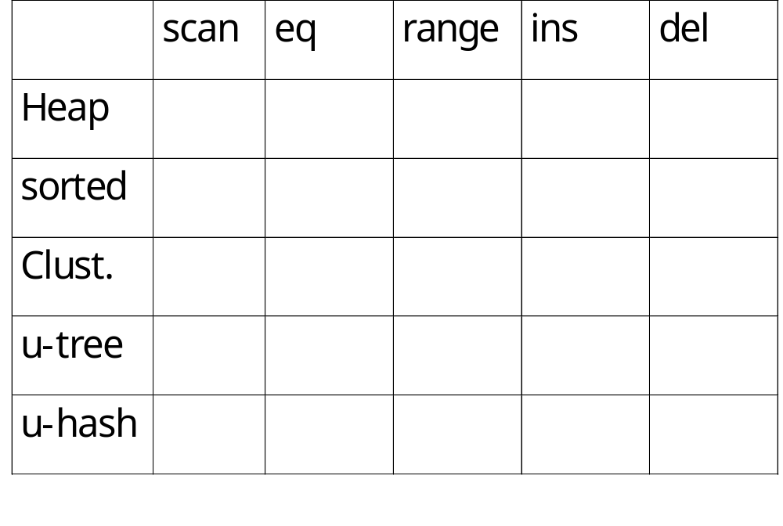
Cost estimation
Assume that:
Clustered index spans 1.5B pages (due to empty space)
Data entry= 1/10 of data record
Notes:
Jun Rao
CSC315
Faloutsos
SCS 15-415

Slide 41
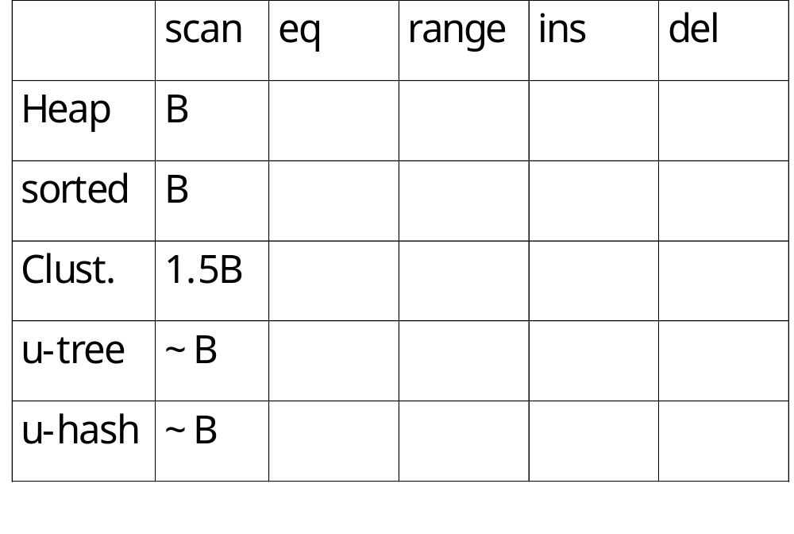
Cost estimation
Notes:
Jun Rao
CSC315
Faloutsos
SCS 15-415

Slide 42
Cost estimation
  heap: seq. scan
  sorted: binary search
  index search
#1
#2
…
#B
Notes:
Jun Rao
CSC315
Faloutsos
SCS 15-415

Slide 43
Cost estimation
index – cost? In general
  levels of index +
  blocks w/ qual. tuples
#1
..
#2
for primary key – cost:
h for clustering index
h’+1 for non-clustering
…
h’
#B
Notes:
Jun Rao
CSC315
Faloutsos
SCS 15-415

Slide 44
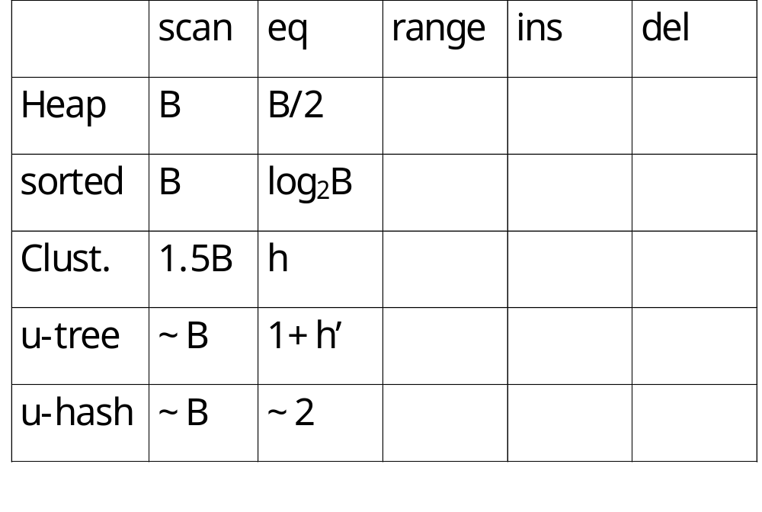
Cost estimation
h= height of btree ~ log_{F} (1.5B)
h’= height of unclustered index btree ~ log_{F} (1.5B)
Notes:
Jun Rao
CSC315
Faloutsos
SCS 15-415

Slide 45
Cost estimation
index – cost?
  levels of index +
  blocks w/ qual. tuples
#1
#2
sec. key – clustering index
h + #qual-pages
…
#B
h
Notes:
Jun Rao
CSC315
Faloutsos
SCS 15-415

Slide 46
Cost estimation
index – cost?
  levels of index +
  blocks w/ qual. tuples
#1
...
#2
sec. key – non-clust. index
h’ + #qual-records
(actually, a bit less...)
…
#B
h’
Notes:
Jun Rao
CSC315
Faloutsos
SCS 15-415

Slide 47
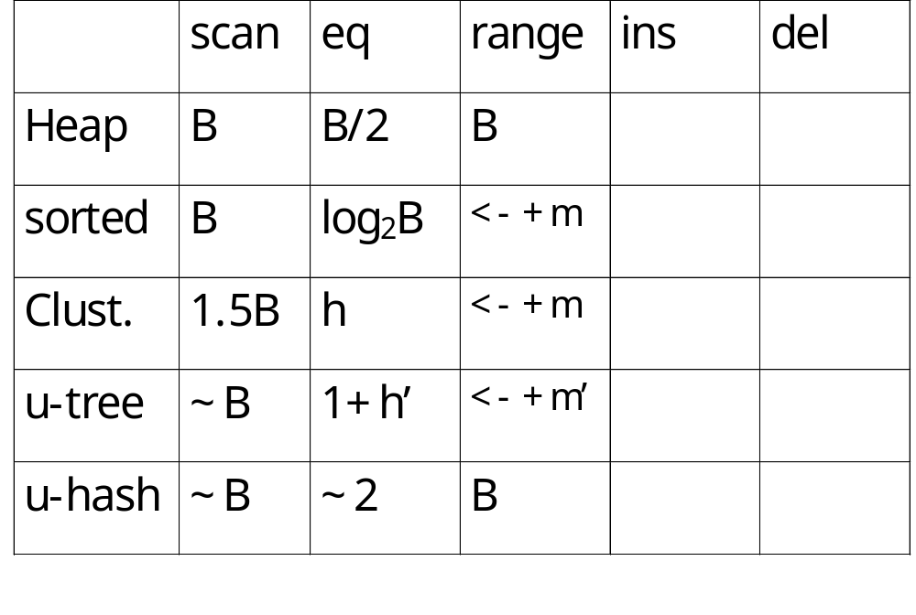
Cost estimation
m: # of qualifying pages
m’: # of qualifying records
Notes:
Jun Rao
CSC315
Faloutsos
SCS 15-415

Slide 48
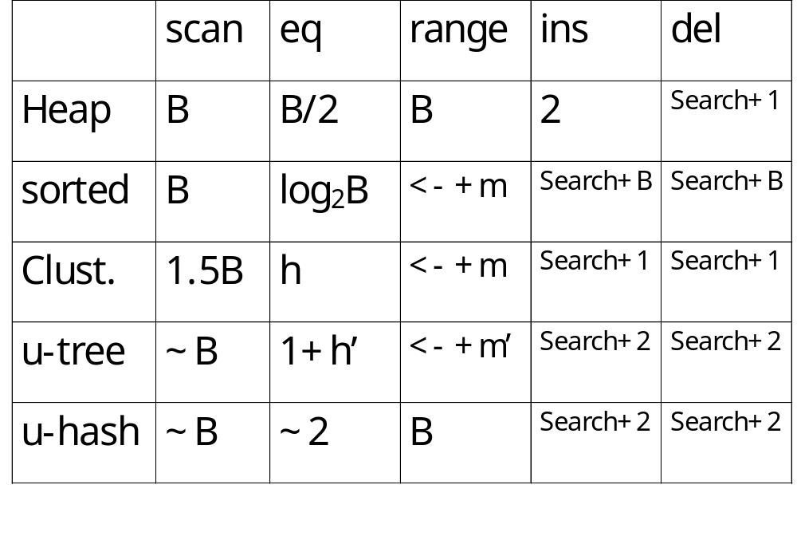
Cost estimation
Notes:
Jun Rao
CSC315
Faloutsos
SCS 15-415

Slide 49
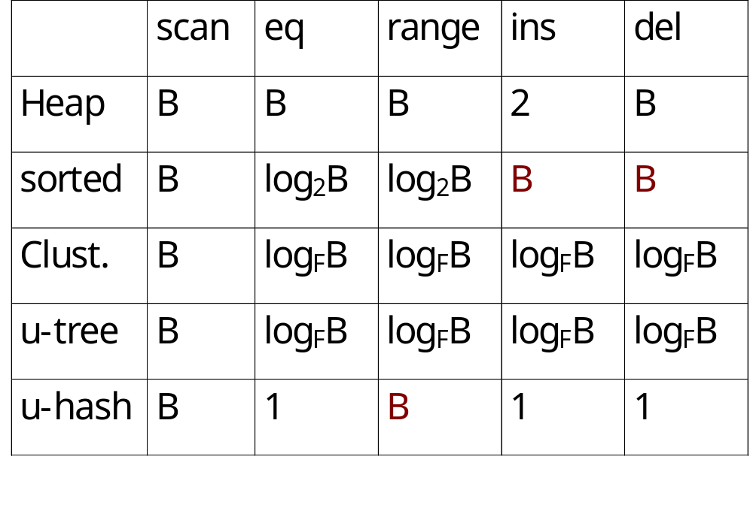
Cost estimation - big-O notation:
Notes:
Jun Rao
CSC315
Faloutsos
SCS 15-415

Slide 50
Index specification in SQL:1999
CREATE INDEX IndAgeRating ON Students
WITH STRUCTURE=BTREE,
KEY = (age, gpa)
Notes:
Jun Rao
CSC315
Faloutsos
SCS 15-415

Slide 51
Summary
To speed up selection queries: index.
Terminology:
  Clustered / non-clustered index
    Clustered = sparse = alt#1
  primary / secondary index
Typically, B-tree index
hashing is only good for equality search
At most one clustered index per table
  many non-clustered ones are possible
  composite indexes are possible
Notes:
Jun Rao
CSC315
Faloutsos
SCS 15-415

