Slide 1
DB Applications
Entity Relationship(ER)
Notes:
Faloutsos - Pavlo
CMU SCS 15-415/615

Slide 2
Database users
naive users
casual users
application programmers
[ DBA (Data base administrator)]

Slide 3

Naïve users who don’t have any DBMS knowledge, but they frequently use the database applications in their daily life to get the desired results.
For examples
Railway’s ticket booking users are naive users.
Clerks in any bank is a naive user because they don’t have any DBMS knowledge, but they still use the database and perform their given task.
Pictorially:
DBMS
data

Slide 4

Casual users/ Temporary Users
select *
from student
Casual Users are the users who occasionally use/access the database but each time when they access the database they require the new information, for example, Middle or higher-level manager.
DBMS
data

Slide 5

App. programmers
Application programmers design, debug, test, and maintain set of programs called “canned transactions” for the Naive (parametric) users in order to interact with database.
DBMS
data

Slide 6
DB Administrator (DBA)
Duties?
DBMS
and meta-data =
catalog
data

Slide 7
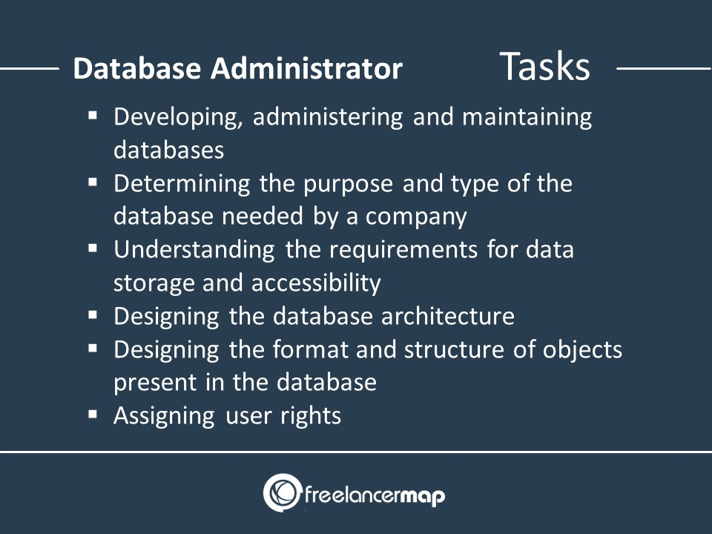

Slide 8
Database Design
Requirements Analysis
Conceptual Design
Logical Design
Schema Refinement
Physical Design
Security Design
Notes:
Faloutsos - Pavlo
CMU SCS 15-415/615

Slide 9
Database Design
✔
Requirements Analysis
Conceptual Design
Logical Design
Schema Refinement
Physical Design
Security Design
user’s needs
high level (ER)
Tables
Normalization
Indices etc
Access controls
Notes:
Faloutsos - Pavlo
CMU SCS 15-415/615

Slide 10
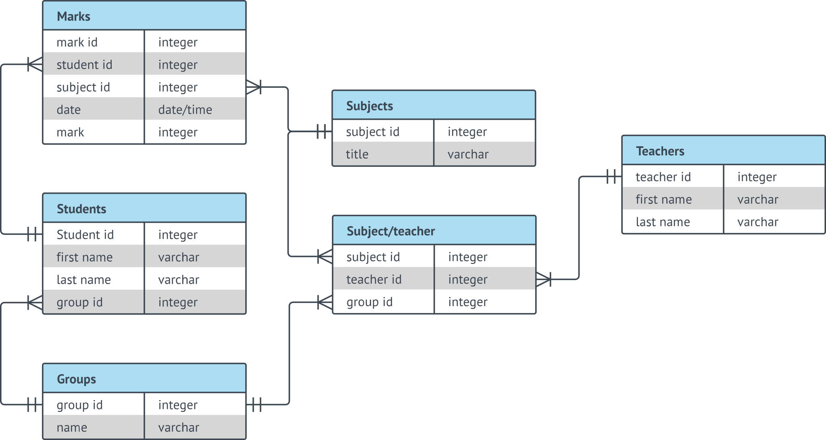
Entity Relationship Diagram (ERD)
Entity Relationship Diagram comprises a graphical representation of database structure and relationships between database objects. In other words, an ER diagram is used to sketch out the design of a database and illustrate its structure.

Slide 11
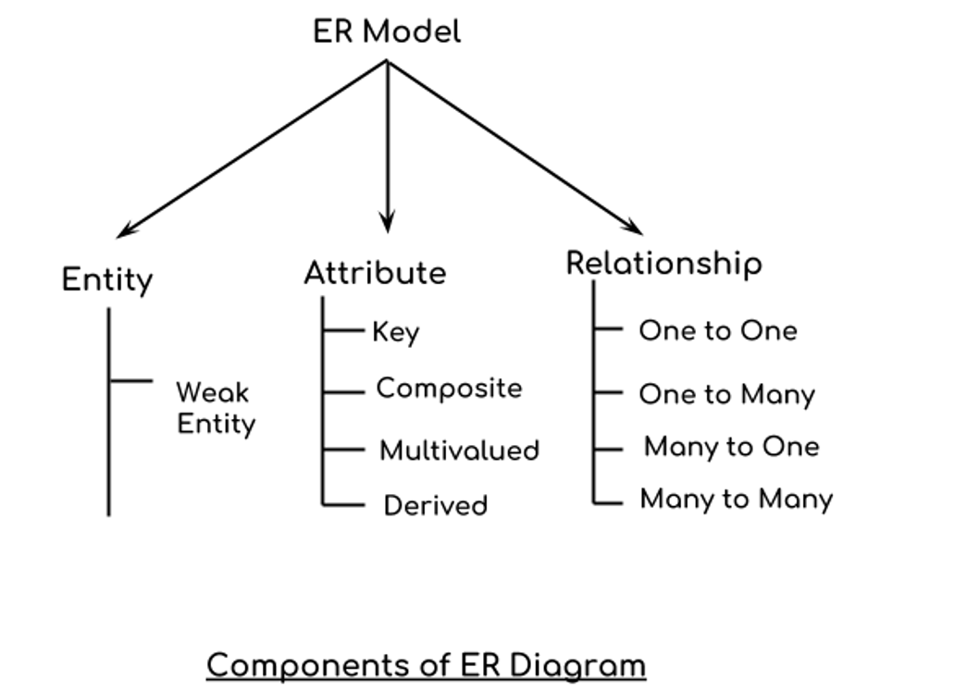
Entity Relationship (ER) Diagram
ER diagrams are created based on three basic concepts: entities, attributes and relationships.

Slide 12
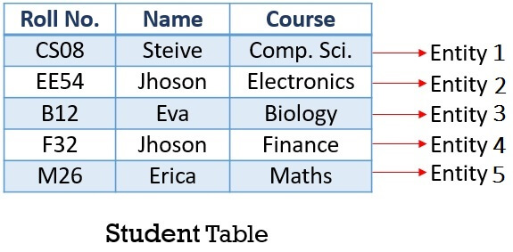
What is Entity in Database?
An entity is a distinguishable real-world ‘object’ that exists.

Slide 13
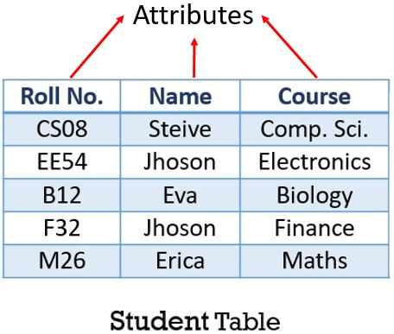
What is Attribute in DBMS?
Attributes describe the characteristics or properties of an entity in a database table.

Slide 14
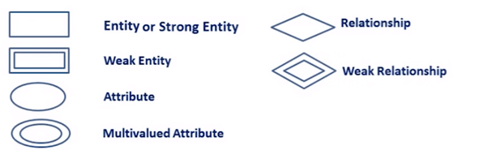
Components &symbols in ER
Rectangles: This Entity Relationship Diagram symbol represents entity types
Ellipses : Symbol represent attributes
Diamonds: This symbol represents relationship types
Lines: It links attributes to entity types and entity types with other relationship types
Primary key: attributes are underlined
Double Ellipses: Represent multi-valued attributes

Slide 15
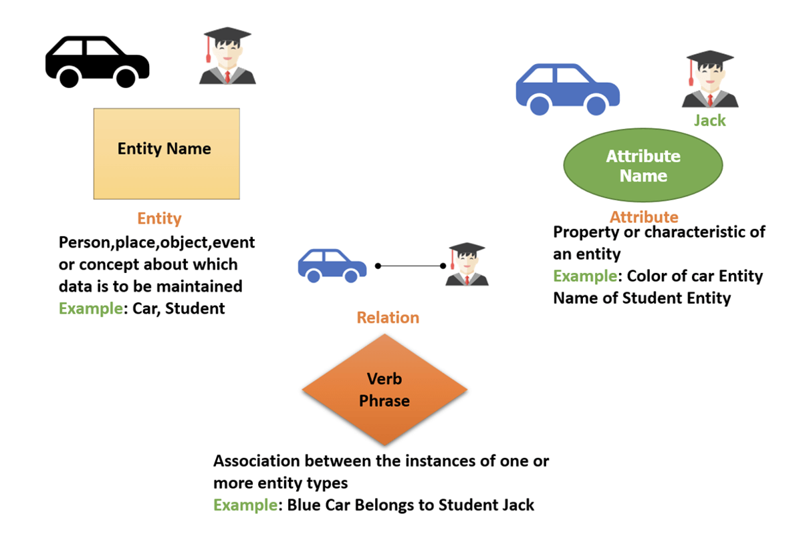
Example

Slide 16
Example
Students, taking courses, offered by instructors; a course may have multiple sections; one instructor per section
nouns -> entity sets
verbs -> relationship sets

Slide 17
Example
Students, taking courses, offered by instructors; a course may have multiple sections; one instructor per section
nouns -> entity sets
verbs -> relationship sets

Slide 18
Example
Students, taking courses, offered by instructors; a course may have multiple sections; one instructor per section
nouns -> entity sets
verbs -> relationship sets

Slide 19
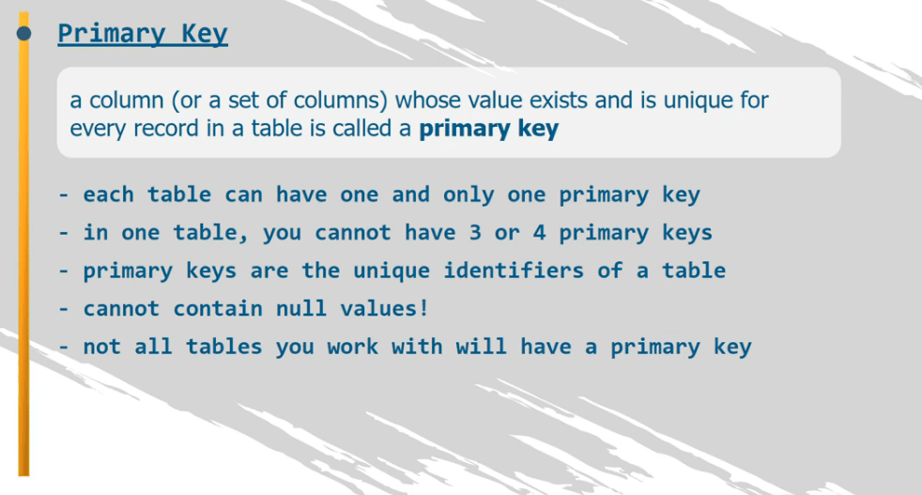
...
name
STUDENT
ssn
primary key =
unique identifier ->
underline
INSTRUCTOR
issn

Slide 20
...
name
STUDENT
c-id
ssn
c-name
COURSE
INSTRUCTOR
issn
but: sections of course (with different instructors)?

Slide 21
ssn
STUDENT
c-id
COURSE
s-id
SECTION
but: s-id is not unique... (see later)
issn
INSTRUCTOR

Slide 22
ssn
STUDENT
c-id
COURSE
s-id
SECTION
Q: how to record that students take courses?
issn
INSTRUCTOR

Slide 23
ssn
STUDENT
N
c-id
takes
M
COURSE
s-id
SECTION
issn
INSTRUCTOR

Slide 24
STUDENT
N
c-id
takes
M
s-id
SECTION
COURSE
N
teaches
1
INSTRUCTOR

Slide 25
STUDENT
N
c-id
takes
M
N
1
s-id
SECTION
has
COURSE
N
teaches
1
INSTRUCTOR

Slide 26
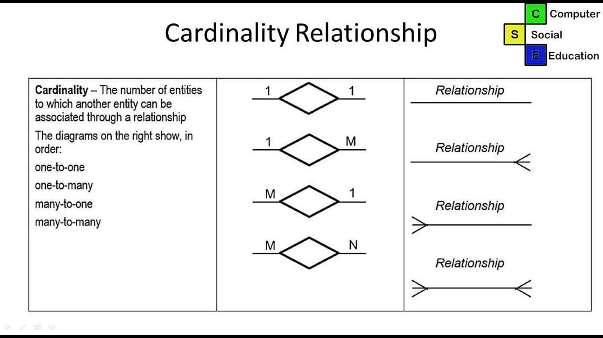
Cardinalities (Relationship)
Cardinality is the numerical relationship between rows of one table and rows in another.

Slide 27
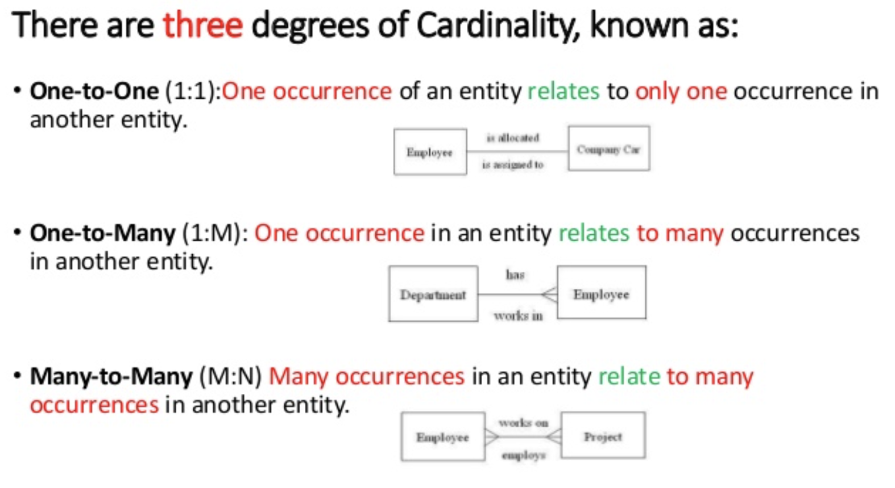
Cardinalities

Slide 28
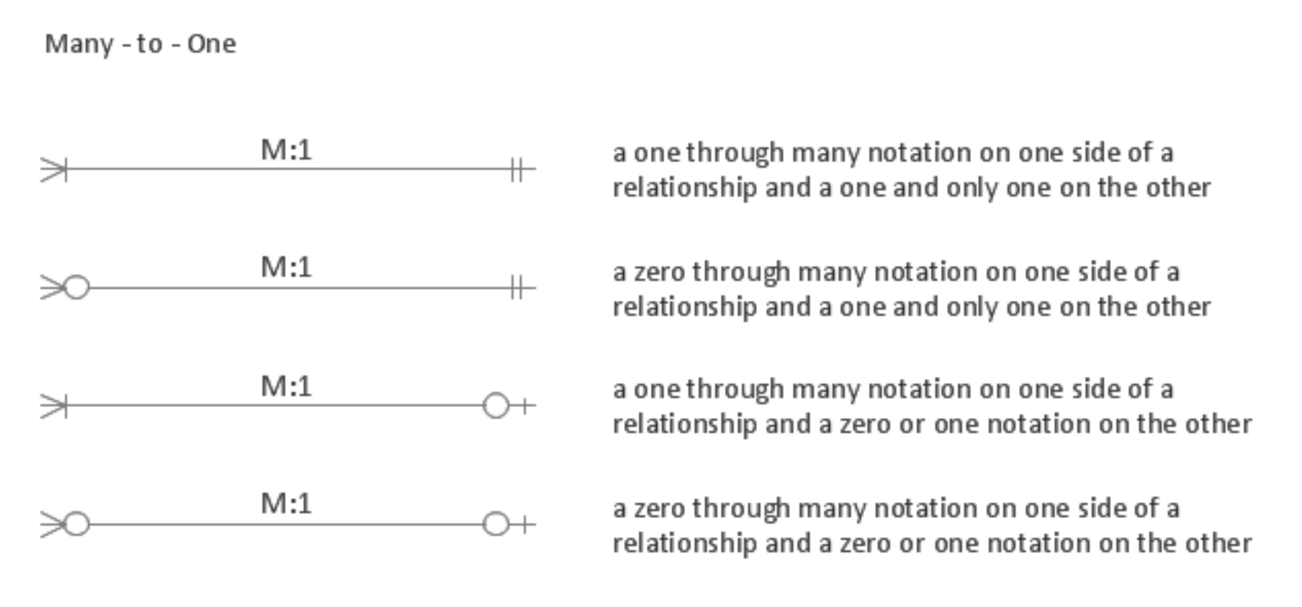
Cardinalities

Slide 29
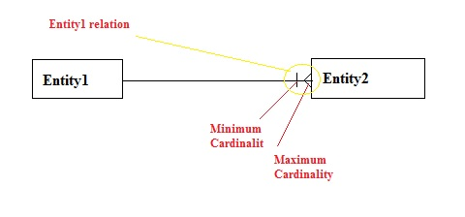
Cardinalities
Symbols closes to the entity is Maximum cardinality and the other one is Minimum cardinality.

Slide 30
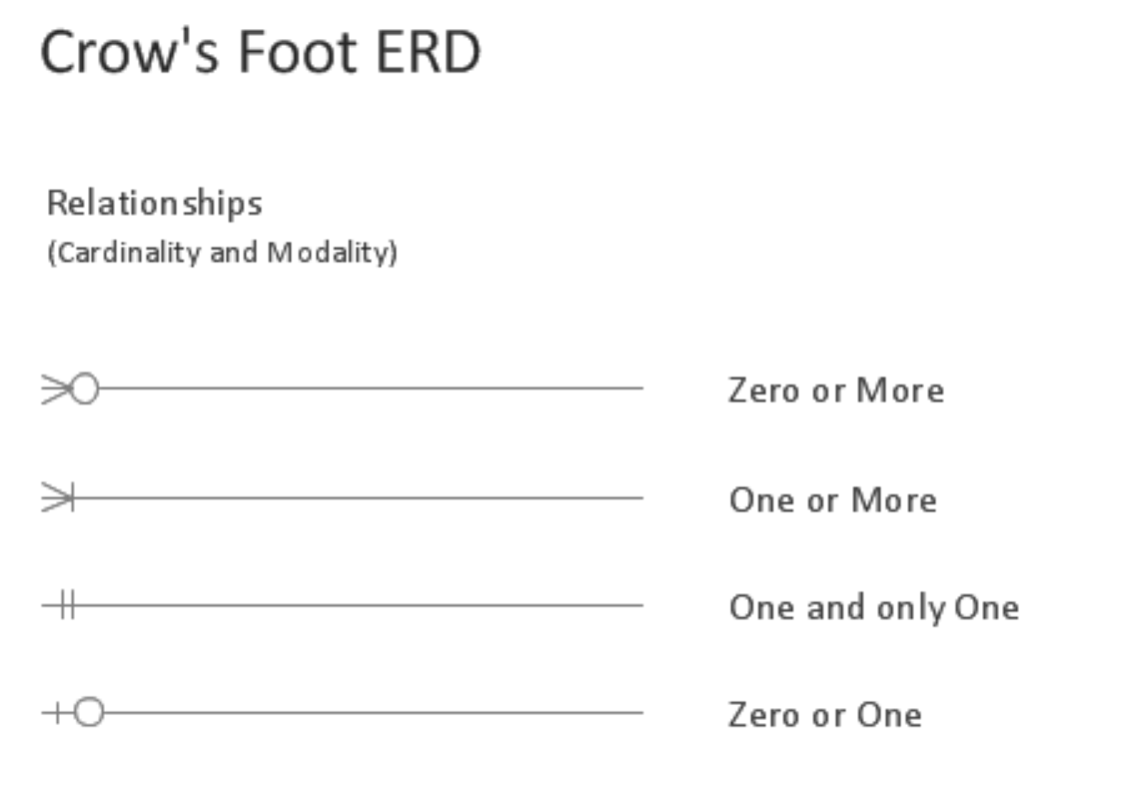
Cardinalities

Slide 31
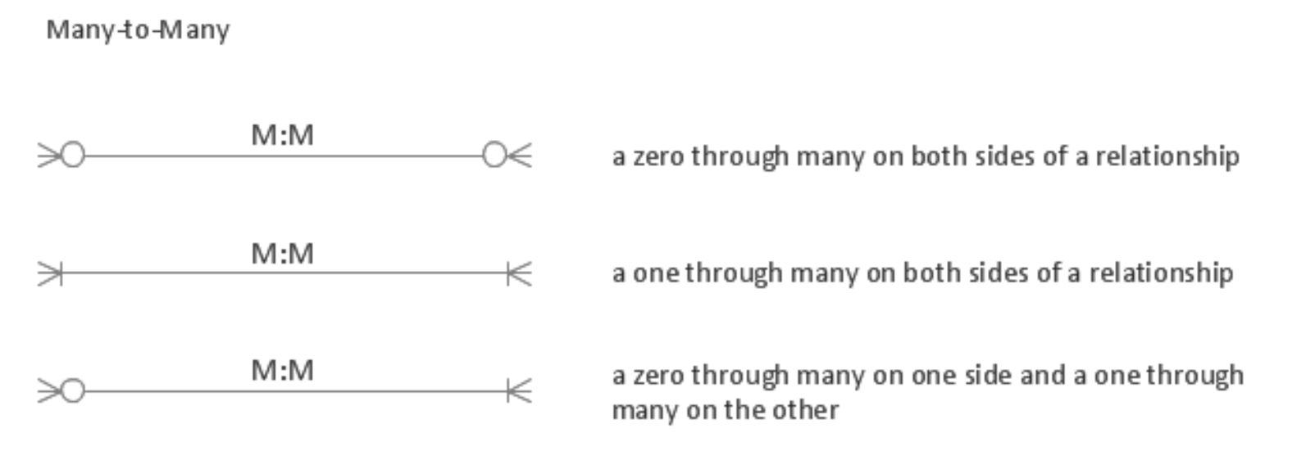
Cardinalities

Slide 32
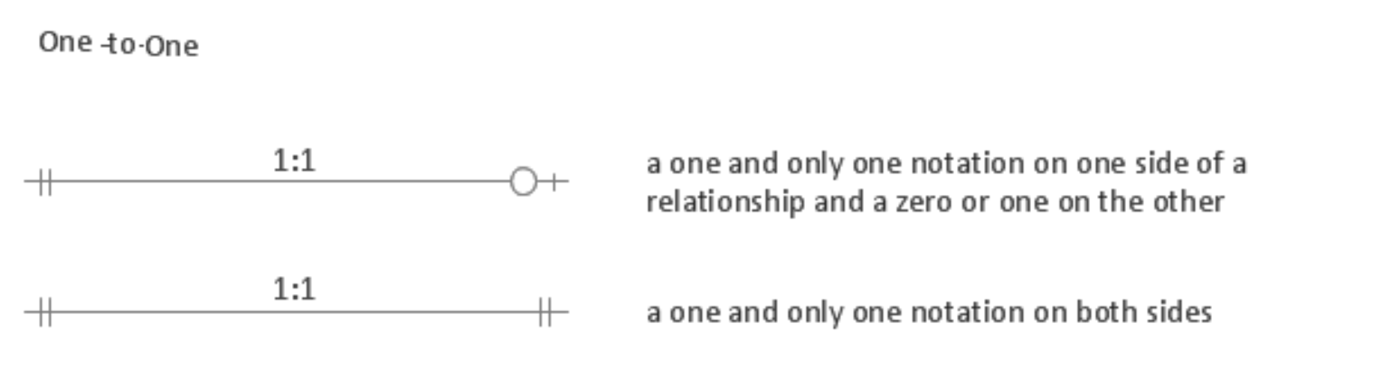
Cardinalities

Slide 33
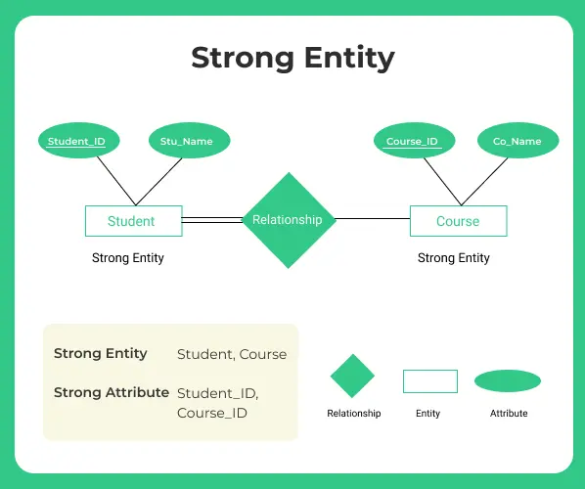
strong entity vs week entity
A strong entity has a primary key, or a table includes a primary key.
A weak entity is not independent as it is reliant on another strong entity. It has to rely on other entities to ensure its existence.

Slide 34
Weak entities
‘section’ has no unique-id of its own!(?)
c-id
N
1
s-id
SECTION
has
COURSE

Slide 35
Weak entities
‘c-id’ + ‘s-id’: unique id for SECTION
partial key (eg., ‘s-id’) - dashed-underline
identifying relationship (eg., ‘has’)
c-id
N
1
s-id
SECTION
has
COURSE

Slide 36
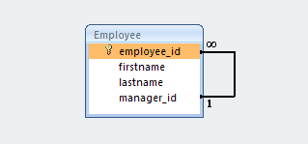
self-relationships
A self-referencing relationship (also known as a recursive relationship) in a database occurs when a column in a table relates to another column in the same table.

Slide 37
More details
self-relationships - example?
manages
1
EMPLOYEE
N

Slide 38

How to Create an ER Diagram
In a university, a Student enrolls in Courses. A student must be assigned to at least one or more Courses. Each course is taught by a single Professor. To maintain instruction quality, a Professor can deliver only one course

Slide 39
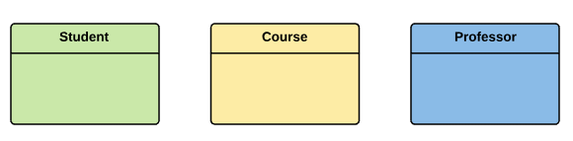
Step 1--- Entity Identification
Three entities: Student, Course, Professor

Slide 40
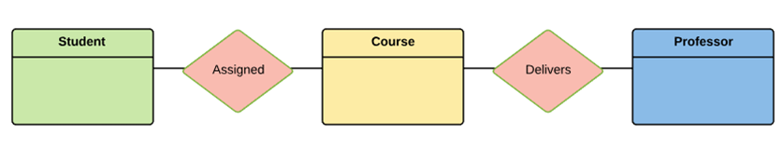
Step 2---Relationship Identification
The student is assigned a course
Professor delivers a course

Slide 41
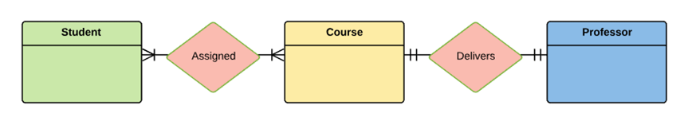
Step 3---Cardinality Identification
A student can be assigned multiple courses
A Professor can deliver only one course

Slide 42
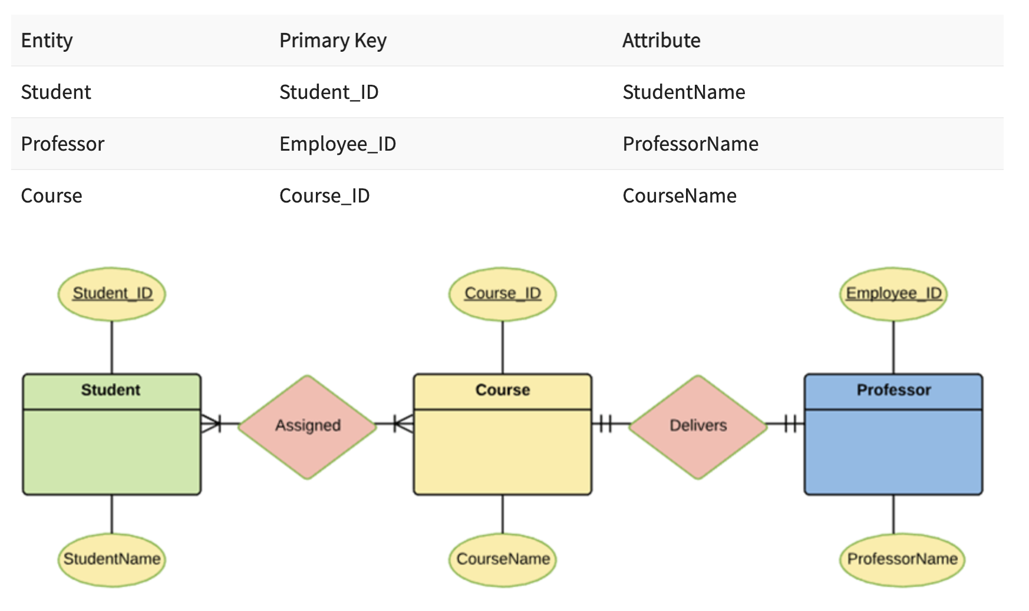
Step 4---Identify Attributes
identify the primary Keys. If a unique key is not readily available, create one.

Slide 43
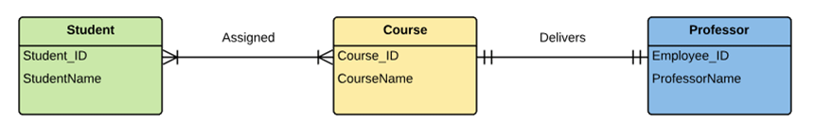
Step 5---Create the ERD Diagram

Slide 44
tools to create an ERD
LucidChart
https://www.lucidchart.com/pages/examples/er-diagram-tool
DBDiagram
https://dbdiagram.io/home
DrawSQL
https://drawsql.app/

Slide 45


