Slide 1
Software Development Life Cycles (SDLCs)
Adj. Lec. Richard Weir
CUNY - College of Staten Island

Slide 2
What are SDLCs?
A methodology with clearly defined processes for creating high-quality software with the lowest cost in the shortest amount of time.
Typically has six phases:
Requirement Analysis
Planning
Software Design
Software Development
Testing
Deployment
How these phases are approached depends on the design approach chosen.

Slide 3
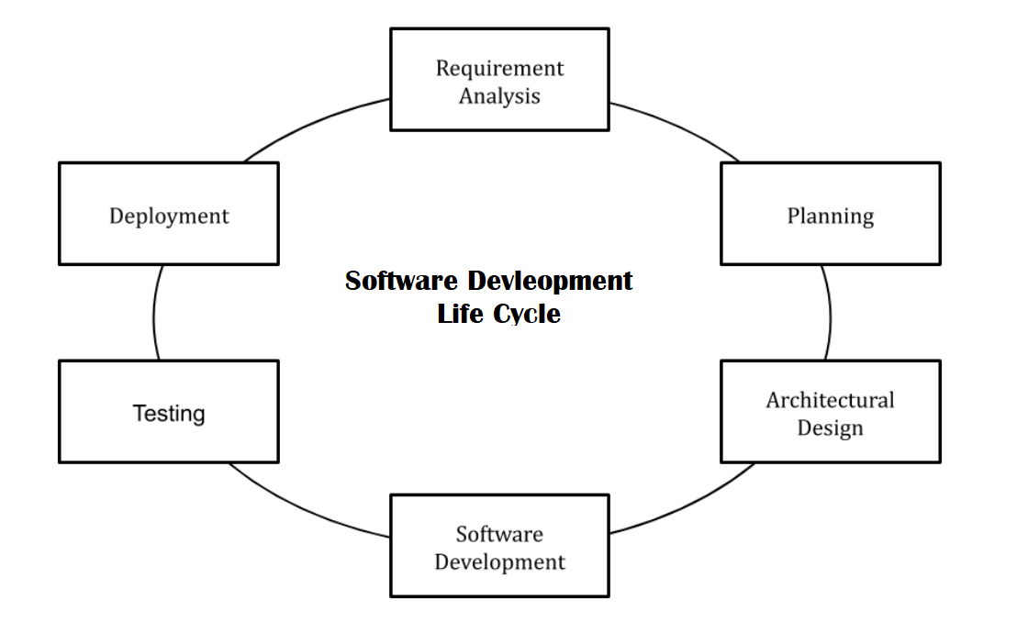
SDLC General Steps

Slide 4
Requirements Analysis
What are the current problems you are trying to solve?
At this point, you would get input from everyone involved in the project (not just developers).
Customers
Salespeople
Industry Experts
Programmers
Other Developers
If another system is in place elsewhere, what are it’s strengths and weaknesses? How can it be improved?

Slide 5
Planning
Now that you have a general idea, you need to focus on what it is you actually want.
Determine the costs involved in the development of the system based on its requirements from the previous step.
Determine the risks involved in this development, and plan to avoid or alleviate those risks.
The goal is to LOWER RISKS involved as much as possible.

Slide 6
Software Design
This is the “how” part of any project.
Compile all software specifications into a Design Sepcification
Get feedback from all stakeholders before you move on to the next stage.
Failing at this stage is going to inflate costs at best; and, at worst, the entire project will be a failure.
Feedback is VERY IMPORTANT!

Slide 7
Software Development
This is the actual building (coding) part of the cycle.
STICK TO THE SPECIFICATIONS!
NO ROGUE BEHAVIOR – no matter how much better your decisions may make the project “better”
Everyone should follow the same general guidelines for coding practices (style of commenting, etc.) so other developers can continue your work if anything happens.

Slide 8
Testing
Does the project work?
Test for defects and deficiencies.
If any problems are found, fix them while moving towards the original specifications.
Do not leave this stage until the project satisfies the original specifications.
Verify, verify, verify!

Slide 9
Deployment
Send your project out into the world! (Almost)
Sometimes, stakeholders will partake in a final beta test, just to make sure that everything is working.
Once that is done, customers can begin using the software.
Sometimes, there is also an extra part of the cycle, Maintenance, in which a company will support the software as it is being used, but this is dependent on the type of software that was developed.

Slide 10
SDLC Models
We will be covering the following models for this course (and it’s on your final!):
Waterfall Model
Iterative Model
Spiral Model
V-Model
Big Bang Model
Agile Model

Slide 11
Waterfall Model
The first Process Model to be produced.
Also called the “linear-sequential life cycle model.”
It is a very rigid design in which each phase must be totally completed before you can move on to the next phase.
There is no overlapping of phases.
Progress moves downward like a waterfall. Each phases cascades into the next.
You cannot move back up the waterfall!

Slide 12
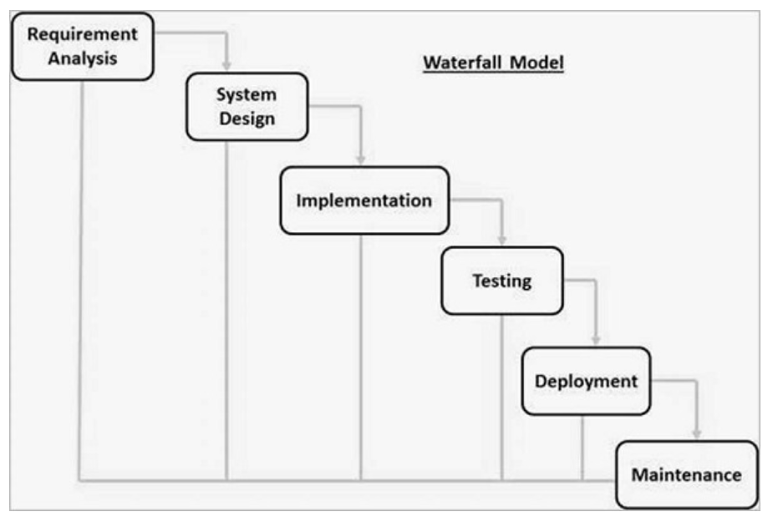
Waterfall Model continued…

Slide 13
Waterfall Model Phases
The phases follow the general phases discussed earlier with some changes:
Implementation (Software Design) – system is developed in small programs called units, which are integrated in the next phase. Each unit is developed and tested for its functionality, called Unit Testing.
Integration (Testing) – All of the units are integrated into a system. Post integration, the entire system is tested for any faults and failures.
Maintenance – There is a maintenance phase, which allows for patching if any unforeseen problems arise.

Slide 14
Waterfall Model – Best Applications
Requirements are very well documented.
Product definition is stable (no changes along the way)
There are no ambiguous requirements.
Ample resources with required expertise are available to support the project.
The project is short!

Slide 15
Waterfall Model - Advantages
Simple and easy to understand and use
Easy to manage due to the rigidity of the model.
Phases are done one at a time.
Works well for smaller projects in which requirements are easily understood.
Clearly defined stages and milestones.
Easy to arrange tasks.
Process and results are well documented.

Slide 16
Waterfall Model - Disadvantages
No working software is produced until late in the cycle
High amounts of risk and uncertainty
Not a good model for complex/OO projects.
Poor model for long and ongoing projects.
Not suitable for a project in which the requirements are constantly changing (model is VERY RIGID)
Cannot accommodate changing requirements (we cannot go backwards in this model)

Slide 17
Iterative Model
Process starts with a simple implementation of a small set of the software requirements and iteratively enhances the evolving versions until the complete system is implemented and ready to be deployed.
Do not start with a full specification of the project.
Identify and build a part of the software, ensuring that it meets specifications.
Repeat this process with another subset of the overall software, incorporating it with other finished subsets of the software.
Continue iterating until all subsets have been built.

Slide 18
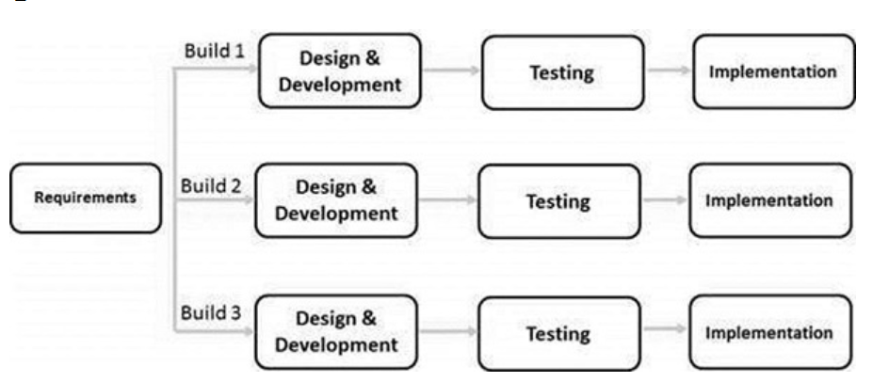
Iterative Model continued…

Slide 19
Iterative Model continued…
The whole requirement is separated into various builds.
During each iteration, the module being developed goes through the requirements, design, implementation and testing phases.
Each of the following modules adds more functionality to the overall project.
This process continues until the complete system is ready as per the requirements.
The key to a successful iterative model is rigorous verification of requirements, and verification and testing of each version of the software against those requirements within each cycle of the model.

Slide 20
Iterative Model: Applications
Requirements are clear and easily understood.
Major requirements must be defined, but there is room for flexibility in features as the software develops.
No time constraints.
New technology is being used and learned as the project develops.
There are some high-risk features and goals which may change in the future.

Slide 21
Iterative Model: Advantages
Some working functionality can be developed quickly and early in the life cycle.
Results are obtained early and periodically.
Parallel development can be planned.
Progress can be measured.
Less costly to change the scope/requirements.
Testing and debugging during smaller iteration is easy.
With every increment, operational product is delivered.
Risk analysis is better.
It supports changing requirements.

Slide 22
Iterative Model: Disadvantages
More resources may be required.
More management attention is required.
System architecture or design issues may arise because not all requirements are gathered in the beginning of the entire life cycle.
Not suitable for smaller projects.
Management complexity is more.
End of project may not be known which is a risk.

Slide 23
Spiral Model
Combines the idea of incremental development with the systematic, controlled aspects of the waterfall model.
Allows incremental releases of the product or incremental refinement through each iteration around the spiral.
The spiral model has four phases. A software project repeatedly passes through these phases in iterations called Spirals.

Slide 24
Spiral Model: Phases
Identifiction – Gathering of requirements; in later phases, get more specific system requirements, subsystem requirements, and unit requirements; constant communication between customer and system analyst
Design - starts with the conceptual design in the baseline spiral and involves architectural design, logical design of modules, physical product design and the final design in the subsequent spirals.
Constructing: In the baseline spiral, when the product is just thought of and the design is being developed a POC (Proof of Concept) is developed in this phase to get customer feedback; in subsequent spirals with higher clarity on requirements and design details a working model of the software called build is produced with a version number. These builds are sent to the customer for feedback.
Evaluation - After testing the build, at the end of first iteration, the customer evaluates the software and provides feedback.

Slide 25
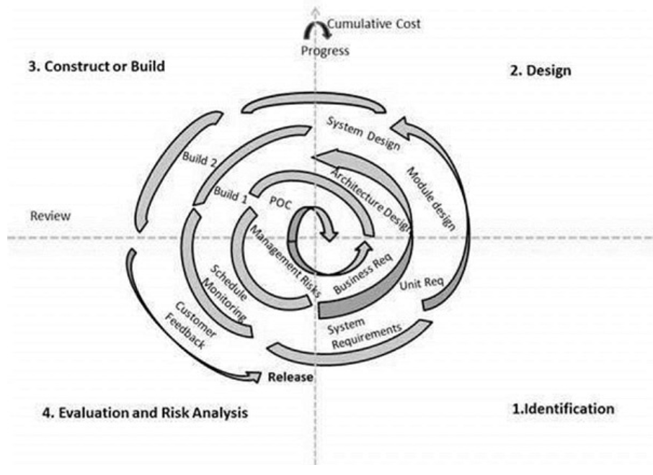
Spiral Model: Illustration

Slide 26
Spiral Model: Application
When there is a budget constraint and risk evaluation is important.
For medium to high-risk projects.
Long-term project commitment because of potential changes to economic priorities as the requirements change with time.
Customer is not sure of their requirements which is usually the case.
Requirements are complex and need evaluation to get clarity.
New product line which should be released in phases to get enough customer feedback.
Significant changes are expected in the product during the development cycle.

Slide 27
Spiral Model: Advantages
Changing requirements can be accommodated.
Allows extensive use of prototypes.
Requirements can be captured more accurately.
Users see the system early.
Development can be divided into smaller parts and the risky parts can be developed earlier which helps in better risk management.

Slide 28
Spiral Model: Disadvantages
Management is more complex.
End of the project may not be known early.
Not suitable for small or low risk projects and could be expensive for small projects.
Process is complex
Spiral may go on indefinitely.
Large number of intermediate stages requires excessive documentation.

Slide 29
V-Model (Verification and Validation Model)
An extension of the waterfall model and is based on the association of a testing phase for each corresponding development stage.
For every phase of the development cycle, there is a corresponding testing phase. (They are parallel)
The coding phase joins together the two sides of the model.

Slide 30
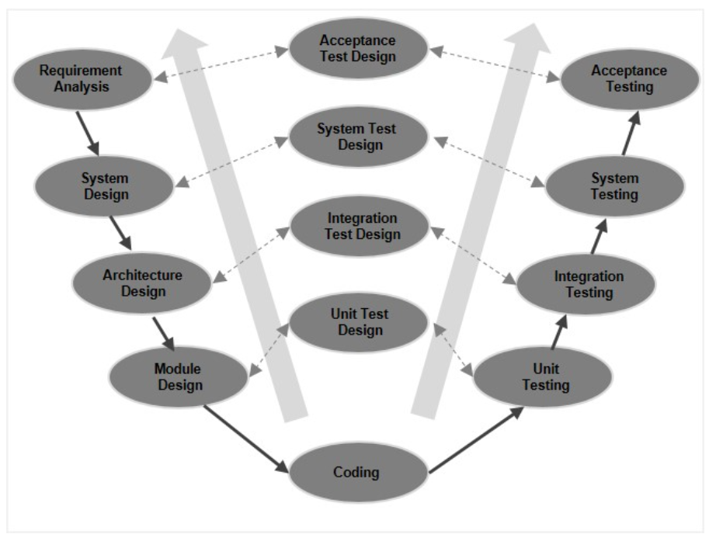
V-Model continued…

Slide 31
V-Model Applications
Almost the same as waterfall model!
Requirements are well defined, clearly documented and fixed.
Product definition is stable.
Technology is not dynamic and is well understood by the project team.
There are no ambiguous or undefined requirements.
The project is short.

Slide 32
V-Model: Advantages
This is a highly-disciplined model and Phases are completed one at a time.
Works well for smaller projects where requirements are very well understood.
Simple and easy to understand and use.
Easy to manage due to the rigidity of the model. Each phase has specific deliverables and a review process.

Slide 33
V-Model: Disadvantages
High risk and uncertainty.
Not a good model for complex and object-oriented projects.
Poor model for long and ongoing projects.
Not suitable for the projects where requirements are at a moderate to high risk of changing.
Once an application is in the testing stage, it is difficult to go back and change a functionality.
No working software is produced until late during the life cycle.

Slide 34
Big Bang Model
Follow no process.
Chaos.
Little planning required.
Requirements are implemented on the fly.
Usually this model is followed for small projects where the development teams are very small.
Focus all the possible resources in the software development and coding, with very little or no planning.

Slide 35
Big Bang Model: Advantages
This is a very simple model
Little or no planning required
Easy to manage
Very few resources required
Gives flexibility to developers
It is a good learning aid for new comers or students.

Slide 36
Big Bang Model: Disadvantages
Very High risk and uncertainty.
Not a good model for complex and object-oriented projects.
Poor model for long and ongoing projects.
Can turn out to be very expensive if requirements are misunderstood.

Slide 37
Agile Model
A combination of iterative and incremental process models with focus on process adaptability and customer satisfaction by rapid delivery of working software product.
Breaks the product into small incremental builds provided in iterations.
Each iteration lasts for about one to three weeks. (time boxes)
Cross functional teams work simultaneously on the different parts of the general design cycle.

Slide 38
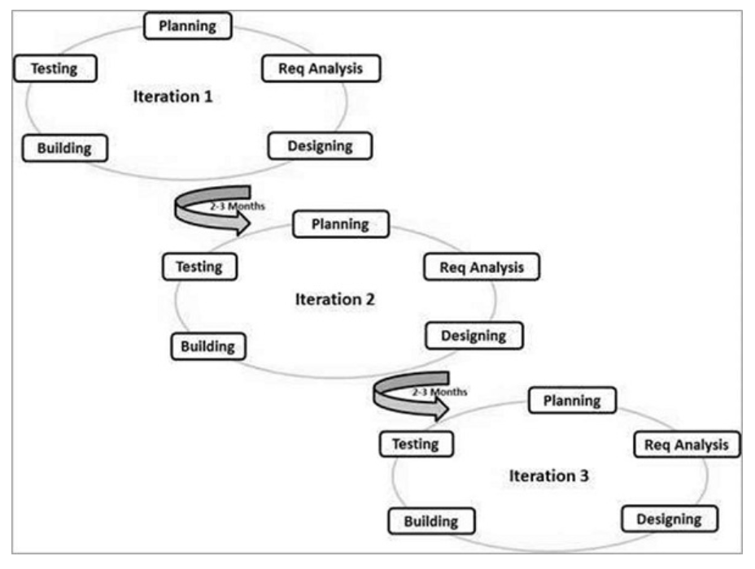
Agile Model continued…

Slide 39
Agile Model continued…
The most popular Agile methods include Rational Unified Process (1994), Scrum (1995), Crystal Clear, Extreme Programming (1996), Adaptive Software Development, Feature Driven Development, and Dynamic Systems Development Method (DSDM) (1995). These are now collectively referred to as Agile Methodologies, after the Agile Manifesto was published in 2001.
The following are the Agile Manifesto Principles:
Individuals and interactions (coworkers)
Working Software (demo with customers – feedback!)
Customer Collaboration (constant!)
Responding to Change (quick responses)

Slide 40
Agile: Comparison to Other SDLC
Agile uses adaptive software development methods, as opposed to the others, which use predictive development methods
Predictive methods are reliant on the requirements analysis and planning phase, whereas the adaptive approach is feature driven.
A team is able to quickly adapt to changing project requirements
The product is tested very frequently, through release iterations, minimizing risk of future failures.
Customer interaction is the backbone of the Agile Model!

Slide 41
Agile Model: Advantages
Is a very realistic approach to software development.
Promotes teamwork and cross training.
Functionality can be developed rapidly and demonstrated.
Resource requirements are minimum.
Suitable for fixed or changing requirements
Delivers early partial working solutions.

Slide 42
Agile Model: Advantages continued…
Good model for environments that change steadily.
Minimal rules, documentation easily employed.
Enables concurrent development and delivery within an overall planned context.
Little or no planning required.
Easy to manage.
Gives flexibility to developers.

Slide 43
Agile Model: Disadvantages
Not suitable for handling complex dependencies.
More risk of sustainability, maintainability and extensibility.
An overall plan, an agile leader and agile PM practice is a must without which it will not work.
Strict delivery management dictates the scope, functionality to be delivered, and adjustments to meet the deadlines.
Depends heavily on customer interaction, so if customer is not clear, team can be driven in the wrong direction.
There is a very high individual dependency, since there is minimum documentation generated.
Transfer of technology to new team members may be quite challenging due to lack of documentation.

