Slide 1
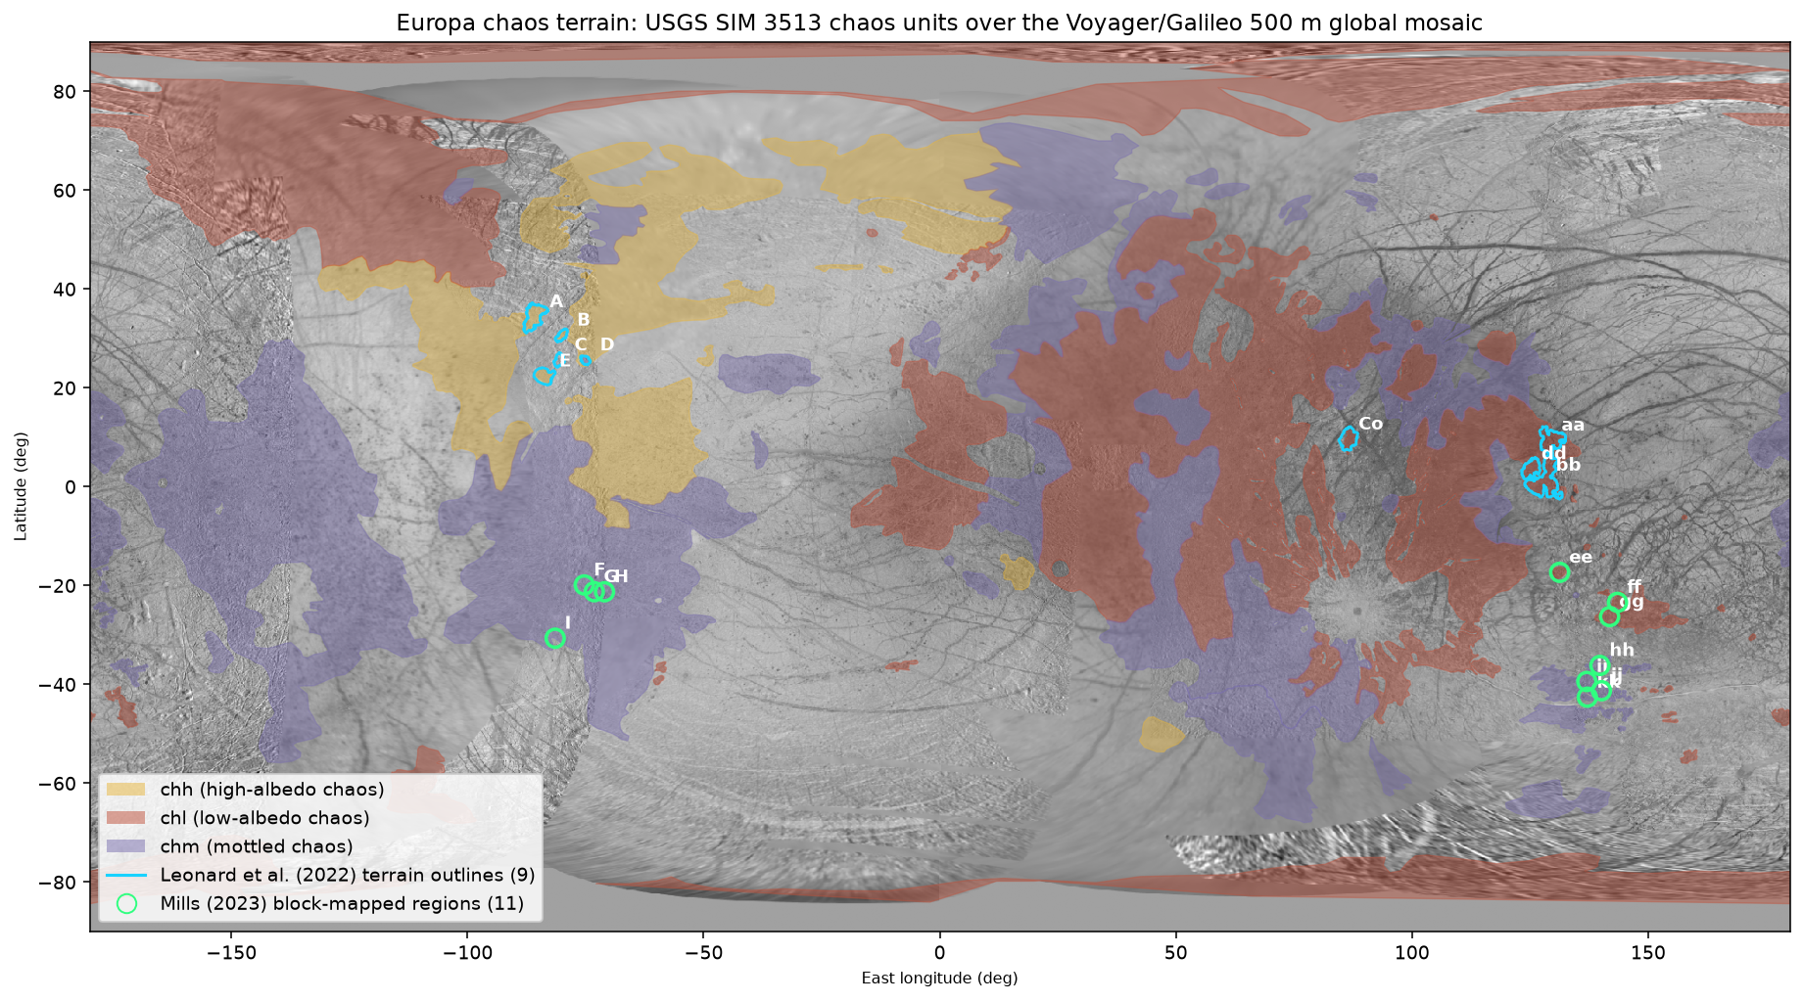
Is Europa's “chaos” one geologic feature type — or several lumped together?
Quantitative morphometrics of 2,643 mapped blocks, 20 block-mapped regions, and 114 global chaos polygons, plus literature synthesis
November 2026

Slide 2
The answer up front
2
Mostly one family — with a small number of genuine impostors.
• Every quantitative test points the same way: canonical chaos forms a single continuous morphological spectrum, not discrete sub-populations.
• Platy→knobby block-size-distribution slope across 20 regions is unimodal (dip test p = 0.19; 1-component GMM beats 2 by BIC).
• “Plates” and “knobs” are the large and small tails of one log-normal block-size continuum.
• USGS map units chh / chl / chm are indistinguishable in planform shape (Kruskal–Wallis p = 0.07–0.77) — they track radiation and sulfur implantation (hemisphere), not formation mechanism.
• Microchaos (5–75 km) → regional chaos → giant units (>1,000 km): a size hierarchy with no natural break.
• But a short list of look-alikes is probably mechanistically distinct: Murias Chaos (extrusive mega-diapir), Moytura Chaos (unique chM unit), and candidate impact-breach sites.

Slide 3
Data
3
Leonard et al. (2022) — Zenodo 12775125
9 chaos terrain outlines (247 arc segments, reconstructed to closed polygons, areas match published to ≤0.9%) + 1,910 block polygons. Includes Conamara (TH_cc) and Murias (LH_E).
Mills (2023) — Zenodo 10162452
737 block polygons with knob/plate labels in 11 lower-RegMap regions (F–I, ee–kk).
USGS SIM 3513 (Leonard, Patthoff & Senske 2024)
Global geologic map GIS: 114 chaos polygons (chh / chl / chm / chM), 2,313 microchaos points, 500-m global mosaic basemap.
Dunn et al. (2023, NeurIPS ML4PS)
Region metadata: plate/knob counts, areas, and centers for all 20 block-mapped regions.
All vector data on the Europa 2000 sphere (R = 1,562.09 km); all areas geodesic.

Slide 4
Methods
4
• Morphometrics — each polygon projected to a local Lambert azimuthal equal-area frame; geodesic area, perimeter, circularity (4πA/P²), solidity, aspect ratio, effective diameter, centroid.
• Block size-frequency distributions — per region, ln(cumulative fractional block area above length scale x = √area) fit linearly; slope m is the platy (≈ −0.2) to knobby (≈ −1.2) metric. Re-derived slopes match Leonard et al. to ~0.07 km⁻¹; same procedure applied to the 11 Mills regions.
• Statistics — Hartigan dip tests, 1D/4D Gaussian mixtures with BIC, k-means and Ward clustering with silhouettes, PCA, Kruskal–Wallis / Mann–Whitney / KS / χ² / Spearman.
• Cross-referencing — each of the 20 block-mapped regions located in its containing SIM 3513 unit polygon; microchaos points spatially joined to units.

Slide 5
Global context: chaos covers ~40% of Europa
5
• 114 chaos polygons of USGS SIM 3513 over the 500-m global mosaic; 20 block-mapped regions marked.
• chl dominates the anti-Jovian hemisphere, chh the sub-Jovian — a pattern the mappers attribute to radiation processing and Iogenic sulfur implantation.
• Exogenic overprint, not formation mechanism.

Slide 6
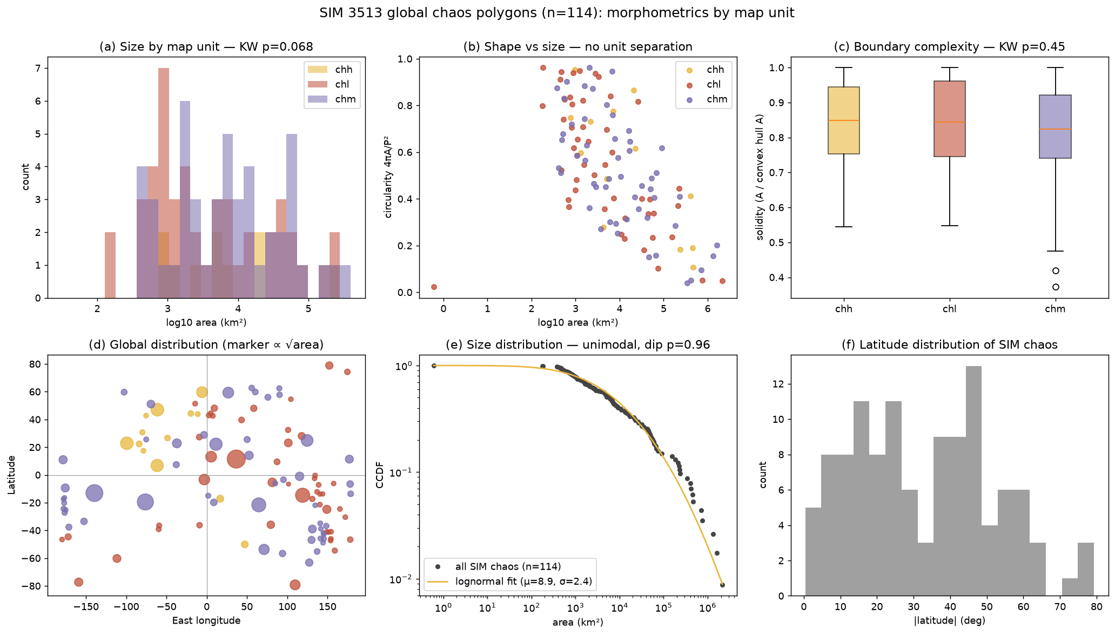
No planform separation among the map units
6
• Across 114 chaos polygons, chh / chl / chm do not differ in log-area (p = 0.068), circularity (p = 0.77), solidity (p = 0.45) or aspect (p = 0.35).
• Sizes form one log-normal-like continuum over 10²–10⁶ km² (dip p = 0.96).
• Only latitude is marginally distinct (p = 0.039) — geographic, not morphological.

Slide 7
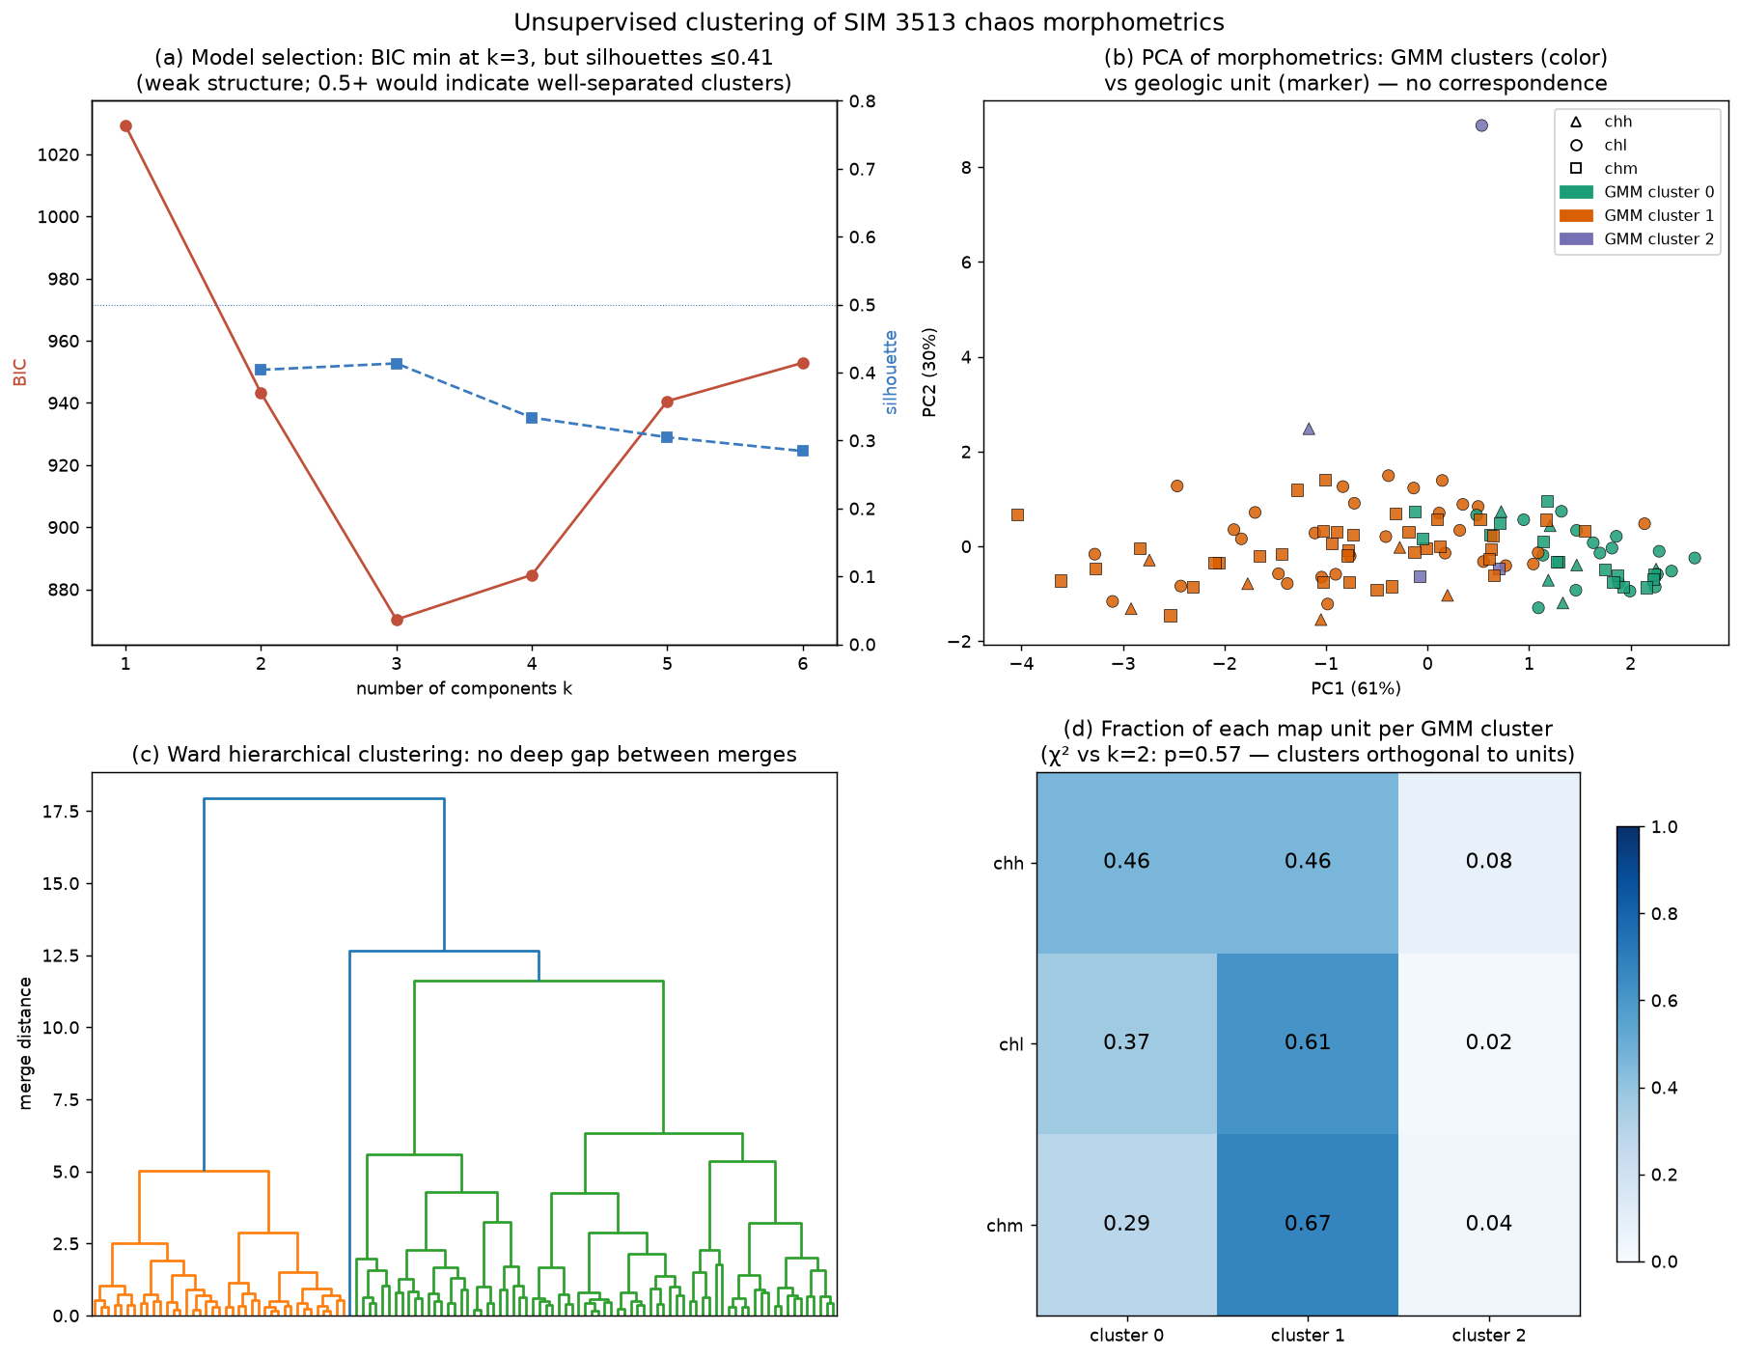
Clustering finds no natural sub-populations
7
• GMM prefers k = 3 by BIC, but structure is weak: silhouettes peak at 0.41 (genuine clusters need ≥ 0.5); no deep gap in the Ward dendrogram.
• PCA shows one elongated cloud; dominant axis is the trivial size–shape covariance.
• Statistical clusters are independent of the geologic map classes (χ² p = 0.57).

Slide 8
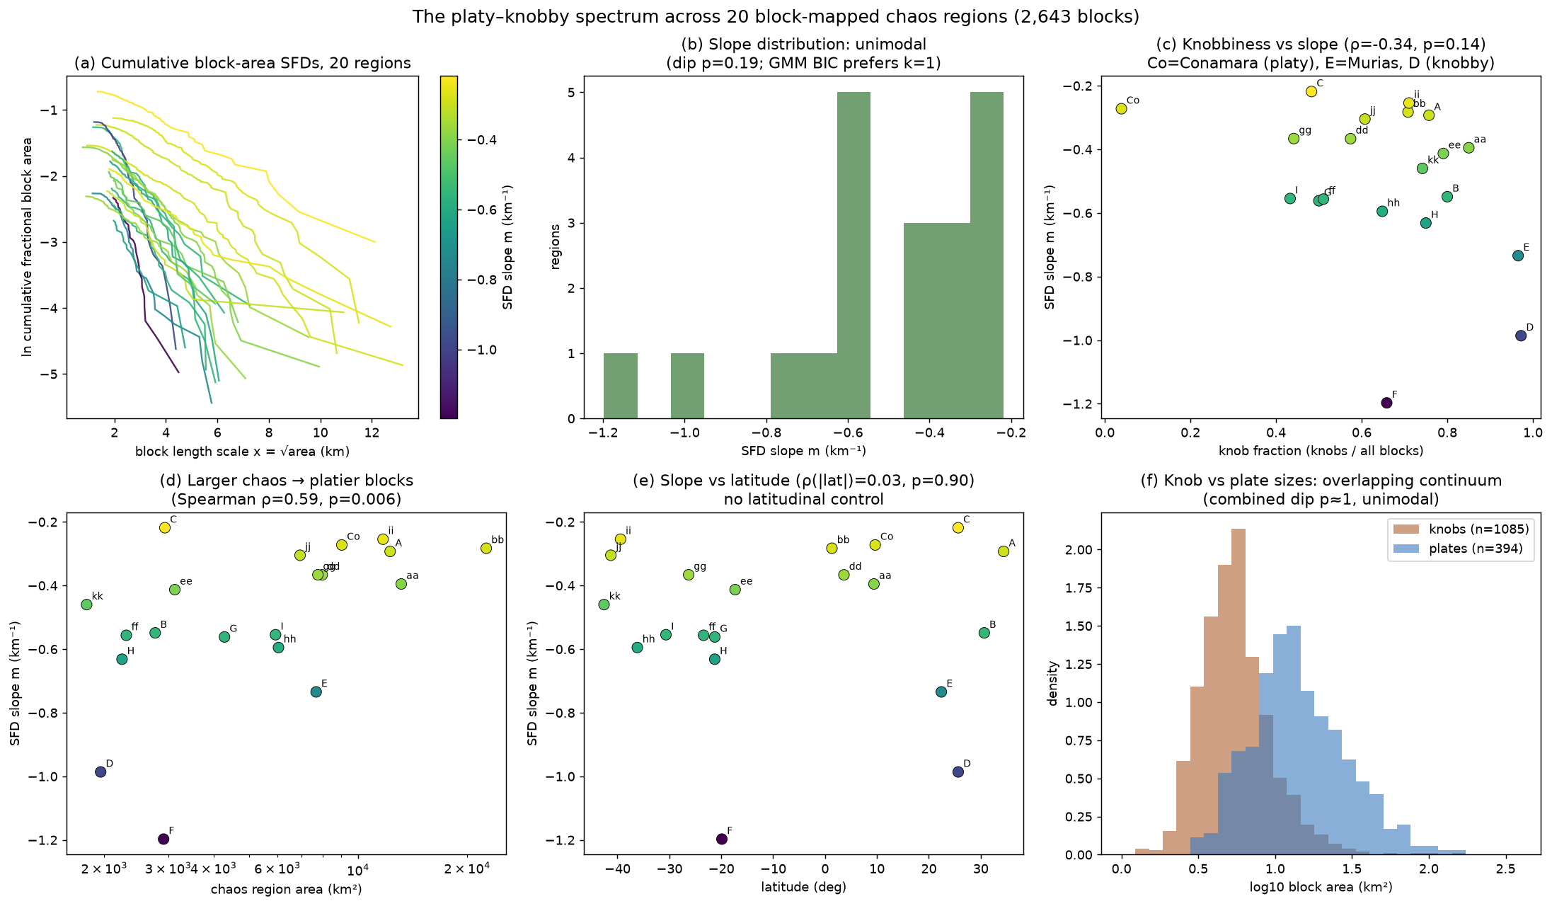
The platy–knobby axis is a continuum (n = 20)
8
• Slopes run continuously from −0.22 (platy) to −1.20 (knobby); unimodal (dip p = 0.19).
• No latitude correlation (ρ = 0.03) — Leonard et al.'s sampling-artifact suspicion confirmed.
• Bigger chaos is platier (ρ = 0.59, p = 0.006): a scale-dependence one mechanism predicts naturally.
• Conamara, the canonical type example, is the least typical region (4% knobs vs ≥ 43% elsewhere).

Slide 9
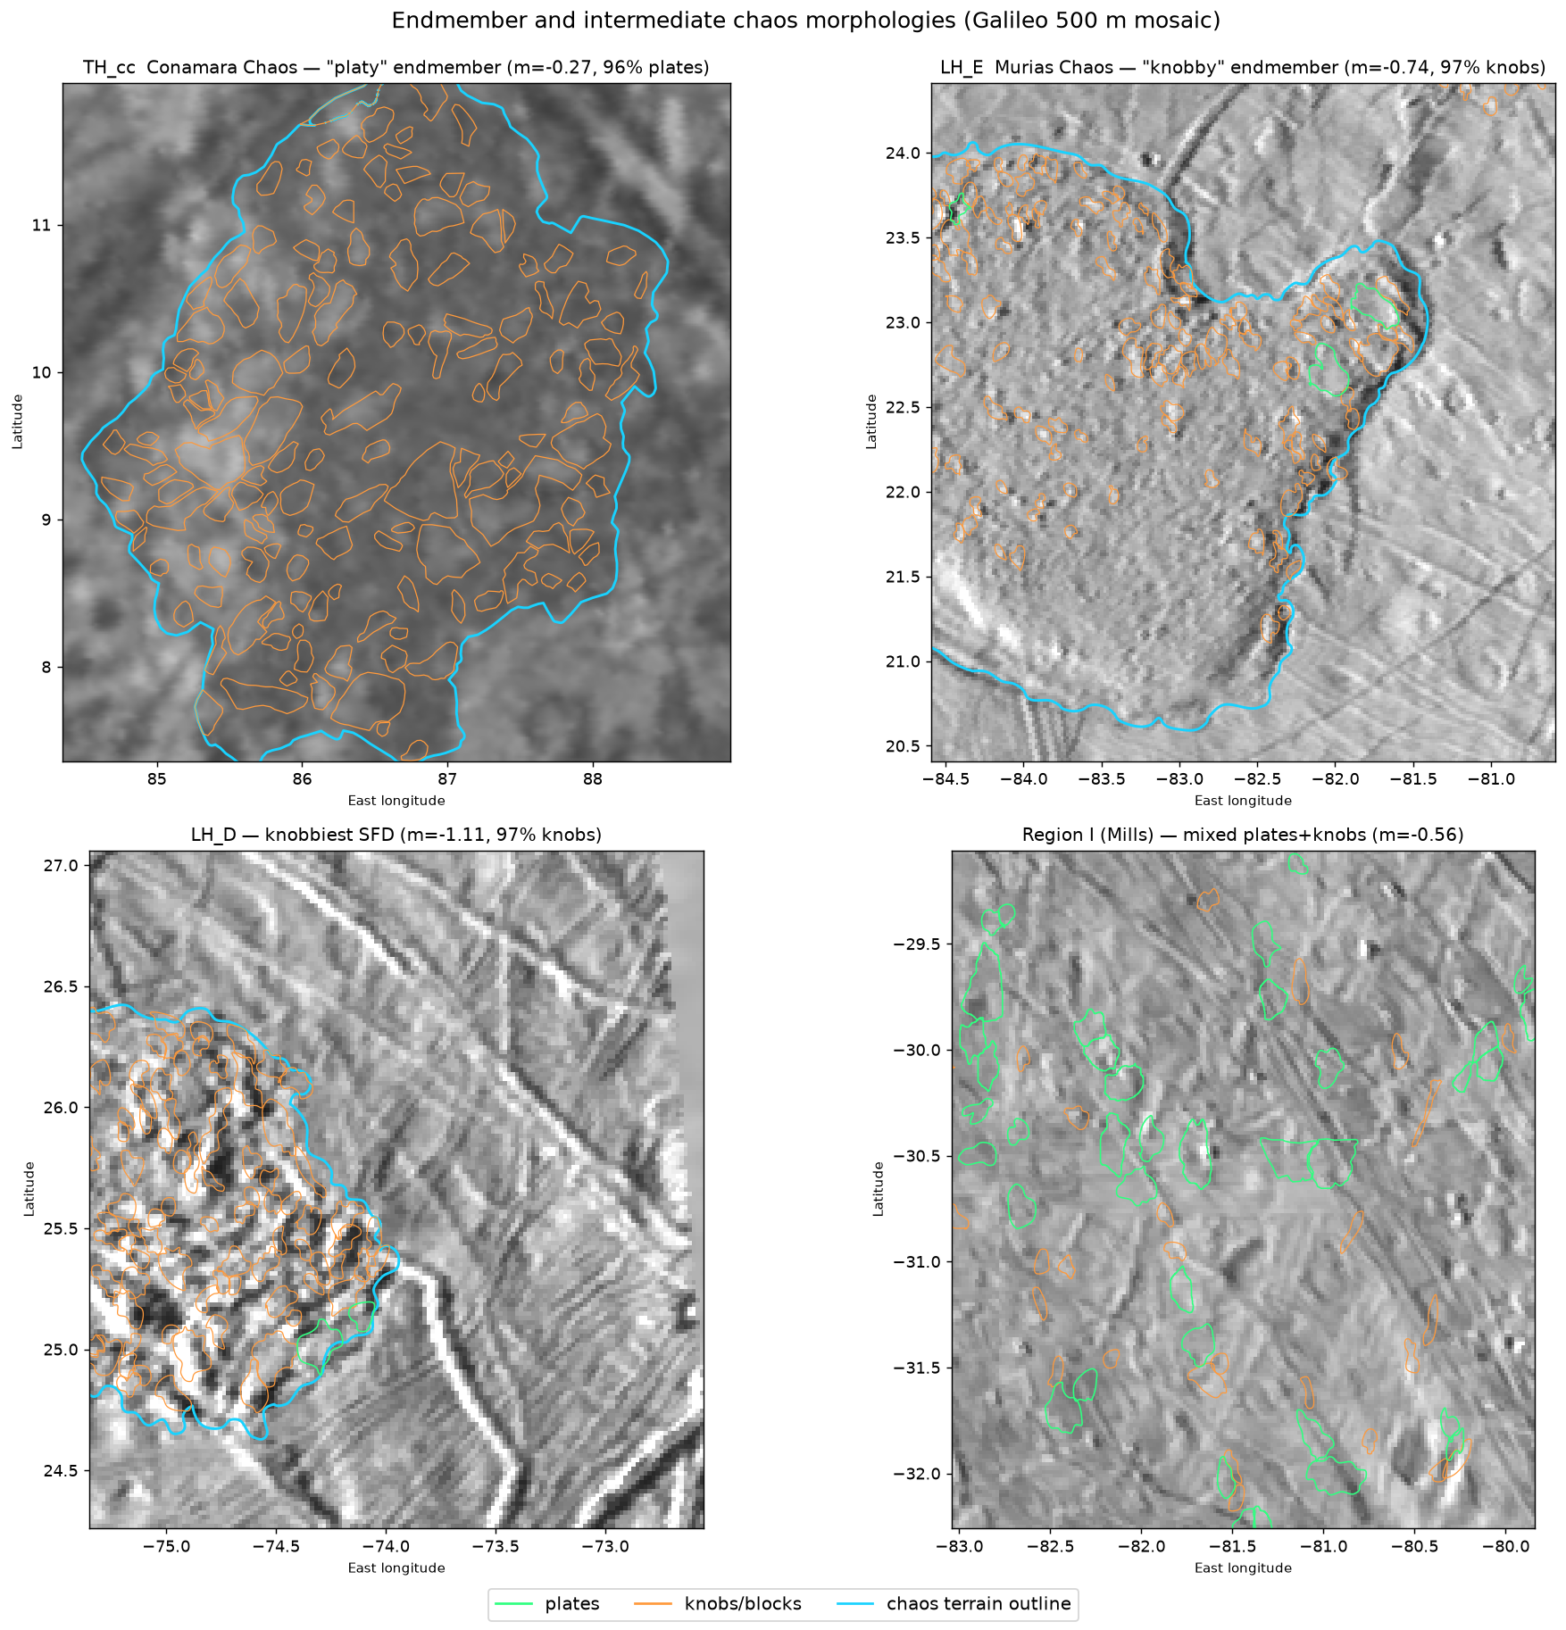
Endmembers look different but connect continuously
9
• Conamara (platy: rafts with preserved ridged-plains texture) vs Murias / LH_D (knobby: small rounded knobs, little texture).
• Regions like I, hh, gg populate every intermediate state; the SFD slope orders them all on one axis.

Slide 10
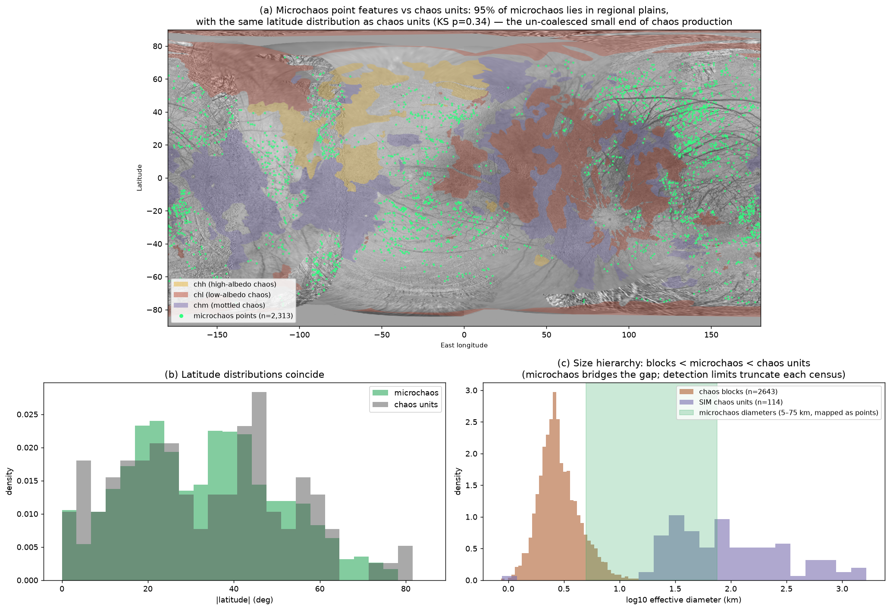
Microchaos: the small end, not a separate species
10
• 2,313 microchaos points (5–75 km), 95% in regional plains; same latitude distribution as chaos units (KS p = 0.34).
• The map itself invokes “incomplete coalescence of microchaos” as the origin of chm mottling.
• Consistent with one production process: small expressions = lenticulae-scale microchaos, large coalesced expressions = regional chaos.

Slide 11
Mechanisms vs. the observed continuum
11
Melt-through of the shell
Carr 1998; Greenberg 1999
Disfavored as the general mechanism (topography, pit/uplift morphometrics, thermodynamics) — but its descriptive core survives inside the sill/lens models.
Diapirism / solid-state convection
Pappalardo 1998; Nimmo & Manga 2002
Explains elevated/domed features and lenticula spacing; needs partial melt or brine to make true blocky chaos.
Brine mobilization
Head & Pappalardo 1999; Fagents 2003
A bridge between diapirism and melt lenses; favored for Thrace-type features.
Perched water / sill collapse
Schmidt 2011; Michaut & Manga 2014
Best current fit: naturally produces a continuum from microchaos (small sills) to giant chaos (large lenses); Thera Macula possibly active today.
Impact breach
Cox 2008; Cox & Bauer 2015
Plausible for individual features (Tyre, Callanish transitional); cannot produce 40% of the surface.
Collins & Nimmo (2009): the constraint list requires one mechanism with internal degrees of freedom (lens depth/size, melt fraction, maturity) — not two or more mechanisms.

Slide 12
The genuine impostors
12
Murias Chaos (“the Mitten”, LH_E)
Elevated, with flow lobes extending tens of km over the plains. Figueredo et al. (2002): “distinct from typical chaos terrain” — the surface extrusion of a rare, large thermal diapir, effectively cryovolcanic. Sits at the knobby extreme (97% knobs) but its topographic signature is what sets it apart.
Moytura Chaos (chM)
The USGS global map gives it its own unit: smooth material standing high, broken by curvilinear depressions, found at exactly one place on Europa. Flagged by the mappers as “a unique morphology of chaos.”
Candidate impact-origin chaos
Km-scale impactors must occasionally breach the shell, and breach sites should look like raft-filled chaos (Cox & Bauer 2015); Tyre and Callanish are transitional. Some individual patches may be impact scars — the global population cannot be.

Slide 13
Caveats
13
• Coverage / resolution bias — only ~15% of Europa imaged at ≤ 250 m/px; the 20 regions sit in two longitude corridors. A real sub-population could hide in unimaged terrain.
• Small n — 20 regions limits power for region-level tests; marginal signals (knob fraction vs SIM unit p = 0.052, leading vs trailing p = 0.058) worth revisiting with Europa Clipper EIS (> 80% coverage at < 100 m/px).
• Planform ≠ topography — the known-distinct features (Murias, Moytura) distinguish themselves in elevation, which 2-D morphometrics cannot capture; stereo DEMs / Clipper altimetry are the natural next discriminator.
• Outline reconstruction — the nine Leonard outlines were reassembled from unclosed arcs (validated to ≤ 0.9% in area).
• Area conventions — published region areas are planar-equirectangular; ours are geodesic. Comparisons account for this.

Slide 14
Bottom line
The core chaos population is one genetic family expressed along continuous axes:
• size (microchaos → Conamara-scale → giant chm/chl fields)
• fragmentation energy (platy → knobby)
• maturity (active Thera → refrozen Conamara → degraded low-albedo chaos)
• exogenic surface state (chh / chl brightness classes)
Platy vs knobby and high- vs low-albedo are coordinates, not categories. The real mislabeling is narrow: a handful of elevated, extrusive features (Murias, Moytura) and possibly a few impact-breach scars carry the “chaos” name while their formation physics is likely different.
Europa Clipper's global imaging and topography should make that short list definitive.

