Slide 1
Algorithms - Practical
Lab 1. Workspaces and Interfaces

Slide 2
Objectives
Understand workspaces in Eclipse
Understand Java Interfaces paradigm
Specify an Interface
Implement the Interface
Use of Interface/Implementation in a Client Object

Slide 3
Workspaces in Eclipse
A workspace is a logical collection of projects.
A workspace is a directory on your hard drive where Eclipse stores the projects that you define to it.
When you specify this directory name to Eclipse, Eclipse will create some files within this directory to manage the projects.
This becomes the standard location for your Eclipse working directory

Slide 4
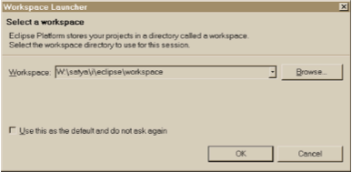
Workspaces in Eclipse
On this startup screen, Eclipse prompts you for the location of the workspace.
Create a directory on a USB drive or a network share and use this as your workspace for ALL subsequent Algorithms work
For illustrative purpose, the directory H:\eclipse_workspace will be used. Substitute in your own specific workspace path when necessary

Slide 5
Workspaces in Eclipse
The following recommendation is made:
Create a directory just for the workspace outside of the Eclipse install directory, on a persistent and portable location
E.g. H:\eclipse_workspace
Use that directory as your one and only workspace to manage most of your projects.
Specify that directory each time you startup Eclipse
If you are using Eclipse on your own laptop, set this as the default (option available on startup)

Slide 6
Workspace in Eclipse
PLEASE NOTE
For all subsequent labs, it is assumed that:
You are using the same workspace
All previous labs have been completed
Any supplementary libraries are available (you will be informed when these are needed)
Your code is working correctly
If you have difficulty with this, please inform me immediately

Slide 7
Java Interfaces
A program component that contains
Public constants
Signatures for public methods
Comments that describe them
Begins like a class definition
Use the word interface instead of class public interface someClass { public int someMethod(); }

Slide 8
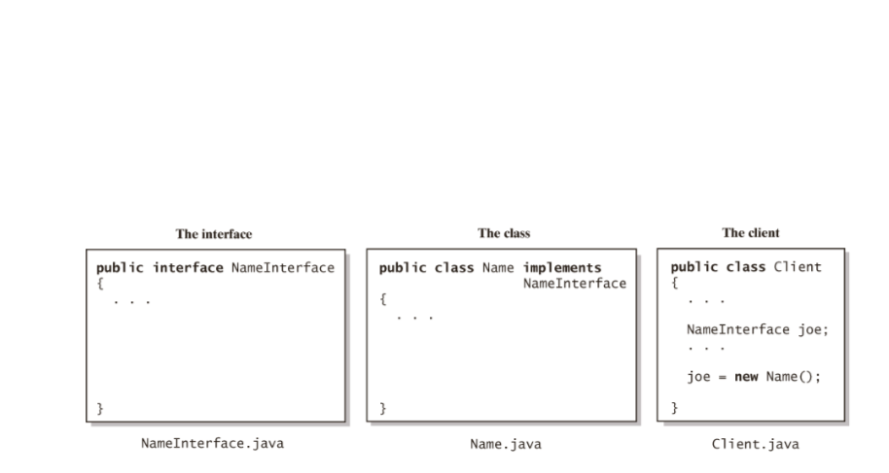
Interface Paradigm
Fig. 1-15 The files for an interface, a class that implements the interface, and the client.

Slide 9
Eclipse: Create a new project
Open Eclipse
Set your workspace to your persistent area (memory stick, network drive)
Wherever you created your workspace last time!
Create a new Project called algorithms
File - >New -> Project -> Java Project

Slide 10
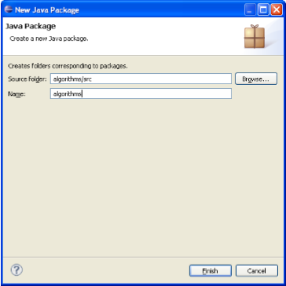
Eclipse: create a new package
Inside the algorithms project, create a new package, also called algorithms

Slide 11
Eclipse: Create an Interface
In the algorithms package, create a new interface, called HelloWorldInterface
Right-click on algorithms Package
Select New –> Interface

Slide 12

Eclipse: Specifying a method
Next, we shall specify a method display() in the Interface.
*Recall* interfaces only identify methods, and do NOT implement them (a WHAT operation)
Add the following line to your interface, so that it resembles:
public interface HelloWorldInterface {
public void display();
}

Slide 13
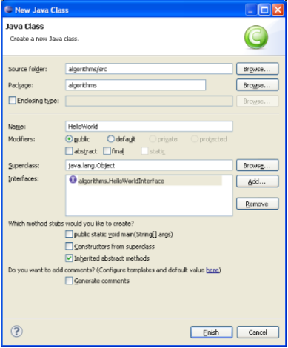
Eclipse: Implementing the Interface
Next we will create a class HelloWorld that implements HelloWorldInterface
In the algorithms package, create a new class called HelloWorld (do not press OK)
In the Interfaces box on the class creation dialogue, add the HelloWorldInterface
Click OK

Slide 14

Eclipse: Implementing the Interface
You’ll see that Eclipse will generate interface methods for you
Add a String data attribute hello to HelloWorld
Create a default constructor that initialises hello to “Hello World!”
Implement the display() method so that it prints “Hello World” to the screen
public class HelloWorld implements HelloWorldInterface {
private String hello;
public HelloWorld(){
hello = "Hello World!";
}
public void display() {
System.out.println(hello);
}
}

Slide 15

Eclipse: Testing the Interface
Next we will create a JUnit test, to test the Interface/Implementation.
In the algorithms package, create a new JUnit test by selecting File->New->JUnit Test and call it HelloWorldTest.
Modify HelloWorldTest to perform the following test (I have not included the JUnit import statements)
public class HelloWorldTest {
@Test
public void testHello() {
HelloWorldInterface hw = new HelloWorld();
assertTrue(hw!=null);
hw.display();
}
}

Slide 16
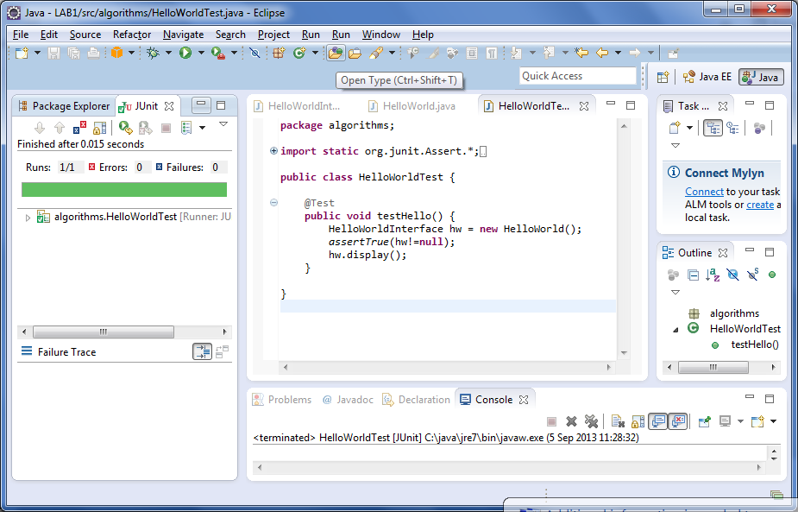
Eclipse: Running the JUnit test
Next we will run HelloWorldTest
Right click on HelloWorldTest
Run – JUnit Test

Slide 17

Eclipse: Creating a Client
In algorithms, create a new class called HelloWorldClient
Add a main function to HelloWorldClient, such that it resembles:
package algorithms;
public class HelloWorldClient {
public static void main(String[] args) {
HelloWorldInterface hw = new HelloWorld();
hw.display();
}
}

Slide 18
Eclipse: Running the Client
Execute HelloWorldClient as a Java Application
Right-click on HelloWorldClient
Run as -> Java Application
You should see “Hello World!” displayed in the Eclipse console.

Slide 19
Java Interfaces
Congratulations! You have now successfully:
Set up your workspace
Created an Interface
Implemented that interface
Created JUnit tests for interface/implementation
Created a client that uses the interface/implementation

