Slide 1

Searching
Frank Walsh
Reference: http://algs4.cs.princeton.edu/33balanced/

Slide 2
Agenda
Symbol Tables
Linked Lists
Binary Tree
Balanced Binary Tree
Hash Tables

Slide 3
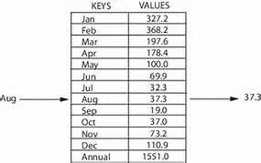
Symbol Tables
A symbol table is a data structure of key – value pairs
Supports two operations:
Get
Put
Get: gets a value associated with a given key.
Put: puts a new key/value pair into the table.
E.g. Dictionaries you’ve been using previously.

Slide 4
Symbol Table Applications

Slide 5
Symbol Tables API

Slide 6
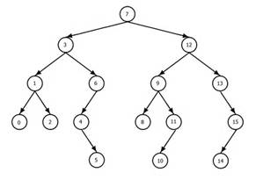
Binary Trees

Slide 7

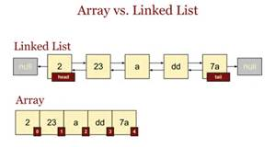
Aside - Linked Lists
Linear collection of data elements, called nodes.
Each node is composed of data and reference to the next node in the sequence.
Allows for efficient insertion or removal of elements.
Implementations in Java SE:
LinkedList
Implements List interface from Collections API

Slide 8
Binary Tree
Combines insertion of Linked List with efficiency of searching a sorted Array
One of the most fundamental algorithms in computer science

Slide 9
Binary Tree Anatomy
A binary tree is composed of zero or more nodes
In Java, a reference to a binary tree may be null
Each node contains:
A value (some sort of data item)
A reference to a left child (may be null), and
A reference to a right child (may be null)
A binary tree may be empty (contain no nodes)
If not empty, a binary tree has a root node
Every node in the binary tree is reachable from the root node by a unique path
A node with no left child and no right child is called a leaf
In some binary trees, only the leaves contain a value

Slide 10
More terminology
Node A is the parent of node B if node B is a child of A
Node A is an ancestor of node B if A is a parent of B, or if some child of A is an ancestor of B
In less formal terms, A is an ancestor of B if B is a child of A, or a child of a child of A, or a child of a child of a child of A, etc.
Node B is a descendant of A if A is an ancestor of B
Nodes A and B are siblings if they have the same parent
a
b
c
d
e
f
g
h
i
j
k
l

Slide 11
Size and depth
The size of a binary tree is the number of nodes in it
This tree has size 12
The depth of a node is its distance from the root
a is at depth zero
e is at depth 2
The depth of a binary tree is the depth of its deepest node
This tree has depth 4
a
b
c
d
e
f
g
h
i
j
k
l

Slide 12
Balance
a
a
b
c
b
c
e
d
e
f
g
d
f
h
i
j
g
h
A balanced binary tree
i
j
An unbalanced binary tree
A binary tree is balanced if every level above the lowest is “full” (contains 2^{n} nodes)
In most applications, a reasonably balanced binary tree is desirable

Slide 13
Binary Search Trees
A binary tree is sorted if every node in the tree is larger than (or equal to) its left descendants, and smaller than (or equal to) its right descendants
Equal nodes can go either on the left or the right (but it has to be consistent)
10
8
15
4
12
20
17

Slide 14
Binary Search Trees (BST)
Examine the following list of keys (sorted).
A,C,E,H,M,R,S,X
Opposite diagram represents keys as two different Sorted Binary Trees.
Each left link references a Binary tree with smaller keys.
Each right link references a Binary tree with larger Keys

Slide 15
Searching a Binary Search Tree.
Look at array location (lo + hi)/2
Searching for 5: (0+6)/2 = 3
Using a binary search tree
hi = 2; (0 + 2)/2 = 1
lo = 2; (2+2)/2=2
7
3
13
0 1 2 3 4 5 6
2
3
5
7
11
13
17
2
5
11
17

Slide 16
Searching a Binary Search Tree

Slide 17
Tree traversals
A binary tree is defined recursively: it consists of a root, a left subtree, and a right subtree
To traverse (or walk) the binary tree is to visit each node in the binary tree exactly once
Tree traversals are naturally recursive
Since a binary tree has three “parts,” there are six possible ways to traverse the binary tree:
root, left, right
left, root, right
left, right, root
root, right, left
right, root, left
right, left, root

Slide 18
BinaryTree class
class BinaryTree<V> { V value; BinaryTree<V> leftChild; BinaryTree<V> rightChild; // Assorted methods… }
A constructor for a binary tree should have three parameters, corresponding to the three fields
An “empty” binary tree is just a value of null
Therefore, we can’t have an isEmpty() method (why not?)

Slide 19
Preorder traversal
In preorder, the root is visited first
Here’s a preorder traversal to print out all the elements in the binary tree:
public void preorderPrint(BinaryTree bt) { if (bt == null) return; System.out.println(bt.value); preorderPrint(bt.leftChild); preorderPrint(bt.rightChild); }

Slide 20
Inorder traversal
In inorder, the root is visited in the middle
Here’s an inorder traversal to print out all the elements in the binary tree:
public void inorderPrint(BinaryTree bt) { if (bt == null) return; inorderPrint(bt.leftChild); System.out.println(bt.value); inorderPrint(bt.rightChild); }

Slide 21
Postorder traversal
In postorder, the root is visited last
Here’s a postorder traversal to print out all the elements in the binary tree:
public void postorderPrint(BinaryTree bt) { if (bt == null) return; postorderPrint(bt.leftChild); postorderPrint(bt.rightChild); System.out.println(bt.value); }

Slide 22
Tree traversals using “flags”
The order in which the nodes are visited during a tree traversal can be easily determined by imagining there is a “flag” attached to each node, as follows:
preorder
inorder
postorder
To traverse the tree, collect the flags:
A
A
A
B
C
B
C
B
C
D
E
F
G
D
E
F
G
D
E
F
G
A B D E C F G
D B E A F C G
D E B F G C A

Slide 23
Analysis of BST
Running times of algorithms on BSTs depend on the shapes of the trees
Depends on order in which keys are inserted
Best Case: perfectly balanced, with ~ lgN nodes between the root and each null link
Worst Case: N nodes on the search path
Good to get Balance…

Slide 24
Balanced Tree

Slide 25
2-3 search trees
In an N-node tree, we would like the height to be ~lg N
Guarantees searches can be completed in ~lg N compares
A 2-3 search tree is a tree that has
A 2-node, with one key, a left link to a 2-3 search tree with smaller keys, and a right link to a 2-3 search tree with larger keys
A 3-node, with two keys and three links, a left link to a 2-3 search tree with smaller keys, a middle link to a 2-3 search tree with keys between the node’s keys, and a right link to a 2-3 search tree with larger keys

Slide 26
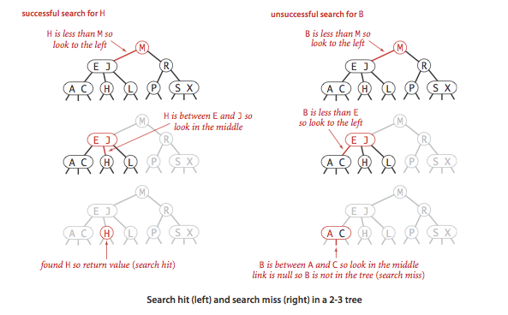
Searching 2-3 node tree

Slide 27
Creation trace & Implementation
Implementation of 2-3 tree is difficult:
need to maintain two different types of nodes
compare search keys against key
copy links and other information from one type of node
convert nodes from one type to another.
Simplified using Red-Black BST
Reuses simple BST structure

Slide 28
Red-Black BST
Basic idea:
use standard BSTs (which are made up of 2-nodes) and add extra information to encode 3-nodes.
Use two different link types:
red links, which bind together two 2-nodes to represent 3-nodes
Black links, which bind together the 2-3 tree.
No node has two red links connected to it.
The tree has perfect black balance : every path from the root to a null link has the same number of black links.

Slide 29
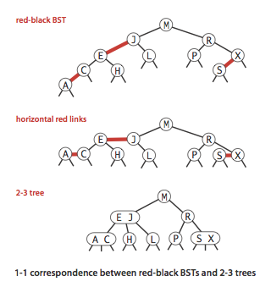
Node implementation

Slide 30
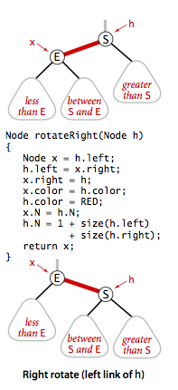
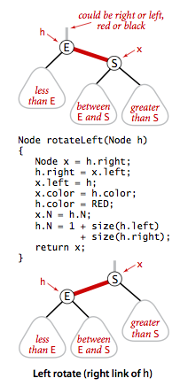
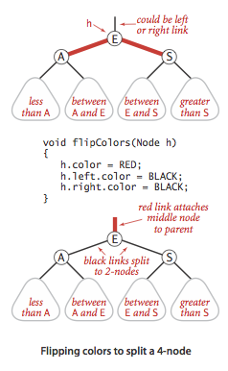
Rotating and Flipping
Right-leaning red links or two red-links in a row can occur during operations (add, delete etc)
This is corrected using a left or right rotate operation.
May need to also “flip” colours

Slide 31
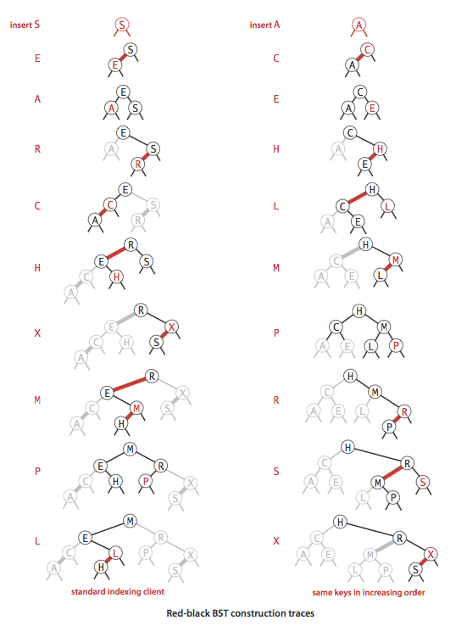
Implementation
Get source code at: http://algs4.cs.princeton.edu/33balanced/RedBlackLiteBST.java.html

Slide 32
Hash Tables

Slide 33
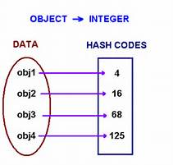
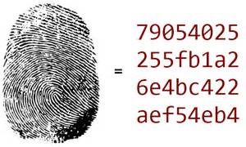
Hash Tables
Using Key, Value pairs for data, if the key values are integers then we can interpret the key as the position in an Array.
For key i, store the value at location i in an array
Example(student Ids)
Where keys are more complicated (e.g. string, phone number), consider Hashing.
An example of Hashing is performing arithmetic operations to transform keys into array indices.
Store value at the corresponding index.

Slide 34
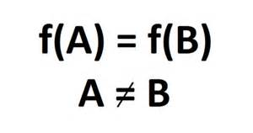
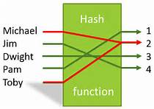
Searching using Hash Tables
Search algorithms that use hashing consist of two separate parts.
a hash function that transforms the search key into an array index.
collision-resolution process two or more different keys hash to the same array index.
This can happen

Slide 35
Hash Functions
Consider an array that can hold M key-value pairs.
This requires a Hash function that can transform a key to an integer range 0 to M-1, [0,M-1].
Hash function should compute index efficiently and evenly distribute values from 0 to M-1 (uniform distribution).

Slide 36

Hashing Positive integers
Modular Hashing:
Choose array of size M where M is a prime number.
For an integer key k, compute k modulo M. This gives the remainder of k divided by M.
Produces uniform distribution from 0 to M-1

Slide 37
Hashing Floats
Key is real number, k, between 0 and 1.
Choose array of size M where M is a prime number.
Multiply k by M and round to the nearest integer to get an index between 0 and M-1.
Better way: Use modular hashing on the binary representation of the key

Slide 38
Hashing Strings
Treat Strings as huge integers.
Choose array of size M where M is a prime number.
Choose small prime number R.
The following computes a hash.
int hash = 0;
for (int i = 0; i < s.length(); i++)
hash = (R * hash + s.charAt(i)) % M;

Slide 39
Multiple Fields
If the key type has multiple integer fields:
Mix together as follows for Student object with strudentId, yearOfBirth, and CourseId fields.
int hash = (((studentId * R + yearOfBirth) % M) * R + CourseId) % M;

Slide 40
Example of User Defined Hash Code
public class Transaction
{
...
private final String who;
private final Date when;
private final double amount;
public int hashCode(){
int hash = 17;
hash = 31 * hash + who.hashCode();
hash = 31 * hash + when.hashCode();
hash = 31 * hash + ((Double) amount).hashCode();
return hash;
}
...
}

Slide 41
References
http://algs4.cs.princeton.edu/home/
https://en.wikipedia.org/wiki/Binary_tree

