Slide 1
Data Abstraction and APIs
Frank Walsh

Slide 2
Todays Lecture
Abstract Data Types
Application Program Interface(API)
Implementing an API
Consuming an API (writing an API client)
Useful APIs for this module

Slide 3
Data Abstraction
A data type is a set of values and a set of operations on those values
primitives(e.g. int)
value (2³¹ and 2³¹- 1)
operations (+,-,*...)
reference types(e.g. Name Java class)
values (firstName, lastName …)
operations (getFirstName(), toString() )
Lots of predefined data types and you can build your own…

Slide 4
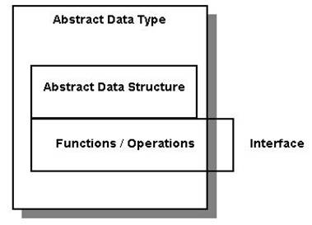
Abstract Data Type (ADT)
Implementation hidden from client.
Hide data from client and focus on operations.
This is Good for algorithms
we can substitute one algorithm for another to improve performance.
no need to change any client code.

Slide 5
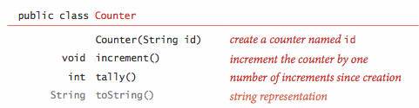
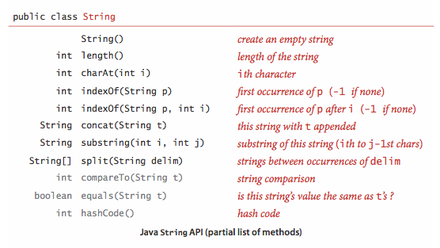
Application Program Interface(API)
Specifies behaviour of Abstract Data Type
API provides a list of Constructors and Instance Methods
Often including short description of methods

Slide 6
Implementing an ADT
Use a Java Class
See implementation of counter API here: https://github.com/fxwalsh/algorithms-2016-examples/blob/master/src/topic1/Counter.java

Slide 7
Client Code
Declare variable of the type
Use to refer to object
Counter c1 = new Counter("ones"); c1.increment(); Counter c2 = c1; c2.increment(); StdOut.println(c1);

Slide 8
Useful ADT Libraries
Stdlib_package.jar
http://introcs.cs.princeton.edu/java/stdlib/stdlib-package.jar
Other useful APIs
http://algs4.cs.princeton.edu/10fundamentals/

Slide 9
Other APIs
Java has thousands of ADTs
Standard system ADTs in java.lang.*
Collection ADTs to facilitate manipulation collections of data of the same( e.g. ArrayList, Stack….)

