Slide 1


Computer Programming Final Erasmus Project
Conor McGinn, Matthew Riddell

Slide 2
Introduction
Objectives:
Develop a desktop application demonstrating advanced object-oriented programming (OOP) concepts.
Create a meaningful application with real-world utility.
Create a Graphical User Interface.
In this Presentation:
Matthew – Interfaces, Classes, OOP Concepts, Constructers, Method Overriding
Conor – GUI, Java Swing, App demonstration

Slide 3
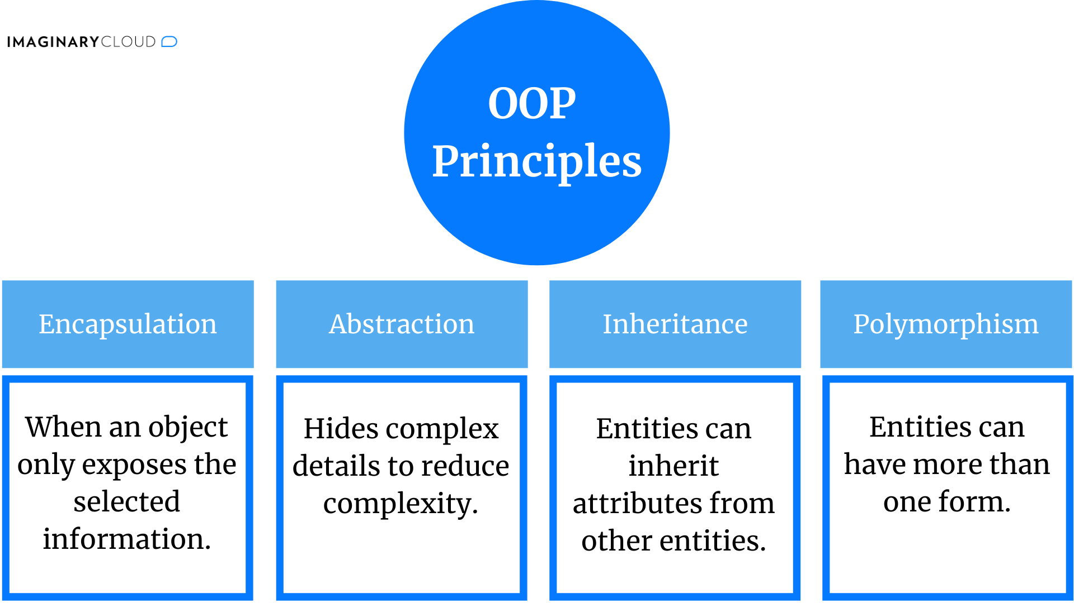
Object-Oriented Programming Concepts
Encapsulation: Bundling data (attributes) and methods that operate on the data into a single unit (class). Restricting direct access to some of the object's components.
Inheritance: Mechanism for creating a new class (subclass) from an existing class (superclass). Subclass inherits attributes and methods from the superclass.
Polymorphism: Ability of different classes to be treated as instances of the same class through inheritance. Method overriding and dynamic method dispatch.
Abstraction: Hiding complex implementation details and showing only the necessary features of an object. Use of abstract classes and interfaces to define abstract methods.

Slide 4
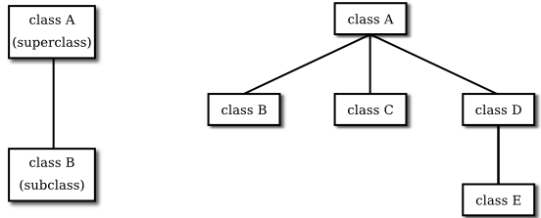
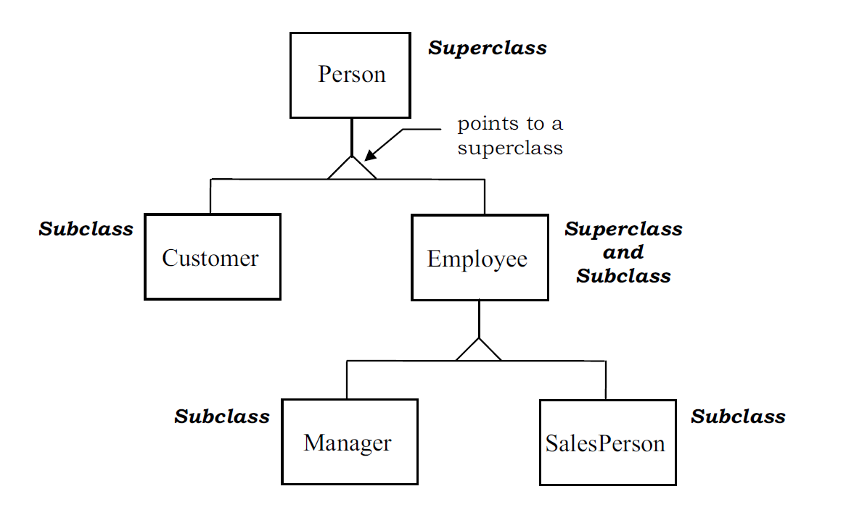
Class Hierarchy
Superclass: Contains common attributes and methods.
Subclasses: Specialized classes that inherit from the superclass.
Subclass of a Subclass: Further specialization, if applicable.

Slide 5
Constructors and Access Methods
Parameterized Constructor: Initializes object with specific values.
Default Constructor: Initializes object with default values.
Copy Constructor: Creates a new object as a copy of an existing object.
Access Methods (Getters and Setters): Methods to get and set the value of an attribute. Promote encapsulation and data hiding.
‘this’ is a reference to the current object.
‘this()’ calls another constructor in the same class.

Slide 6
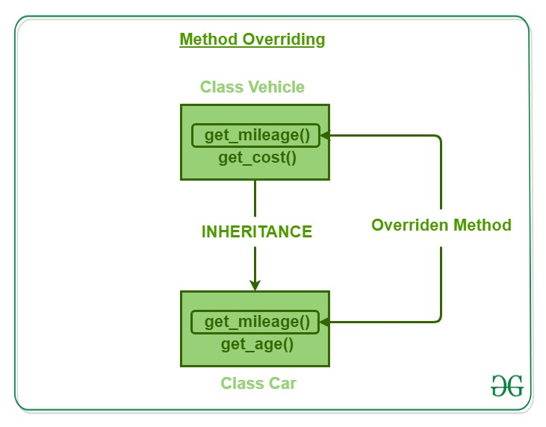
Method Overriding and Use of super
Overriding Methods: Subclass provides a specific implementation of a method that is already defined in its superclass.
Enhances or modifies behaviour inherited from the superclass.
Use of ‘super’: Calls methods and constructors of the superclass. Example: super.print() calls the print() method of the superclass.

Slide 7

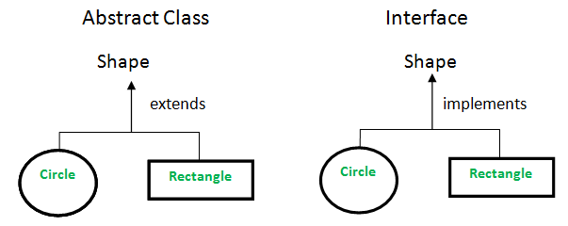
Interfaces and Abstract Classes
Interfaces: Define a contract that implementing classes must follow.
Only method declarations, no method implementations.
Abstract Classes: Cannot be instantiated.
Can have both abstract methods (without implementation) and concrete methods (with implementation).

Slide 8
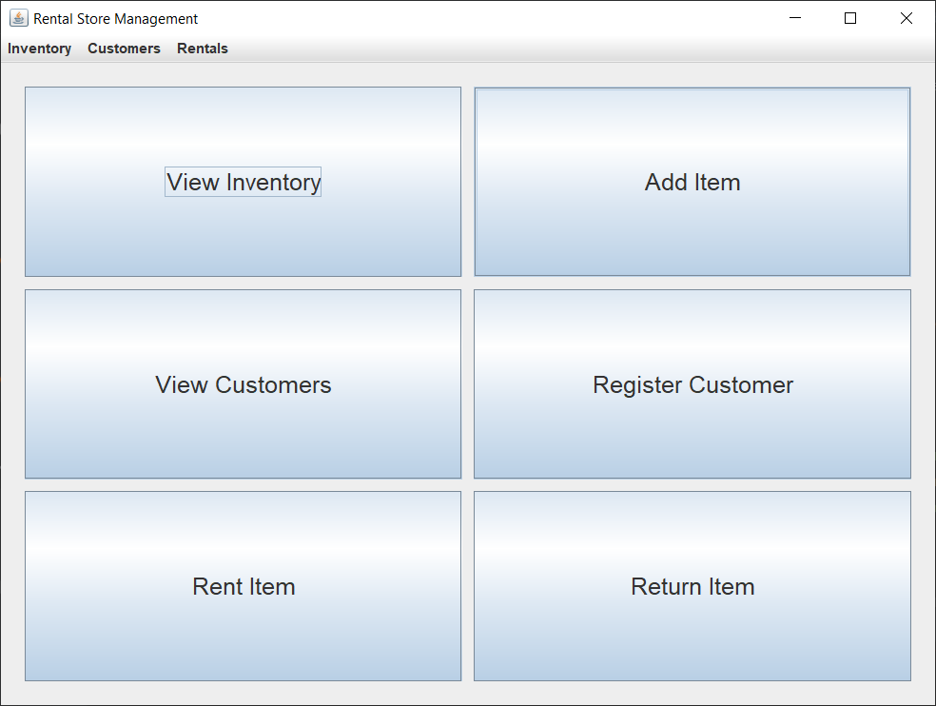
App demonstartion
Swing is a set of GUI (Graphical User Interface) components for Java programs.
The project utilizes Java Swing to create a graphical interface for the rental store management system.
Components such as JFrame, JPanel, JButton, and JTextArea are used to design the interface.
Layout managers like GridLayout and BorderLayout help organize the components within the frame.
Users interact with the GUI to view inventory, add items, register customers, rent items, and return items.
Dialog boxes are used for user input and displaying information.

Slide 9
Thank you!

Slide 10
Bibliography
Oracle Java Swing Documentation:
https://docs.oracle.com/javase/tutorial/uiswing/
Java Swing Tutorial by TutorialsPoint:
https://www.tutorialspoint.com/swing/index.htm
Object-Oriented Programming (OOP) Concepts:
https://www.geeksforgeeks.org/
Understanding Dynamic Method Dispatch in Java:
https://www.tutorialspoint.co
https://www.geeksforgeeks.org/dynamic-method-dispatch-runtime-polymorphism-java/
Java Object Class Methods:
https://www.geeksforgeeks.org/object-class-in-java/

