Slide 1
project graphics: Wireless V2I Communication Protocols for Driver Assistance
Includes: block diagram & flow chart
By: conor power, Daniel collins., scout case, james tompkins

Slide 2

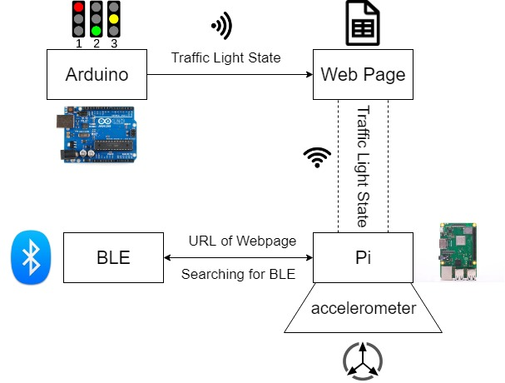
Block diagram:
The Arduino pushes the traffic light state to a web page via Wi-Fi.
The Raspberry Pi, connected to the vehicle, reads the state from the web page.
BLE on traffic light establishes a connection with the Pi and sends URL of web page.
Pi and accelerometer communicate to decide on action to take i.e. slow down, stop or continue ahead.

Slide 3

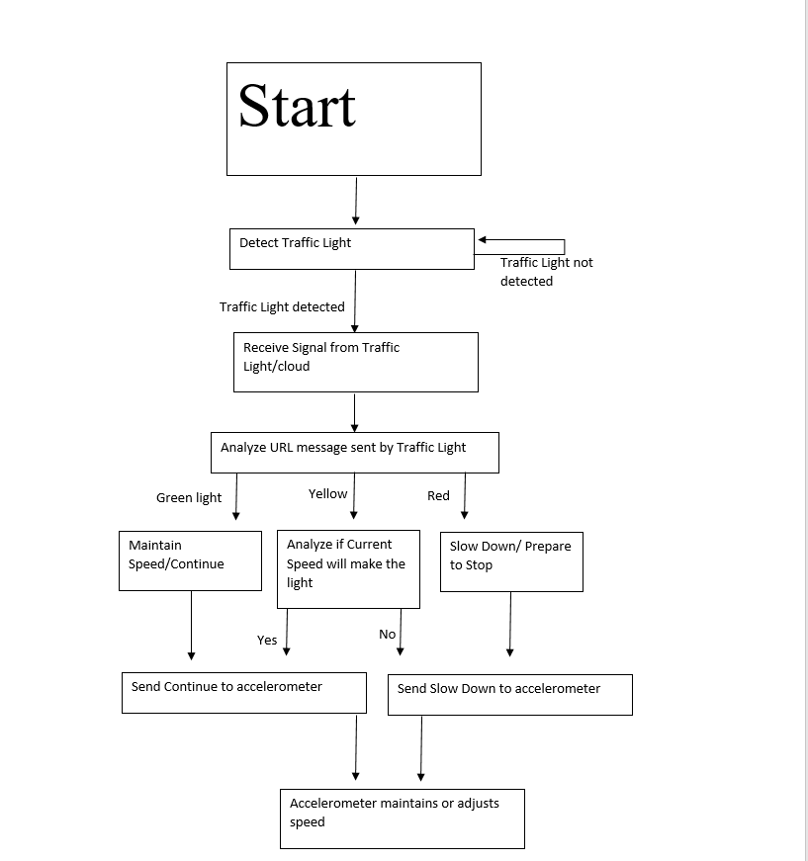
Flow chart
If traffic light is not detected, Raspberry Pi keeps searching.
When signal is detected, Raspberry Pi reads website URL from BLE beacon.
Depending on traffic light state and vehicle speed, the vehicle will slow down/stop or continue ahead.
An accelerometer will be used to maintain or adjust the vehicle speed.

