Slide 1
vNetworking Intro

Slide 2
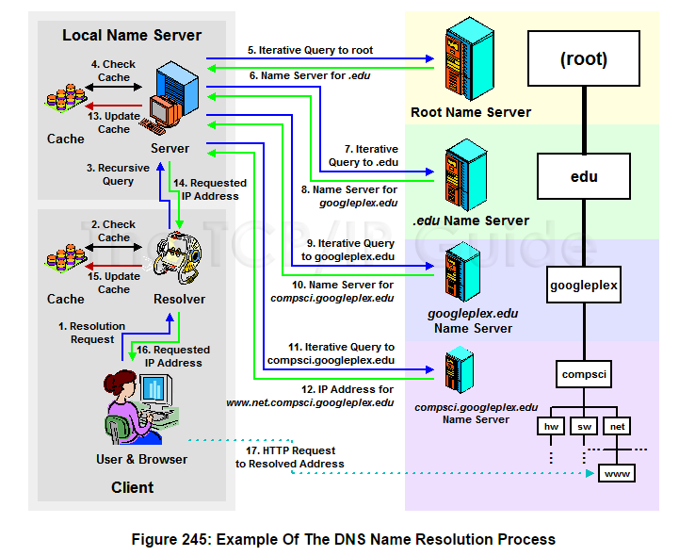
DNS ReCap! (Thanks CS&DC)

Slide 3
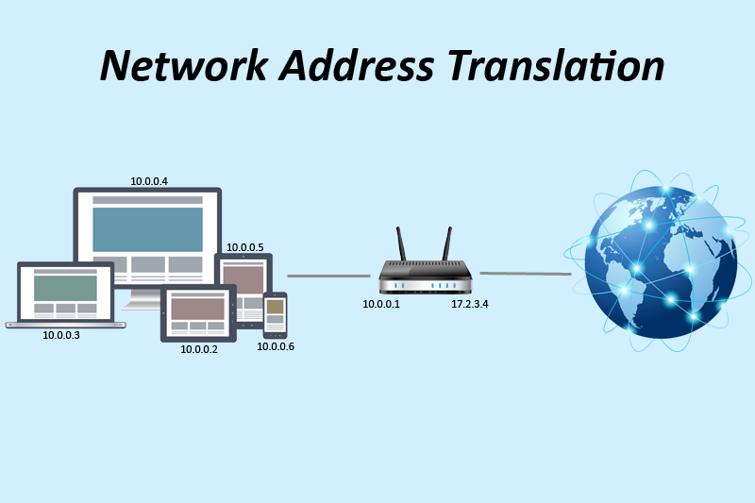
NAT

Slide 4
Network Virtualization
Network Virtualization
It is a process of logically segmenting or grouping physical network(s) and making them operate as single or multiple independent network(s) called “Virtual Network(s)”.
Enables virtual networks to share network resources
Allows communication between nodes in a virtual network without routing of frames
Enforces routing for communication between virtual networks
Restricts management traffic, including ‘Network Broadcast’, from propagating to other virtual network
Enables functional grouping of nodes in a virtual network
Notes:
Network virtualization involves logically segmenting or grouping physical network(s) into discrete logical entities called “virtual network(s)”, and making them behave as single or multiple independent network(s). Network virtualization allows multiple virtual networks to share network resources without leaking information among them.
A virtual network appears as a physical network to the nodes connected to it. Two nodes connected to a virtual network can communicate among themselves without routing of frames, even if they are in different physical networks. Network traffic must be routed when two nodes in different virtual networks are communicating, even if they are connected to the same physical network. Network management traffic, including ‘network broadcast’ within a virtual network, does not propagate to any other nodes that belong to a different virtual network. This enables functional grouping of nodes with a common set of requirements in a virtual network, regardless of the geographic location of the nodes.

Slide 5



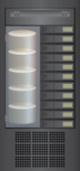
Network Virtualization in VDC
Involves virtualizing physical and VM networks
Physical Server
Physical Server
Physical Network
Consists of following physical components:
Network adapters, switches, routers, bridges, repeaters, and hubs
Provides connectivity
Among physical servers running hypervisor
Between physical servers and clients
Between physical servers and storage systems
Hypervisor
Hypervisor
PNIC
PNIC
Physical Network
Client
PNIC – Physical NIC
Storage Array
Notes:
In VDC, network virtualization involves virtualization of both physical and ‘Virtual Machine (VM)’ networks.
The physical network may consist of network adapters, switches, routers, bridges, repeaters, and hubs.
The physical network provides connectivity:
Among physical servers running hypervisor
Between physical servers and clients
Between physical servers and storage systems

Slide 6


Network Virtualization in VDC (contd.)
VM Network
Resides inside physical server
Consists of logical switches called “virtual switches”
Provides connectivity among VMs inside a physical server
Provides connectivity to Hypervisor kernel
Connects to physical network
Physical Server
Physical Server
VNIC
VNIC
VNIC
VNIC
VNIC
VNIC
VM Network
Hypervisor Kernel
VM Network
Hypervisor Kernel
PNIC
PNIC
Physical Network
Client
PNIC – Physical NIC
VNIC – Virtual NIC
Storage Array
Notes:
A VM network resides inside a physical server. It includes logical switches, called ‘virtual switches’, which function similar to physical switches. The VM network enables communication among VMs within a physical server. For example, a VM which is running a business application may need to filter its traffic via a firewall server which could be another VM within the same physical server. It is beneficial to connect these VMs internally through the VM network. Connecting them through a physical network will add more delay to the VM traffic because it travels over the external physical network.
Hypervisor kernels are connected to the VM network. Hypervisor kernels communicate with the management server and storage systems using the VM network. The management server could be a VM hosted in a physical server.
For communication between two VMs residing in different physical servers and between a VM and its clients, the VM traffic must travel through both the VM and physical networks. Hypervisor traffic is also required to transfer between the VM and physical networks. Hence, the VM network must be connected to the physical network.

Slide 7

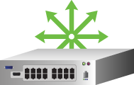


Network Virtualization in VDC (contd.)
VM and physical networks are virtualized to create virtual networks
Hypervisor -Uses built-in networking and network virtualization functionalities
To create virtual switch and configuring virtual networks on it
Virtual Network 1
VM1
VM3
VNIC
PNIC
PNIC
VNIC
Virtual Switch
Physical Switch
Physical Switch
Virtual Switch
PNIC
PNIC
VM2
VM4
VNIC
VNIC
Virtual Network 2
Notes:
Network virtualization allows an administrator to create multiple virtual networks in VDC. These virtual networks may span across both VM and physical networks and share physical and virtual switches. A virtual network provides grouping of all the nodes that belong to the same functional unit in an organization. Virtual LAN and virtual SAN are examples of virtual networks.
In the figure shown on this slide, two virtual networks are created on both virtual and physical switches. Virtual network 1 provides connectivity to VM1 and VM3 and enables communication between them without routing of frames. Similarly, VM2 and VM4 belong to virtual network 2 and are allowed to communicate without routing.

Slide 8
Benefits of Network Virtualization
Benefit | Description
Enhances security | Restricts access to nodes in a virtual network from another virtual network Isolates sensitive data from one virtual network to another
Enhances performance | Restricts network broadcast and improves virtual network performance
Improves manageability | Allows configuring virtual networks from a centralized management workstation using management software Eases grouping and regrouping of nodes
Improves utilization and reduces CAPEX | Enables multiple virtual networks to share the same physical network, which improves utilization of network resource Reduces the requirement to setup separate physical networks for different node groups
Notes:
Network virtualization provides enhanced security by restricting access to nodes located within a virtual network from another virtual network. Therefore, sensitive data of one virtual network is isolated from other virtual networks.
Network broadcasts within a virtual network are not allowed to propagate to other virtual networks. Restricting broadcast preserves network bandwidth, which consequently improves virtual network performance for usual network traffic.
Virtual network allows grouping of nodes based on an organization’s requirement. When new requirements come, an administrator changes the virtual network configuration using a management software and regroups nodes. The management software provides an interface to configure virtual networks from a centralized management workstation. The interface enables an administrator to send configuration commands to physical switch OS and/or hypervisor. As regrouping of nodes does not require re-cabling or physical movement of equipments, network management becomes easy.
Network virtualization allows multiple virtual networks to share the same physical network. This improves utilization of network resources. Network virtualization also cuts down the capital expenditure (CAPEX) in procuring network equipments for different node groups.

Slide 9
Components of VDC Network Infrastructure
VDC network infrastructure includes both virtual and physical network components
Components are connected to each other to enable network traffic flow
Component | Description
Virtual NIC | Connects VMs to the VM network Sends/receives VM traffic to/from VM network
Virtual switch | Is an Ethernet switch that forms VM network Provides connection to virtual NICs and forwards VM traffic Provides connection to hypervisor kernel and directs hypervisor traffic: management, storage, VM migration
Physical adapter: NIC | Connects physical servers to physical network Forwards VM and hypervisor traffic to/from physical network
Physical switch, router | Forms physical network that supports Ethernet/FC/iSCSI/FCoE Provides connections among physical servers, between physical servers and storage systems, and between physical servers and clients
Notes:
Similar to Classic Data Center (CDC) networking, there are basic building blocks to perform networking in a VDC. A VDC network infrastructure consists of both physical and virtual components, as listed on this slide. These components are connected to each other to enable network traffic flow.
Network components such as virtual NIC, virtual HBA, and virtual switch are created inside a physical server using hypervisor. Virtual NICs enable VMs to connect to VM network. They send and receive VM traffic to and from the VM network. Virtual HBA enables a VM to access FC RDM disk/LUN assigned to the VM.
Virtual switches form VM networks and support the Ethernet protocol. They provide connection to the virtual NICs and forward the VM traffic. They also direct management, storage, and VM migration traffic to/from hypervisor kernel.
Physical adapters, such as Network Interface Card (NIC), Host Bus Adapter (HBA), and Converged Network Adapter (CNA), allow physical servers to connect to physical network. They forward VM and hypervisor traffic to/from a physical network.
A physical network includes physical switches and routers. Physical switches and routers provide connections among physical servers, between physical servers and storage systems, and between physical servers and clients. Depending on the network technology and protocol supported, these switches direct Ethernet, FC, iSCSI, or FCoE traffics.
Note: VM migration enables moving a VM from one physical server to another, and is controlled from management server. If a resource crunch occurs at a physical server, VMs are migrated to another physical server, which has sufficient resource to run these VMs. VM migration is discussed in module 7, Business Continuity in VDC.

Slide 10


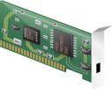
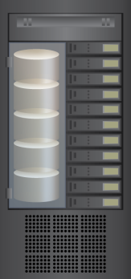
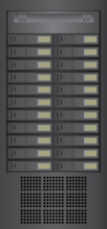
Network Connectivity and Traffic Flow: Example
Physical server
VM1
VM2
VM3
Traffic type:
VM
VNIC
VNIC
VNIC
Hypervisor Kernel
Traffic type:
VM
Management
Virtual Switch
(Ethernet)
PNIC
Traffic type:
Management
Physical Switch
(Ethernet)
Clients
Physical Servers
NAS/iSCSI Storage Array
Notes:
The connectivity among VDC network components varies based on the type of protocol and the physical adapter used to enable physical server access to the storage system.
In this example, physical servers are connected to the IP storage system, such as a NAS or an iSCSI storage array. A physical Ethernet switch is used to connect physical servers and the storage system.
Each physical server hosts multiple VMs that are connected to a virtual switch. Each VM has at least one virtual NIC which transfers/receives VM I/Os in the form of Ethernet frames. These Ethernet frames travel through virtual and/or physical switches before reaching their destination (Clients and any other VMs residing in other physical servers.)
Hypervisor kernel is also connected to the virtual switch. Hypervisor kernel leverages the virtual and physical switches to send the IP storage, management, and VM migration traffic.
A physical server has one or more physical NICs (one NIC in this example). NICs provide a link between the virtual and physical switches and forwards VM and hypervisor kernel traffic between the switches.

Slide 11
Virtual Network Component: Virtual NIC
Connects VMs to virtual switch
Forwards Ethernet frames to virtual switch
Has unique MAC and IP addresses
Supports Ethernet standards similar to physical NIC
Notes:
A VM can have one or more virtual NICs. The working of a virtual NIC is similar to a physical NIC, even though the virtual NIC is used for connecting VMs and virtual switches. The guest Operating System sends network I/Os to the virtual NIC through a device driver similar to a physical NIC. Virtual NIC forwards I/Os in the form of Ethernet frames to a virtual switch for further transmission to destination. Each virtual NIC has unique MAC and IP addresses and responds to the standard Ethernet protocol exactly as how a physical NIC would. Hypervisor generates these MAC addresses and allocates a MAC address to a virtual NIC at the time of VM creation.

Slide 12
Virtual Network Component: Virtual Switch
Is a logical OSI layer 2 switch that supports Ethernet protocol
Resides inside a physical server
Is created and configured using hypervisor
Maintains MAC address table for frame forwarding
Directs network traffic to/from VMs and hypervisor kernel
VM to VM within physical server
VM to physical network
Hypervisor kernel: IP storage, VM migration, and management
Notes:
A virtual switch is a logical layer 2 (OSI model) Ethernet switch that resides inside a physical server that uses a hypervisor. Virtual switches are created and configured using hypervisor.
Virtual switches provide traffic management for VMs and hypervisor kernel. Each virtual switch maintains a MAC address table, which includes a list of MAC addresses and corresponding virtual switch ports for frame forwarding. The virtual switch forwards frames to a virtual switch port based on the destination MAC address of the frame.
Virtual switches enable communication among VMs within a physical server and direct VM traffic to a physical network. Switching of VM traffic to physical network allows VMs to communicate with their clients or with VMs hosted on another physical server. A virtual switch also handles the hypervisor kernel traffic so as to enable the management server access the physical server, hypervisor kernel access the IP storage, and migrate VMs from one physical server to another.

Slide 13


Virtual Network Component: Virtual Switch (contd.)
May connect to multiple physical NICs
Connection to multiple NICs performs load balancing and failover
Physical Server
VM1
VM2
VM3
VNIC
VNIC
VNIC
Hypervisor Kernel
Virtual Switch
PNIC
PNIC
PNIC
Load balancing and failover
Physical Switch
Notes:
A virtual switch may be connected to one or more physical NICs. If a virtual switch is connected to more than one physical NIC, it allows the virtual switch to distribute outbound traffic across multiple physical NICs. Some of the physical NICs may be configured as standby. In the event of an active physical NIC hardware failure or its network link outage, virtual switches failover the traffic to a standby physical NIC.
A virtual switch has no control over the inbound traffic. The load balancing and failover of inbound traffic is performed by supported physical switches that are connected to the virtual switch via physical NICs.

Slide 15
Virtual Network Component: Virtual Switch (contd.)
May have no connection to any physical NIC
If virtual switch has no connection to physical NIC, it directs VM traffic within the physical server
Physical Server
VM with Firewall Application
VM1
VM2
VNIC
VNIC
VNIC
Hypervisor Kernel
Virtual Switch 1
Virtual Switch 2
PNIC
Physical Switch
No direct connection between virtual switches
Frames may be transferred between virtual switches via a VM
Physical NICs are not shared between virtual switches
Notes:
Virtual switches can also be created without a connection to any physical NIC. In this case, all VMs that are connected to that virtual switch will only be able to send traffic among themselves locally; for example, a virtual switch connects a VM running firewall application to another VM protected by the firewall.

Slide 16
VirtualBox (vNIC not attached)
Not attached: VirtualBox reports to the guest that a network card is present,
but that there is no connection.
As if no Ethernet cable was plugged into the card.
This way it is possible to "pull" the virtual Ethernet cable and disrupt the connection, which can be useful to inform a guest operating system that no network connection is available and enforce a reconfiguration.

Slide 17
Type 2 specifics VirtualBox : NAT
Network Address Translation (NAT) is the simplest way of accessing an external network from a virtual machine - does not require any configuration on the host network and guest system. (For this reason, it is the default networking mode in VirtualBox.)
A virtual machine with NAT enabled acts much like a real computer that connects to the Internet through a router.
The "router", in this case, is the VirtualBox networking engine, which maps traffic from and to the virtual machine transparently.
In VirtualBox this router is placed between each virtual machine and the host. This separation maximizes security since by default virtual machines cannot talk to each other.
The disadvantage of NAT mode is that, much like a private network behind a router, the virtual machine is invisible and unreachable from the outside internet; you cannot run a server this way unless you set up port forwarding (described below).

Slide 18
NAT (ii)
The network frames sent out by the guest operating system are received by VirtualBox's NAT engine, which extracts the TCP/IP data and resends it using the host operating system.
To an application on the host, or to another computer on the same network as the host, it looks like the data was sent by the VirtualBox application on the host, using an IP address belonging to the host. VirtualBox listens for replies to the packages sent, and repacks and resends them to the guest machine on its private network.

Slide 19
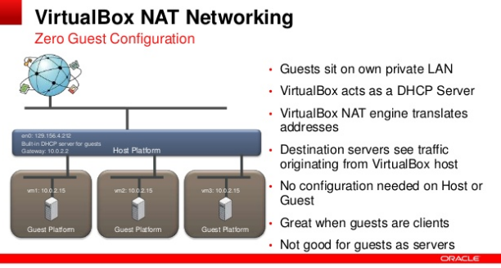
The virtual machine receives its network address and configuration on the private network from a DHCP server integrated into VirtualBox. The IP address thus assigned to the virtual machine is usually on a completely different network than the host. As more than one card of a virtual machine can be set up to use NAT, the first card is connected to the private network 10.0.2.0, the second card to the network 10.0.3.0 and so on.

Slide 20
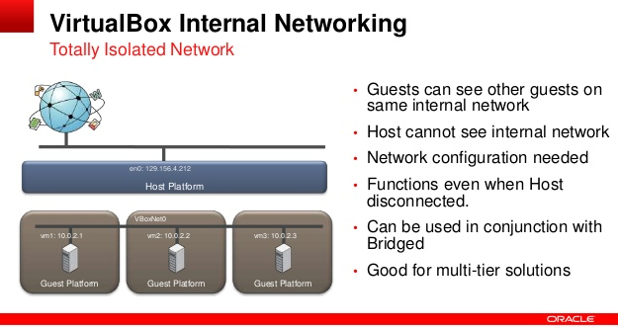
Internal networking: This can be used to create a different kind of software-based network which is visible to selected virtual machines, but not to applications running on the host or to the outside world.

Slide 21
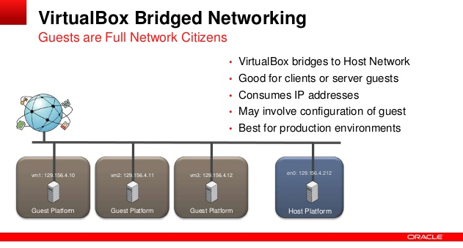
Bridged Networking
More advanced networking needs such as network simulations and running servers in a guest.
When enabled, VirtualBox connects to one of your installed network cards and exchanges network packets directly, circumventing your host operating system's network stack.

Slide 22
Bridged Networking
VirtualBox uses a device driver on your host system that filters data from your physical network adapter.
This driver is therefore called a "net filter" driver.
Allows VirtualBox to intercept data from the physical network and inject data into it, effectively creating a new network interface in software.
When a guest is using such a new software interface, it looks to the host system as though the guest were physically connected to the interface using a network cable: the host can send data to the guest through that interface and receive data from it. This means that you can set up routing or bridging between the guest and the rest of your network.
For this to work, VirtualBox needs a device driver on your host system.

Slide 23
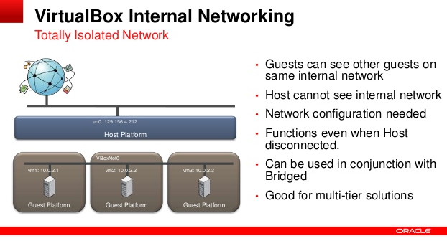
Internal Networking

Slide 24
Virtual Local Area Network (VLAN)
VLAN
A logical network, created on a LAN or across LANs consisting of physical and virtual switches, enabling communication among a group of nodes, regardless of their location in the network.
Benefit
Controls broadcast activity and improves network performance
Simplifies management
Increases security levels
Provides higher utilization of switch and reduces CAPEX
Notes:
A VLAN is a logical network created on a LAN or across multiple LANs consisting of virtual and/or physical switches. The VLAN technology can divide a large LAN into smaller virtual LANs or combine separate LANs into one or more virtual LANs. A VLAN enables communication among a group of nodes based on functional requirements of an organization, independent of the nodes location in the network. All nodes in a VLAN may be connected to a single LAN or distributed across multiple LANs. The benefits of a VLAN are as follows:
Broadcast traffic within the VLAN is restricted from propagating to another VLAN. For example, a node receives all broadcast frames within its associated VLAN, but not from other VLANs. Hence, the term VLAN is often used to convey a broadcast domain. Restricting broadcast using VLAN frees bandwidth for user traffic, which, thereby improves performance for the usual VLAN traffic.
VLANs facilitate easy, flexible, and less expensive way to manage networks. VLANs are created using software. Therefore, they can be configured easily and quickly compared to building separate physical LANs for various communication groups. If it is required to regroup nodes, an administrator simply changes the VLAN configurations without moving nodes and re-cabling.
VLANs also provide enhanced security by isolating sensitive data of one VLAN from any other VLANs. Restrictions may be imposed at the OSI layer 3 routing device to prevent inter VLAN routing.
Since a physical LAN switch can be shared by multiple VLANs, the utilization of the switch increases. It reduces capital expenditure (CAPEX) in procuring network equipments for different node groups.

Slide 25
Configuring VLAN
Define VLAN IDs on physical switch
Each VLAN is identified by a unique number: VLAN ID
Choose necessary VLAN IDs from hypervisor’s built-in VLAN ID pool
Required for virtual switches
Assign VLAN ID to physical and virtual switch ports
To include switch ports to a VLAN
To enable grouping of switch ports into VLANs
Notes:
To create VLANs, an administrator first needs to define VLAN IDs on physical switches. Hypervisors have built-in VLAN ID pools. The administrator selects the necessary VLAN IDs from the pools. The next step is to assign a VLAN ID to a physical or virtual switch port or port group. By assigning a VLAN ID to a switch port, the port is included to the VLAN. In this manner, multiple switch ports can be grouped into a VLAN. For example, an administrator may group switch ports 1 and 2 into VLAN 101 (ID) and ports 6 to 12 into VLAN 102 (ID).
The technique to assign VLAN IDs to switch ports is called ‘port-based VLAN’ and is most common in VDC. Other VLAN configuration techniques are MAC-based VLAN, protocol-based VLAN, and policy-based VLAN. Discussion on these configuration techniques are beyond the scope of this course.

Slide 26
Configuring VLAN (contd.)
Nodes become VLAN members when connected to VLAN ports
Switch forwards frames between switch ports that belong to common VLAN
VLAN traffic is transferred through routers
During inter VLAN communication
When VLAN spans different IP networks
VM and storage systems may be members of multiple VLANs
Requires support of respective operating system
Notes:
When a node is connected to a switch port that belongs to a VLAN, the node becomes a member of that VLAN. Frames that are switched between ports of a switch must be within the same VLAN. Each switch makes forwarding decisions by frames and transfers the frames accordingly to other switches and routers. The VLAN traffic passes through a router for inter VLAN communication or when a VLAN spans across multiple IP networks.
Multiple VLANs may also be configured at the VM or storage system, provided guest Operating System or array Operating System supports such configurations. In this scenario, a node can be member of multiple VLANs.

