Slide 1
Virtualisation

Slide 2
Hypervisor/ VMM types
MS Definition (http://msdn.microsoft.com/en-us/library/ff541670.aspx)
The hypervisor is a layer of software that runs above the physical hardware and below one or more operating systems. The hypervisor's main purpose is to provide isolated execution environments called partitions. The hypervisor provides each partition with the partition's own set of hardware resources (for example, memory, devices, and CPU cycles). The hypervisor must control and arbitrate access to the underlying hardware.
The hypervisor is a single binary that contains several components (for example, scheduler, partition management, and virtual processor management).

Slide 3
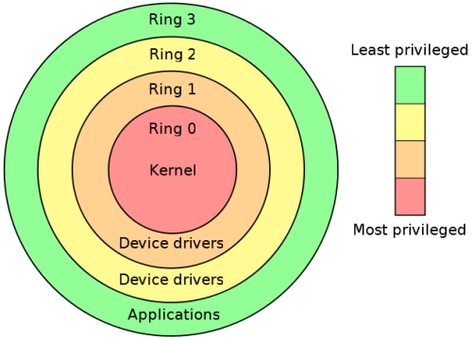
Recap : OS Security Levels
Execution of different functions is performed at different levels of the processor called rings. Ring 0 OS Kernel , Ring 3 Applications user mode
Lower the rings, higher level of system provided
Security Perspective:
Do not want a general purpose user to have access to a resource that is shared with other users.
Code that runs in Ring 0 must be very careful how it executes in order to ensure the system stability.
Virtualisation Implications?
http://static.arstechnica.com/2009/03/20/RingModel.jpg

Slide 4
Virtual Hardware Platform
A Collection of computing resources allocated from a physical host server to a virtual machine (VM) during the virtualisation process.
As we know, Virtualisation creates a layer of abstraction between the application and the underlying computer hardware.
This allows hypervisor software to assign, control and monitor the computing resources that form the virtual hardware platform for a workload.
The process of creating a VM assigns a default virtual hardware platform to the VM.
Virtual hardware assignments include memory, processor cores, optical drives, network adapters, I/O ports, a disk controller and one or more virtual hard disks (VHDs).

Slide 5
Virtual Hardware Platform Versatility
Administrator can adjust the levels of each resource –
adding more memory and additional processor cores, allocating another VHD or assigning more network adapter ports, for example. Increasing Page | 18
resource levels will normally boost that workload's performance or responsiveness -- especially on older physical servers -- or allow the VM to support more users.
Conversely, administrator can remove virtual hardware from a VM.
For example, an application may not be able to utilize a full 2 GB of memory or two processor cores. Removing excess resources will free those resources for allocation elsewhere, improving the performance of other busy workloads or increasing utilization on the physical

Slide 6
Process?
Guest OS makes system calls to the emulated hardware.
These calls (which would actually interact with underlying hardware) , are intercepted by the virtualization hypervisor which maps them onto the real underlying hardware.
The hypervisor provides complete independence and autonomy of each virtual server to other virtual servers running on the same physical machine.
The hypervisor also monitors and controls the physical server resources, allocating what is needed to each operating system and makes sure that the guest OS (the virtual machines) cannot disrupt each other.
With full virtualization, guest OS is not aware it is being virtualized and thus requires no modification.

Slide 7
Hardware Emulation/Virtualisation
VM presents a simulated hardware interface to guest operating systems.
Hardware emulation? – the hypervisor creates an artificial hardware device with everything it needs to run an operating system and presents an emulated hardware environment that guest operating systems operate upon.
provides a complete simulation of the underlying hardware
Technique used to provide support for unmodified guest operating systems.
means all software, OSs and applications that can run natively on the hardware can also be run in the virtual machine.
Unmodified? OS kernels that have not been altered to run on a hypervisor - therefore still execute privileged operations as though running in ring 0 of the CPU.
Full virtualisation uses the hypervisor to coordinate the CPU of the server and the host machine's system resources in order to manage the running of guest operating systems without any modification.
In this scenario, the hypervisor provides CPU emulation to handle and modify privileged and protected CPU operations made by unmodified guest operating system kernels.

Slide 8
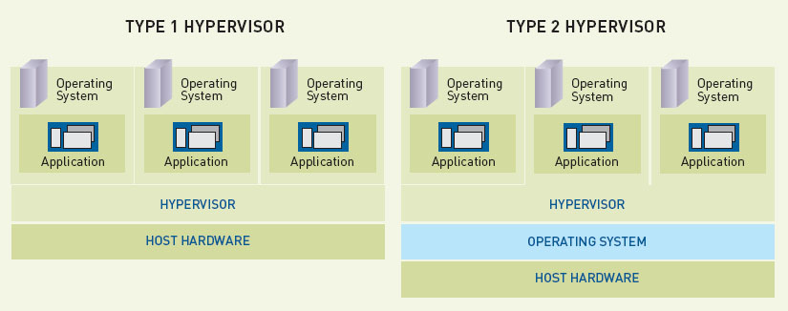
Types of VMM
Type 1 deal with hardware virtualisation
Runs directly in the hardware without the need for interleaving operating system.
Type 2 focuses on process virtualisation - not server virtualisation
Dependency on the VMM to understand the underlying operating system.
http://www.maximumpc.com/files/u17625/whitepaper_vm_full.jpg

Slide 9
Type 1 Hypervisor
Type 1 (or Native, Bare-metal)
Runs directly on the host's hardware to control the hardware and to monitor guest operating systems.
Hypervisor handles resource and memory allocation for the virtual machines plus provides interfaces for higher level administration and monitoring tools.
Guest operating system runs on another level above the hypervisor.
Typically preferred approach - can achieve higher virtualisation efficiency by dealing directly with the hardware.
Security? Type 1 Hypervisor runs directly on the hardware of the host system in ring 0.
Examples: MS Hyper-V, VMWare ESX Server , Xen etc
- Industry-level deployment

Slide 10
Type 2 Hypervisor
Type 2 (Hosted or Guest OS)
Hypervisors run on a host operating system that provides virtualization services, such as I/O device support and memory management.
Physical host computer system runs a standard unmodified operating system such as Windows, Linux, Unix or MacOS X
Virtualisation layer runs on top of that OS being in effect a hosted application.
In this architecture, the VMM provides each virtual machine with all the services of the physical system, including a virtual BIOS, virtual devices and virtual memory. This has the effect of making the guest system think it is running directly on the system hardware, rather than in a virtual machine within an application. Used on client systems where efficiency is less critical & support for a broad range of I/O devices is important and can be provided by the host operating system.
e.g. Oracle/ Sun VirtualBox, VMware Workstation and Microsoft Virtual PC

Slide 11
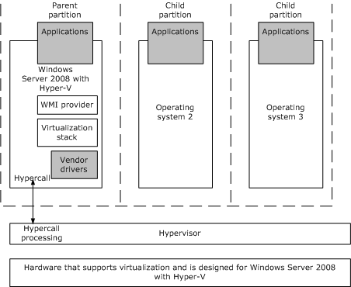
Micro-Kernelised (Type 1)Hypervisor
http://msdn.microsoft.com/en-us/library/ff541670.aspx
Only the functions that are absolutely required to share the hardware amongst the virtual machines are contained in the hypervisor. Other OS functions in Parent Partition – in MS case Windows Server.
Review: Kernel is the essential centre of an OS, the core that provides basic services for all other parts of the operating system. Shell - outermost part of an OS that interacts with user commands.

Slide 12
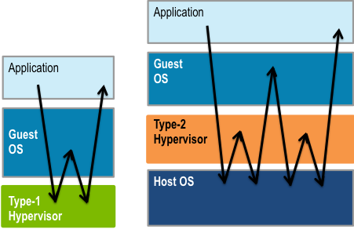
Speed Considerations?
http://microkerneldude.files.wordpress.com/2012/01/type-1-2-cost.png

Slide 13
Hardware Virtualisation for Type 1
Most of the time when a system crashes it is due to a device driver which run in Ring 0.
A single OS running on a system can arbitrate between request from many apps. But what about a virtual environment with many guest OS’s?
Need to maintain control of all platform resources - should be placed at ring 0.
But all OS’s run at ring 0?
Could invent a VMM that runs at ring 0 when a guest OS runs a potentially conflicting instruction. (big overhead head per instruction)
Modify guest OS to run it in a virtual environment.
AMD and Intel came to rescue!
Built hardware virtualisation tech into chips that allow specially written software to run at the level below traditional ring 0.

Slide 14
VMM Modes
2 modes to run under virtualisation:
root operation and non-root operation.
Usually only the virtualisation controlling Virtual Machine Monitor (VMM) runs under root operation, while operating systems running on top of the virtual machines run under non-root operation.
Software running on top of virtual machines is also called “guest software”.

Slide 15
Intel Virtualisation Technology (VT)
Technology enables at CPU to act as if it were several CPUs working in parallel in order to enable several operating systems to run at the same time in the same machine.
Processors with VT have an extra instruction set called Virtual Machine Extensions or VMX.
VMX brings 10 new virtualisation-specific instructions to the CPU:
VMPTRLD, VMPTRST, VMCLEAR, VMREAD, VMWRITE, VMCALL, VMLAUCH, VMRESUME, VMXOFF and VMXON

Slide 16
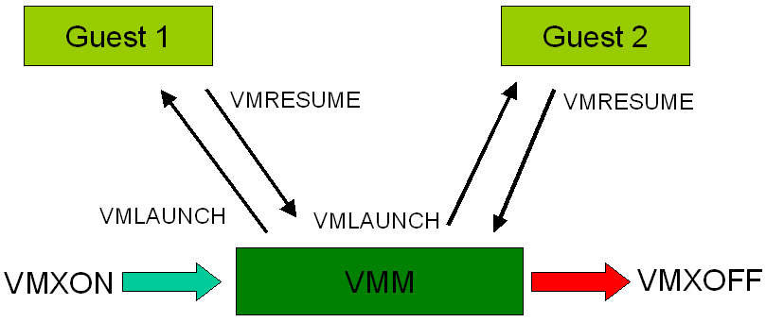
VT Operation
To enter virtualisation mode, Guest 1 software executes VMXON instruction and then calls the VMM software.
VMM software can enter each virtual machine using the VMLAUNCH instruction, and exit it by using the VMRESUME instruction.
If the VMM wants to shutdown and exit the virtualization mode, it executes the VMXOFF instruction.
www.hardwaresecrets.com

