Slide 1
Deadlock Detection
RAG Reduction

Slide 2
Process of Reduction
Find Processes that have all the resources that they need
Arrows only going into Process, not out from a Process
Remove the Process from the Graph
Release any resources that the Process held
Grant any resource requests to Processes that were waiting on these resources
Repeat until you cant take any more processes away, either leaving Deadlocked Processes or none
If no more processes left then there is no Deadlock!

Slide 3
State Transitions
State transitions can be represented as transitions between the corresponding resource allocation graphs. Here are the rules for state transitions:
REQUEST: if process Pi has no outstanding request, it can request simultaneously any number (up to multiplicity) of resources R1, R2, ..Rm. The request is represented by adding appropriate requests edges to the RAG of the current state.
ACQUISITION: if process Pi has outstanding requests and they can all be simultaneously satisfied, then the request edges of these requests are replaced by assignment edges in the RAG of the current state
RELEASE: if process Pi has no outstanding request then it can release any of the resources it is holding, and remove the corresponding assignment edges from the RAG of the current state.
Here are some important propositions about deadlocks and resource allocation graphs:
If a the RAG of a state of a system is fully reducible (i.e. it can be reduced to a graph without any edges using ACQUISITION and RELEASE operations) then that state is not a deadlock state.
If a state is not a deadlock state then its RAG is fully reducible
A cycle in the RAG of a state is a necessary condition for that being a deadlock state

Slide 4
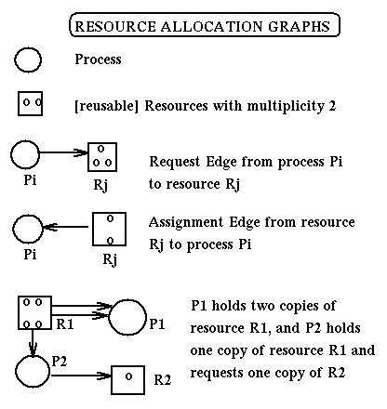

Slide 5
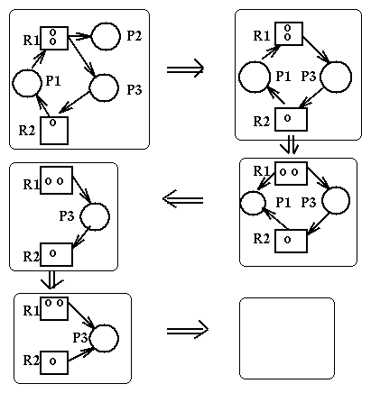
Reduction Example
No Deadlock!
http://www.cis.temple.edu/~ingargio/cis307/readings/deadlock.html

Slide 6
Reduction Example
P2
R1
R2
P1
Deadlock!

Slide 7
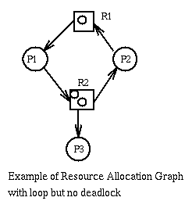
Reduction Example
No Deadlock!
http://www.cis.temple.edu/~ingargio/cis307/readings/deadlock.html

