Slide 1
Processes to Threads

Slide 2
Processes, Threads and Processors
Hardware can interpret N instruction streams at once
Uniprocessor, N==1
Dual-core, N==2
An OS can run 1 process on each processor at the same time
Concurrent execution increases performance

Slide 3
Processes and Threads
So far, we have seen that the concept of a process embodies two concepts.
Resource ownership.
Scheduling/execution
These two characteristics are independent of each other, and are treated as so by some (newer) operating systems.
In such systems, the unit of dispatching is called a thread (or lightweight process), while the unit of resource ownership is still referred to as a process.
Multithreading refers to the ability of the OS to support multiple threads of execution within a single process. The traditional single threaded approach contained a single thread, or instruction trace, per process.

Slide 4
Thread Implementation
In the single threaded process model, the representation of a process includes its PCB, user address space and user and kernel stacks. In the multithreaded process model, there is still a single PCB and user address space, but also separate stacks for each thread, and a separate thread control block.
Thus, threads share the state and resources of that process. They reside in the same address space and have access to the same data, so that if one thread opens a file for reading, other threads in that process can also access that file.

Slide 5
Processes and Threads
Process abstraction combines two concepts
Concurrency
Each process is a sequential execution stream of instructions
Protection
Each process defines an address space
Address space identifies all addresses that can be touched by the program
Threads
Key idea: separate the concepts of concurrency from protection
A thread is a sequential execution stream of instructions
A process defines the address space that may be shared by multiple threads
Threads can execute on different cores on a multicore CPU (parallelism for performance) and can communicate with other threads by updating memory

Slide 6
Introducing Threads
A thread represents an abstract entity that executes a sequence of instructions
It has its own set of CPU registers
It has its own stack
There is no thread-specific heap or data segment (unlike process)
Threads are lightweight
Creating a thread more efficient than creating a process.
Communication between threads easier than processes.
Context switching between threads requires fewer CPU cycles and memory references than switching processes.
Threads only track a subset of process state (share list of open files, pid, …)
Examples:
OS-supported: Windows’ threads,
Language-supported: Java

Slide 7
How Can it Help?
How can this code take advantage of 2 threads?
for(k = 0; k < n; k++)
a[k] = b[k] * c[k] + d[k] * e[k];
Is there a missed opportunity here?
Rewrite this code fragment as:
do_mult(l, m) {
for(k = l; k < m; k++)
a[k] = b[k] * c[k] + d[k] * e[k];
}
main() {
CreateThread(do_mult, 0, n/2);
CreateThread(do_mult, n/2, n);
What did we gain? (On a Uni-Processor? On a multi-Processor?)

Slide 8
How Can it Help?
Consider a Web server
Create a number of threads, and for each thread do
get network message from client
get URL data from disk
send data over network
What did we gain?

Slide 9
Overlapping Requests (Concurrency)
Request 1
Thread 1
Request 2
Thread 2
get network message (URL) from client
get URL data from disk
send data over network
get network message (URL) from client
get URL data from disk
send data over network
(disk access latency)
(disk access latency)
Total time is less than request 1 + request 2
Time

Slide 10
Threads have their own…?
65
47
of
65
CPU
Address space
PCB
Stack
Registers
0

Slide 11
Threads vs. Processes
Threads
A thread has no data segment or heap
A thread cannot live on its own, it must live within a process
There can be more than one thread in a process, the first thread calls main & has the process’s stack
If a thread dies, its stack is reclaimed
Inter-thread communication via memory.
Each thread can run on a different physical processor
Inexpensive creation and context switch
Processes
A process has code/data/heap & other segments
There must be at least one thread in a process
Threads within a process share code/data/heap, share I/O, but each has its own stack & registers
If a process dies, its resources are reclaimed & all threads die
Inter-process communication via OS and data copying.
Each process can run on a different physical processor
Expensive creation and context switch

Slide 12
Advantages of Threads
The benefits of threads are performance related:
It takes far less time to create a new thread in an existing process than to create a new process (in Solaris 2, the speed up factor is about 30).
It takes less time to terminate an existing thread, or to switch between two threads within the same process
Threads can communicate more efficiently. If two processes wish to communicate, they must use the kernel to do so, whereas threads do not need to invoke the kernel.
A program may continue to run, even if part of it is blocked or is doing a complex operation,, thus increasing responsiveness to the user.
Multiprocessor architectures can be utilised more efficiently, with each thread running concurrently on a different CPU.

Slide 13
Thread Implementation
In the single threaded process model, the representation of a process includes its PCB, user address space and user and kernel stacks. In the multithreaded process model, there is still a single PCB and user address space, but also separate stacks for each thread, and a separate thread control block.
Thus, threads share the state and resources of that process. They reside in the same address space and have access to the same data, so that if one thread opens a file for reading, other threads in that process can also access that file.

Slide 14
Implementing Threads
Process’s
address space
TCB for
Thread1
Processes define an address space; threads share the address space
Process Control Block (PCB) contains process-specific information
Owner, PID, heap pointer, priority, active thread, and pointers to thread information
Thread Control Block (TCB) contains thread-specific information
Stack pointer, PC, thread state (running, …), register values, a pointer to PCB, …
mapped segments
PC
SP
State
Registers
…
DLL’s
Heap
TCB for
Thread2
Stack – thread2
PC
SP
State
Registers
…
Stack – thread1
Initialized data
Code

Slide 15
Threads’ Life Cycle
Threads (just like processes) go through a sequence of start, ready, running, waiting, and done states
Start
Done
Ready
Running
Waiting

Slide 16
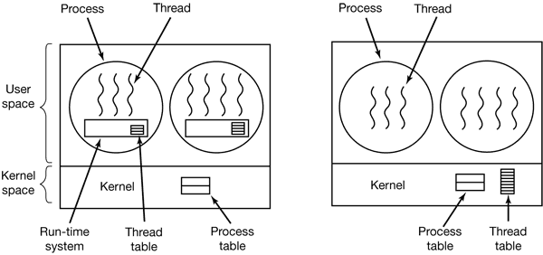
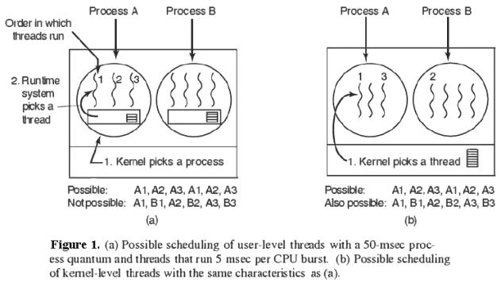
User-level vs. Kernel-level threads

Slide 17
Kernel-Level Threads
Kernel Level Threads Kernel level threads are managed by the OS, therefore, thread operations (ex. Scheduling) are implemented in the kernel code. This means kernel level threads may favour thread heavy processes.
Moreover, they can also utilise multi-processor systems by splitting threads on different processors or cores.
Good choice for processes that block frequently.
If one thread blocks it does not cause the entire process to block.
Kernel level threads have disadvantages as well.
They are slower than user level threads due to the management overhead.
Kernel level context switch involves more steps than just saving some registers.
Finally, they are not portable because the implementation is operating system dependent.

Slide 18
User-Level Threads
User-Level Threads
User level threads are managed by a user level library however, they still require a kernel system call to operate.
It does not mean that the kernel knows anything about thread management.
Here Kernel only takes care of the execution part.
The lack of cooperation between user level threads and the kernel is a known disadvantage. In this case, the kernel may not favour a process that has many threads.
User level threads are typically fast.
Creating threads, switching between threads and synchronizing threads only needs a procedure call.
They are a good choice for non-blocking tasks, otherwise the entire process will block if any of the threads blocks.

Slide 19
User Level Threads
An application begins with a single thread and begins running that thread. This application and it’s thread are allocated to a single process managed by the kernel
While the application is running, it may spawn a new thread to run within the same process (spawning is a library utility).
The library creates a data structure for the new thread and passes control to one of the threads within this process using some scheduling algorithm.
The kernel is unaware of this activity. It continues to schedule the process as a unit and assigns a single execution state to that process.

Slide 20
Languages vs. Systems
Kernel-level threads have won for systems
Linux, Windows
User-level threads still used for languages (Java)
User tells JVM how many underlying system threads
Default: 1 system thread
Kernel-level thread vs. process
Each process requires its own page table & hardware state (significant on the x86)

Slide 21
ULT Example
Say Process B is executing in its thread 2....
Thread 1
Thread 2
Ready
Running
Ready
Running
Blocked
Blocked
Process B
Ready
Running
Blocked

Slide 22
ULT Example: One Possibility
Thread 2 makes a system call that blocks B.
Control is passed to the kernel, which places B in the Blocked state, and passes control to another process
According to the data structure maintained by the threads library, thread 2 is still running.
Thread 1
Thread 2
Ready
Running
Ready
Running
Blocked
Blocked
Process B
Ready
Running
Blocked

Slide 23
ULT Example: Another Possibility
A quantum expires and control is passed to the kernel
B is placed in the Ready state and control passed to another process
According to the data structure maintained by the threads library, thread 2 is still running
Thread 1
Thread 2
Ready
Running
Ready
Running
Blocked
Blocked
Process B
Ready
Running
Blocked

Slide 24
Latency and Throughput
Latency: time to complete an operation
Throughput: work completed per unit time
Multiplying vector example: reduced latency
Web server example: increased throughput
Consider plumbing
Low latency: turn on faucet and water comes out
High bandwidth: lots of water (e.g., to fill a pool)
What is “High speed Internet?”
Low latency: needed to interactive gaming
High bandwidth: needed for downloading large files
Marketing departments like to conflate latency and bandwidth…

Slide 25
Thread or Process Pool
Creating a thread or process for each unit of work (e.g., user request) is dangerous
High overhead to create & delete thread/process
Can exhaust CPU & memory resource
Thread/process pool controls resource use
Allows service to be well conditioned.

