Slide 1
Memory Management

Slide 2
Memory Management
Most OSs have three levels of storage:
Secondary Memory. High volume, low cost, slower storage.
Main Memory. Smaller, faster, and more expensive than secondary storage. A program must be in main memory in order to be executed or referenced by the CPU.
Cache. High speed storage that is much faster than main memory. Programs in main memory are moved to the cache before being executed, where they can be executed much faster. It is more expensive than main memory, and typically only small caches are used.

Slide 3
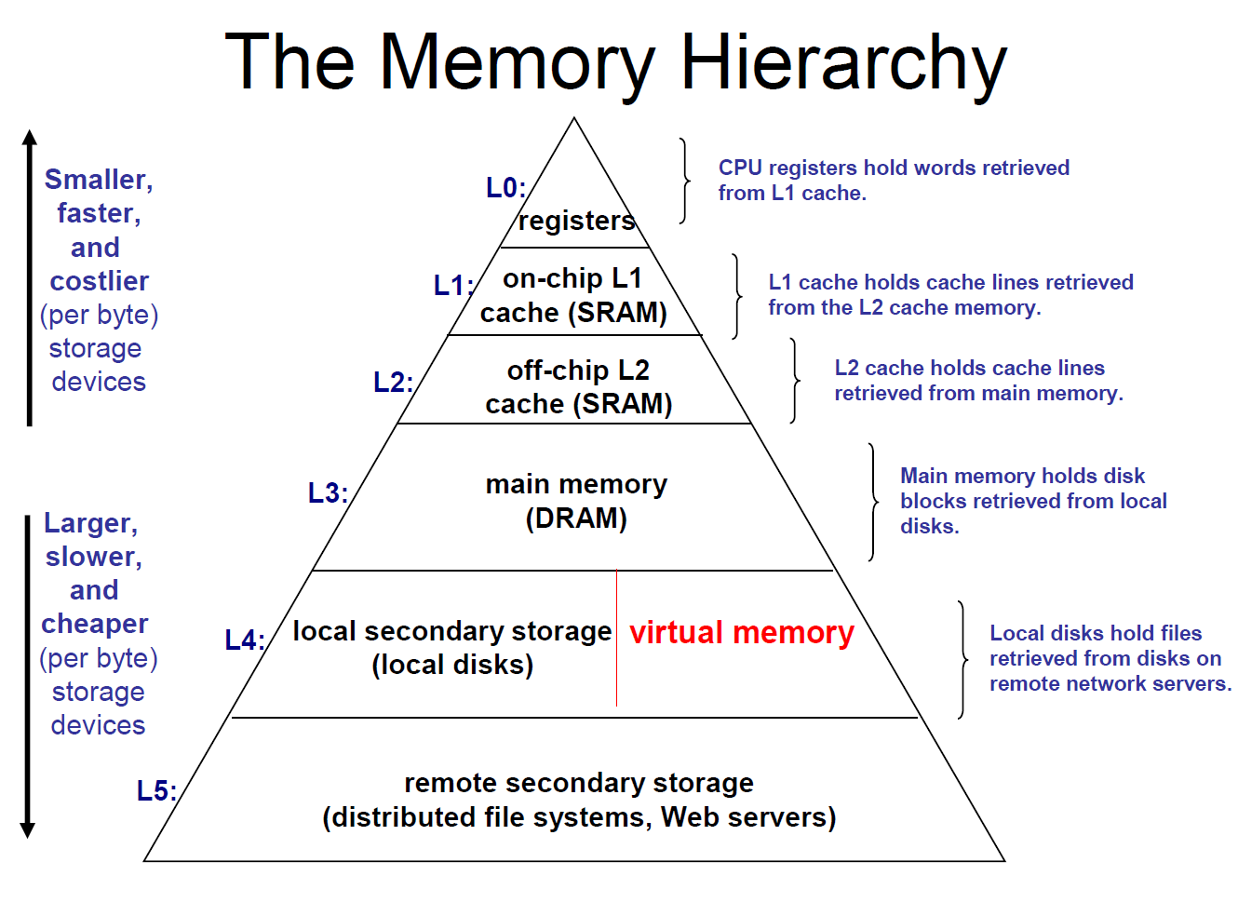
(SRAM = flip flops! DRAM capacitor & transistor)

Slide 4
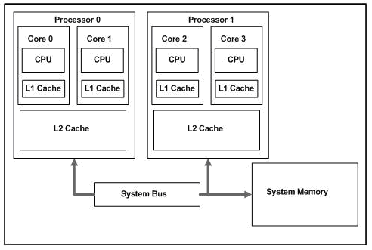
Intel dual-core, dual-processor system

Slide 5
Memory Management
Storage organisation refers to the way in which the main storage is viewed. It addresses issues such as:
do we allow one or more users in main memory at one time?
how is main memory divided (partitioned) between them? can these partitions be changed dynamically?
can processes run in any partition?
Storage management determines how a particular storage organisation can be exploited to give optimal performance. It addresses issues such as:
when to we get a new program to place in memory?
when asked for, or anticipated?
where do we place the next program to be run?
should programs be placed as tightly as possible, or as quickly as possible?

Slide 6
Considerations?
Why Use Disks? Multiprogramming!
More than one application running at one time
May need more than available main memory to store all needed programs and data
May want to share data between applications
Cheap, large (but, slow)

Slide 7
Evolution of Storage Allocation Strategies
There are two main categories of Storage Allocation.
Contiguous Storage Allocation: Each program occupies a single contiguous block of storage. This was used by early computing systems.
Noncontiguous Storage Allocation: The program is divided into several blocks which are placed throughout the main storage. Although this is more difficult to manage, it can increase throughput. This is used by most systems today.

Slide 8
Single User Contiguous Storage Allocation
The earliest systems allowed only a single user at a time. Each user wrote all the code necessary to implement a particular application, including machine level I/O operations. These were quickly integrated into an Input/Output Control System, and users would call the routines in the IOCS to perform I/O operations.
Programs which were larger than the main storage could be run using overlays. If a particular section is not needed for the duration of the program’s execution, another section can be brought in to occupy the storage used by the section no longer needed.
Storage in these systems was divided into a portion holding the OS routines, a portion holding the user’s program, and an unused portion. The OS portion was protected from damage by the user’s program by the use of a boundary register, which checked whenever the program referenced a storage address that the OS would not be damaged.

Slide 9
Historic - Overlays
Programmers had to use the principal of locality to choose segments of a program to keep in memory during program execution
• 80/20 rule (80% of the time executing 20% of the code)
• Use program phase behaviour
• Tedious to do by hand • Difficult to determine overlay set, especially
when considering multiprogramming
main limitations imposed on programmers=size of the computer's memory.
If the program was larger than the available memory, it could not be loaded, which placed severe restrictions on program size.
The obvious solution would be to increase the amount of memory available, but this would significantly increase the cost of the computer system.

Slide 10
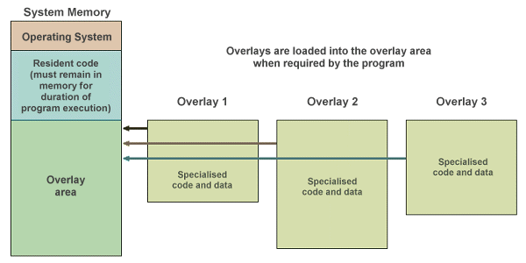
Historic - Overlays
The programmer divided the program into a number of logical sections.
A small portion of the program had to remain in memory at all times, the remaining sections (or overlays) were loaded only when they were needed. The use of overlays allowed programmers to write programs that were much larger than physical memory, although responsibility for managing memory usage rested with the programmer rather than the operating system.

Slide 11
Fixed Partition Multiprogramming
Single user systems were a considerable waste of resources, since the CPU stayed idle while I/O operations were performed.
Multiprogramming systems were designed and implemented, in which several users competed for system resources. To achieve this, several jobs had to reside in main storage at once. This required more storage, but was justified by the increased resource usage.
The earliest multiprogramming systems used fixed partition multiprogramming in which main storage was divided into a number of fixed size partitions, each holding a single process.
A process could run only in a single partition, so if its one was busy and others were free, it still had to wait. This wasted storage, but was easy to implement. These were soon replaced with re-locatable programs that could run in any partition big enough to hold them.
Protection was implemented using a pair of boundary registers. These held the low and high boundaries of a user partition. Accesses to the OS were made using a Supervisor Call instruction.

Slide 12
Variable Partition Multiprogramming
In Variable Partition Multiprogramming, no assumptions are made about how large processes will be. As they arrive, they are given exactly as much storage as they need, and so there is no waste.
Processes Waiting
A 430k
B 350k
C 180k
D 200k
Processes Waiting
D 200k
OS
OS
OS
Process C
Process C
Process B
Process D
Process A
Process A
Kernel
Kernel
Kernel
Initial State
After loading 3 processes
When D is loaded in gap left by B

Slide 13
Storage Compaction
Waste does occur as processes finish, and free storage areas (“holes”) are left in main storage.
These can be filled by other processes, but these will in turn leave spaces themselves.
This can be solved somewhat by coalescing spaces. When a process finishes, the OS checks whether the storage being freed borders on other free areas.
If it does, the existence of a single space is recorded in the free storage list.
Sometimes when a process requests a certain amount of space, no individual space is large enough to hold it, although the sum of all the spaces may be big enough.
Storage Compaction involves moving all occupied areas of storage to one end of main storage, leaving one large storage space.
The drawbacks of compaction are
it consumes system resources,
all processing must cease while it is performed, resulting in erratic response times for users,
processes are relocated in storage, and so relocation information must be maintained,
it may be necessary to compact frequently.

Slide 14
Storage Placement Strategies
Storage placement strategies are used to determine where in memory to place incoming processes and data.
The most common strategies are:
Best-fit. An incoming process is placed in the space in which it fits most tightly and leaves the smallest amount of unused space. This is the most intuitive strategy.
First-fit. An incoming process is placed in the first available space large enough to hold it. A variation of this strategy is Next-fit, in which the search begins at the point at which the previous search ended. The advantage is that a decision can be made quickly
Worst-fit. An incoming process is placed in the largest possible space. The advantage is that the remaining space may be large enough to hold another process.

Slide 15
Virtual Storage
Virtual Storage is a technique that allows the execution of a process that may not be completely in memory.
It refers to the ability of a computer to address a storage space much larger than that available in its primary memory.
This allows processes to run that may be larger than the available main memory.
Since only a small part of a process needs to be in main memory at any time - the rest can be kept in secondary storage.
Virtual Storage operates by disassociating the addresses referenced in a running process (“virtual addresses”) from the addresses available in main memory (“real addresses”).

Slide 16
What is Virtual Memory?
Technique (an abstraction) for using disks to extend the apparent size of physical memory beyond it’s actual physical size – Automatic storage allocation
Logical memory – memory as seen by the process
• Physical memory – memory as seen by the processor
Components
1 Memory Management Unit (MMU) in CPU
mapping function between logical addresses and physical addresses
2 Operating System
controls the MMU
3 Mapping tables
guide the translation

Slide 17
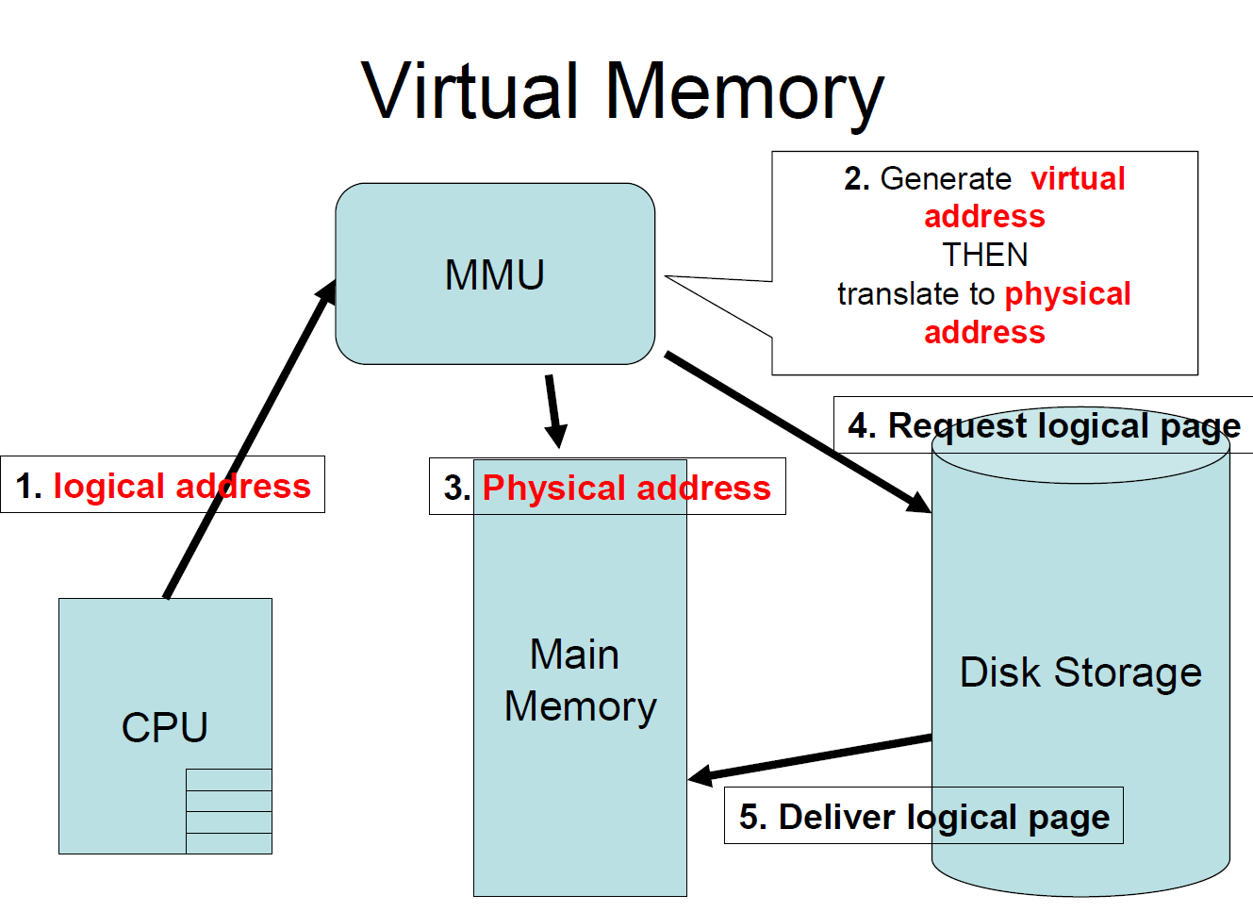

Slide 18
Virt Mem Addressing
Effective address – address computed by processor (as viewed by CPU)
Logical address – same as effective address (as viewed outside CPU)
Virtual address – generated by MMU
Physical address – actual address in memory (hard disk?)
Why Have Virtual Addresses? Virtual address can be larger than the logical address, allowing program units to be mapped to a much larger virtual address space (physical address: depends on mem size!)
Virtual Memory Advantages? Simpler addressing
– Programs can be compiled with their own address space
No need for compiler to generate addresses that are unique from addresses for other programs
Don’t need to break program into fragments (overlays) to accommodate memory limitations

Slide 19
Dynamic Address Translation
Even though a process references only virtual addresses, they must actually run in real storage. Thus, virtual addresses must be mapped into real addresses as a process executes.
This can be done by Dynamic Address Translation mechanisms.
These maintain address translation maps illustrating which virtual storage locations are currently in main memory, and where they are.
This is done in units of blocks, since a byte-by-byte mapping, for instance, would require an enormous volume of storage.
The larger the blocks are, the less block mapping information that must be maintained. However it will take longer to transfer large blocks between secondary and primary storage.
What size should the blocks be?
If they are all the same size, they are called pages, and the virtual storage organisation is called paging.
If they can be of different sizes, they are called segments, and the organisation is segmentation.

Slide 20
Segmentation
A program can occupy separate blocks of storage.
These do not have to be the same size, nor do they have to be adjacent to one another.
This makes the problem of protecting boundaries more complex, since a pair of boundary registers is no longer sufficient.
One of the main advantages of segmentation is that segments correspond to the user’s view of memory.
A program consists of logical elements such as a data structures section, functions and procedures etc.
A compiler would create separate segments reflecting this division.
Segments are transferred into real memory as complete units and all the locations within a segment are placed in contiguous locations in primary storage.
The placement strategies are identical to those used in variable partition multiprogramming.

Slide 21
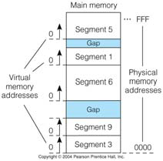
Segmentation
Divide memory into segments (varying sizes)
Problem:
External fragmentation

Slide 22
